Slide 1
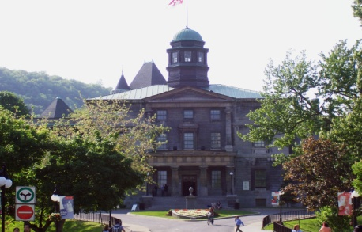
Student Housing and Hospitality Service
180 seconds
of Student Housing and Hospitality Service

Slide 2
Student Housing and Hospitality Service
5
is the number of services that make up SHHS
SHHS is made up of 4 different main services:
Housing (Summer business, Conference Services, student housing)
Food Service (residences, Retail, contracted or Self operated, vending and catering)
Finance / One Card
Residence Life and Floor fellows
Residence admission /customer service and service point
With in house support services:
Facilities taking care of our 33 buildings
Marketing and communication
Finance
HR taking care of our 300 full time and part time employees

Slide 3
McGill Feeding McGill
180,000
MacDonald Campus eggs served to the downtown campus

Slide 4
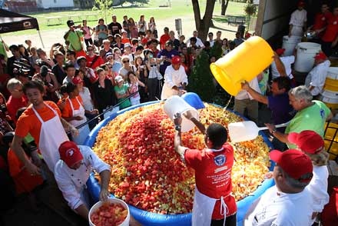
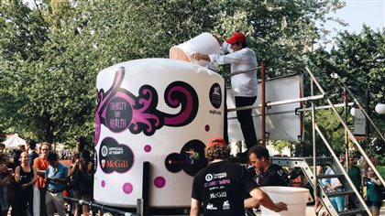
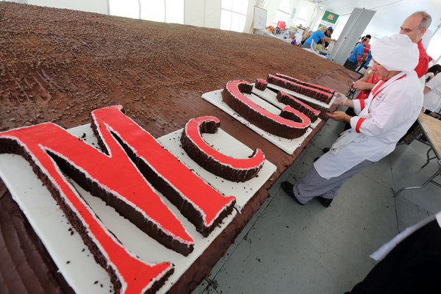
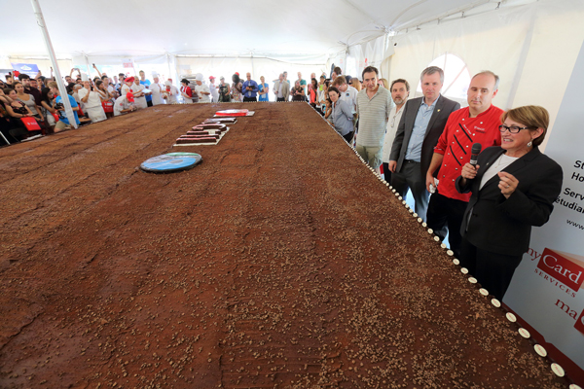
Food Services
3 world records

Slide 5
Food Service Local commitment
34,000
The number of Saint Viateur Bagels served
Show just one more part of our local purchasing commitment.

Slide 6
Residences (Housing)
3400 students
living with us from over 100 different countries

Slide 7
Movies on Campus
85,000$
generated from films on campus
Most of that going back to the faculties where the films were shot.

Slide 8
Conferences
307
events in the SHHS Conference spaces; a little shy of the 334 events held last year. However, we generated $231,703

Slide 9
Summer business
$3,713,811
revenue for rooms rented during the summer.

Slide 10
Finance and One Card
56 Vending Machine
30 locations accepting the one card for this coming year
2017 Create a SHHS bursary endowment of $80,000 for students living in residences that may need financial need, and we will continue to add to this amount.

Slide 11
Roddick Roast
8,000 lbs of Coffee our first year with Retail coming in September 2017
•Fairtrade. Certified Organic. Bird Friendly. •This small COOP has 1,091 fairtrade and organic certified producers. Each one produces on average 1,400 pounds.
•The farms are between ½ - 4 hectares in size.
•Fair Trade guarantees the minimum price of $1.40 per pound.
•Fair Trade gives the COOP a 20 cent premium per pound on top of the minimum.
•McGill matches this premium for an additional 20 cent premium per pound, which is referred to as the McGill premium.
•This premium goes to the COOP to improve conditions for the farmers.
•The Organic Premium is 30 cents per pound.
•COOP gets paid $2 per pound. 70% goes to the farmers and 30% goes to operating the building of the COOP, of which the farmers are the owners.
•It takes approximately 100 coffee beans for each cup of coffee.
•Coffee is a smoky and chocolaty blend.
•COOP sits at an altitude of 800-1000m.

Slide 12
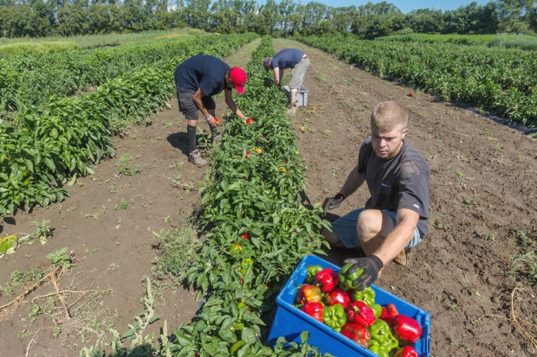
McGill Feeding McGill
67,000 lbs of fresh produce from MacDonald Campus was served in our downtown food service

Slide 13
Service point
Our customer service team at service point handle questions and services the entire campus including our:
Over 2700 first year students,
200 grad students and now including special accommodation for close to
100 exchange students,
over 2000 people during Open House
And this year we reached out through social media, and the largest webinar ever hosted at McGill with over 300 students in attendance from around the world.

Slide 14
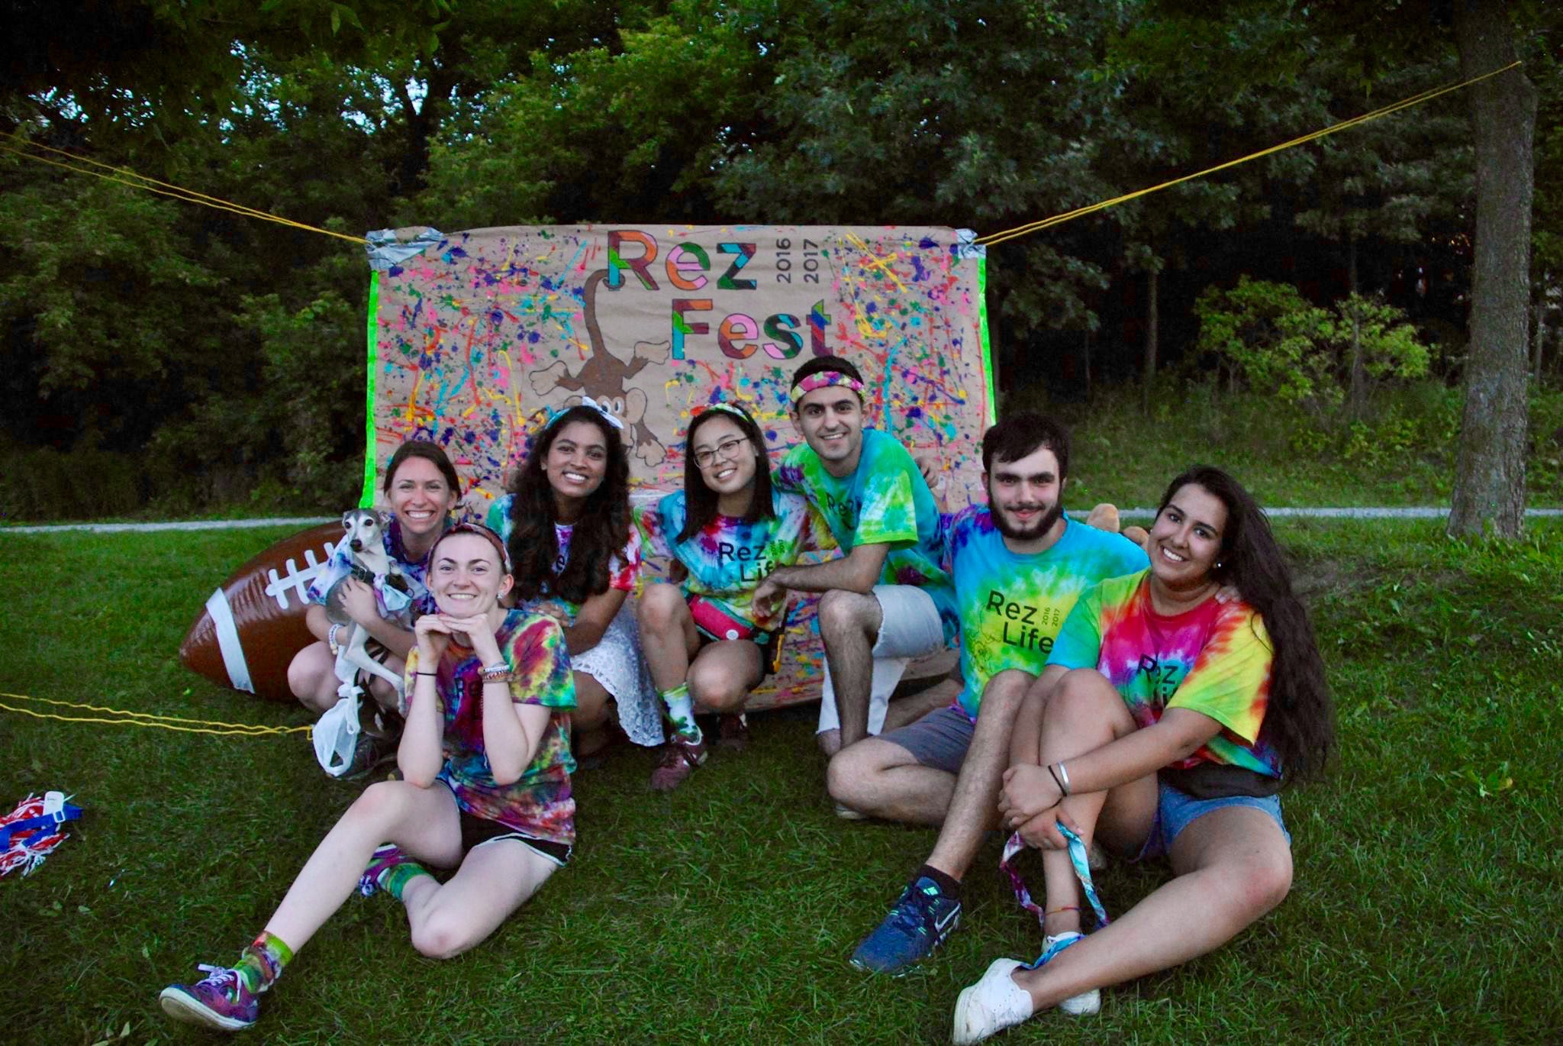
Rez Life
77 floor Fellows
And
6 Full time rez life managers

Slide 15
Rez Life
4578 Likes on Facebook
4408 followers

Slide 16
SHHS
Thanks you and welcomes you to our services

