Slide 1



Raising awareness of the importance of exercise training in solid organ transplant: A description of a knowledge dissemination project
Presented by: Dr. Tania Janaudis-Ferreira
Co-Is: Drs. Sunita Mathur & Tom Blydt-Hansen

Slide 2
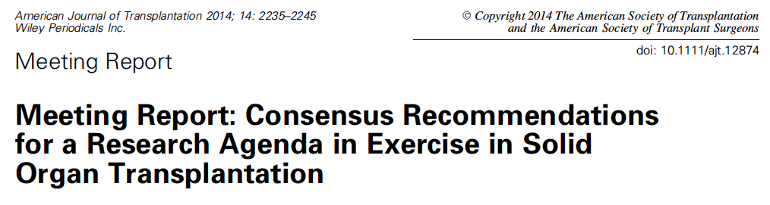
S Mathur*, T Janaudis-Ferreira*, L Wickerson, LG Singer, J Patcai, D Rozenberg, T Byldt-Hansen,
EL Hartmann, M Haykowsky, D Helm, K High, N Howes, BM Kamath, L Lands, S Marzolini, C Sonnenday
Notes:
This project was identified as a priority during a CIHR-funded meeting
that was held in 2013 in Toronto
Disseminate the best

Slide 3
Background
Exercise capacity is associated with mortality on transplant waitlist
Frailty is associated with delayed graft function
Frailty predicts early hospital readmission and post-transplant mortality
Impaired exercise capacity persists in the post-transplant period
Garonzik-Wang 2012
McAdmans-DeMarco 2013, 2015
Notes:
Just to give you a brief backround on why exercise training is important for transplant candidates and recipients
impacts on quality of life, return to work and ability to fulfill family and societal roles

Slide 4
Background
Lack of application of existing evidence into clinical practice
Only ~ 20% of the Transplant Programs in Canada offer a rehab program for SOT recipients (Trojetto et al. 2011)
HCPs are challenged by lack of knowledge of the evidence on optimal ways to assess and train SOT candidates and recipients
Patients endorse lack of knowledge about exercise
Notes:
Although there is strong evidence that such impairments can be ameliorated through exercise training ¹⁰, there is a lack of application of existing evidence for exercise training into clinical practice for SOT recipients
Based on a 2011 survey, there are very few dedicated SOT rehabilitation programs in Canada ¹¹; the majority of them are for heart and lung transplant recipients, with only one program available for liver recipients and none for kidney recipients.

Slide 5
Objectives
1) raise awareness of exercise in solid organ transplant among HCPs and directors of transplant programs;
2) provide evidence-based information on exercise to patients, their families and transplant advocacy groups; and
3) build a national network of HCPs and researchers with an interest in exercise
Notes:
Disseminate the outcomes of the meeting
Awareness is the first step toward improved adherence to evidence-based treatments
Dissemination grant – help it happen
Application – make it happen

Slide 6
Key steps
Oversight by a national steering committee
Systematic review of the research evidence on the effects of exercise in SOT
On-site interactive presentations to the largest multi-organ transplant centres in Canada
Pre-visit site preparation (online survey)
Patient-directed workshop
Establishment of a network in rehab & transplantation
Development of web-based resources
Notes:
With oversight by a national steering committee, the key steps in implementing this dissemination project included
pre-visit site preparation including an online survey on additional information that the attendees would like to receive
The co-principal investigators of this proposal have performed a systematic literature review to synthesize the evidence on exercise limitation and training in SOT. Our CIHR-funded planning meeting was instrumental in collecting best practices in exercise training and assessment from national and international experts. The perceived barriers that healthcare professionals and patients encounter regarding exercise training were also discussed at the meeting.

Slide 7
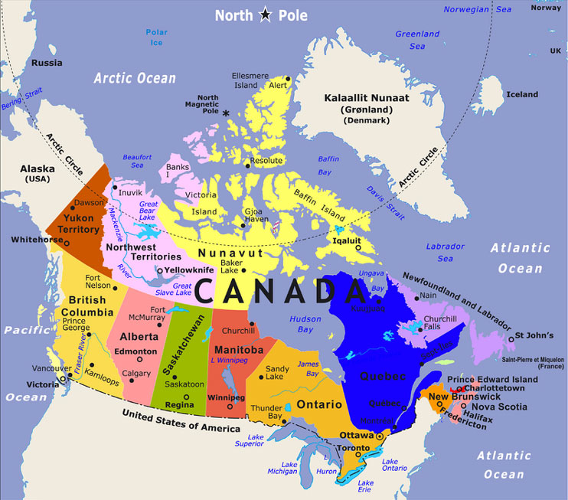
10 sites
> 280 HCPs
-St Paul’s Hospital
-BC Children's Hospital
-GF Strong Rehab Centre
-Hospital for Sick Children
-Toronto General Hospital
-London Health Sciences Centre
-QE II Health Sciences Centre
-Alberta Transplant Institute
London
-Notre Dame Hospital
-Royal Victoria Hospital
Notes:
Ten multi-organ transplanted centres were visited across Canada
More than 280 HCPs attended the onsite presentations
EVALUATIONS GOOD TO EXCELLENT
Likelihood to use the information to clinical practice – likely

Slide 8
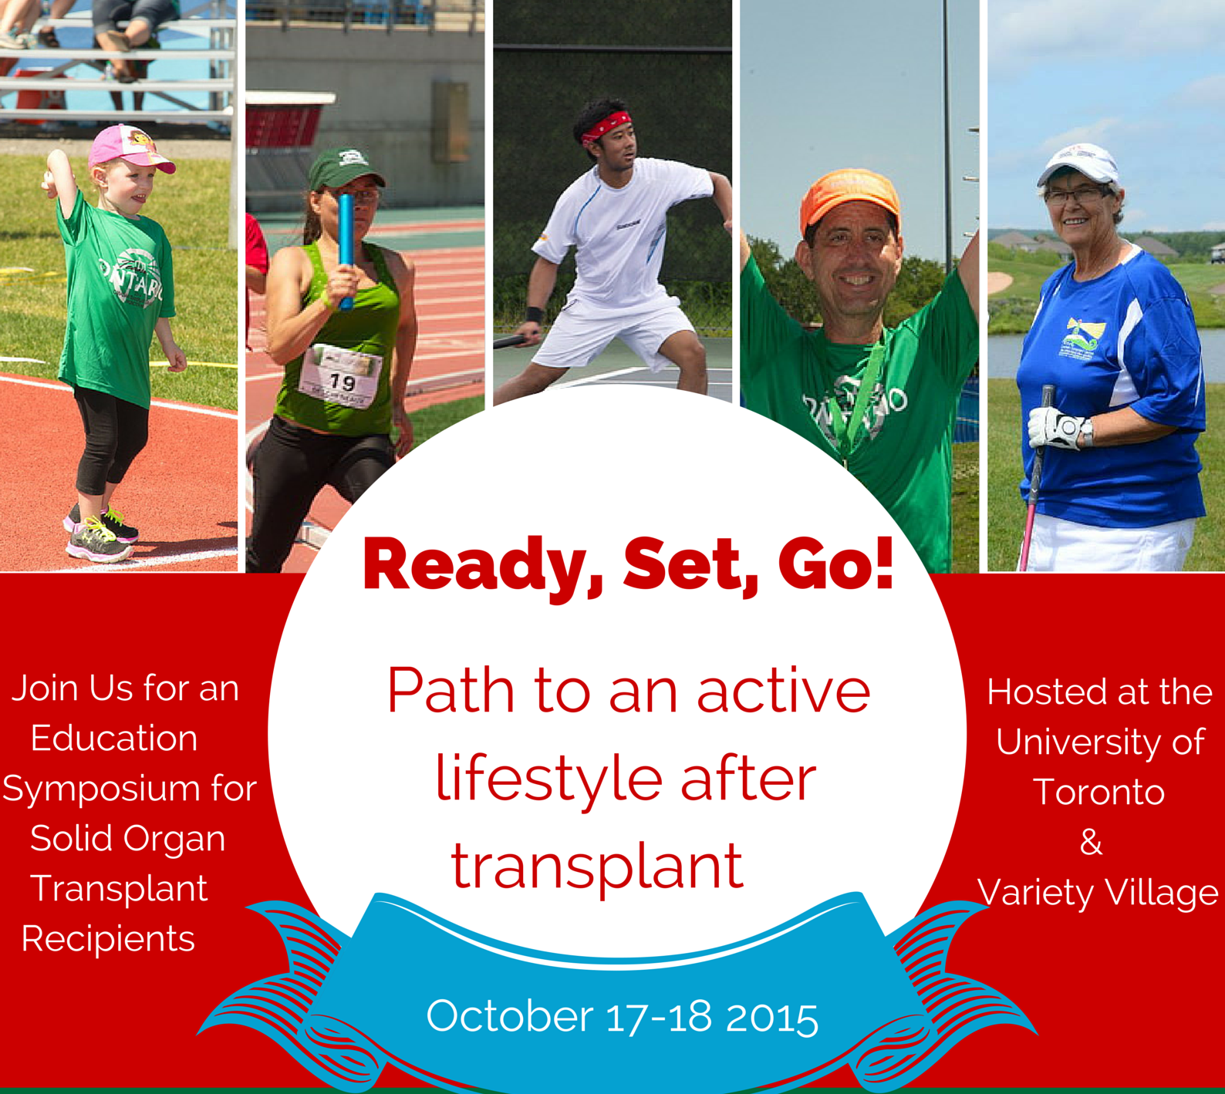
96 participants
Agenda, slides and videos available online
Topics:
Safe and effective exercise
Medical considerations
Nutrition for exercise/sport
Injury Prevention
Training for Sport
Goal Setting
Notes:
A workshop was delivered for patients and their families (adults and children)
Published soon: details about participants characteristics, their level of physical activity, workshop evaluation
Survey on whether or not they achieved their personal goals

Slide 9

Twitter: @JanaudisFerr @SunitaMathur1
Notes:
Can-Restore website (videos and slides)
This is the website that was created
Another important accomplishment was the recognition of this project by the Canadian National Transplant Research Program which incorporated our dissemination into their structure.
They offered assistance to create the CAN-RESTORE website and to host it.
The CNTRP -connects more than 300 scientists, students, collaborators, patient partners and knowledge-users at 30 sites throughout Canada to carry out research and develop resources to increase access to transplantation and improve survival and quality of life of transplant patients
They received 33 million dollars in 2013 from different funding partners…
A program that originally consisted of physicians, surgeons and basic scientist in the are of immunology. We are thrilled to be part of the CNTRP and bring the the notion that rehabilitation is important for transplant candidates and recipients.

Slide 10
Conclusion
Unique and sustainable opportunities for HCPs to increase their knowledge and enhance their ability to apply the evidence in their practice
With increased knowledge, patients should be in a better position to advocate for improved access to rehabilitation
Our project provided opportunities to expand the network for exercise in SOT in Canada which itself will continue to translate new knowledge to the clinical practice community
Notes:
Our dissemination project provided

Slide 11
Acknowledgments
Drs. Sunita Mathur (U of T) & Tom Blydt-Hansen (UBC)
CIHR
CNTRP
CAN-RESTORE’s steering committee

