Slide 1

AIMD: A simplified framework of Knowledge Translation interventions
Heather Colquhoun,
Assistant Professor
Department of Occupational Science and Occupational Therapy
University of Toronto
1st National Knowledge Translation Conference in Rehabilitation May 4 & 5 2016, Montreal, Quebec

Slide 2
The people…
In particular: Peter Bragge (Monash), Cynthia Lokker (McMaster), Jeremy Grimshaw (Ottawa Hospital Research Institute)
But also: Lauren Albrecht, Justine Baron, Ann Dadich, Laura Damschroder, Kristin Danko, Maria Fernandez, Signe Agnes Flottorp, Heather Gainforth, Kate Gooding, Ian Graham, Susanne Hempel, Simon Kitto, Jennifer Leeman, Danielle Mazza, Ann McKibbon, Susan Michie, Stuart Nelson, Teryl Nuckols, John Ovretviet, Hugo Sax, Shannon Scott, Kathleen Stevens, Gjalt-Jorn Y. Peters, Michael G. Wilson
Notes:
Internaional and multi-sectoral (Impl or KT scientists that would describe themselves as working in the use of evidence for policy decision making, patient saftey, Q improvement, provider behaviour change, systems applications,

Slide 3


The funders….

Slide 4
“In many respects, the most troublesome problems of any science centre around its most basic terms and fundamental concepts, and not around its more sophisticated concerns. Indeed to the extent that everything either follows from or is based on a discipline’s most basic terms and fundamental concepts, problems at a higher level can always be traced back to problems at a more fundamental level”
    Mitroff & Sagasti. Epistemology as general systems theory: An approach to the design of complex decision-making experiments. Phil Soc Sci 1973, 3:117–134.

Slide 5
Foundational terms
Knowledge Translation (Canada)
Implementation Science (UK)
Dissemination and Implementation (US)

Slide 6
100 terms describing KT
46 used in titles and abstracts

Slide 7
Search filters
Notes:
Found KT articles but also missed too many of them.

Slide 8
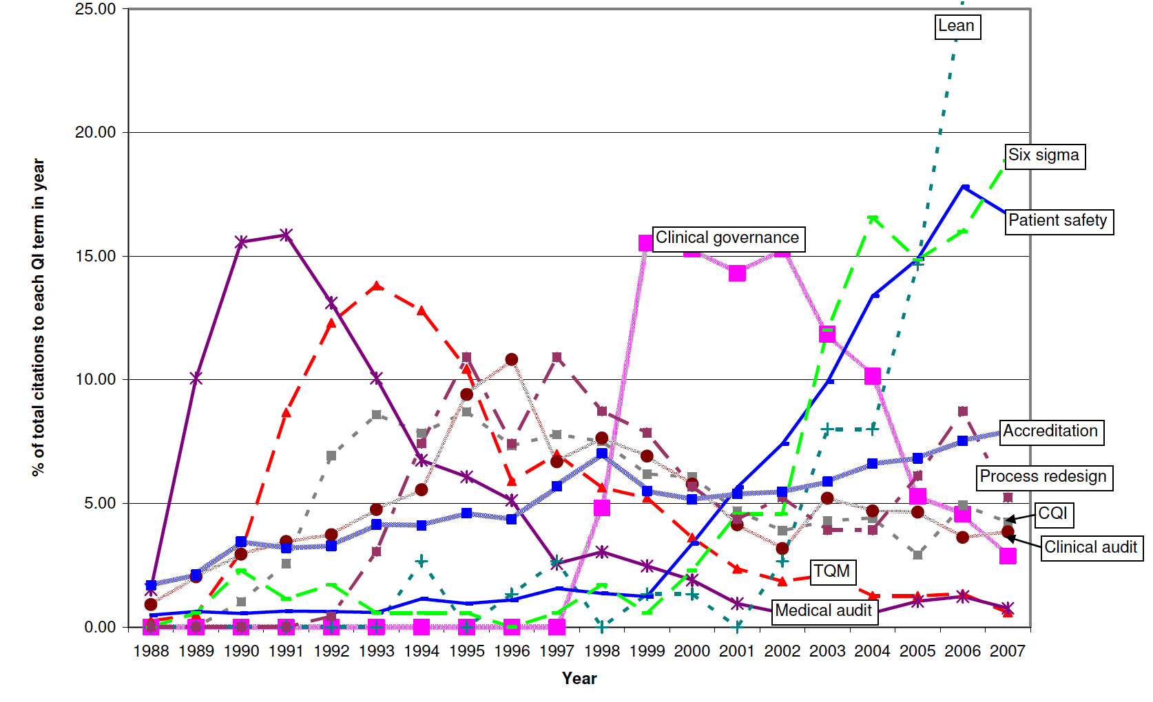
Figure 1: The distribution by year of the total use of each of the 10 common QI terms in citation titles/abstracts ~20,000 citations over 20 years (Walshe et al International Journal for Quality in Health Care 2009; Volume 21, Number 3: pp. 153–159)
Notes:
This work by Walshe et al. looking at QI terms in over 20k citations illustrates the ‘trends’ in QI terminology over a 20-year period
“Figure 1 The distribution by year of the total use of each of the 10 common QI terms in citation titles/abstracts

Slide 9
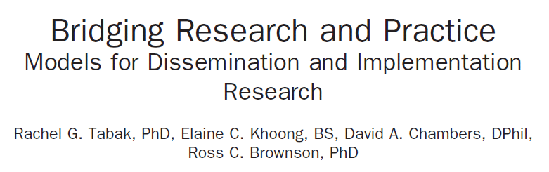
61 Models
51 Models
Notes:
Terminology issues extend to our models.
classify or describe knowledge translation interventions

Slide 10
The problems this causes…..
  Limits our communication (internal/external)
  Hinders collaboration across sectors, disciplines, geography
  Limits our ability to learn from each other’s work
  Impedes progress (Larson 2013, Addiction, 108, 1532–1533 ‘Addicted to constructs: Science in reverse’)
  Unnecessarily complicates knowledge search and synthesis (decreases efficiency and speed)
  How often do we read that poor intervention description makes it difficult to make solid conclusions?
Notes:
I’m not against diversity, think it’s really important. But I’m not sure the current diversity in models, language is helping us very much.
The lack of any form of shared conceptualiization for KT interventions is harming us.
Different terms that mean the same thing,
How often do we read that the description of the interventions makes it different to make solid conclusions about what to do

Slide 11
Our aim
Develop, test and refine a simplified framework for interventions to promote and integrate evidence into health practices, systems and policies
Simple, shared language, can work across all sectors, focused on the terms we use (name and define), agnostic to other frameworks
Notes:
Minimum dataset. How often do we read that the description of the interventions makes it different to make solid conclusions about what to do (SR and otherwise)

Slide 12
Overview
Multidisciplinary, multi-sector international workgroup of 29 members
1. Initial meeting September 2012 – draft framework
  Colquhoun et al., Implementation Science, 2014, 9:51
2. Validation of draft framework
  Validation exercise (51 intervention frameworks, 37 primary studies, 7 reporting guidance’s)
3. 2nd meeting February 2015
  Developed a refined framework: AIMD framework
Notes:
I am going to be very brief on 1 and 2 for time reasons, but happy to take questions later.

Slide 13
AIMD
Aims: What do you want your intervention to achieve and for whom?
Ingredients: What comprises the intervention?
Mechanism: How do you propose the intervention will work?
Delivery: How will you deliver the intervention?
Intervention’s intended effects & beneficiaries
Defining characteristics (component parts, ingredients that can bring about change, be described and reproduced)
The (theoretical or empirical) processes by which an intervention effects change
How, who, dosage / frequency / intensity, level (e.g. individual vs. organizational)
Notes:
Ingredients: Education, skill building, Audit and feedback
Delivery: workshop, pamphlet, audit and feedback mailed to GP’s

Slide 14
AIMD
Aims: What do you want your intervention to achieve and for whom?
Ingredients: What comprises the intervention?
Mechanism: How do you propose the intervention will work?
Delivery: How will you deliver the intervention?
Notes:
Every intervention has an aim, ingredient(s), a mechanism, and delivery

Slide 15
Potential applications of AIMD
Way to think about your intervention, not a stand alone method for intervention design
Forces us to separate ingredients from delivery
Forces us to consider mechanisms (how is our educational workshop going to change people’s behaviour?)
Advance conceptualization & communication of KT interventions
Facilitate research identification and synthesis
Improved effects of interventions?
Notes:
If we had a decade of KT intervention science that described using these terms, that people thought about when they designed/evaluated, considered for their intervention, using these terms in reproting – we would be further ahead.
1. Education delivered in a pamphlet or a workshop. Think of our intervention as a workshop but really we delivered an educational intervention with a workshop, or a pamphlet. Pamphlet could be menat to educaiton, presuade, give you an incentive.
BCW strategy or technique: Ingredient
Functions: Mechanims (persuasion)

Slide 16
Thank you
heather.colquhoun@utoronto.ca

