Slide 1
Using KT model and framework to inform implementation: An example from arthritis research
Linda Li, PT, PhD
Associate Professor & Harold Robinson/Arthritis Society Chair
Canada Research Chair in Patient-oriented Knowledge Translation
University of British Columbia
Arthritis Research Canada

Slide 2



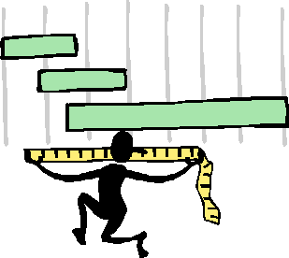

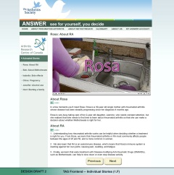

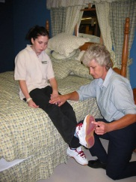
Implement
Identify
Analyse
Measure
Develop & evaluate
Notes:
I think we would all agree that considerable resources have been devoted to health research and the production of new knowledge.
But we also know that new research evidence will not change patient outcomes unless it is applied in clinical practice and policy decision-making. This is why the implementation phase of a research cycle is extremely important.

Slide 3
Outline
Discuss the need for investment in knowledge translation (KT).
Illustrate the use of the Knowledge-to-Action (KTA) Process in arthritis research.
Describe a framework, the Consolidated Framework for Implementation Research (CFIR), and its application.

Slide 4
Quality of care in chronic diseases
Disease / condition | Pass rate: Managed care | Pass rate: Primary care
Stroke | 82% | 65%
Hypertension | 77% | 72%
Heart failure | 71% | --
Diabetes | -- | 74%
Depression | 31% | --
Osteoarthritis | 31% | 29%
Disease / condition | Pass rate: Managed care | Pass rate: Primary care
Stroke | 82% | 65%
Hypertension | 77% | 72%
Heart failure | 71% | --
Diabetes | -- | 74%
Depression | 31% | --
Osteoarthritis | 31% | 29%
Li (2011) | -- | 22% (non-pharmacological)
Grønhaug (2014) | -- | 47%
Doubova (2015) |  | 20-26% (non-pharmacological)
Askari et al., PLoS One, 2011
Notes:
In the last 50 years, health research has come a long way in improving survival, reducing severe disability and improving quality of life. Unfortunately, it is also not hard to find examples where research is not being used in practice.
One way to provide objective measure of the performance in health care is to use quality indicators. These are evidence-based tools that provide a ‘pass rate’ that indicates the percentage of people received the necessary treatment or service out of the total who needed the care. Around the late 90’s/early 2000, a number of quality indicators were developed. A recent systematic review examined the quality of care in chronic diseases in older adults found that, compared to a variety of chronic diseases, the pass rate for OA care was consistently low across managed care and primary care setting.

Slide 5
The ‘K’ on OA management
Year | Country | Guideline organization
2003 | Europe | EULAR-knee
2005 | Europe U.K. | EULAR-hip MOVE Consensus Group
2007 | Europe | EULAR-hand
2008 | U.S. International France U.S. | National Collaborating Centre for Chronic Conditions OA Research Society International (OARSI) French Clinical Practice Guideline Group American College of Clinical Pharmacy
2009 | U.S. | American Physical Therapy Association
2011 | Netherlands U.S. | The Dutch OA Guideline Group Michigan Quality Improvement Consortium
2012 | U.S. Asia Canada | American College of Rheumatology Chronic Pain Advisory Board The Ottawa Panel
2013 | U.S. | American Academy of of Orthopaedic Surgeons
Adapted from: Nelson et al., Semin Arthritis Rheum, 2014
Notes:
This is particularly alarming because the knowledge on OA management, has been quite consistent over the years. A team in Chapel Hill has recently reviewed the 15 guidelines and recommendations in OA management.
What they found was that the recommendations on the first-line pharmacological and non-pharmacological management were in remarkable agreement across organizations and countries.
This is just 1 example that demonstrates why we need to invest in knowledge translation and implementation research.

Slide 6
The ‘death valleys’ between research and practice
Implementation interventions
Valley 1
Valley 2
Basic biomedical research
Clinical science & knowledge
Clinical practice & policy decision making
Translational continuum
Adapted from: 1) Reis et al., Clin Transl Sci, 2008, 1(1):9-10; 2) Canadian Institutes of Health Research
Notes:
Reis and colleagues have identified 2 ‘death valleys’ in the knowledge translation continuum. Valley 1 represents the delay for basic biomedical research translated into clinical science and knowledge. Valley 2 represents another gap between clinical knowledge and clinical practice, as well as policy decision making.
In most situation, an active intervention is needed to close these ‘death valleys’. These types of interventions, which aim to promote the systematic use of research knowledge and other evidence-based practices in routine clinical practice or decision-making is what is known as ‘Implementation Intervention’
In the past, implementation of effective health services interventions has been a haphazard process. Martin Eccles, who is the Editor-in-chief of the journal Implementation Science has remarked that this was ‘an expensive version of trial-and-error’. Many implementation scientists, such as Richard Grol and others, have argued that knowledge translation and implementation need to be grounded in strong theoretical basis in order to have a better chance to be successful.

Slide 7
Adapted from:
Nilsen, Implement Sci, 2015
Theoretical approaches
1. Describing / guiding a process
2. Explaining what influences outcomes
3. Evaluating the process
Process models
Determinant frameworks
Classic theories
Implementation theories
Evaluation frameworks
Notes:
In a recent paper, Nilsen outlining 3 aims of using theoretical approaches in implementation science. First, theoretical approach can guide the process of translating research into practice. Many Process Models have been developed for this purpose, and I will focus on one of them in a moment.
Second, it helps us understand or explains what influences implementation outcomes., through the application of Determinant Frameworks, Classical Theories, and theories that are specifically developed for implementation science.
Finally, theoretical approach can guide the evaluation of the implementation effort. An example of an evaluation framework is the PRECEED-PROCEED model, which has been used extensively in heath services research.
Process Model are designed to illustrate the process of moving research into practice.

Slide 8
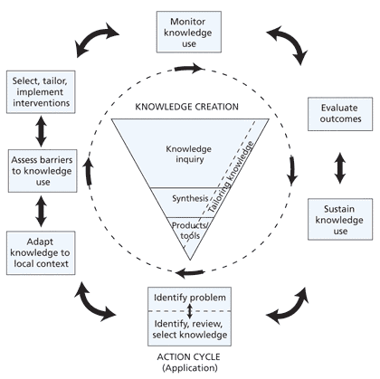
Knowledge-to-Action Process
Straus, Tetroe & Graham, 2013
Graham et al., 2006
Notes:
Process Model are designed to illustrate the process of moving research into practice. An example is the Knowledge-to-action Process. Initially developed by Graham, which described a single direction process, the model was updated by Straus and colleagues in 2013 to illustrate an iterative process. In fact, in the recent publication the authors encourage people to view this as a fluid process in which that every step could take place before or after the other steps when it is applied in real life.
At the core of the model is what they call the ‘Knowledge Funnel’. As the knowledge moves through the funnel, it becomes more distilled and refined, and presumably more useful to stakeholders. These include the 2nd generation of knowledge, such as systematic reviews and the 3rd generation of knowledge, such as practice guidelines and quality indicators.
In order for these knowledge product to be used to inform practice, it needs to move into the Action Cycle, which involves an iterative process of identifying the problem between what is known and what is currently done in practice, adapt the knowledge to the need of the users, assess the barriers to use the knowledge, select and tailor the implementation intervention. Once the implementation process is in place, there needs to a plan to monitor the knowledge use, for example, if there is a change in practice behavior; the impact on patient outcome, and the sustainability of the use. Throughout this process, new issues may be identified that may require further adaptation of the knowledge, tailoring of the implementation process, and further evaluation.
An example of applying the Knowledge-to-Action Process is our recent project that aims to improve the use of medication in patients with RA.

Slide 9


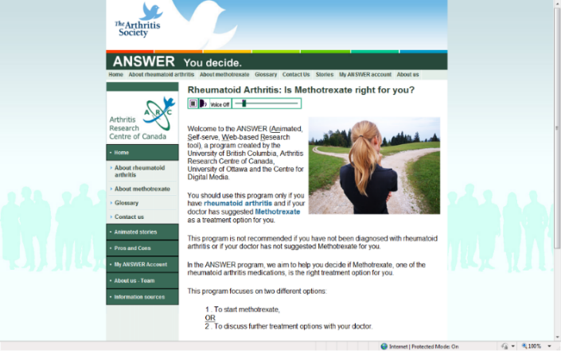
ANSWER
A patient decision aid for patients with rheumatoid arthritis

Slide 10
Reasons for not using rheumatoid arthritis medication
Not suggested by the doctor
Did not think they needed medication
Fear of side-effects; preferred to avoid medications
Don’t know that DMARDs prevent joint damage
Feeling uncertain about taking DMARDs
  Concern about the consequences of RA
  Concern about side effects
Lacaille et al. 2007
Notes:
Reasons for RA patients feeling reluctant about using medications include: 1) a lack of health professional advice, 2) fear of side effects, 3) preference to avoid medications, and 4) perceived lack of need. Further, patients have perceived a shortage of credible and user-friendly information about treatment options.
Our qualitative interview further revealed that patients felt uncertain about taking DMARDs. On the one hand, they were concern about the consequences of RA. On the other hand, they worried about the side effects.

Slide 11
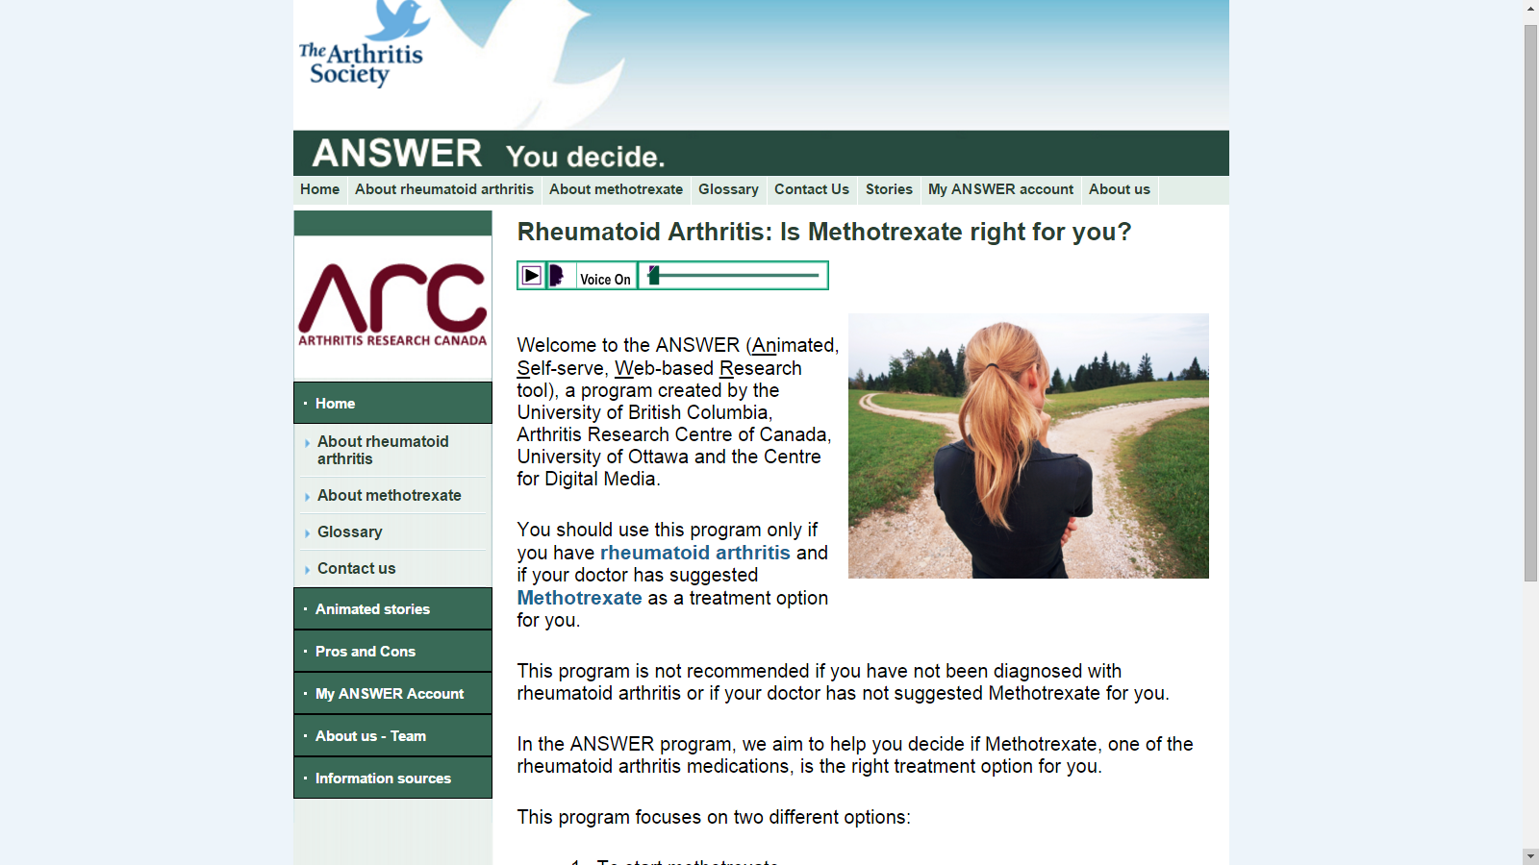
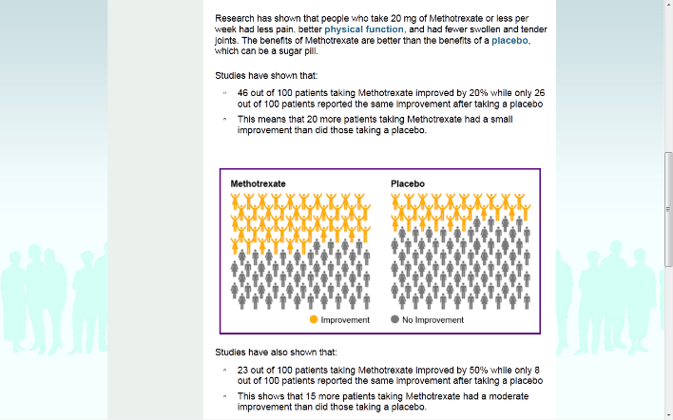






ANSWER: an online patient decision aid on methotrexate
Li et al., Arthritis Care Res, 2014
Notes:
Based on these findings, our consultation with patient partners, and the literature on shared decision-making, we developed an online patient decision aid called ANSWER. ANSWER was created based on the information from the Cochrane systematic review on methotrexate and clinical practice guidelines on RA management.
One challenge of the traditional patient decision aid was that it presented the evidence in a clear, but dry style,. So they were not very engaging, which was part of the reasons why the uptake of this type tool was poor. We reviewed the literature on patient education, and subsequently adapted the information in the animated storybook format. In ANSEWR, we presented the consequences of taking methotrexate versus doing nothing in 6 animated story. At the bottom are the screenshots from the 6 stories.
We then tested the ANSWER in 30 patients with RA, who were advised by their rheumatologists to consider methotrexate. The results showed that patients felt less conflicted about their treatment decision, and that their knowledge about methotrexate improved significantly after using the ANSWER.

Slide 12
New issue…
57% of rheumatologists were unfamiliar with patient decision aids.
67% felt that their use required reorganization of practice and workflow.
Qualitative interviews:
  Did not see a difference between patient decision aids and the existing patient education tools
  Information is solely based on RCT findings
  Fear of impairing MD-patient communication
Notes:
During the evaluation, we also identified important barriers to the implementation of the ANSWER. We conducted a survey of rheumatologists in Canada and found that 57% were unfamiliar with patient decision aids. Also, 67% felt the use patient decision aids would require that they reorganize their practice and workflow.
Our qualitative interviews of a sample of the survey respondents have further revealed important issues and misconceptions about patient decision aids. First, some rheumatologists viewed patient decision aids as another education tool, and so they would rather continue using what they are familiar with. Second, many felt the information presented was limiting because it is only based on RCT findings. And finally, rheumatologists felt that patients may make a decision based on the information from the patient decision aid, without consulting with their physicians. In order to implement PtDA in clinical practice, we need to tackle these issues.

Slide 13
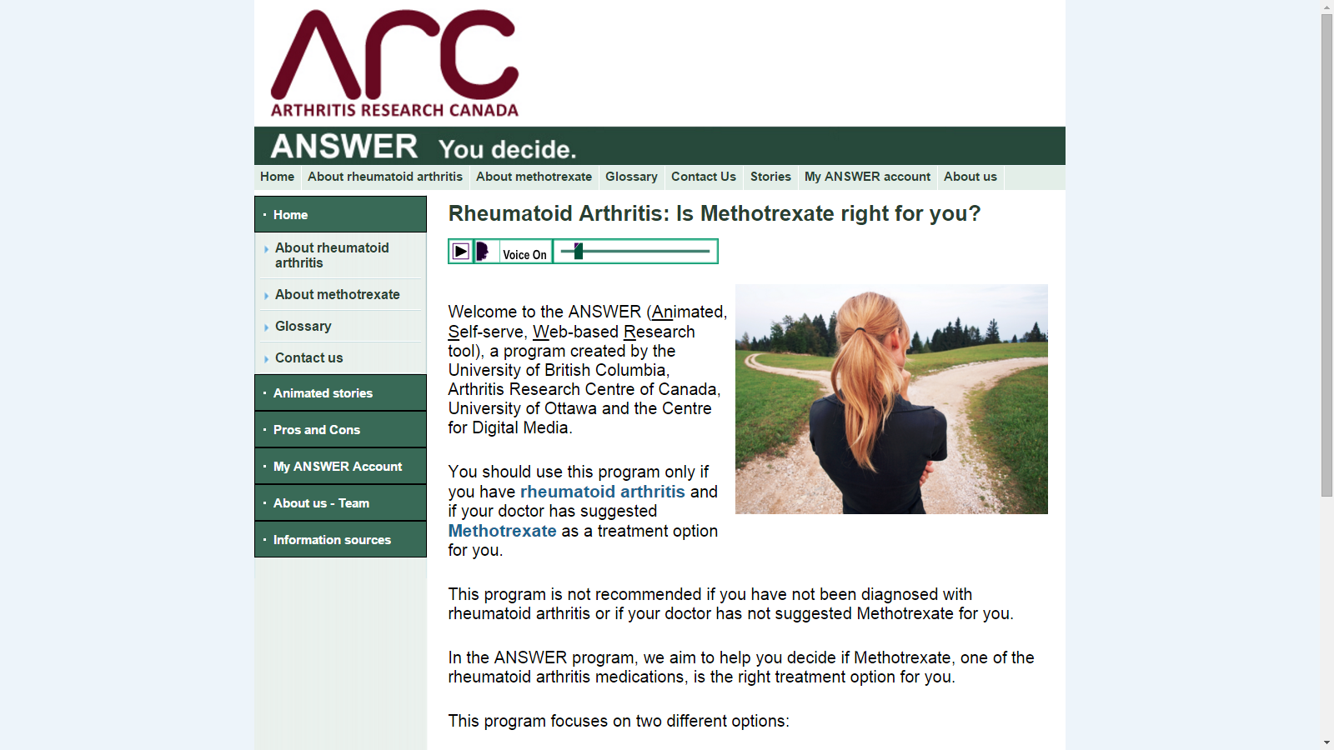
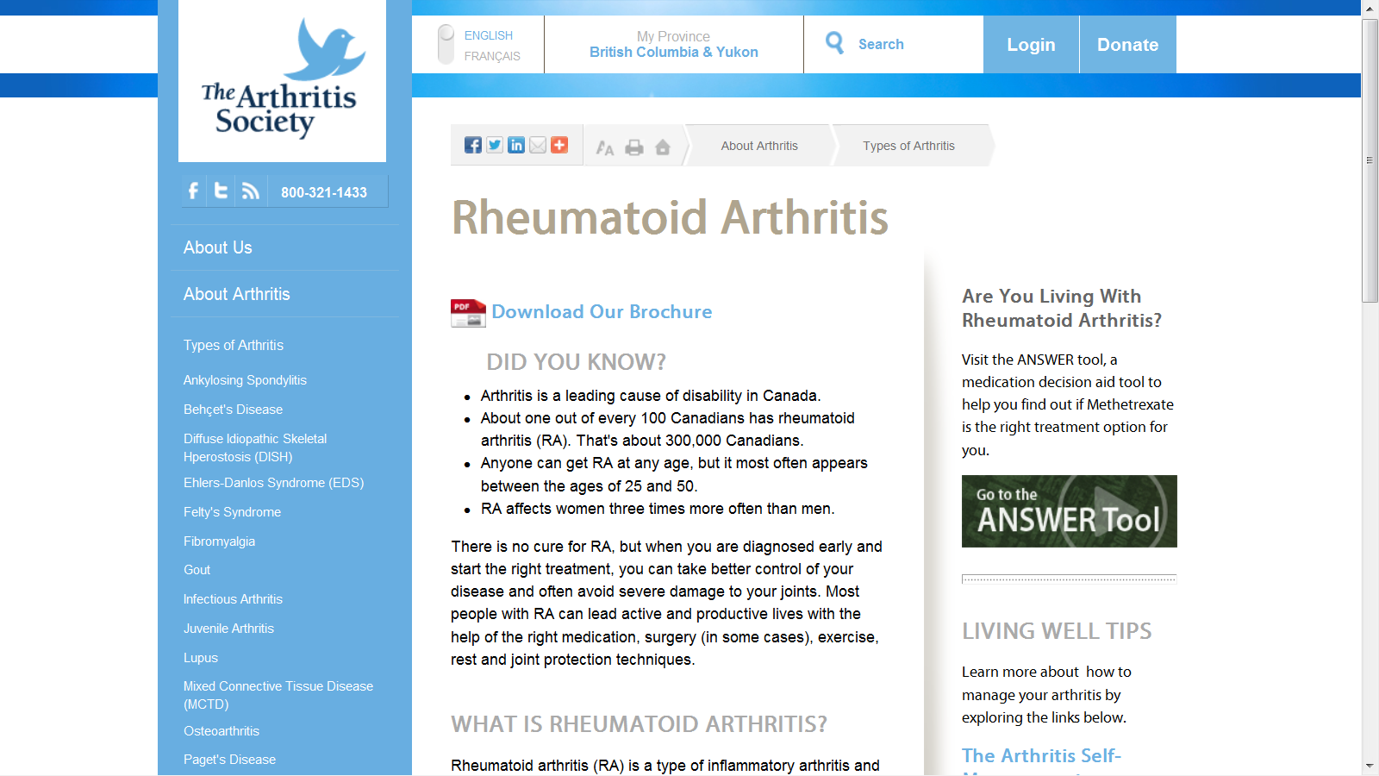
Sustaining knowledge use
Arthritis Research Canada
answer.arccanada.org
The Arthritis Society
Notes:
ANSWER is hosted by Arthritis Research Canada for public access. We have also partnered with The Arthritis Society to direct their website visitors to the ANSWER. Since it was release in 2012 up to 2014, ANSWER has been access by over 6,000 users.

Slide 14
Application of the Knowledge-to-Action Process in ANSWER
3
1
2
4
5a
1
5b
Notes:
To sum it up, we applied the Knowledge-to-Action Process starting by identifying the discrepancy in the use of DMARD use by patients with RA,
During the process of developing patient-friendly information on RA treatment, our qualitative study on patient’s help-seeking experience revealed important barriers and their sense of uncertainty when faced with the treatment decision.
Based on the literature in share decision-making, we develop an online patient decision aid to guide patients thinking through the pros and cons about using methotrexate.
We then evaluated the ANSWER tool, and confirmed the partnerships for its public release after the evaluation.
During this process, we identified issues that could affect the uptake of the ANSWER from the rheumatologist’s perspective. We continue to work with our rheumatologist collaborators to address these issues. In addition, we are tracking the usage data for ANSWER to identify any potential issues from the patient’s perspective.

Slide 15

ANSWER 2: a patient decision aid on biologics
Notes:
Building on this experience, we have received funding CIHR to develop a more comprehensive decision aid on biologics with a team of rheumatologists, decision scientists and patients. The RCT for ANSWER-2 is underway in Canada, as well as the U.S.

Slide 16
Adapted from: Nilsen et al., Implement Sci, 2015
Theoretical approaches
Describing / guiding a process
Explaining what influences outcomes
Evaluating the process
Process models
Determinant frameworks
Classic theories
Implementation theories
Evaluation frameworks
Notes:
Back to the diagram by Nilsen. Process models, such as the Knowledge-to-action Process, describe or guide the process of translating research into practice. But, what they do not do is to explain what influence implementation outcomes. To address this topic, we need to turn to Determinant Frameworks.

Slide 17
Consolidated framework for Implementation Research (CFIR)
‘Meta-theoretical framework’, a synthesis of 19 implementation theories and models.
5 domains
  The health services intervention
  Outer setting
  Inner setting
  Individuals involved
  The implementation process
Damschroder et al., Implement Sci, 2009
Notes:
One of the most robust framework for understanding the determinants affecting implementation outcome is the Consolidated Framework for Implementation Research, or CFIR. The CFIR is a meta-theoretical framework, which was created from a synthesis of 19 implementation theories and models.
It has 5 domains, including the health services intervention, the settings, which was divided into the outer and the inner settings, the characteristics of individuals involved, and the implementation process.

Slide 18
Consolidated framework for Implementation Research (CFIR)
2
1
4
3
5
Damschroder et al., Implement Sci, 2009
Notes:
This is the schematic of CFIR which depicts the complex interactions between a health services intervention and the settings and individuals. The framework suggests that most health services interventions are not designed in or for the setting where it will be used. Without active adaptation, these interventions often come to a setting as a poor fit, resisted by people who will be affected by the intervention. Therefore, an active process is needed, taking into account the characteristics of individuals and settings, to modify the intervention so that it fits the environment.
An intervention can be thought of as having a Core Component, which is not modifiable, and an Adaptable Component, which can be adaptable to fit the settings without compromising the integrity of the that intervention.
The next 2 domains are the outer and inner setting. Generally, the outer setting includes the economic, political and social context in which the organization resides. And the inner setting includes the structural , political and cultural contexts through which the implementation process will proceed. Changes in the outer setting can influence implementation, often mediated by the change in the inner setting. It is important to note that the line between inner and outer setting is not always clear and the interface is dynamic and sometimes messy.

Slide 19
CFIR domains and constructs
Outer setting | Inner settings | Individuals | Process
Patient needs and resources | Structural characteristics | Knowledge & beliefs about intervention | Planning
Cosmopolitanism | Network and communications | Self-efficacy | Engaging
Peer pressure | Culture | Individual stage of change | Executing
External policies and incentives | Implementation climate | Identification with organization | Reflecting / evaluating
 | Readiness for implementation | Other personal attributes
Damschroder et al., Implement Sci, 2009
Notes:
Through the synthesis of the existing models and theories, the CFIR has develop a comprehensive list of constructs under each domain, from the context of the settings to the attribute of everyone involved and the implementation process.

Slide 20
Application of CFIR
Guides capacity and needs assessment prior to implementation.
Informs the assessment of barriers and facilitators to implementing a health services intervention in specific settings.
Complements existing models and theories
Notes:
CFIR can be used in full or in parts to guide the assessment of needs and capacity before implementation and identify barriers. Also, it can be use to complement other existing models or theories with its comprehensive taxonomy of each constructs.

Slide 21
Use CFIR to complement the
Knowledge-to-Action Process
CFIR
Outer setting
Inner setting
Individuals
Notes:
For example, one of the steps in the Knowledge-to-Action framework is to identify barriers to knowledge use in order to inform the selection of an appropriate health service intervention. However, the model does not specify what those barriers may be and how to assess them.
To this end, the CFIR provides a list of constructs for researchers to consider.

Slide 22
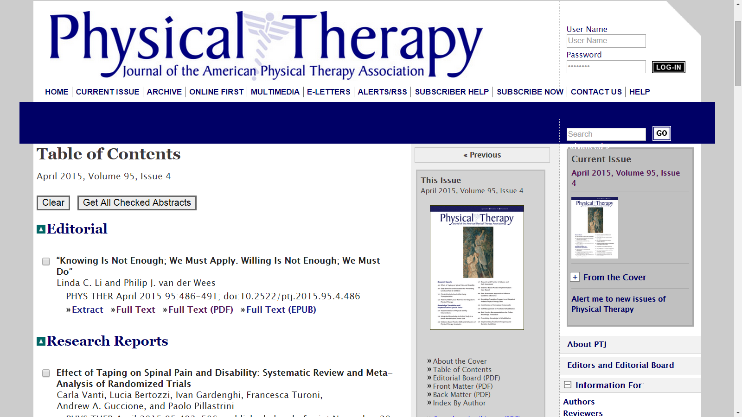
Physical Therapy, KT & Implementation Science Special Issue, 2015

Slide 23
Summary
Investment in KT is necessary.
The Knowledge-to-Action Process can be applied fluidly to guide the KT process.
The Consolidated Framework for Implementation Research (CFIR) provides a structure for adapting and studying a health service intervention for local use.
The use of models and frameworks can help to open the ‘black box’ of implementation
Notes:
In summary, I have made the case that an investment in KT is necessary for improving arthritis care. I have reviewed the Knoweldge-to-Action Process and showed how it can be applied to guide the KT process. In addition, the CFIR can provide a structure to understand the interaction of different players when adapting a health service intervention for local use. And as such, it helps to open the ‘black box’ of implementation

Slide 24



Acknowledgements
Patient partners:
Cheryl Koehn, Alison Hoens, Kelly English, Karen Tsui, Otto Kamensek, Sheila Kerr, Lianne Gulka, Annette McKinnon, Ruta Cumming, Pam Monte, and many more …
Research collaborators
John Esdaile Diane Lacaille
Chris Shaw Diane Gromala
Aileen Davis Jolanda Cibere
Nick Bansback Lynne Feehan
Elaine Yacyshyn Allyson Jones
Jacek Kopec Paul Adam
Alison Hoens
Catherine Backman
Trainees
Jenny Leese Bao Chau Tran
Cam Clayton Alex Klemm
Clayon Hamilton
> 25 Master’s students @ Centre for Digital Media, Vancouver
Staff members
Jasmina Memetovic Navi Grewal
Graham Macdonald Eric Sayre
Juyoung Yoo
Notes:
I would like to acknowledge all the individuals who have contributed to our work in KT, in particular the many Patient Partners who are listed at the top.

Slide 25
The ‘death valleys’ between research and practice
Closing
Valley 1
Valley 2
Basic biomedical research
Clinical science & knowledge
Clinical practice & policy decision making
Translational continuum
Adapted from 2 sources: 1) Reis et al, Clin Transl Sci, 2008, 1(1):9-10; 2) Canadian Institutes of Health Research
Notes:
Reis and colleagues have identified 2 ‘death valleys’ in the knowledge translation continuum. Valley 1 represents the delay for basic biomedical research translated into clinical science and knowledge. Valley 2 represents another gap between clinical knowledge and clinical practice, as well as policy decision making.

Slide 26
Pain & functional status assessment Pass rate: 48.6% (32.6 – 64.6) | Surgical referral Pass rate 78.9% (67.4 – 94.2)
Drug treatment Pass rate: 37.5% (30.8 – 44.5) | Non-drug treatment Pass rate 36.1% (27.8 – 44.7)
Basedow and Esterman., J Eval Clin Pract, 2015
Notes:
A new meta-analysis led by a group in Australia tells the story about the quality of care in OA. Here you see the forest plot and the estimated pass rate of 4 categories of OA management, including Pain and Functional Status Assessment, Surgical Referral, Drug treatment, and Non-Drug Treatment.
What they found was that the quality of care for Surgical Referral did quite well and reached a pass rate of 79%, On the other hand, non-drug treatment has the lowest pass rate of the 4 categories at 36%, followed by drug treatment at 37%. .

Slide 27
Notes:
Traditionally, implementation of effective health services interventions has been a haphazard process. Martin Eccles, who is the Editor-in-chief of the journal Implementation Science has remarked that this was ‘an expensive version of trial-and-error’. Many implementation scientists, such as Richard Grol and others, have argued that knowledge translation and implementation need to be grounded in strong theoretical basis in order to have a better chance to be successful.
In a recent debate paper, Nilsen outlining 3 aims of using theoretical approaches in implementation science. First, theoretical approach can guide the process of translation research into practice. Second, it helps us understand or explains what influences implementation outcomes. And Third, it guides the evaluation of the implementation effort.
He then identified 5 categories of theoretical approaches that can be used to achieve these 3 aims.
Process Model are designed to illustrate the process of moving research into practice.

Slide 28
Acute/sub-acute low back pain management
Li
1998
Canada: 1 in 3 used modalities of uncertain effectiveness
Only 46% thought practice guidelines were useful
Harte
2005
UK: 41% used lumbar traction
Bishop
2008
UK: 28% of health professionals advised patients to remain off work
Hendrick
2013
NZ: 95% of PTs advised return to normal/light duties
Only 52% thought practice guidelines were useful
Notes:
Perhaps a consistent observation here is that knowledge products alone, such as clinical practice guidelines, are insufficient for improving practice. Often, active, deliberate and evidence-based implementation strategies are required.

Slide 29

Knowledge Translation
Knowledge users know and use research evidence to inform decision making and practice.
Research is informed by the current available evidence , as well as the experience and information needs of knowledge users.
Dr. Jeremy Grimshaw
CRC in Health Knowledge Transfer & uptake
Notes:
Knowledge translation is about ensuring that Knowledge users know and use research evidence to inform their decision making, and that research is informed by current available evidence and the experiences and information needs of the knowledge users

Slide 30
Knowledge-to-Action Process
Straus, Tetroe & Graham, 2013
Graham et al., 2006
Notes:
Process Model are designed to illustrate the process of moving research into practice. An example is the Knowledge-to-action Process. Initially developed by Graham, which described a single direction process, the model was updated by Straus and colleagues in 2013 to illustrate an iterative process. In fact, in the recent publication the authors encourage people to view this as a fluid process in which that every step could take place before or after the other steps when it is applied in real life.
At the core of the model is what they call the ‘Knowledge Funnel’. As the knowledge moves through the funnel, it becomes more distilled and refined, and presumably more useful to stakeholders. These include the 2nd generation of knowledge, such as systematic reviews and the 3rd generation of knowledge, such as practice guidelines and quality indicators.
In order for these knowledge product to be used to inform practice, it needs to move into the Action Cycle, which involves an iterative process of identifying the problem between what is known and what is currently done in practice, adapt the knowledge to the need of the users, assess the barriers to use the knowledge, select and tailor the implementation intervention. Once the implementation process is in place, there needs to a plan to monitor the knowledge use, for example, if there is a change in practice behavior; the impact on patient outcome, and the sustainability of the use. Throughout this process, new issues may be identified that may require further adaptation of the knowledge, tailoring of the implementation process, and further evaluation.
An example of applying the Knowledge-to-Action Process is our recent project that aims to improve the use of medication in patients with RA.

