Slide 1
Speed (Up)Dating 19 November 2015 Leacock 232

Slide 2
Our mission The mission of the Student Affairs Collective is to provide a supportive, inclusive and empowering forum for all administrative and academic staff who support students, to broaden institutional knowledge, to share best practices, and to offer opportunities for personal and professional development. -- Staff Empowering Staff

Slide 3
The McGill Commitment
One of the Principal’s five priorities
Specifically, “Providing all students with a stimulating, innovative, and inquiry-based educational experience.”
Based on four pillars and supported by Faculty commitments
Expressed on website (launching soon) and supported through philanthropic efforts
Led by the Office of Student Life and Learning
ollivier.dyens@mcgill.ca

Slide 4
Health Promotion Initiatives
Shag Shop continues online this year & kiosks continued on campus
Peer Health Educators running campaigns throughout the semester on mental health, sexual health, nutrition, active living, drug & alcohol education
Setting up for Self Care Challenge, prospectively February
Health Promotion, Healthy McGill
Jocelyn Micallef & Allyson Brisebois Interim Health Promotion Coordinators
Health.promotion@mcgill.ca
www.mcgill.ca/healthymcgill

Slide 5
Safer Spaces Certificate Tynan Jarrett
Certificate received upon completion of six workshops
Interactive sessions designed to help address challenging topics openly and honestly
Focused on building awareness, skills and tools
Unit: SEDE – Social Equity and Diversity Education Office
Contact Person(s) & Contact Info: Tynan Jarrett tynan.jarrett@mcgill.ca

Slide 6
#ConsentMcGill Education and Crisis Support
Becoming an Active Bystander Workshop
Alcohol and Consent Workshop
Office of the Dean of Students
Bianca Tetrault (Liaison Officer Harm Reduction)
514-398-3786
Bianca.tetrault@mcgill.ca
Consent McGill Facebook Page

Slide 7
Dobson Centre for Entrepreneurship
Build something you care about
Come to our events and get mentored
Enter the McGill Dobson Cup Start-UP Competition ($100,000 in prize money)
Carol Clelland, Manager, Administration
514-398-2433
carol.clelland@mcgill.ca
Join us on Facebook: facebook.com/DobsonCentre
Follow us on Twitter: twitter.com/DobsonCentre
Check out our Entrepreneurship Community: facebook/groups/DobsonCentreCommunity

Slide 8
News from Service Point Dammit, I’m not here! (A deregistration process)
A clean up process of newly-admitted students who are registered but did not come to McGill, hence “Dammit, I’m not here!”
This avoids bigger issues re government-reporting to the Ministry of Education
Basic criteria for report:
Newly-admitted & registered for courses
No ID card issued
No payments received
No legal documents received
Hunting for clues (correspondence from the student, Minerva login activity, etc)
End result: Withdrawal with refund
Contact Us:
Service Point - Legal Documentation
legaldocumentation@mcgill.ca servicepoint@mcgill.ca
(514)398-7878
Service Point Hotline
for internal offices
ext. 4466

Slide 9
Course Equivalencies
Course Equivalency System
Course request/review management system
Equivalency database – over 18,000 courses reviewed
Transfer Credit Assessment Form
Minerva Form – approval of transfer credits for a given student
Required for all students who participate in Exchange or Study Away
Equivalencies at admission
Math and Science table -> Equivalency database
New equivalencies via the Course Equivalency System
ceqadmin@mcgill.ca
http://www.mcgill.ca/students/transfercredit/course-equivalency-faqs

Slide 10
New Initiative Découvrez le “French Side” de McGill
Objective: Create a portal and a promotional campaign that promote the University’s French opportunities to the surrounding community (on campus and in Montreal)
Targeted People: McGill employees, McGill students and people from the community – francophones and non francophones, actual or future prospects
Un “site” vaut mille mots –
Let’s explore the website and the promotional video: http://vivreenfrancais.mcgill.ca/
Language and Intercultural Communication – School of Continuing Studies
Manon Gadbois
Program Coordinator & Project Leader for the Vivre McGill en français Initiative
T: 514 398-2142
manon.gadbois@mcgill.ca or vivremcgillenfrancais.scs@mcgill.ca

Slide 11
Counselling Service Update
1. Mental Health First Aid
2-day training, increase mental health literacy & learn tools for supporting students in distress Contact: lorraine.bush@mcgill.ca
2. Specialized Teams
In the Consultation Meeting student may request:
Substance Misuse Team: work on issues related to alcohol or substance use
PRIDE Team: sensitive to LGBTQ issues
*NEW* Sexual Diversity Discussion Group (online registration)
3. December Workshops & Online Self-help

Slide 12
News from ODoS
Two new advising initiatives from the Office of the Dean of Students for 2015/2016:
Dean of Students Award for Excellence in Undergraduate Student Advising
All advising staff (administrative and academic) are eligible to be nominated for the new annual Award, by either a student or colleague
Nomination deadline: March 1, 2016
Prize: $500, and the admiration of all!
Details and nomination instructions on the Advising website
Advising Support Fund
$1000.00 per year (June 1 – May 31) is now available to advising offices, units or groups to support staff or student-facing advising initiatives or activities
Up to $200 per request (one request from a unit/office/group per year)
Application and details on the Advising website
For more information: https://www.mcgill.ca/students/advising/foradvisors
*Questions? Penny Kaill-Vinish – penny.kaill-vinish@mcgill.ca / Margaret Colton – margaret.colton@mcgill.ca

Slide 13
Experiential Learning & Reflection Initiatives
Help students to make the most of their experience and degree, to make sense of things and make a bigger plan for their lives
eX Program:
Pre-experience workshop (goal setting and mindful engagement)
eXBook (tool – guiding questions, self-assessment and reflection)
Post-experience reflection workshop (guided reflection on skills and personal and professional development)
CaPS Degree Menus:
Provide students with a clear visual “map” for their time at McGill
“Four-Year Plan” plus “What Can I do with my Degree?” and More!
Advice and information on academics, wellness, involvement and career planning
Tool for staff (particularly in advising and recruitment) and students
McGill Career Planning Service (CaPS)
Jan Bottomer, M.A. Music and Arts Career Advisor; Jan.Bottomer@mcgill.ca
Cindy Mancuso M.Ed. Career Counsellor; Cindy.Mancuso@mcgill.ca

Slide 14
Mental Health Service
1. McGill Mental Health Hub Connecting students to support and information surrounding mental well-being
mcgillmentalhealthhub.ca
2. WRAP
Group psychoeducation
6 sessions, 2 hours each
Learn about wellness and creating plans to cope with stress/triggers/crises
Funded by Innovation Fund
3. Emergency Hours
11am – 2pm weekdays
4. Medical Notes Policy
Mental Health Service
Emily Yung Mental Health Education Coordinator
emily.yung@mcgill.ca

Slide 15
Academic Writing: Additional Support for Students
Student-tutor meeting time increased: Up to 7 hours per student, per semester; undergrads and grads
McGill Writing Centre Tutorial Service: http://www.mcgill.ca/mwc/tutorial-service
“Crunch-time” writing workshops: A selection of 2-hour workshops designed to support students with end-of-term assignments
Descriptions and schedule:
http://www.mcgill.ca/mwc/tutorial-service/workshops
Placement testing for Winter 2016 academic writing credit courses: Early testing for ESL students who don’t want to wait until January to plan their schedules
Schedule: http://www.mcgill.ca/mwc/courses/placement-tests
The McGill Writing Centre
mwc@mcgill.ca

Slide 16
McGill Family Resources Coordinator- SEDE
An SPF funded project w/ goal to institutionalize McGill FCP by 2017.
Assist staff & student parents via research, support, advocacy, centralize resources
Current projects: Drop ins, Webinar, SWAP, Collective Kitchen, Focus groups, workshops.
McGill Social Equity and Diversity Education Office (SEDE)
Tanya Lalonde, Family Resources Coordinator
Family.coordinator@mcgill.ca
FB: McGill Family Care Program - SEDE

Slide 17
Advising syllabus: An adaptable template
Advising syllabus : What it is?
Rationale : Why use one?
Adaptable template : Create your own
For more information, or to access the templates, please email michelle.maillet@mcgill.ca
McGill Academic Advisers Network (AAN)
Advising Syllabus Committee
Dr. Julie Major, Program Adviser, Faculty of Agricultural and Environmental Sciences
Kathy Roulet, Program Adviser, McGill School of Environment
Michelle Maillet, Program Adviser, Department of Geography

Slide 18
Reimagining Mentoring…
Across McGill
What’s in a name?
From Staff-Student Mentoring
To Mentoring Across McGill
Growing our program
WPC (Widening Participation Committee) mentors
NEW! Young alumni mentors
Looking forward
Reaching more students and making mentoring more accessible
Student ambassadors
Pop-up mentoring!
undergrad.mentoring@mcgill.ca
Mcgill.ca/mentoring

Slide 19
Peer Programs Network
What’s New?
We have a new name
We have a new logo
We have new programming
We have Project Development Specialist
Alex Megelas
We have new PPN committee team members
Michael Dougan, Samantha Goldberg, Andrea Taylor
Who Do We Support?
Students seeking peer support
Students in a peer support role
Peer program coordinators (staff and students)
How Can You Learn More?
www.mcgill.ca/peerprograms
peersupport@mcgill.ca

Slide 20
Office for Students with Disabilities Access, Accommodations and Partnerships
Access
Academic Accommodations
Partnerships
Office for Students with Disabilities – disabilities.students@mcgill.ca
Teri Phillips – teri.phillips@mcgill.ca
Tanja Beck – tanja.beck@mcgill.ca
Jess Giles – jessica.giles@mcgill.ca
Patricia Diaz del Castillo – patricia.diazdelcastillo@mcgill.ca

Slide 21
Admissions Unit
What we do
Admission, UG, Grad
Deferrals
Curriculum review
Credit/exemption
Document verification
Resources
www.mcgill.ca/applying
www.mcgill.ca/students/transfercredit/prospective
What’s new for 2016
Admissions Unit, Enrolment Services
Karen J’bari, Senior Admissions Officer karen.jbari@mcgill.ca

Slide 22
Updates in Rez
New Resources in Rez
Peer Support Centre- Uni Hall, Mon & Wed, 12pm-4pm
Social Work Intern-Sexual Assault- Uni Hall, Fri 1pm-3pm
Tutorials- RVC Caf, Mon-Thurs, 2:30pm-4:30pm
Race Project
Full roll out in January
Holiday Hosting
Staff volunteers needed!
Residence Life
Samantha Goldberg: samantha.goldberg@mcgill.ca
Holiday Hosting: Julianna Duholke, advisor.residences@mcgill.ca

Slide 23
Closing Remarks
Please take your tickets out for a draw.
Gault Nature Reserve
of McGill University
Ecomuseum Zoo
Marché Mac Market
Stay tuned for news regarding Advising Day 2016!

Slide 24
Additional Resources from Mental Health Services

Slide 25
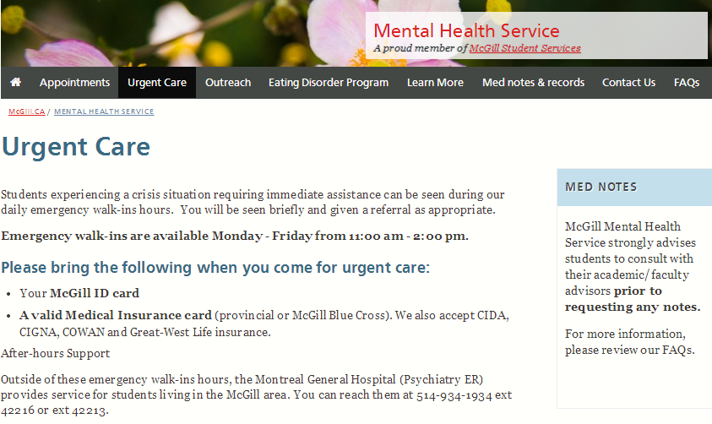
Updated Emergency Hours

Slide 26
Medical Notes Policy

