Slide 1
Mental Health and Wellness Trivia

Slide 2
What is stress?
A) The body’s reaction to any change that requires a response
B) The body’s reaction with a physical, mental and/or emotional response.
C) A normal part of life
D) All the above
D

Slide 3
What are the three main types of responses to stress?
A) Fright, Flee, Fight
B) Fright, Freeze, Fight
C) Flight, Fight, Freeze
D) Flight, Freeze, Run
C

Slide 4
What is Mental health and wellness?
A) Affects how we think, feel, and act, and helps us determine how we can handle stress
B) The way your brain acts
C) Not knowing your thoughts
D) Knowing about physical illnesses
A

Slide 5
What is “Muin” in English
A) Mother
B) Bear
C) Moose
D) Dog
B

Slide 6
What is self-care:
A) Taking care of other people
B) Putting other people’s needs before your own
C) Putting your needs first and caring for yourself
D) Taking care of your family
C

Slide 7
What are the four areas of balance:
A) Physical, Emotional, Spiritual, Mental
B) Nature, Physical, People, Technology
C) Physical, Mental, Spiritual, Nature
D) Emotional, Social, Nature, Mental
A

Slide 8
What are examples of Spiritual Self-Care activities?
A) Eating healthy
B) Sleeping 7-9 hours
C) Participating in cultural activities
D) Having Coffee with a friend
C

Slide 9
What is “Wela’lin” in English
A) Good Morning
B) Hello
C) Welcome
D) Thank You
D

Slide 10
What are examples of Mental Health Self-Care activities?
A) Drinking lots of water
B) Challenging your brain
C) Prayer
D) Smudging
B

Slide 11
What are examples of Emotional Self-Care activities?
A) Puzzles
B) Playing sports
C) Prayer
D) Setting boundaries with people
D

Slide 12
What are examples of Physical Self-Care activities?
A) Hunting & Dancing
B) Going to community events
C) Surrounding yourself with positive people
D) Smudging
A

Slide 13
What is anxiety?
A) A feeling and Survival instinct
B) Natural response to stressful situations
C) It is a feeling of fear and/or worry of what is about to come or what has happened
D) All the above
D

Slide 14
What is “Kitpu” in English
A) Kitten
B) Bear
C) Eagle
D) Caribu
C

Slide 15
What does anxiety help us do?
A) Avoid conflict
B) Avoid danger and gives us a boost of adrenaline to solve problems
C) Not worry about everyday life
D) All of the above
B

Slide 16
In Canada Anxiety ranks in the top five most common mental illnesses in Canada. Out of five what rank is Anxiety?
A) 1: the most common mental illness
B) 2: the second most common mental illness
C) 3: the third most common mental illness
D) 4: the fourth most common mental illness
A

Slide 17
What makes anxiety a disorder?
A) It does NOT start impacting everyday activities that we should enjoy.
B) Preventing someone from living in balance
C) Things such as panic attacks are getting better
D) all of the above
B

Slide 18
What does a panic attack resemble?
A) A heart attack
B) Uncontrolled breathing
C) Isolation
D) none of the above
A

Slide 19
What is “Kwe’ ” in English
A) Eagle
B) Bye
C) Sorry
D) Hello
D

Slide 20
How many different types of Anxiety Disorders are there?
B
Agoraphobia
Body Focused Repetitive Behaviours
Generalized Anxiety Disorder
Health Anxiety
Hoarding Disorder (HD)
Obsessive-Compulsive Disorder
Panic Disorder
Post Traumatic Stress Disorder
Separation Anxiety
Social Anxiety Disorder
Specific Phobia
https://www.anxietycanada.com/learn-about-anxiety/anxiety-in-adults/?gclid=Cj0KCQjwy6T1BRDXARIsAIqCTXrpMCyK7QvUN4WPJdTNo96Wmc5H6UivZ7YgSirMJ72T9cSIx482blEaAnmtEALw_wcB
A) 6
B) 11
C) 8
D) 9

Slide 21
How many minutes of exercise a day can help with anxiety?
A) 1 hour
B) 30 mins-45mins
C) 15 mins- 30mins
D) 0 mins
C

Slide 22
Which of the following can help with anxiety?
A) Exercise
B) Mindfulness
C) Breathing exercises
D) All of the above
D

Slide 23
1 out of ______ Canadians will experience an anxiety disorder in their lifetime.
A) 20%
B) 50%
C) 25%
D) 15%
C

Slide 24
What is “Teluisi” in English
A) How are you?
B) My name is..
C) Talk to me
D) What is this?
B

Slide 25
What is panic disorder ?
A) A short time of intense fear with/or sudden panic attacks that reoccur
B) General anxiety and worry
C) Constant worry about past things or future events
D) Fear of social situations
A

Slide 26
What is Generalized Anxiety Disorder?
A) increase anxiety around social situations
B) Excessive anxiety and worry about things we cannot control for 6 months that prevents people from enjoying daily activities.
C) An intense fear, such as spiders, heights or snakes
D) An increase of panic
B

Slide 27
What is a phobia disorder?
A) An increase of panic
B) An intense fear: Such as spiders, heights, certain sounds, weather.
C) Fear of social situations
D) An increase of worry surrounding past events or future events
B

Slide 28
What is social anxiety disorder?
A) A phobia of people
B) Intense worry surrounding people, places and things
C)It is a fear of being humiliated or embarrassed in public where people often feel that they are being judged negatively.
D) Worry about being alone
C

Slide 29
What is “Tia’m ” in English
A) Beaver
B) Bear
C) Moose
D) Dog
C

Slide 30
What is separation anxiety disorder?
A) Excessive anxiety of being separated from home or from a parent or caregivers.
B) Anxiety only children experience
C) Intense worry about being in crowds or groups
D) Fear of being in public places
A

Slide 31
What is agoraphobia?
A) The fear of open spaces or going outside
B) Not avoiding situations and places where they feel a panic attack could happen, such as malls.
C) A& B are correct
D) The fear of having a panic attack or symptoms in place where help may not be available, or become embarrassed or escape is difficult.
D

Slide 32
What is self-esteem?
A) Person’s overall sense of self-worth or personal value.
B) Does not play a part in your motivation and success throughout life
C) Not being able to see all your abilities & weaknesses together
D) All of the above
A

Slide 33
What is assertiveness?
A) Allows others to put their opinions above your own
B) The ability to express your thoughts, beliefs, and opinions
C) Aggressively pushing your opinions on other people
D) Not being able to say no
B

Slide 34
What is “Katew” in English
A) Maple tree
B) Beaver
C) Eel
D) Worm
C

Slide 35
What are ways to boost self-esteem?
A) Focusing on the positives and taking a social media break
B) Being open to compliments and identifying your strengths and areas of opportunity
C) Avoiding negative self-talk and expressing your values and beliefs without others influencing change
D) All of the above
D

Slide 36
What is mindfulness?
A) Thoughts in our mind
B) Being in the present, being aware of our thoughts and feelings in the moment. Brings us back to the present.
C) Constantly thinking about past events and things in the future
D) Having your mind full of thoughts, feeling, emotions
B

Slide 37
Which of the following are grounding techniques?
A) Hand of senses: 5 see, 4 touch, 3 hear, 2 smell, 1 taste
B) Laying on the ground
C) A & B
D) Avoiding what is making us anxious
A

Slide 38
Tie Breaker
List as many symptoms and signs of stress as you can

Slide 39
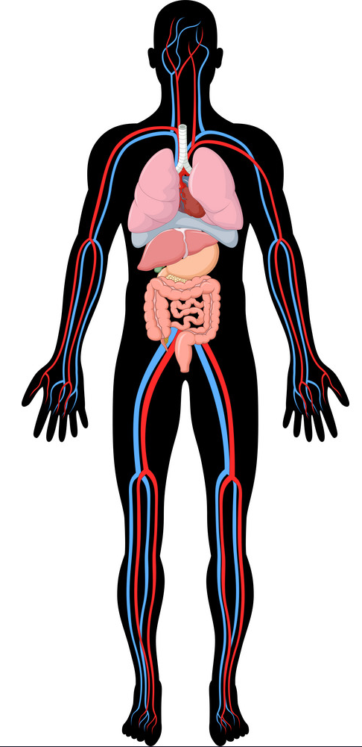
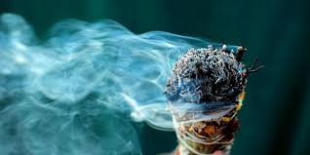
4 Types of Stress Symptoms
Physical self:
Aches & pains
Constipations
Rapid heart beat
Frequent colds
Eating to much/little
Sleeping to much/little
Nausea/ dizziness
Lack of energy
Spiritual self:
Stopping cultural practices
Isolation
Sense of loneliness
Nervous habits ( Ex: nail baiting, pacing)
Procrastination
Mental self:
Troubles with memory
Difficulty concentrating
Anxious thoughts
Constant worry
Negative thoughts
Loss of humor
Emotional self:
Unable to relax
Moodiness
Irritable/ angry
Unhappiness
Feeling overwhelmed
Crying

