Slide 1


Chapter 2:
The Program and Sessions
Note: the adapted version will be ready in 2016
Acknowledgement for creating this PowerPoint document:
Anishinabe research Team: Whitbeck, Walls, Crawford, and several Anishinabe partners from Western Ontario and Manitoba
Training Manual
Funded by the Public Health Agency of Canada; Innovative Strategies

Slide 2
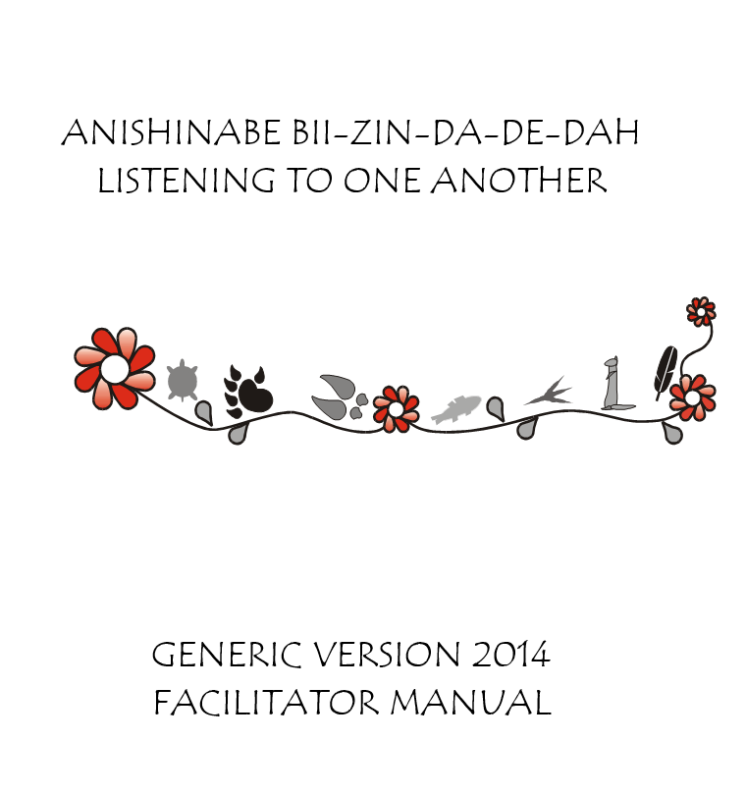

Chapter 2 Overview
Notes:
This section will give you a broad understanding of the current program and will allow you to view each session in more detail to inform your decisions about adaptation. The current program has 14 possible sessions, but may be modified to fit the needs of your community.

Slide 3
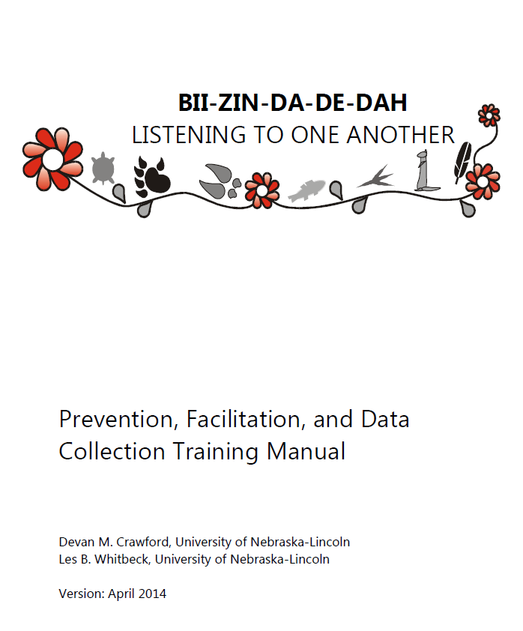
Listening to One Another
Chapter 1: Introduction to the Prevention Program
Chapter 2: The Program and Sessions
Chapter 3: Community Adaptation
Chapter 4: Facilitating Techniques
Chapter 5: Safety Considerations
Chapter 6: Ethics and Confidentiality
Chapter 7: Optional Data Collection
Notes:
Chapter 1: Introduction to the Prevention Program
Chapter 2: The Program and Sessions
Chapter 3: Community Adaptation
Chapter 4: Facilitating Techniques
Chapter 5: Safety Considerations
Chapter 6: Ethics and Confidentiality
Chapter 7: Optional Data Collection

Slide 4
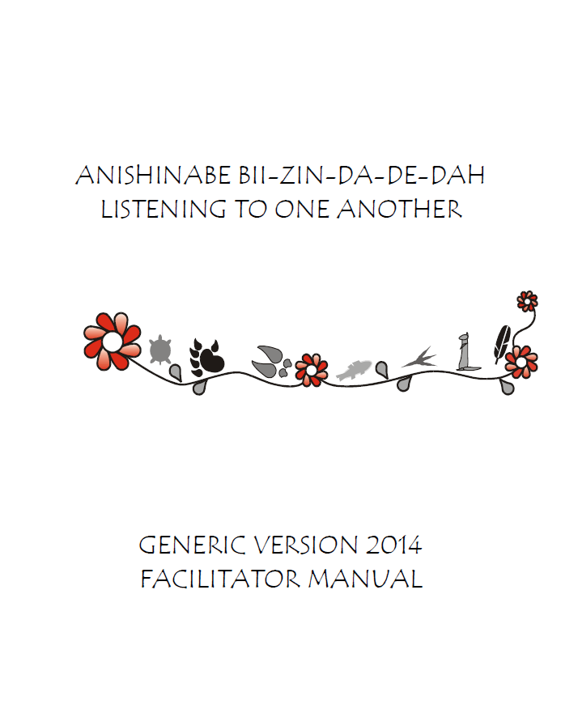
Listening to One Another
Session 1: Opening Feast
Session 2: Community History
Session 3: Family
Session 4: A Good Way of Life
Session 5: Working Together
Session 6: Living in Harmony
Session 7: Balance
Session 8: Problem Solving
Session 9: Making Choices
Session 10: Communication
Session 11: Valuing Differences
Session 12: Social Support
Session 13: Empowerment
Session 14: Celebration Feast
Notes:
Here is an overview of the sessions.

Slide 5
Parent and Youth Booklets
Parent Booklet:
Listening to One Another
Youth Booklet:
Listening to One Another
Notes:
There are both parent and youth booklets available for use in this program.

Slide 6
Activities and Activities Manual
Activity Booklet
Listening to One Another
Example Youth Activities
Listening to One Another –
Notes:
There is also an activity booklet used to help facilitate the activities in each session.

Slide 7

First Session
n Overview of the 14 Sessions
Opening Feast
Notes:
Ashangewin (Welcoming Feast)
This session is designed as a welcome feast. A facilitator should explain the overall goals of the program and the expectations of families for participating in the program. At the end of this session, participants should be thinking about their family, values, and culture.

Slide 8

Second Session
Community History
Notes:
Gaapi Anishinaabe Ihzi Waabaak (Anishinabe History)
This session focuses on Anishinabe History. At the end of this session, participants should be thinking about Anishinabe history and be thinking about how to utilize talking circles in their families.

Slide 9

Third
Session
Family
Notes:
Gakina Indinawemaaganag (My Family)
This session focuses on family talking circles and the traditional Anishinabe family. At the end of this session, participants should be thinking about how talking circles could be used as a tool for coping with stress and bonding with their family.

Slide 10


Fourth Session
A Good Way of Life
Notes:
Minobimaadiziwin (A Good Way of Life)
This session focuses on the stages of life and living a good life. At the end of this session, participants should be thinking about their own lives and how their choices affect the quality of their lives and the lives of other family members.

Slide 11





Fifth Session
Working Together
Notes:
Naadamaagoziwin O’Nandowaabandan (Help Seeking)
This session focuses on discussing feelings and problems to identify solutions. At the end of this session, participants should be thinking about their feelings, problems, and healthy methods of solving these problems.

Slide 12
Sixth Session
Change: will be delivered in Session 7 under the title: BALANCE rather than ‘Anger Management’
Notes:
Dakoobidon Gi Nishkaadiziwin (Anger Management)
This session focuses on anger and ways to manage feelings of anger. At the end of this session, participants should be thinking about ways to communicate their feelings of anger and to deal with those feelings in productive ways.

Slide 13
Seventh Session
Change: will be delivered in Session 6 under the title: LIVING IN HARMONY rather than ‘Healthy Self, Health Relationships’
Notes:
Healthy Self, Healthy Relationships
This session focuses on being healthy and establishing healthy relationships. At the end of this session, participants should be aware of cyberbullying and ways of coping with it, as well as methods of coping with sadness and depression.

Slide 14
Eigth Session
Problem Solving
Notes:
Naadamaagoziwin (Problem Solving)
This session focuses on problem solving. At the end of this session, participants should understand the STEPS (or similar) method to problem solving and information sharing.

Slide 15

Ninth Session
Change: will be delivered in Session 11 under the title: VALUING DIFFERENCES rather than ‘Being different’
Notes:
Ma-Jaa-Nin-Diway (Being Different)
This session focuses on being different and addressing discrimination. At the end of this session, families should have a plan for addressing discrimination in their community.

Slide 16

Tenth Session
Peer Communication
Notes:
Dibi Shkoo Dibaa Jimo Win
(Peer Communication)
This session focuses on peer communication. At the end of this session, youth should understand ways of communicating that build healthy friendships. Parents should have new tools to encourage children to build positive peer relationships

Slide 17

Eleventh Session
Change: will be delivered in Session 9 under the title: Making Choices rather than ‘Refusal Skills’
Notes:
Gawiin Ni Wii Izhichigesii (Refusal Skills)
This session focuses on refusal skills and monitoring. At the end of this session, youth participants should understand various methods of peer pressure and how to refuse it and parents should learn new tools for monitoring their children.

Slide 18

Twelfth Session
Social Support
Notes:
Bimaadizi Wiidookaagewin (Building Social Support)
This session focuses on building social support. At the end of this session, participants should have completed their personal mission statement and be aware of behaviors that build trust in relationships.

Slide 19

Thirteenth Session
Empowerment
Notes:
Community Empowerment
This session focuses on community strengths and empowerment. At the end of this session, participants should be thinking about their community, its strengths, and ways to improve it.

Slide 20

Fourteenth Session
Celebration Feast
Notes:
Gitchi Ashangewin (Celebration Feast)
This session is a celebration feast. At the end of this session, participants should have celebrated the conclusion of the program and have learned ways to incorporate things they have learned here into their daily lives.

