Slide 1
ATOC 555 Barbados field course
29 November 2023
Prof. John GYAKUM
Prof. Djordje ROMANIC

Slide 2
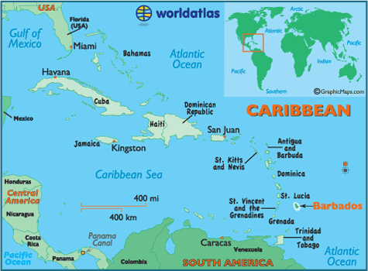
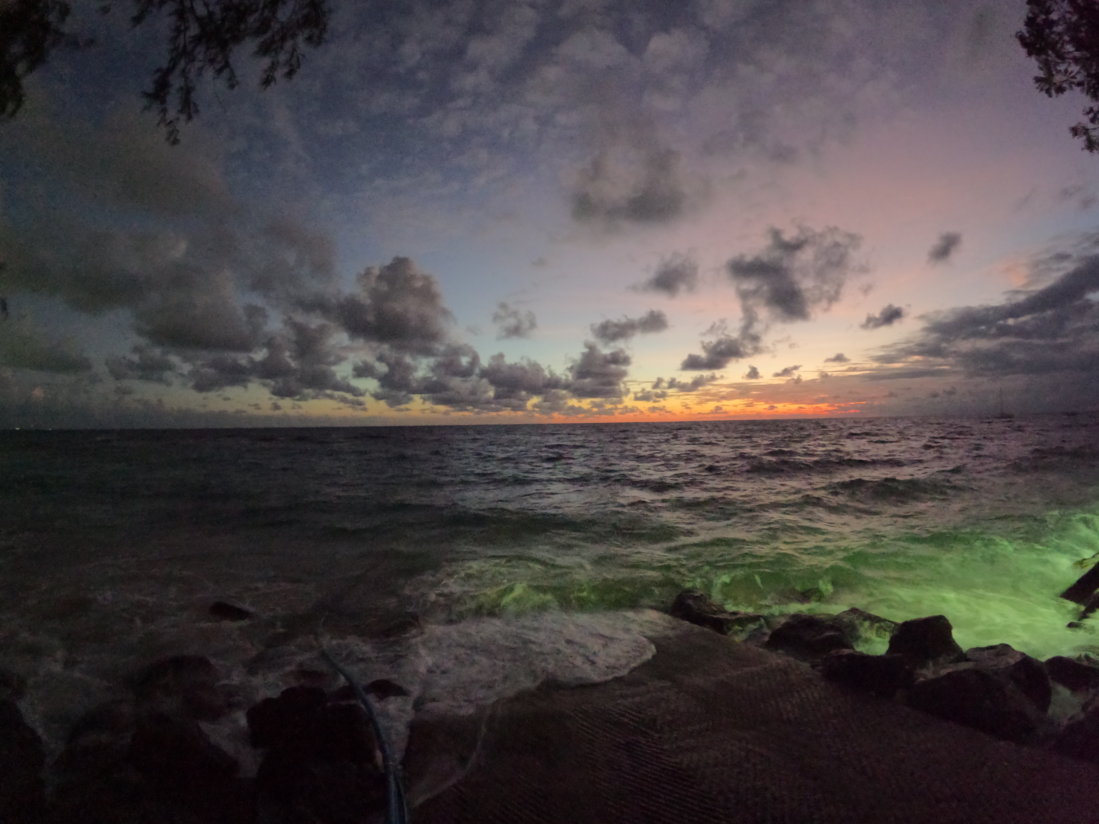
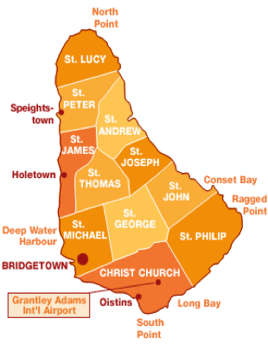
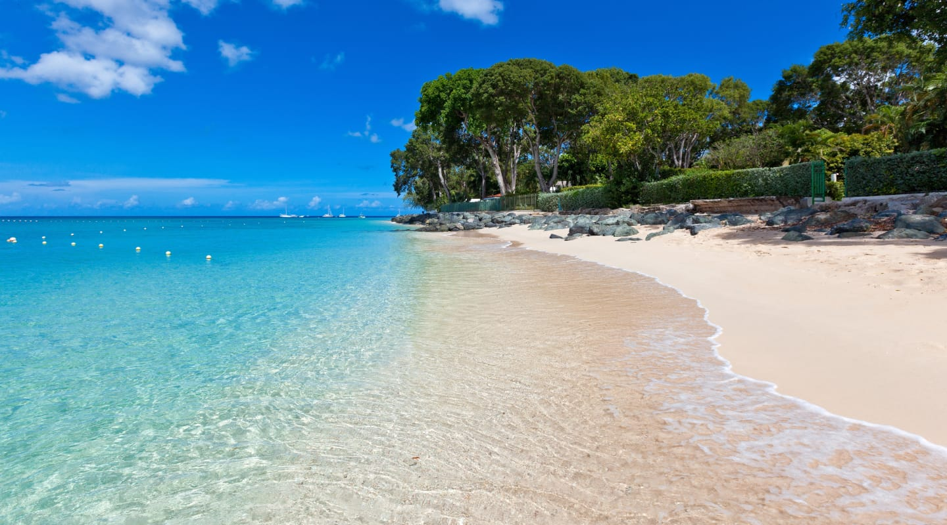
Location

Slide 3
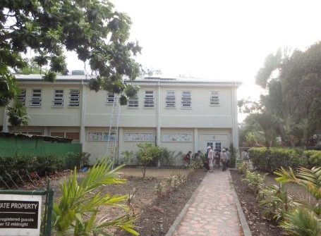
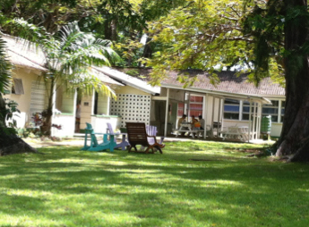
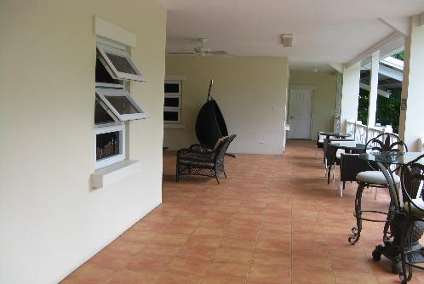
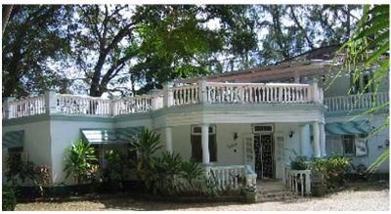
Bellairs campus

Slide 4
ATOC 555 Barbados Field Course
Preparation and visit of the Gault Nature Reserve site near Montreal:
18 April – 2 May 2024
Field course in Barbados:
3 – 17 May 2024
Completion of course report and data analysis in Montreal:
18 May – 1 June 2024
Instructors:
Professor John Gyakum (john.gyakum@mcgill.ca)
Professor Djordje Romanic (djordje.romanic@mcgill.ca)

Slide 5
Methods of instruction
Lectures
Field measurements
Microclimate of different sites
Boat trips and sea surface temperature
Environmental chemistry
Site visits
The Caribbean Institute for Meteorology and Hydrology (CIMH)
The University of the West Indies
Advanced Global Atmospheric Gases Experiment (AGAGE) site
Beaches (all beaches are public!)
Discussions
Reading assignments
Presentations

Slide 6
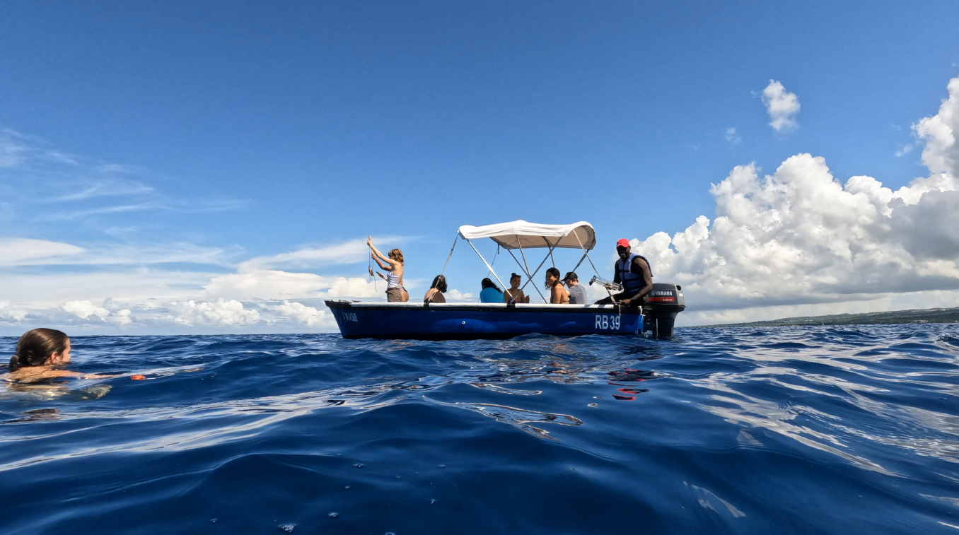
September 2023, Barbados

Slide 7
A 150-m long rope with a probe
for water temperature measurements attached at the far end of the rope.

Slide 8
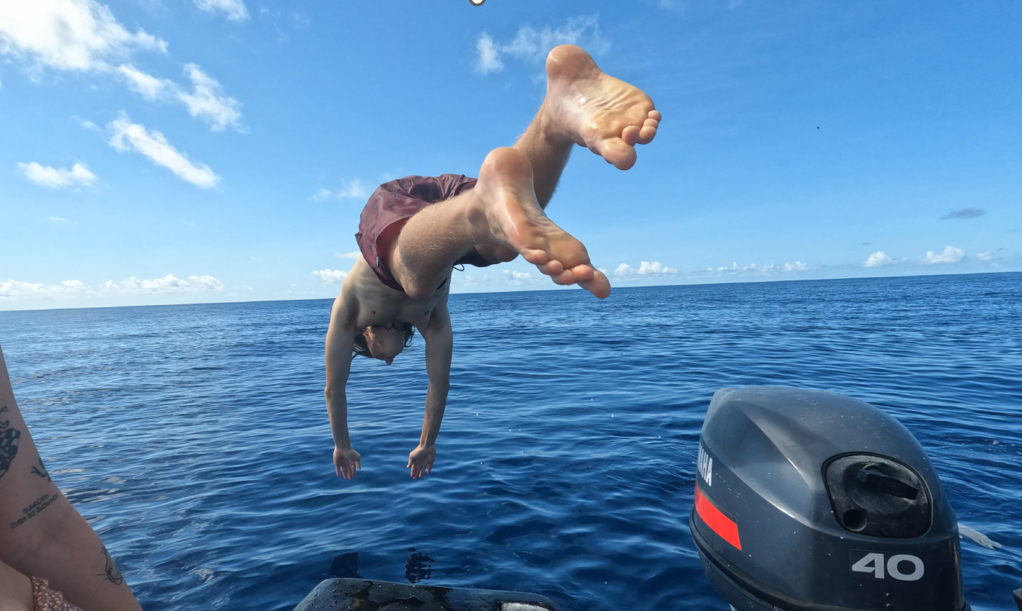
Aftermath…

Slide 9
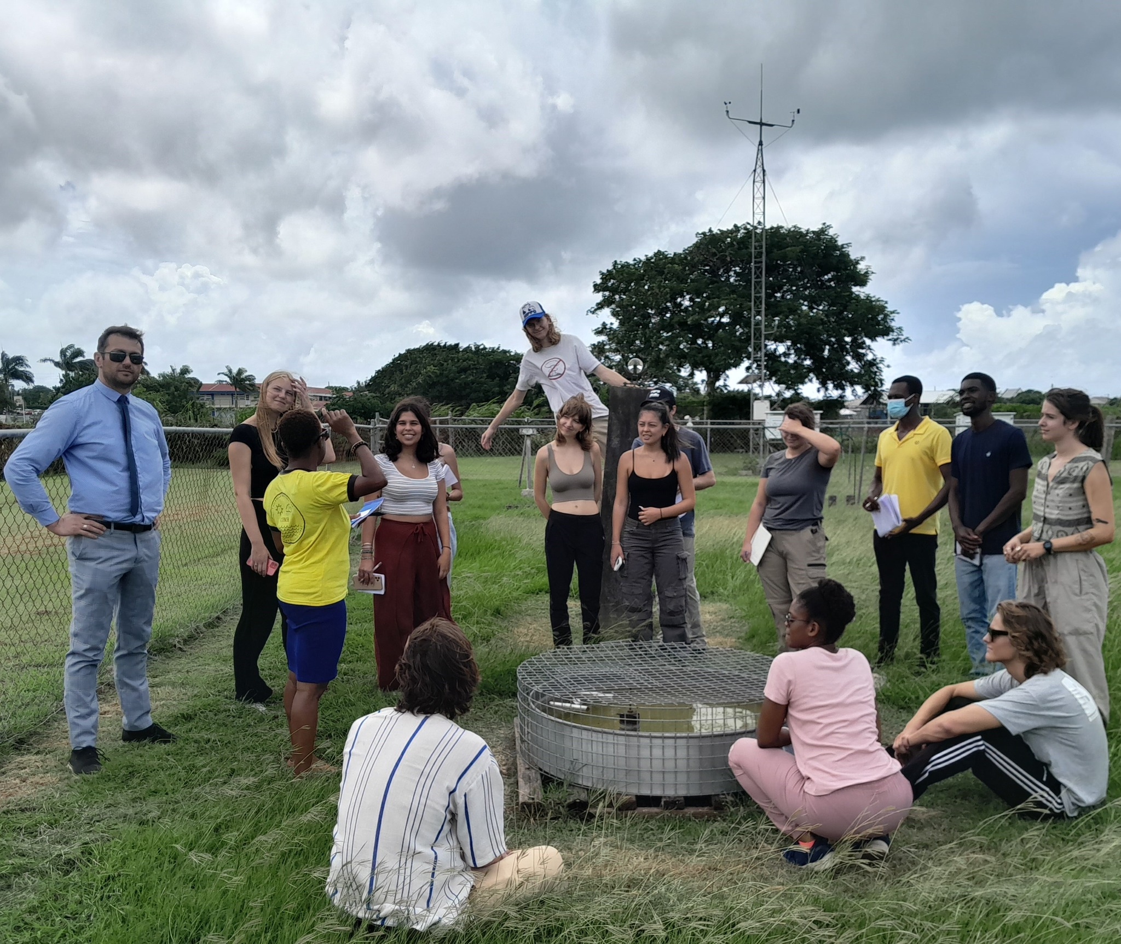
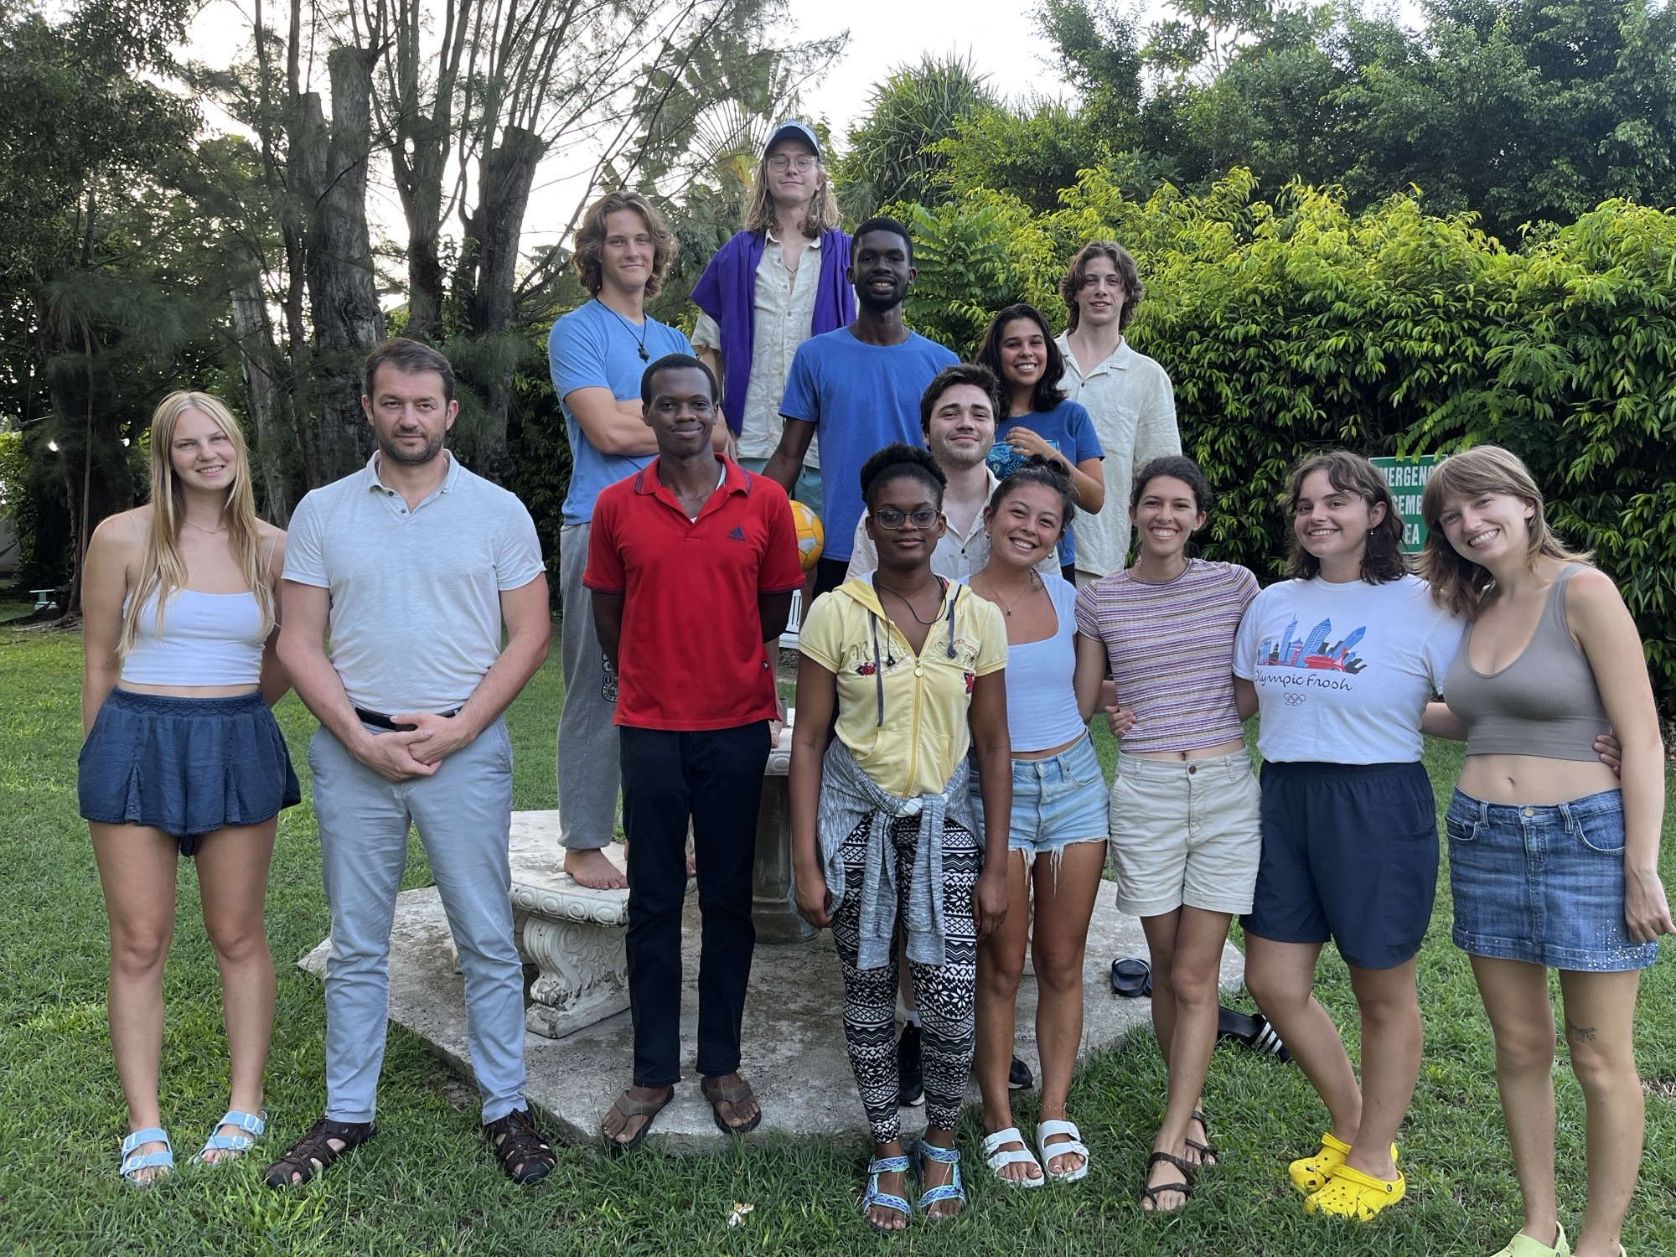
CIMH visit

Slide 10
ATOC 555 application
Open to AOS, Bieler School of Environment, and ESS students
1-page letter of intent
Serves as the statement of research interests
Curriculum vitae
Copy of transcripts
Prerequisite:
Permission of instructors
Send your application materials to admin.aos@mcgill.ca
Deadline: To be determined, but around 1 March 2024
ATOC 555 website: https://www.mcgill.ca/meteo/programs-0/undergraduate-studies/atoc-555-fieldcourse
Next information session: 17 January 2024 @17 h

