Slide 1
Integrated Services Project
Spotlight on Service
March 27th, 2009.
Welcome
Notes:
Kathleen

Slide 2

McGill – The Student-Centred, Research-Intensive University
Notes:
Kathleen

Slide 3
McGill University
Introduction and Molson Hall
http://www.youtube.com/watch?v=o9zfrdjX_P0
By: Peter Rifkin, student
Notes:
Kathleen

Slide 4
Principal’s Task Force on Student Life and Learning
The Principal’s Task Force on Student Life and Learning at McGill encourages the University to ensure that decision-making at all levels is informed by principles and goals appropriate to a student-centred, research-intensive University.
From the first contact of prospective students with the University, interactions among students, faculty, and administrative and support staff are based on mutual trust and respect. McGill strives to make the information needed by students easily accessible to them.
The University provides students with a wide variety of academic and support services, striving to make them easy to access…Students’ best interests are a principal focus of academic, administrative, and support staff.
McGill University, Final Report: Principal’s Task Force on Student Life and Learning at McGill, 2006
http://www.mcgill.ca/files/principal/Executive-Summary.pdf
Notes:
Mary Jo

Slide 5
SLL Values
The development of the project, services, new organizational structure, and position descriptions has been guided by these values:
  Integrity
  Accountability
      Equity
  Caring
  Diversity
  Respect
  Continuous Improvement
  Sustainability
  Transparency
Notes:
Mary Jo
Values that were described in the Student Life and Learning Task Force report are re-iterated here to remind us that these values are of prime importance as we move forward with the project and that we intend for the Service to exemplify these values at all times.

Slide 6
Goals
Build on the tradition of excellence at McGill and support of the goal of becoming the student-centred University by:
  Creating a single point of contact for many administrative support services, making services and information more accessible to students;
  Transforming the profile of the services from ‘behind the scenes’ and ‘scattered’ to a cohesive and prominent place in the heart of campus;
  Providing intensive professional development to our employees to equip them to provide best in class services to our students;
  Empowering our employees to make decisions and solve problems on the front line – the buck stops here.
Notes:
Mary Jo
The concept of integrating front-line student services has been around for a long time. The idea really became more of a goal for the University once the results of the Principal’s task force on Student Life and Learning became published. Students in surveys as far back as the 90’s told us that they wanted one place where they could go to complete a number of administrative tasks. Universities all around North America (if not beyond) have been talking and working towards a one-stop kind of service for students for several years.
Kathleen will introduce next slide - Keyboard slide.
Hence this project brings together several important goals that we are focused on as we move forward.

Slide 7

Leading edge?
Keyboard pants!
Notes:
Kathleen

Slide 8
Integrated Services in brief
Functions – Provide advice and information, Educate, Administer, Refer
Processes – Admissions, Awards, Fees, Financial Aid, Registration, Exams, Convocation, Exchange
Media - In Person, Phone, Mail, Fax, Web
Space - McLennan: Welcome Centre and integrated services centre
Notes:
Kathleen
At a very high level, the new integrated service will function to Advise, Educate Administer and Refer.
With regards to the media that we will be employing to deliver the service, we will use everything at our disposal. In fact providing integrated services does not always have to mean in-person visits, but will certainly encompass the deliver of services through enhanced self-service facilities on Minerva.

Slide 9
Fun Question #1
Name 2 of the values that are guiding the Integrated Services project:
Possible responses:
  Integrity Accountability Equity
  Caring Diversity Respect
  Continuous Improvement
  Sustainability Transparency
Notes:
Kathleen

Slide 10
3 Distinct Areas
Service Point – for current students who require support
Welcome Centre – for future students and families to learn about McGill University
Specialist area – for back-of-house staff seating and call centre
Notes:
Mary Jo

Slide 11
Services to be
Integrated
Student Accounts (all)
Enrolment Services (from James, Burnside and Annex)
International health card distribution, forms completion, fee deferrals (student awards and aid office)
Front line functions and services for graduate and postdoctoral students
First level advising Arts and Science student affairs
Notes:
Mary Jo

Slide 12
Space
Location: McLennan Library – street level, Sherbrooke and McTavish
Entrance will be on McTavish
Our space will benefit from another project in place to revitalize the terrace between Redpath and McLennan
Notes:
Mary Jo

Slide 13
Fun Question #2
Name 3 services to be integrated that will be located in the NewService Point:
Possible Responses:
Student Accounts (all)
Enrolment Services (from James, Burnside and Annex)
International health card distribution, forms completion, fee deferrals (student awards and aid office)
Front line functions and services for graduate and postdoctoral students
First level advising Arts and Science student affairs
Notes:
Mary Jo

Slide 14
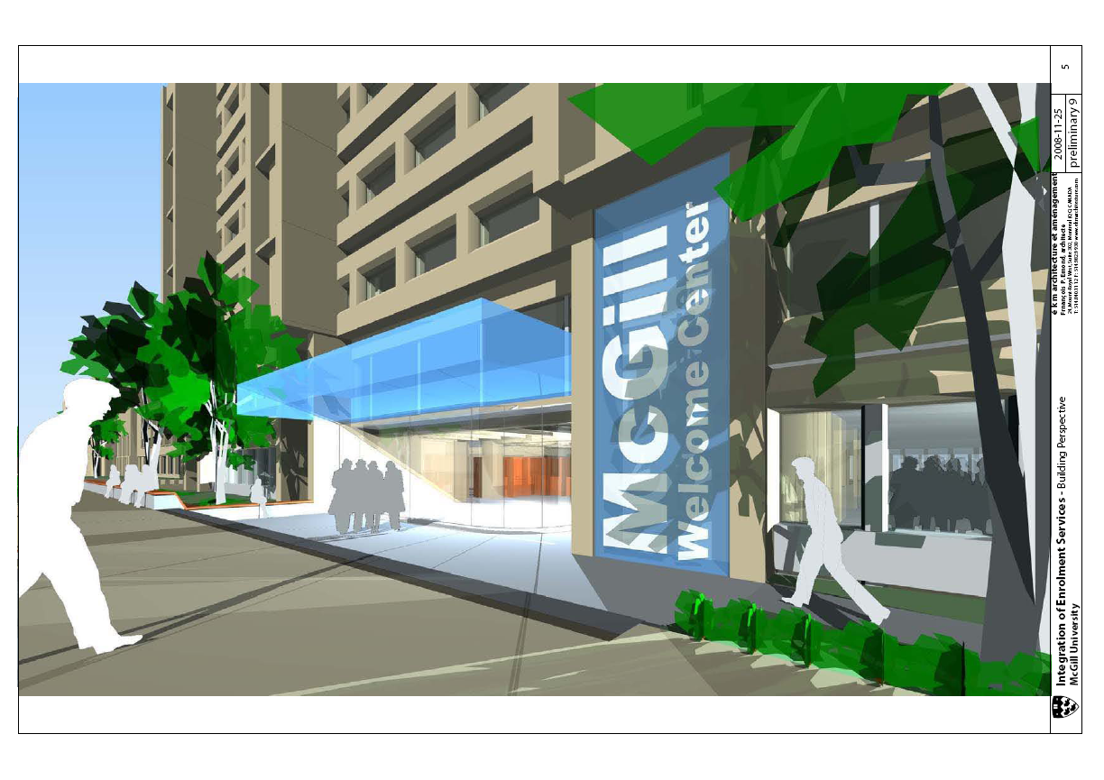
Notes:
Kathleen
This is a very rough artist’s rendition of how the entrance to the new service can be envisioned. You’ll note the disappearance of the concrete dividers that currently separate the sidewalk from the building. Banners and or canopies will designate a welcoming grand entrance to the Welcome Centre and the service centre.

Slide 15
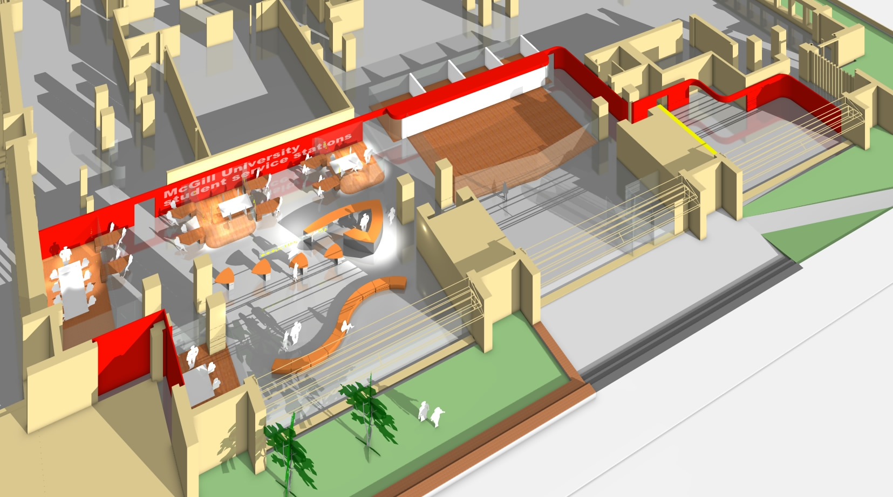
Welcome Centre
Service Area
Waiting area
McTavish
Notes:
Kathleen

Slide 16

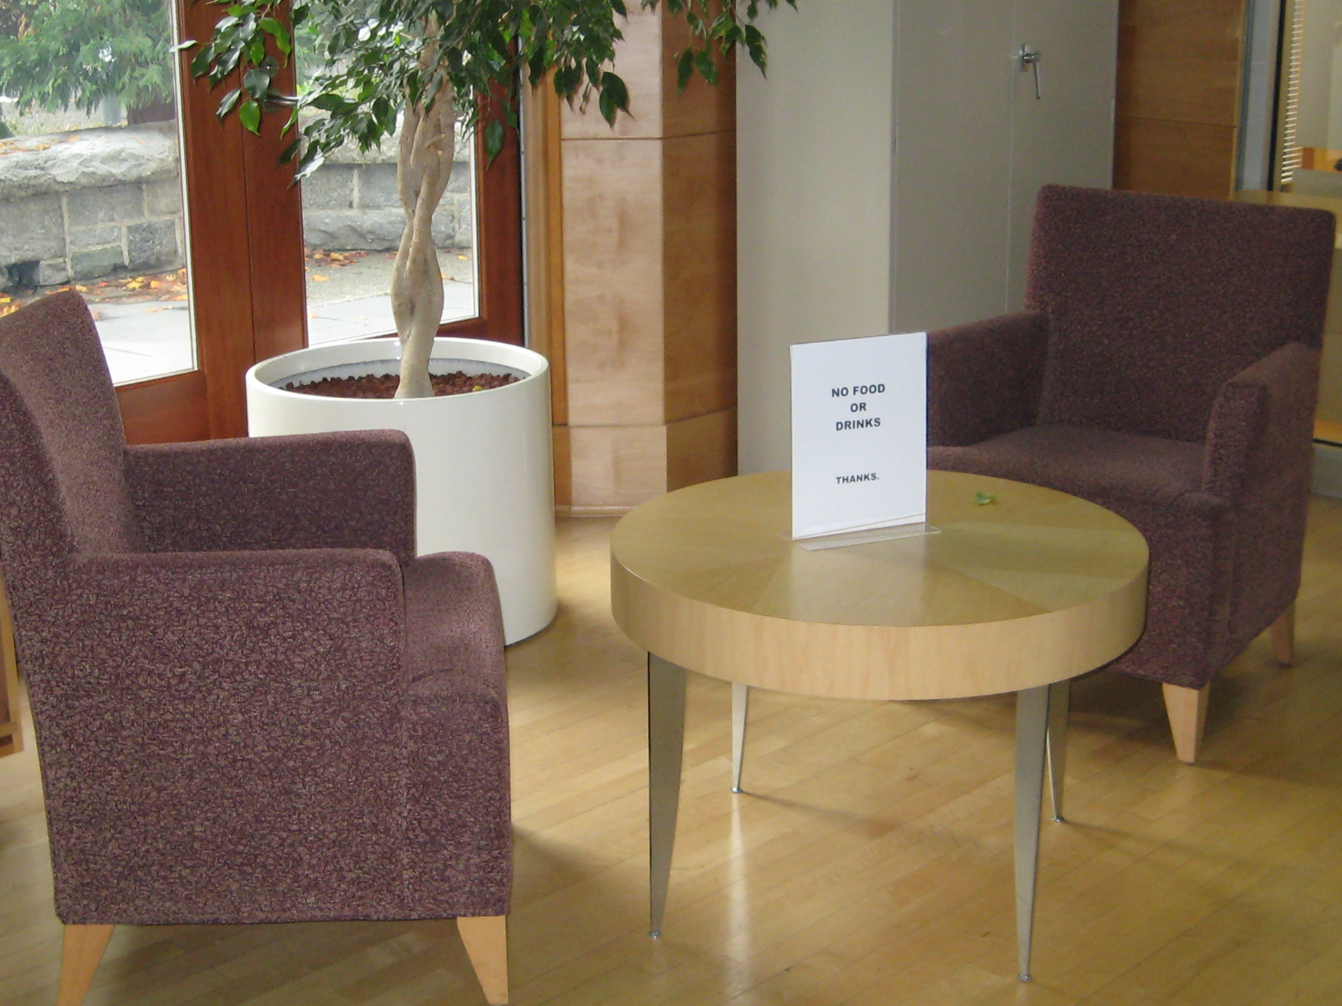
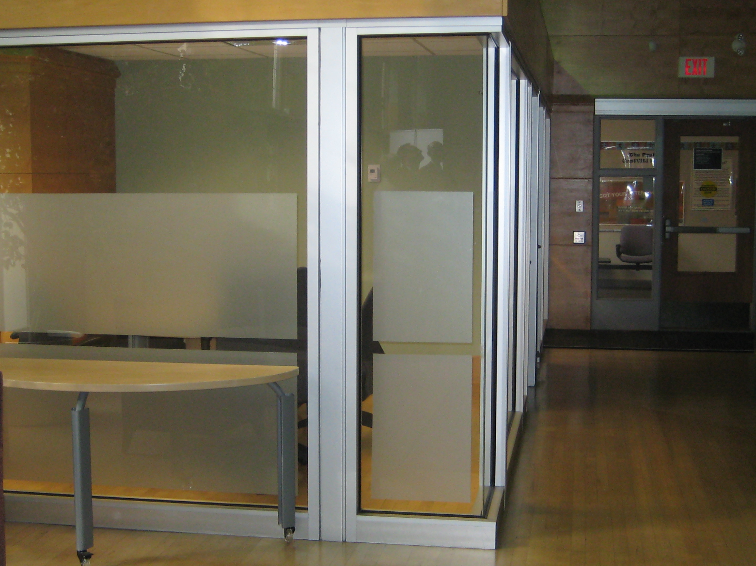





Inspiration
Notes:
Kathleen

Slide 17
Service Point
12 individual service desks (seated interactions)
Permanent photo-ID and express area (up to 3 spots, standing interactions)
Triage desk (up to 2 spots, standing interactions) in entrance area
3 private meeting offices in Service Point (for meetings with students)
Large waiting area; wireless, windows, seating, Q-nomy
Notes:
Mary Jo
How this space looks and is designed is of the utmost importance to the project team.

Slide 18
Welcome Centre
Area for advising future students and families about McGill options; departure point for tours
Two self-serve computers
Storage for luggage and back packs
LCD flat screen technology for showing videos
Washrooms for guests
Contained access to area (including building entrance, multipurpose room and Welcome Centre) for weekend and evening events
Presentation facilities for up to 55 people
Notes:
Mary Jo

Slide 19
Fun Question #3
What is the name of the new integrated services unit for current students?
Notes:
Mary Jo

Slide 20

Logo Contest
Deadline for submissions:
March 31, 2009.
Open to:
McGill students
Alumni
Staff (excluding project team members)
* Group submissions will be considered (only one prize will be awarded).
Notes:
Kathleen

Slide 21
Project Timeline
Notes:
Kathleen

Slide 22
Fun question #4
How many (permanent and temporary) service desks will be located in the new Service Point?
Notes:
Mary Jo
Answer: 12

Slide 23
Working together – Links between partners
    2 positions in the Service Point will have explicit accountability for liaising with partner offices to share and receive information on a timely basis and refine business processes
    A cross-divisional service council will be created to share information about new policies, service innovations and resolve problems.
        The Council will meet monthly and members will be appointed to represent each partner
Notes:
Mary Jo

Slide 24

Partnerships, Identity, Linkages, Hand-offs
    How will your team partner with the Service Point to provide service to students in the future?
Notes:
Mary Jo

Slide 25
Links and hand-offs
Service Point
Faculty Advising Offices
IT Helpdesk
Faculty Admissions
Student Services
Notes:
Mary Jo

Slide 26
Questions?
Notes:
Kathleen

Slide 27
Game
In a group at your table:
Assign a person to take notes during the discussion and another person who will present the results.
Each person in each group names three pieces of information:
    2 linkages his/her unit will have with Service Point, and
    1 linkage his/her unit will not have with Service Point.
The others in the group are asked to guess which two are true.
Scribe takes notes of the accurate linkages.
Presenter shares the information with the meeting participants
You have 7 minutes!
Notes:
Kathleen

Slide 28
http://www.online-stopwatch.com/eggtimer-countdown/full-screen/
Notes:
Kathleen

Slide 29
Thanks and have a
great weekend!
Notes:
Kathleen

