Slide 1
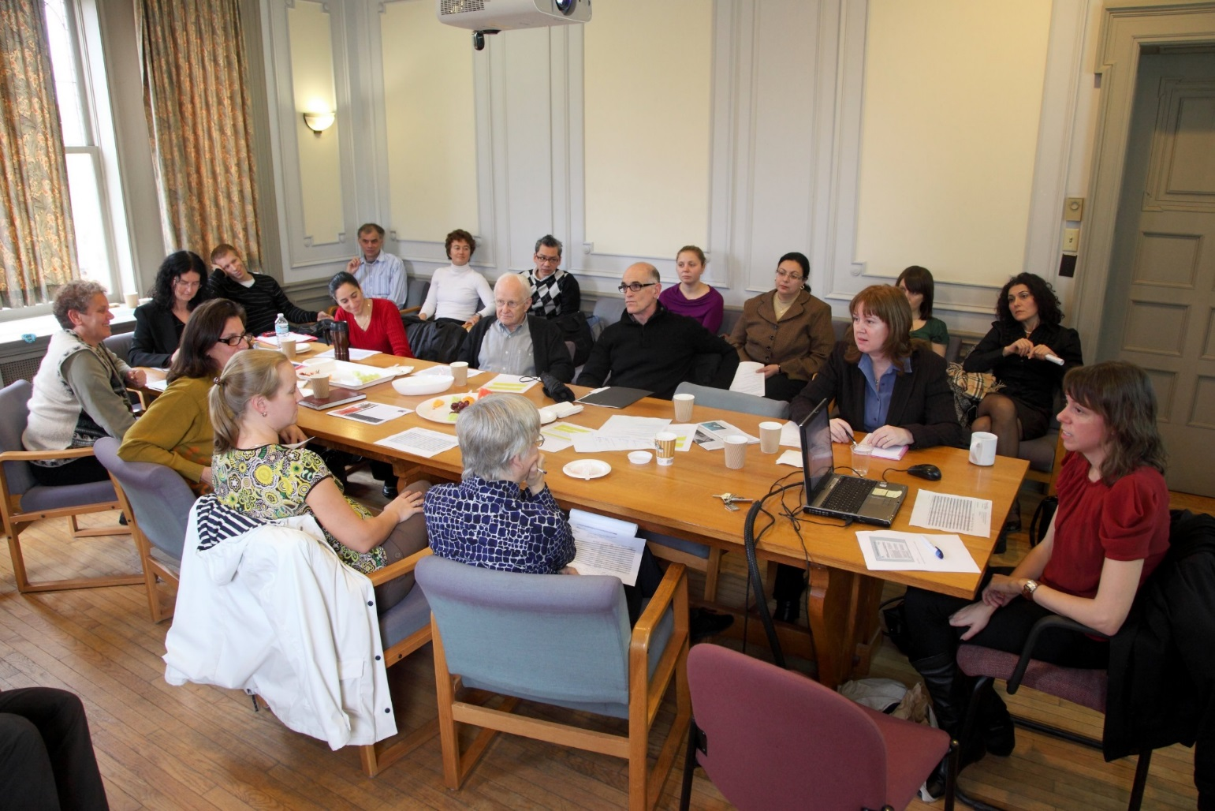
The Centre has served as the focus of a very important community, bringing us in contact with individuals with different experiences, all of whom made their own unique contributions to the community.
Thoughts on the Centre

Slide 2
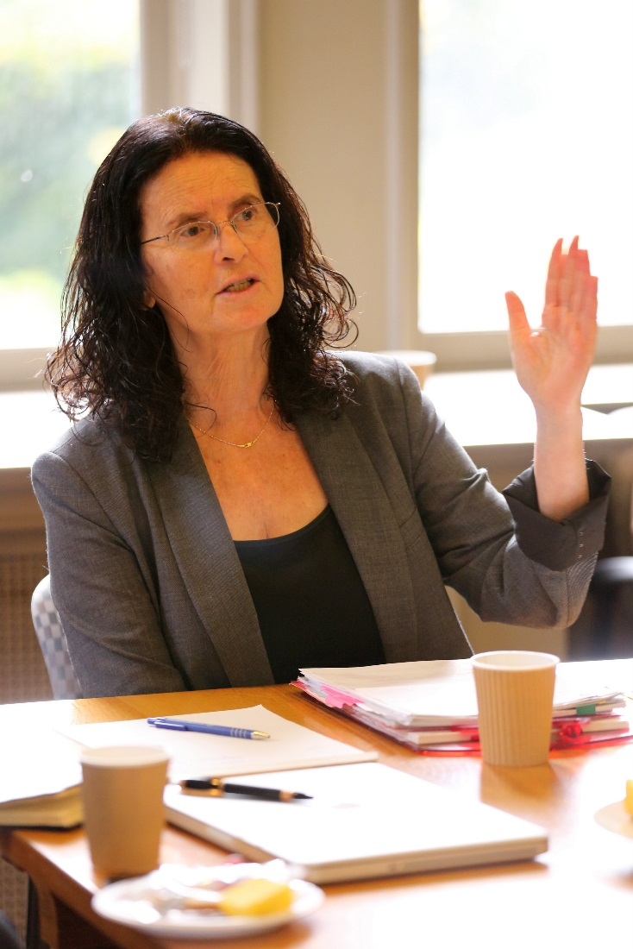
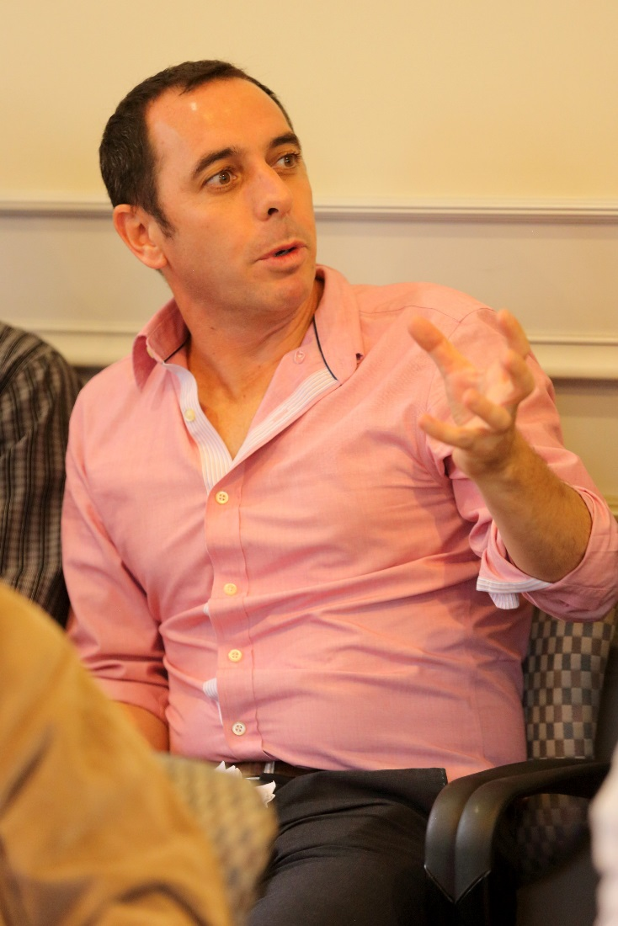
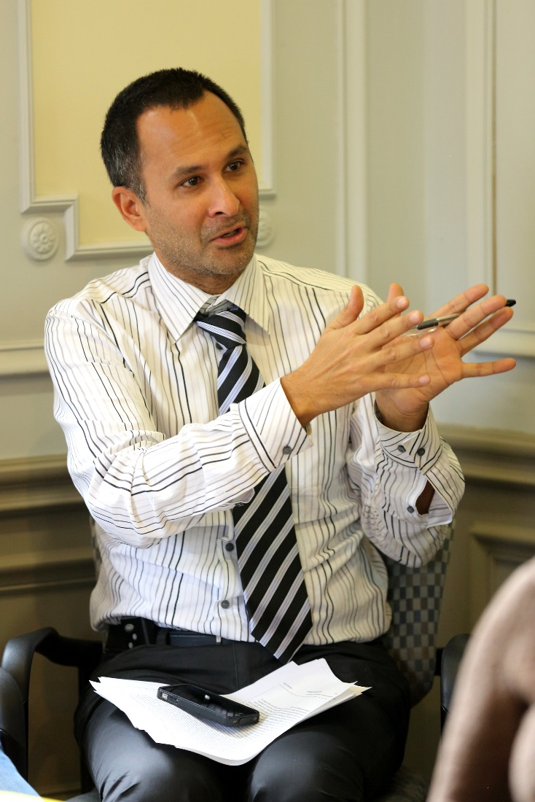

Slide 3
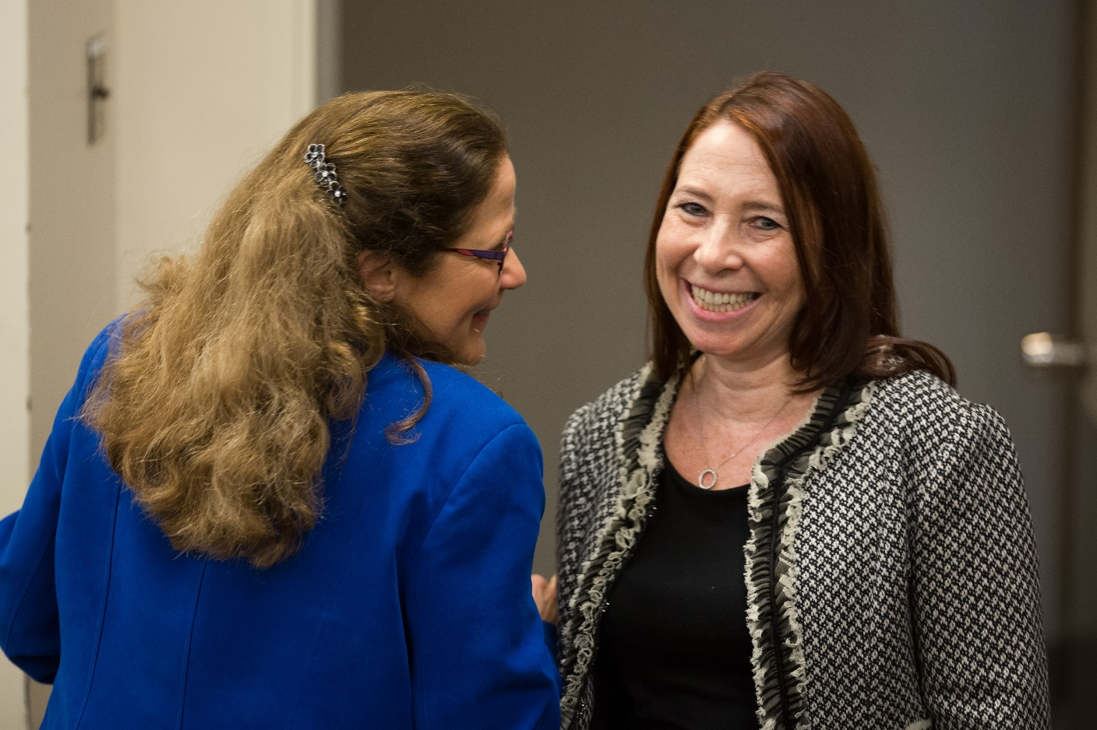
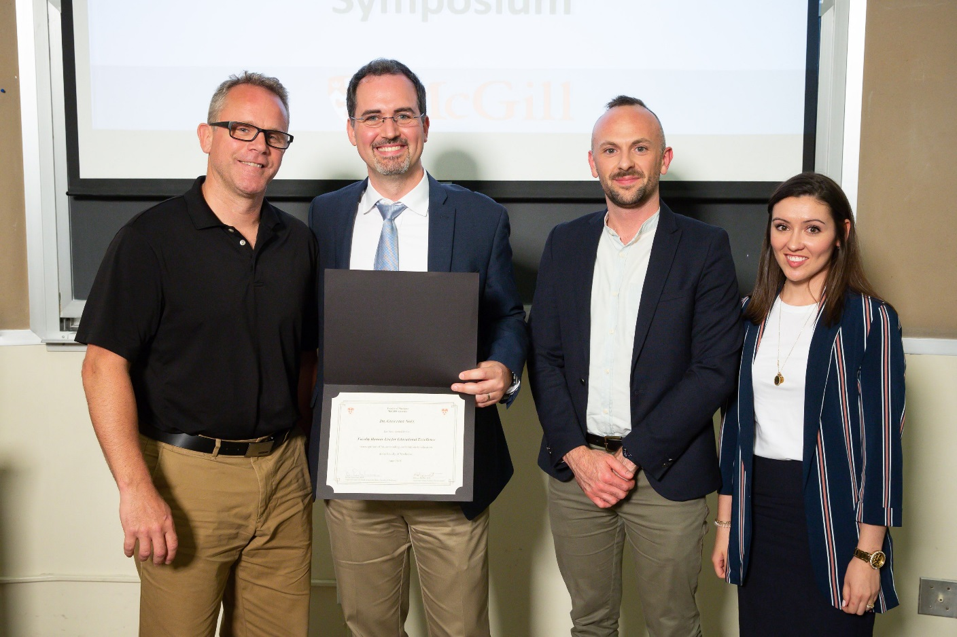

Slide 4
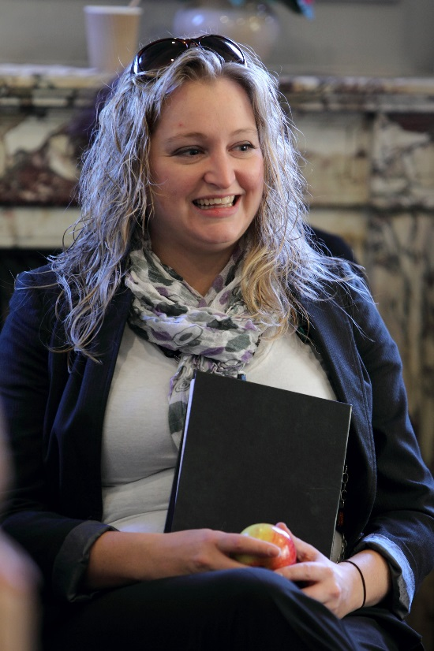
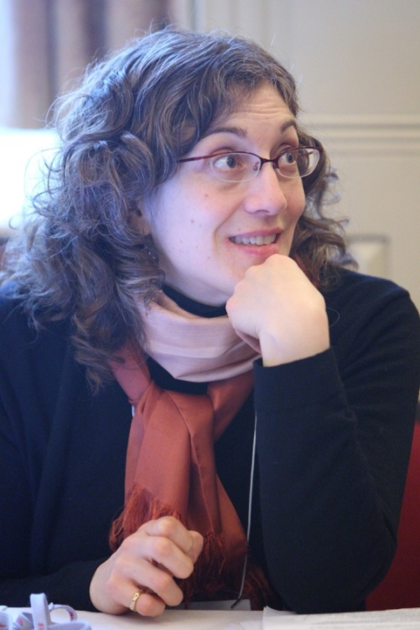
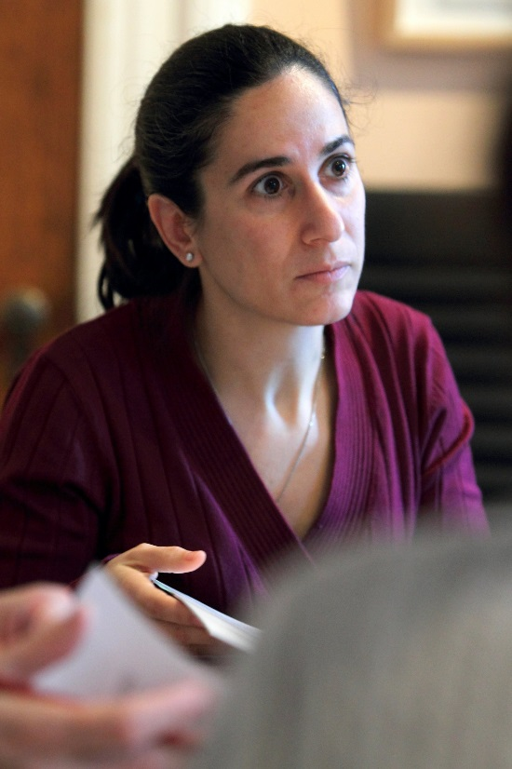
A physical and virtual centre to connect and recognize health professions educational innovators and researchers and to validate health professions education research.
Thoughts on the Centre

Slide 5
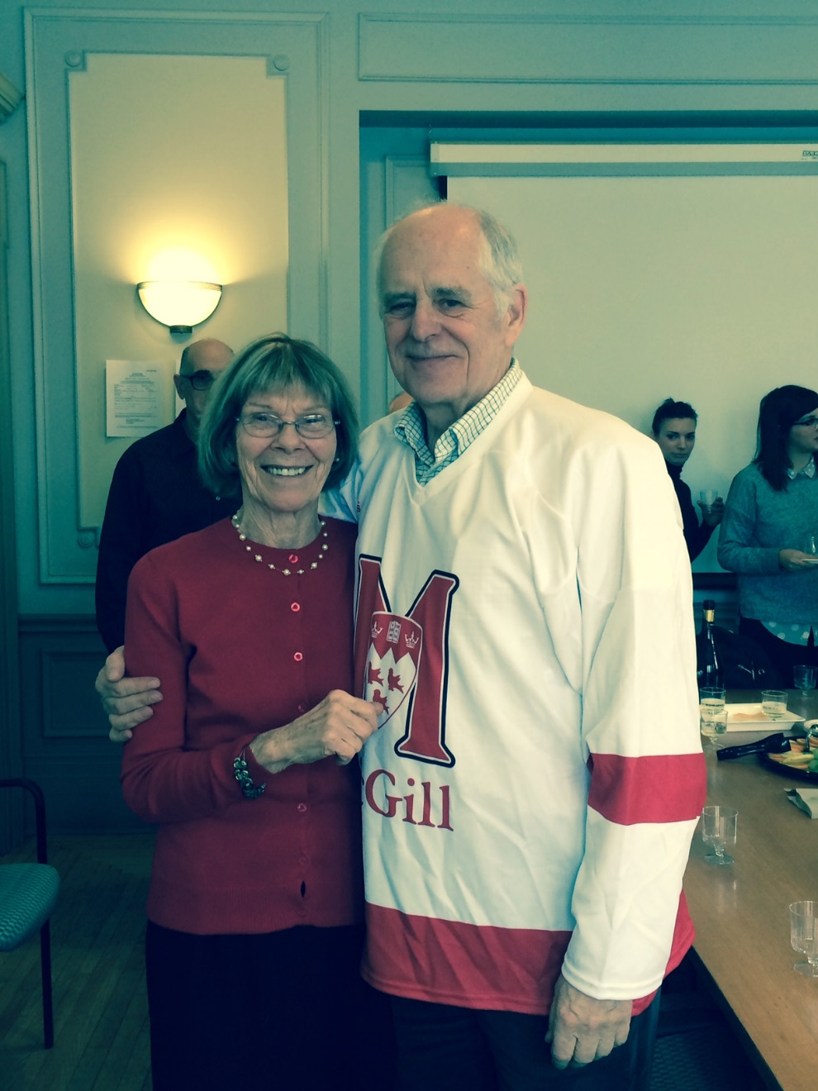
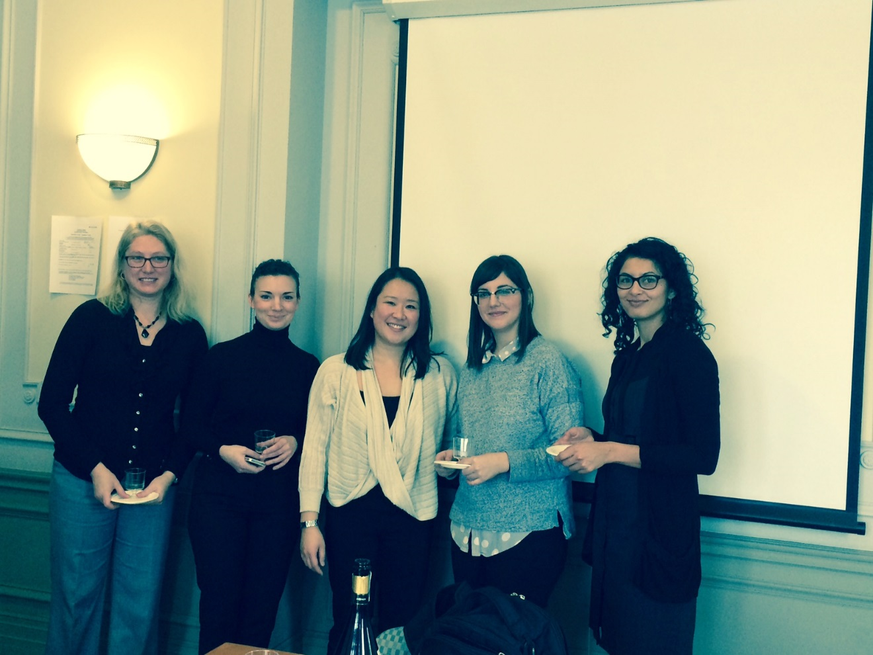

Slide 6
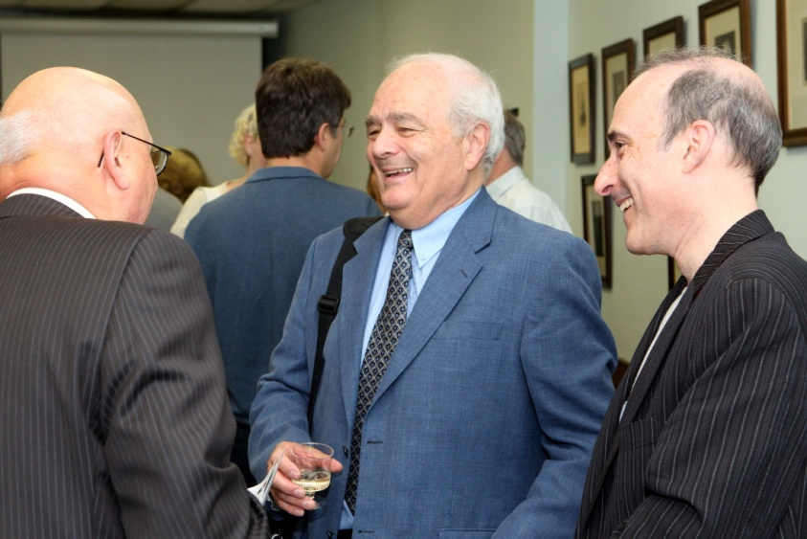
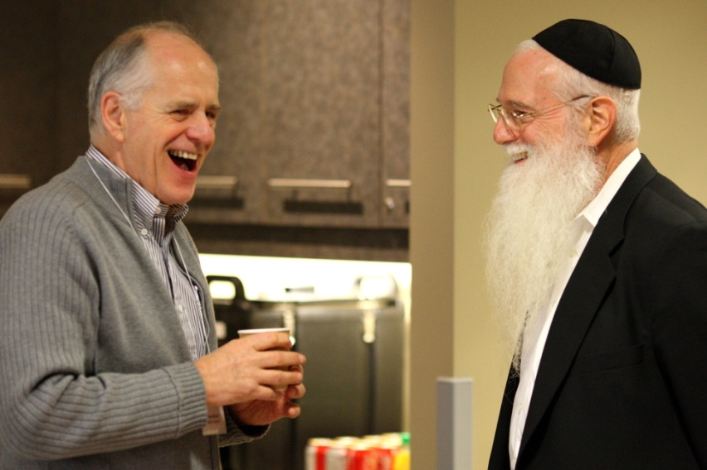
Meeting clinical colleagues and thinking about research questions that could impact their practice.
Thoughts on the Centre

Slide 7
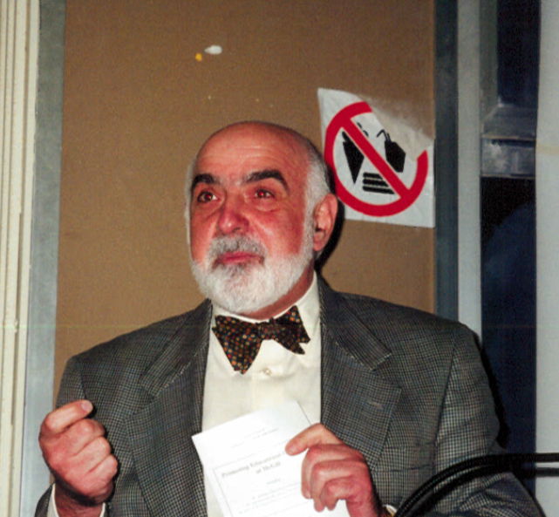
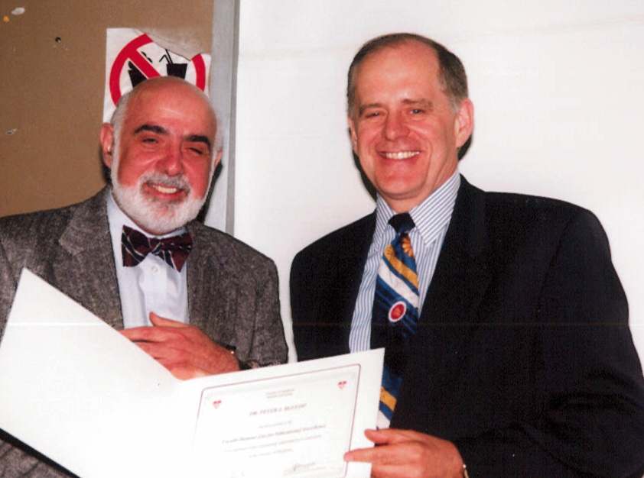

Slide 8
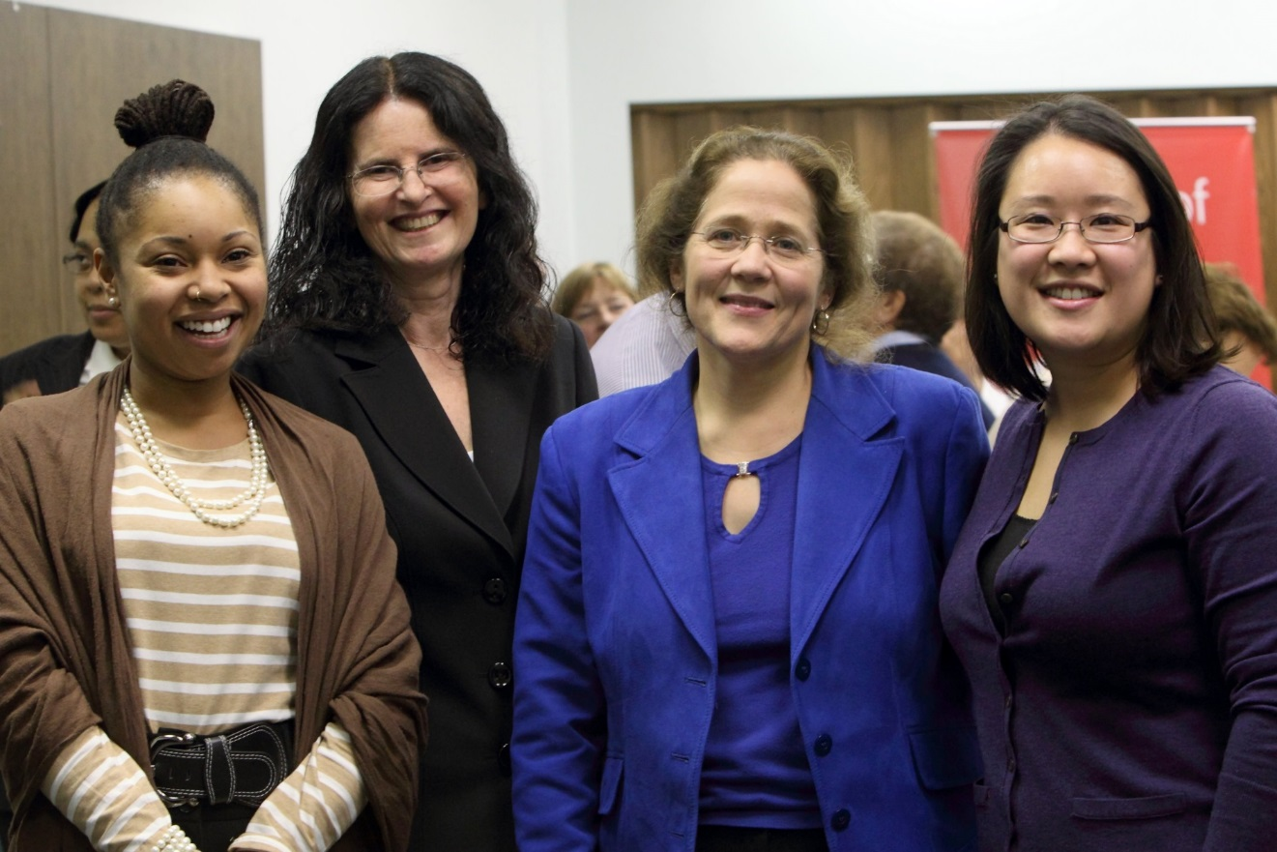
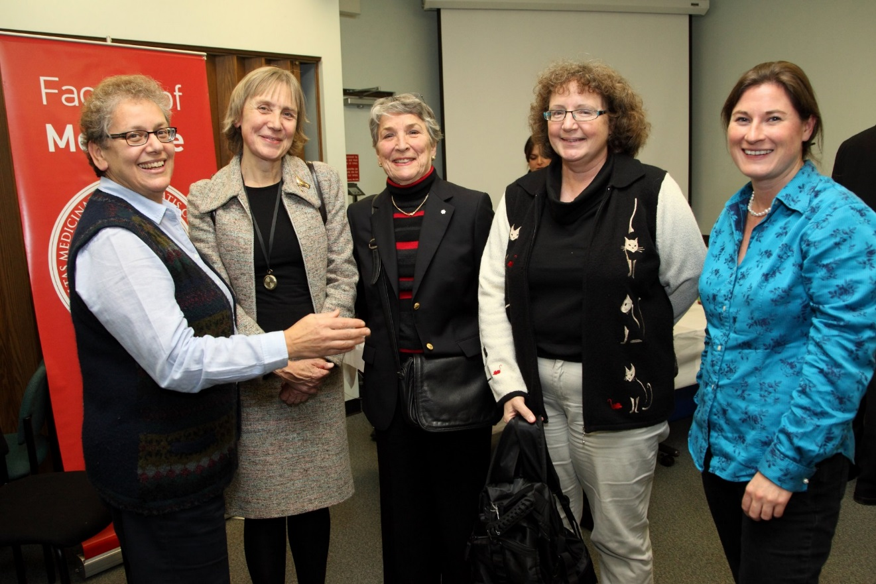
Thoughts on the Centre
A special place away from clinical responsibilities that fostered learning, sharing and having fun.

Slide 9
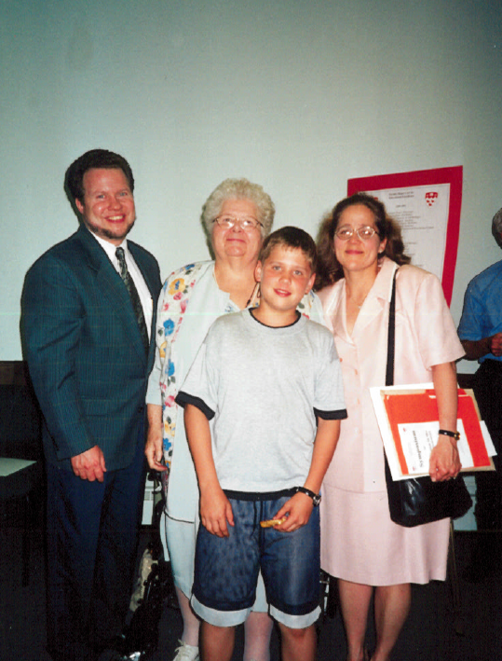
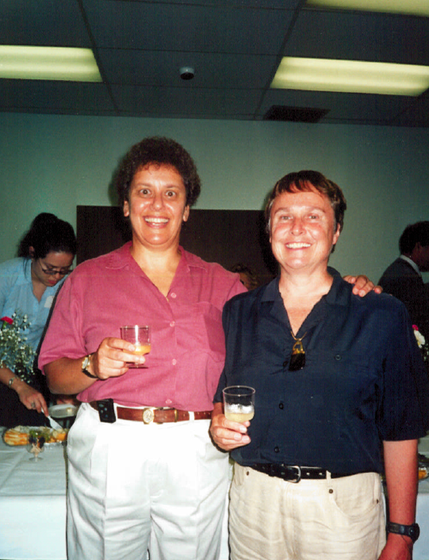

Slide 10
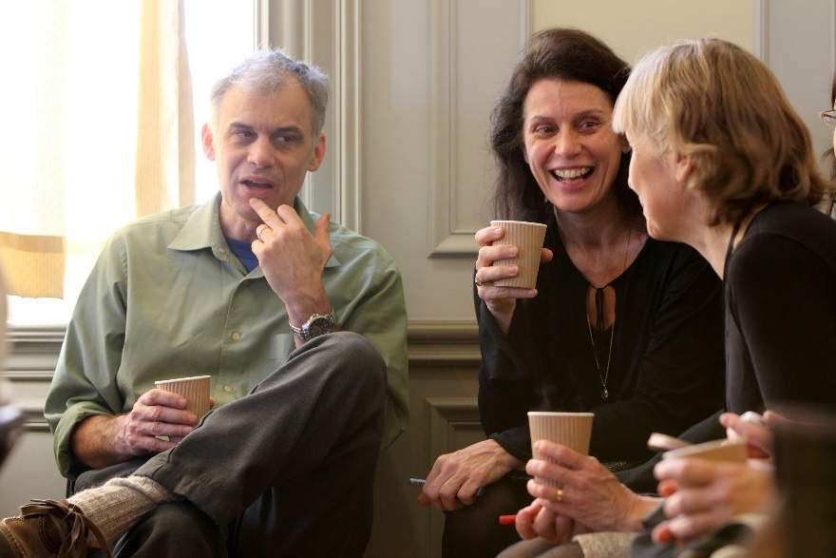
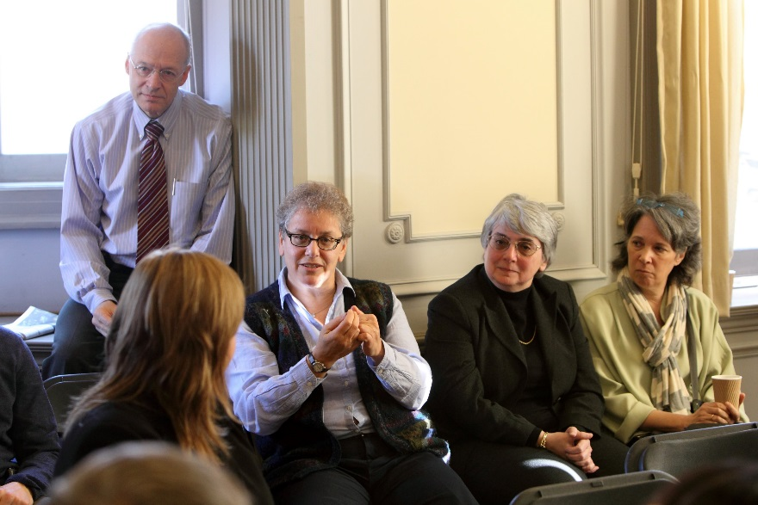
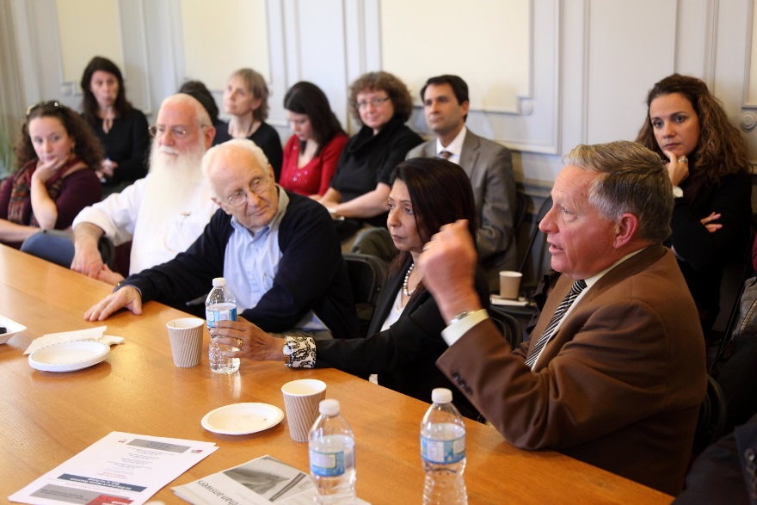
The Institute will expand the capacity of the Centre by attracting individuals with different backgrounds and adding significant numbers of graduate students to our community. This should allow us to both expand our mission and better fulfil it.
Thoughts on the Institute

Slide 11
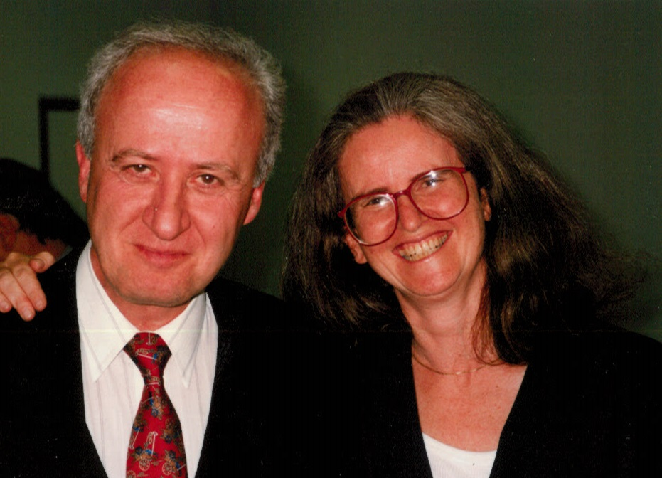
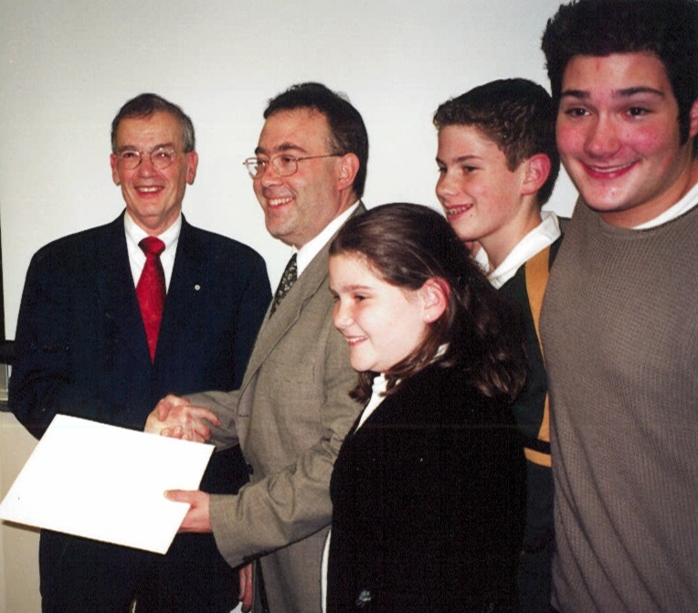

Slide 12
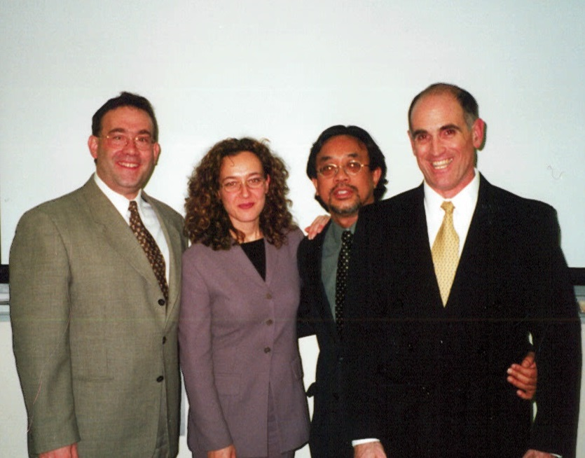
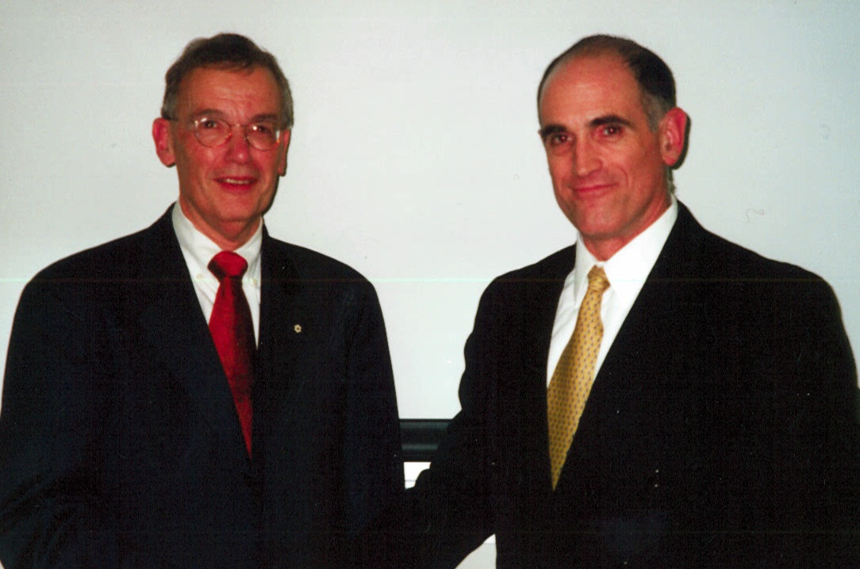
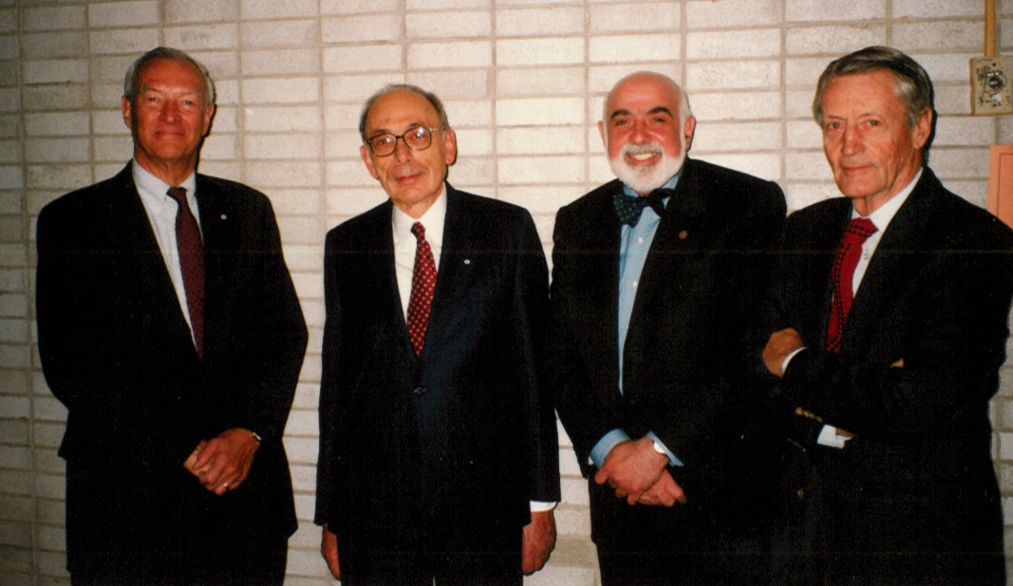
To gather for foundational MedEd academic exchanges and productivities, rooted in evidence, experience, expertise, excellence.
Thoughts on the Centre

Slide 13
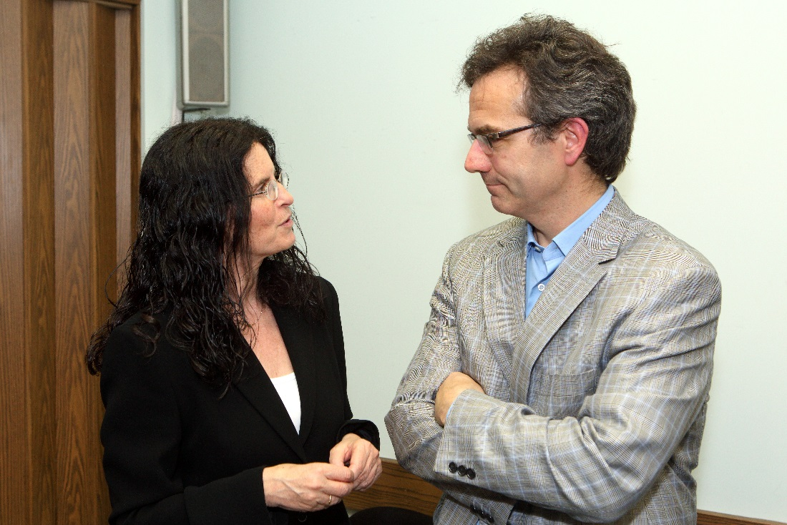
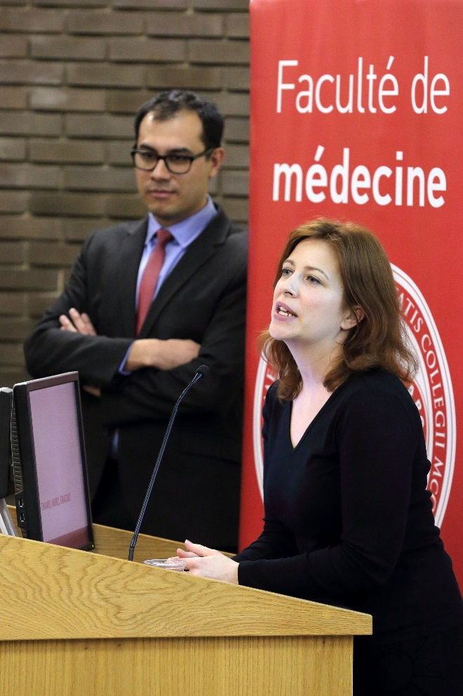
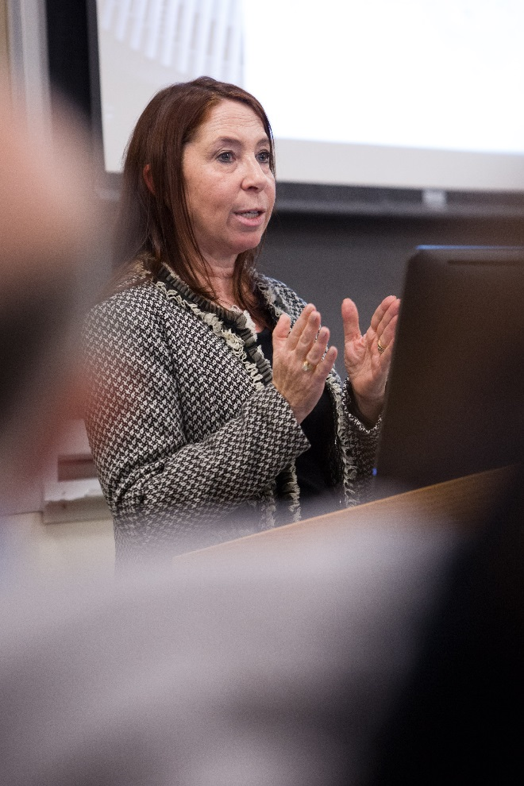
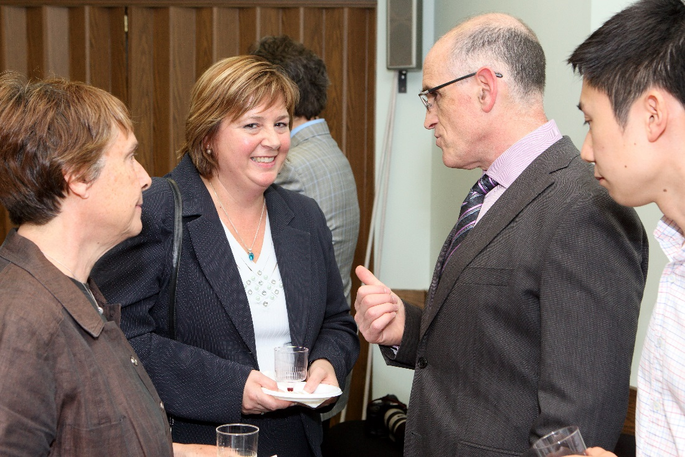

Slide 14
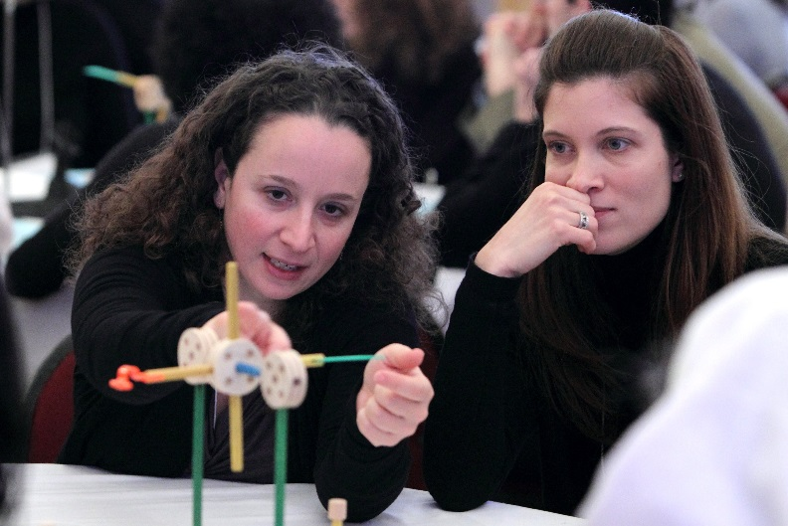
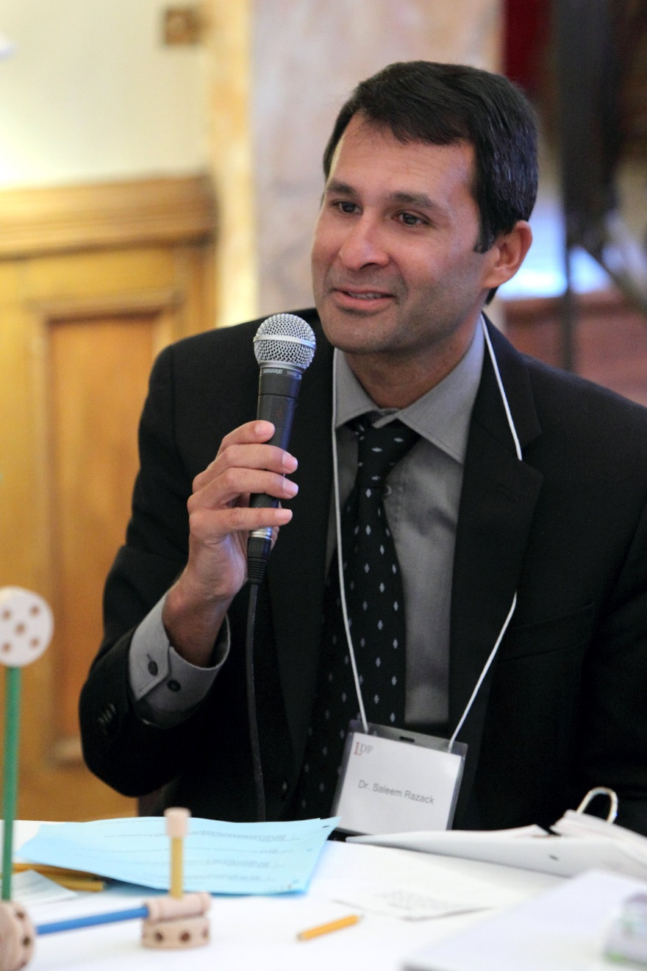
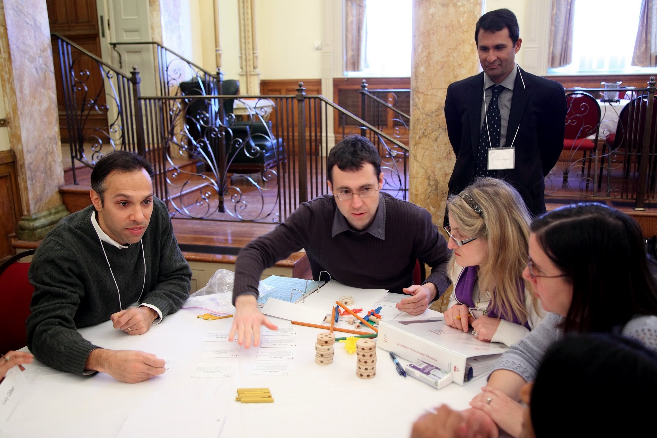

Slide 15
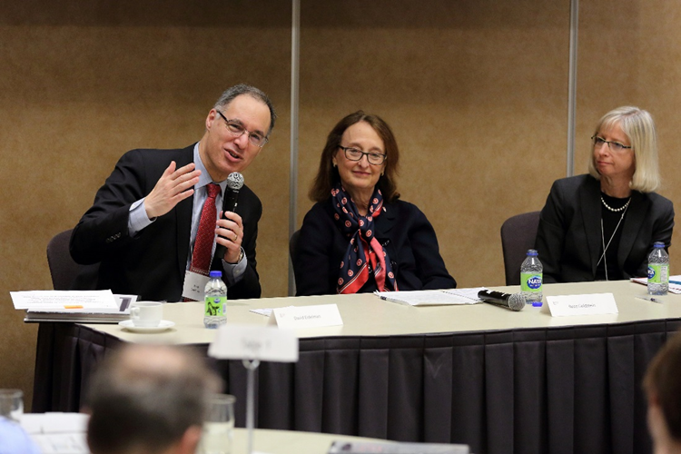
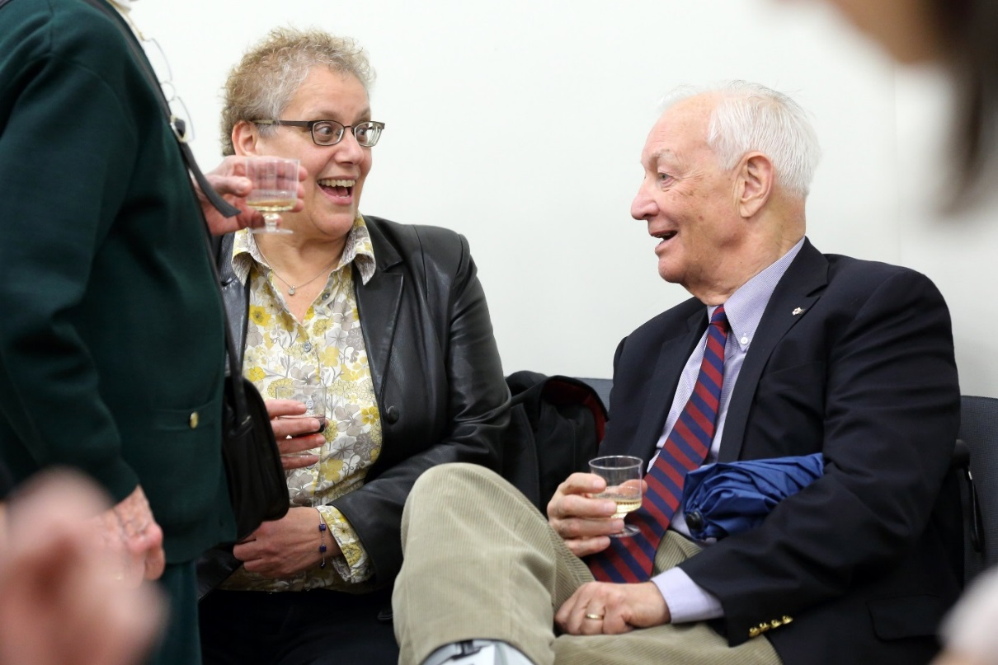
The Centre has clearly been very successful in the world of medical education and we have all been privileged and pleased to share in its success. The expanded mission implied in institute status should allow us to reach even higher levels of accomplishment.
Thoughts on the Institute

Slide 16
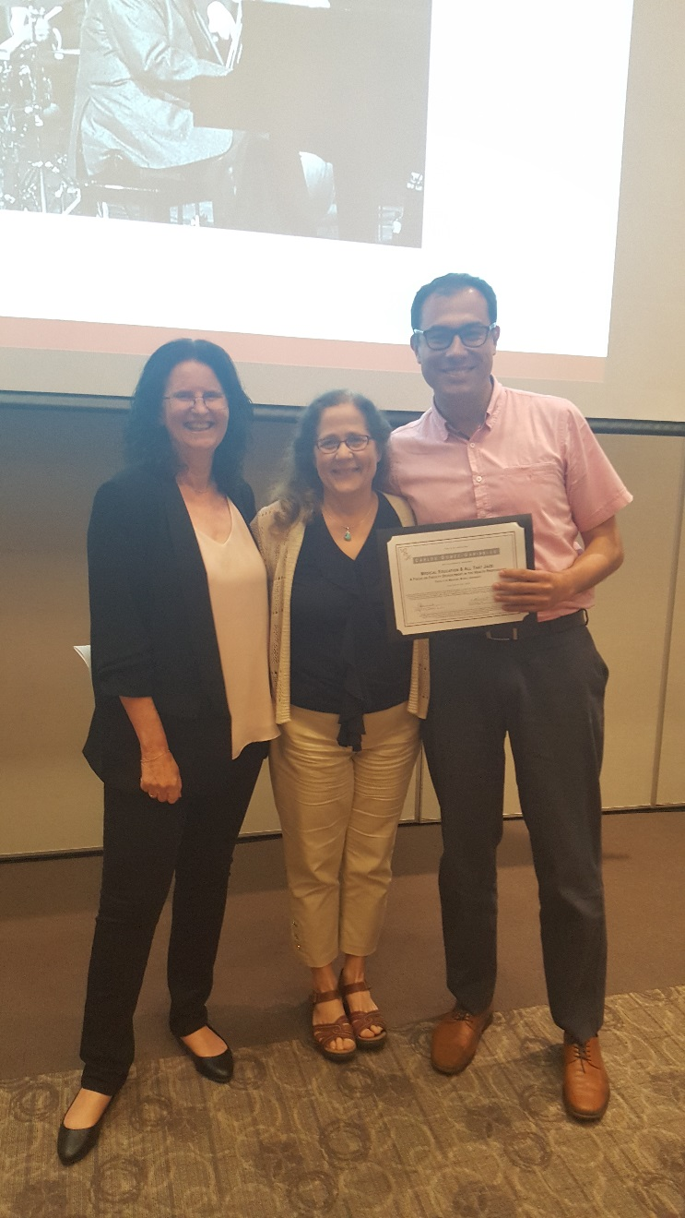
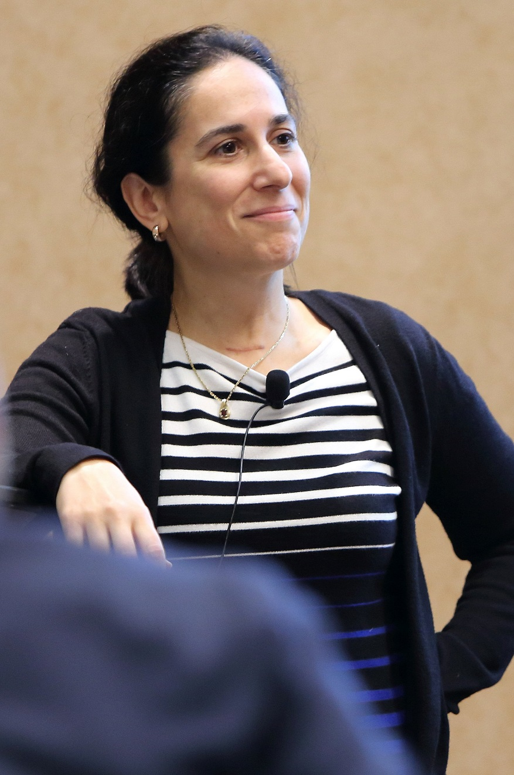
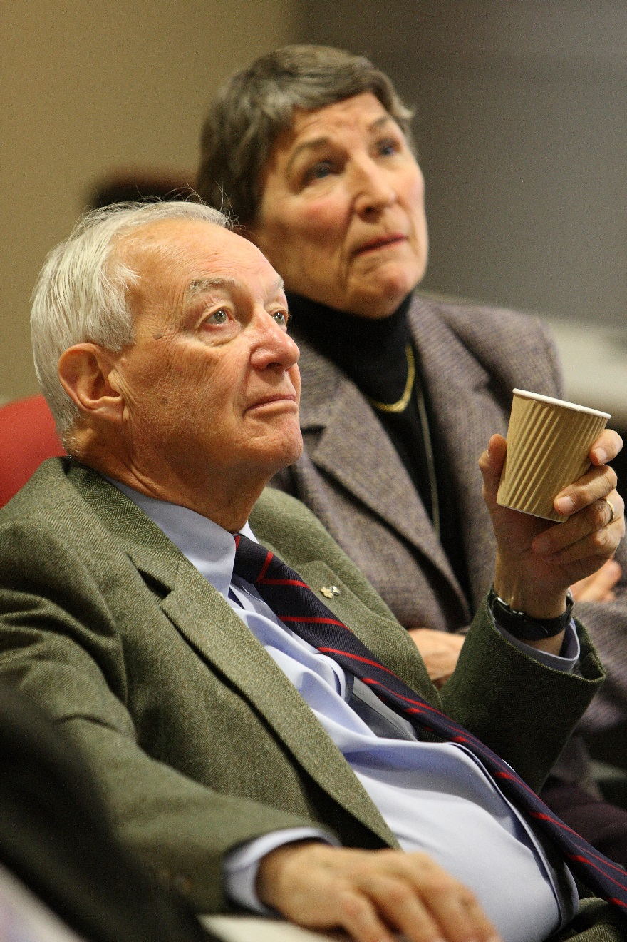

Slide 17
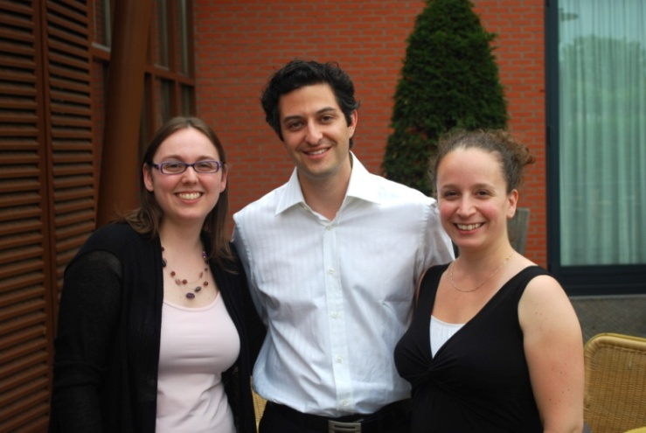
An important transformation with the creation of a new exciting era of endeavour and innovation - all within the profile accorded to an academic institute.
Thoughts on the Institute

Slide 18
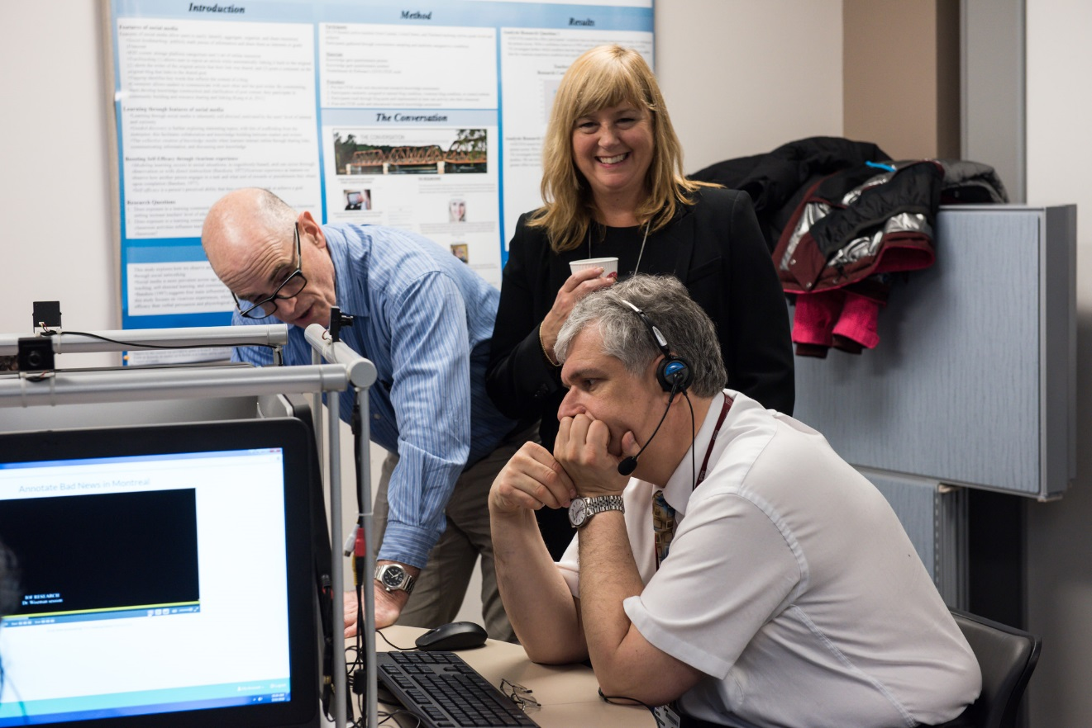
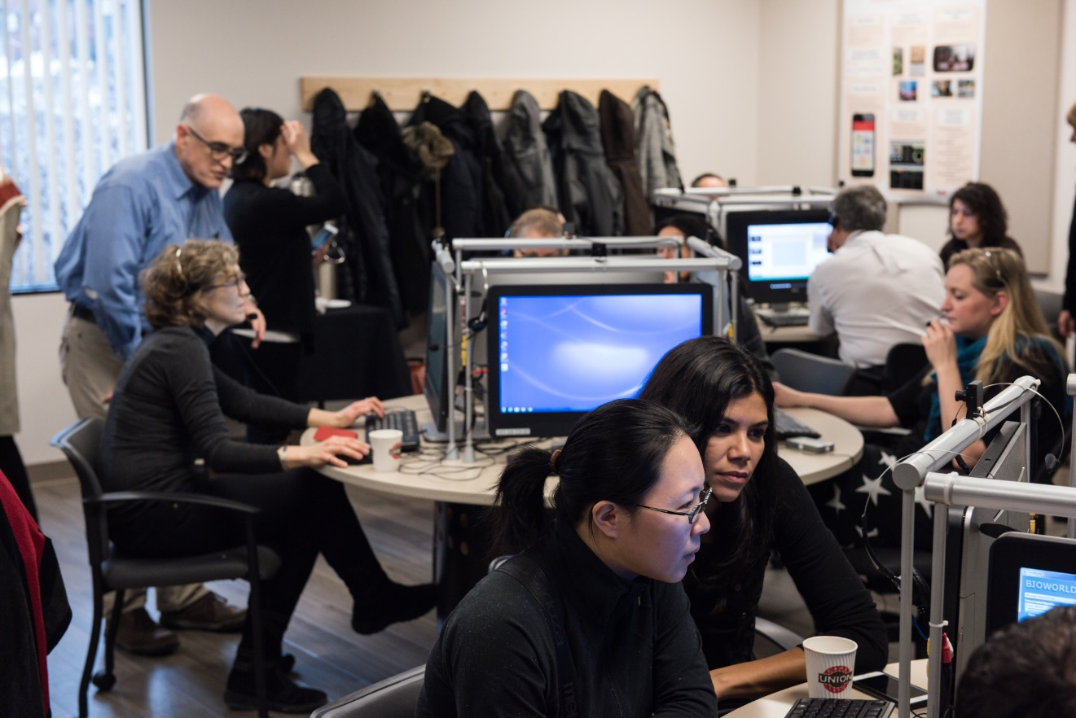

Slide 19
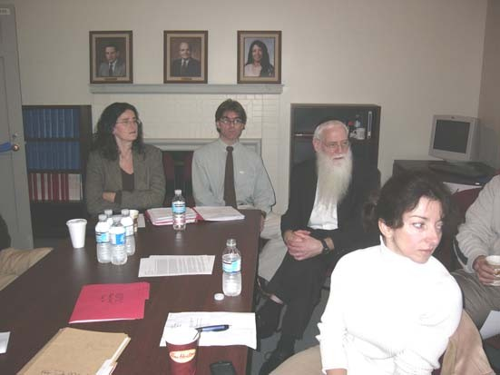
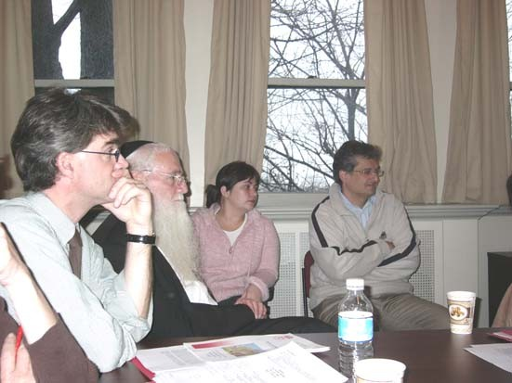
The Centre was my first research home as a graduate student that launched me on my way.
The Centre was like an oasis from the daily bustle where I could reflect on medical education.
Thoughts on the Centre

Slide 20
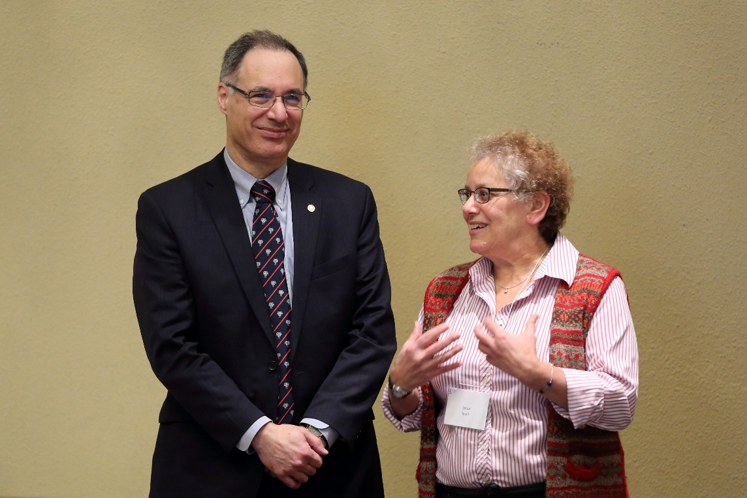
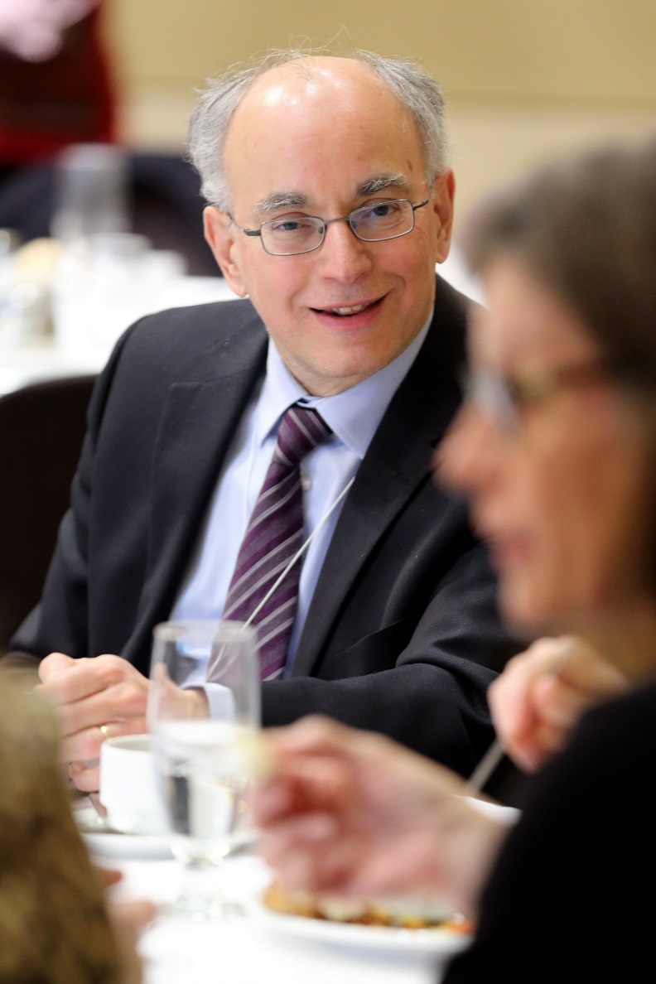
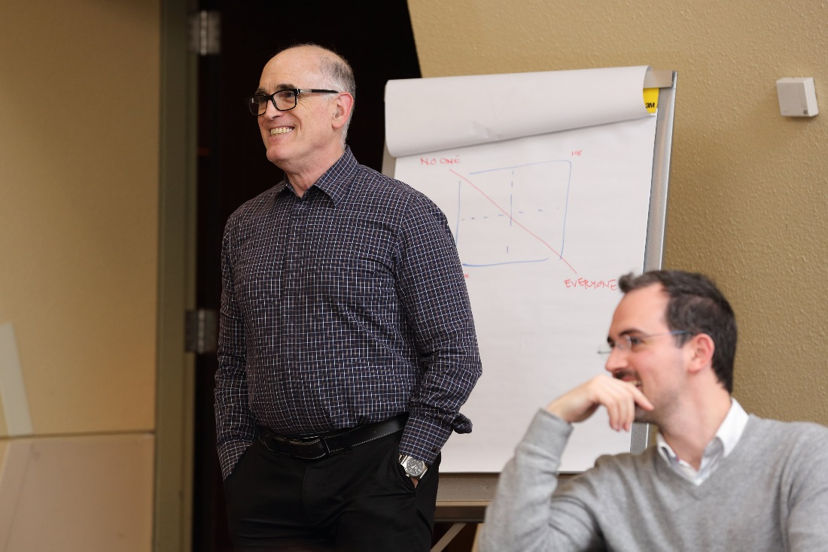

Slide 21
A welcoming community of health professions education experts and researchers that thrive to make the field advance.
Thoughts on the Centre

Slide 22
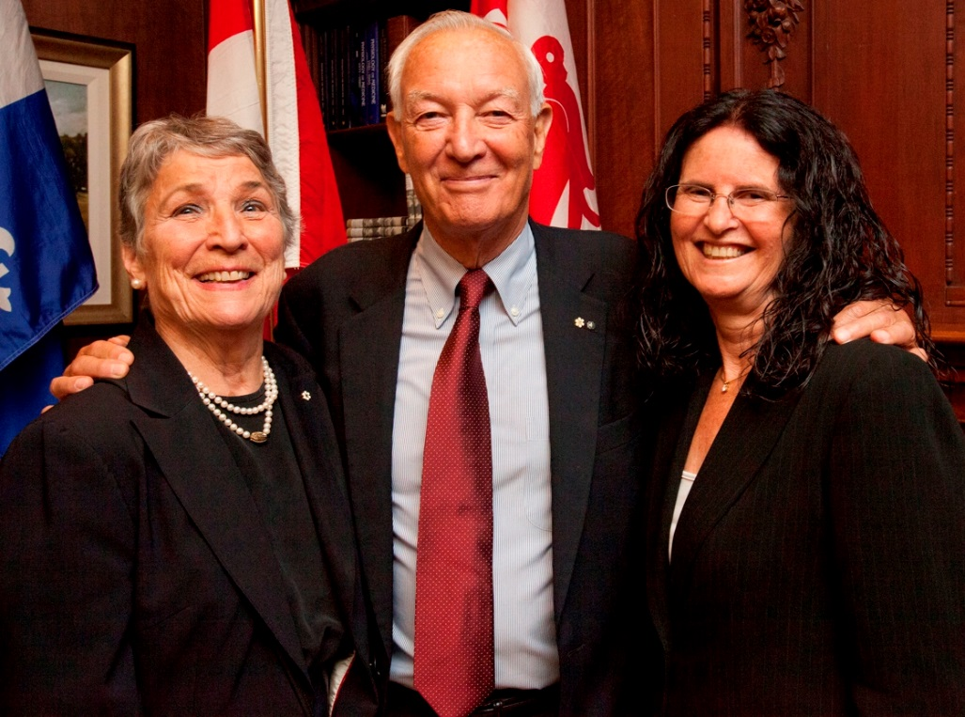

Slide 23
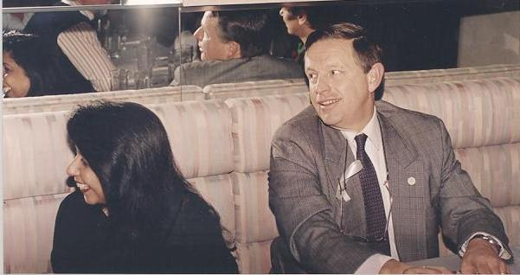
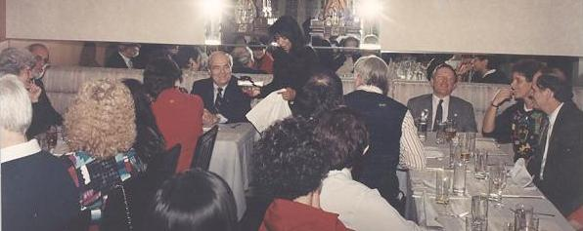
Steeped in tradition.
Thoughts on the Centre

Slide 25
To sustain and grow branches of academic and scholarly innovation in health sciences education.
Thoughts on the Institute

Slide 27
The Institute will broaden the scope of my literacy in regards to the expertise brought around the table.
Thoughts on the Institute

Slide 29
The Centre was a home that provided tremendous support to help develop my medical education career path. For all of this, I feel privileged and say thank you to the Centre for Med Ed!
Thoughts on the Centre

Slide 32
A new beginning to learn and be immersed in medical education research.
Thoughts on the Centre

Slide 35
A new chapter – home, community and refuge – but with solid construction updated to the new “building” codes to better serve its purpose as a space for excellence in health sciences education research and scholarship.
Thoughts on the Institute

Slide 38
A home, community and refuge where my intellectual growth in health professions education scholarship was always enhanced.
Thoughts on the Centre

Slide 40
Centre for Medical Education Directors
Dr. Hugh Scott
(1975-1979)
Dr. Dale Dauphinee
(1979-1993)
Dr. Vimla Patel
(1994-2001)
Dr. Peter McLeod
(2001-2005)
Dr. Yvonne Steinert
(2005-2019)

Slide 42
The Future is Now!
Thoughts on the Institute

