Slide 1
REGULATING DRONES AND LIABILITY ISSUES
10th Annual McGill Conference on International Aviation Liability & Insurance -June 23, 2017
Presentation by Serap Zuvin

Slide 2
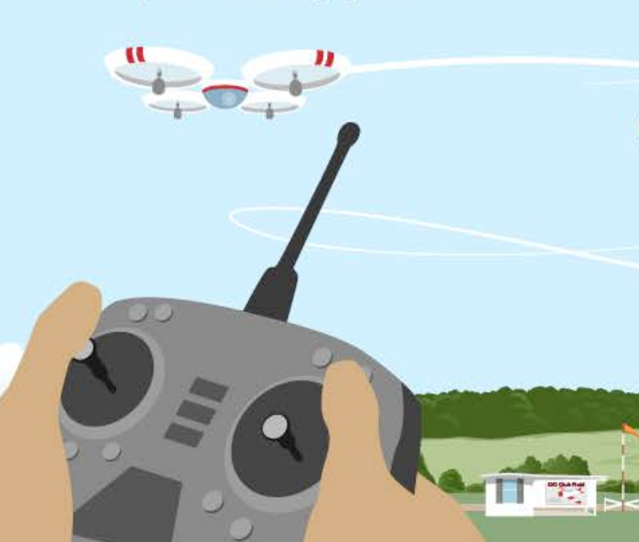
Today’s Agenda
Analysis of Current Global jurisdiction
Overview of Legislation in the EU
Developments in EU Regulation
Riga Declarations
EASA Prototype
Third Party Liability and Insurance Issues
Future of Regulations
Image: "Commercial Drones Facing Pilot Shortage." Jetwhine RSS. N.p., n.d. Web.

Slide 3
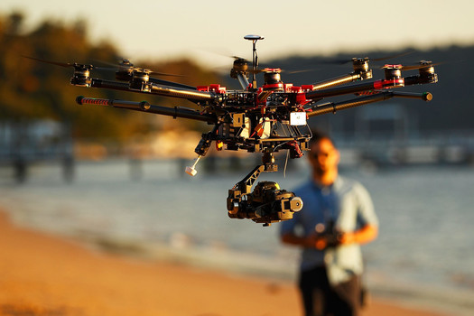
Current Global jurisdiction
Unmanned Aerial Vehicle (“UAV”)→ “aircraft on which no pilot on board and controlled remotely”
ICAO emphasizes 3 components
the unmanned aircraft itself
the remote pilot station on the ground,
the command and control link between the aircraft and the remote pilot station.
Image: "Commercial Drones Facing Pilot Shortage." Jetwhine RSS. N.p., n.d. Web.

Slide 4
Current Global jurisdiction
UAV regulations need to be improved to catch up with the manned aircraft industry
Chicago Convention:
Authorisation from the flown over state,
Respect of fly over terms,
Safety of the state
“Purpose of Use” is the key factor to enforce regulations

Slide 5
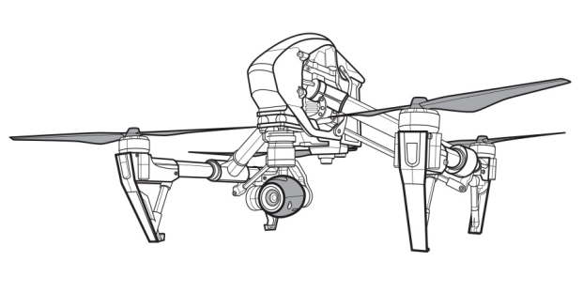
Overview of Legislation in the EU
Regulation 216/2008
- The EU legislation that is currently in effect
- Covers only the drones with a Maximum Take-Off Weight of >150 kg,
- Not being used for military, customs, police, fire-fighting, search and rescue or experimental work.
Riga Declarations
- Efforts to ensure safe and sustainable emergence of drone services
- Focus on the risk of operation
3 Basic Criteria:
EASA Prototype UAV Regulation
- The Proposal disregards the weight limit of 150kg.
- Proposes a uniform structure
i. Open Category
ii. Specific Category
iii. Certified Category
1. A well designed regulatory framework
2. Focus on a broad spectrum of technologies
3. The principle of “proportionality”
Uniform UAV Regulation
Image: "Drone Sketch." Drawing Images. N.p., n.d. Web.

Slide 6
Developments in EU Regulation EASA Prototype UAV Regulation
Open Category
For the Drones representing a low risk
Specific Category
Drones representing a medium risk
Certified Category
Drones representing the highest risk.
Police enforces the rules under this category
No Aviation Authority involvement
License is not required for remote pilots.
Limitations exist (VLOS, maximum altitude, and distance from airport and sensitive zones)
Must be registered with the National Civil Aviation Authority for operation
License is not required for remote pilots.
These Drones can only be operated, under conditions similar to commercial manned aircraft. They are deemed as risky as manned aircraft.
License is required for remote pilot
Operator has to be approved by the National Civil Aviation Authority.

Slide 7
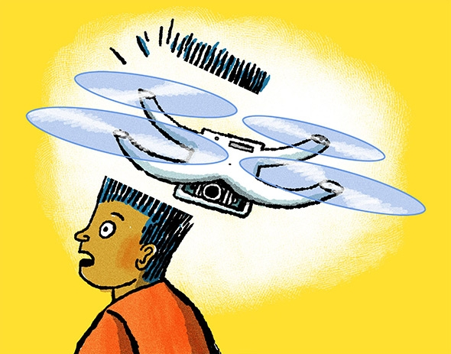
Third Party Liability and Insurance Issue EASA Prototype UAV Regulation
No regulation to address third party liability and insurance in drone accidents
Need for a clear regulatory framework relating to the incidents causing personal or property damage
Considering Rome Convention as a benchmark to resolve the issue
Image: Stevenson, Seth. "Planning to Buy Your Kid a Drone for Christmas? Read This First." Slate Magazine. N.p., 27 Nov. 2014. Web.

Slide 8
Third Party Liability and Insurance Issue Rome Convention
Rome Convention
Includes regulations with respect to damages to third parties caused by foreign aircrafts.
Failed to attract widespread support from the Member States due to unsatisfactory levels of compensation
Its principles are suitable for shaping the future of a EU regulation for third party liability regime for drones
Image: Stevenson, Seth. "Planning to Buy Your Kid a Drone for Christmas? Read This First." Slate Magazine. N.p., 27 Nov. 2014. Web.

Slide 9
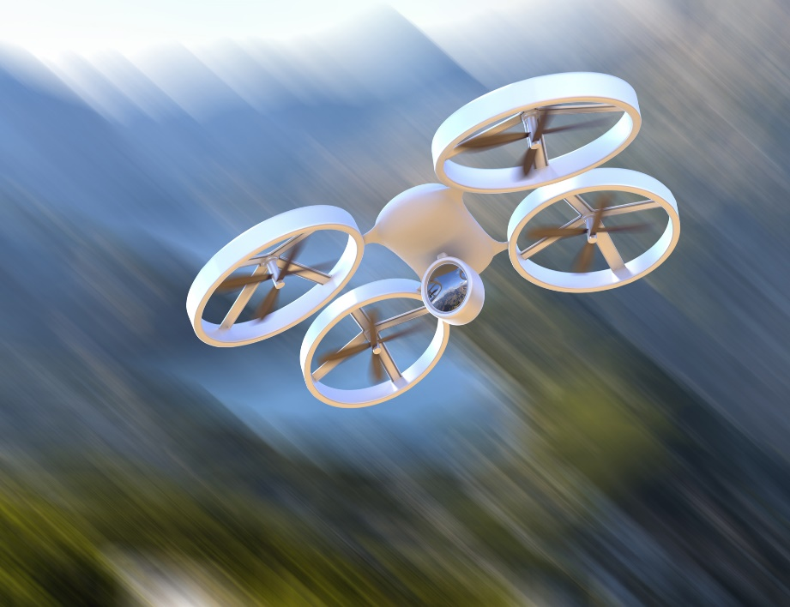
Future of Regulations
Notices of Proposed Amendments(EASA)
ICAO RPAS Panel, a roadmap towards internationally agreed standards
Current efforts for regulating EU is not sufficient
A worldwide regulation is a necessity
Image: "Drones Are the Future of the Internet of Things." Drone Analyst. N.p., 04 Jan. 2017. Web.

