Slide 1


THE CHALLENGES OF AIRCRAFT LEASING AND FINANCE
THE ELEVENTH ANNUAL MCGILL UNIVERSITY/PEOPIL CONFERENCE ON INTERNATIONAL AVIATION LAW: LIABILITY, INSURANCE & FINANCE
DUBLIN, IRELAND
20 OCTOBER 2018
Donald G. Gray
Chair, Aviation & Aerospace Group
Blake, Cassels & Graydon LLP
Toronto, ON, Canada
Aviation & Aerospace Group

Slide 2
INDEX
Boeing Current Aircraft Finance Market Outlook 2018
International EETCs
Cape Town Convention and AWG CTC Compliance Project

Slide 3

Aviation & Aerospace
The Leader in Canadian Aviation Law and Aircraft Financing
Awards and Recognition
Chambers Global: The World’s Leading Lawyers for Business – Transportation: Aviation – Canada (Band 1)
Who’s Who Legal: Thought Leaders Transport: Aviation – Donald Gray, one of Top 11 in the World
Legal Media Group’s Guide to the World’s Leading Aviation Lawyers
Legal Media Group’s The Best of the Best – Aviation (Canada)
The Legal 500 Canada – Transport Aviation
The Best Lawyers in Canada – Aviation Law
Air Finance Journal – North American Aviation Law Firm of the Year 2015
Selected AWG Global External Counsel, 2017
According to Who’s Who Legal Canada 2015, “[Blakes] boasts the country’s leading aviation finance practitioners”, Donald Gray was listed as “Most Highly Regarded” aviation finance lawyer in Canada and among Top 10 in the World

Slide 4
Boeing Current Aircraft Finance Market Outlook 2018

Slide 5

CURRENT AIRCRAFT FINANCE MARKET OUTLOOK
2018
Kostya Zolotusky
Boeing Capital Corporation
4
Copyright © 2017 Boeing. All rights reserved.
BOEING PROPRIETARY

Slide 6
Strong aircraft financing environment
2009
2010
2011
2012
2013
2014
2015
2016
2017
2018F
LEASING COMPANIES
CAPITAL MARKETS
COMMERCIAL BANKS
EXPORT CREDIT AGENCIES
PRIVATE EQUITY & HEDGE FUNDS
TAX EQUITY
INSURANCE
NEW SOURCES OF FUNDING
AIRFRAME & ENGINE MANUFACTURERS
SATISFACTORY
CAUTIONARY
MAJOR CONCERN
5

Slide 7
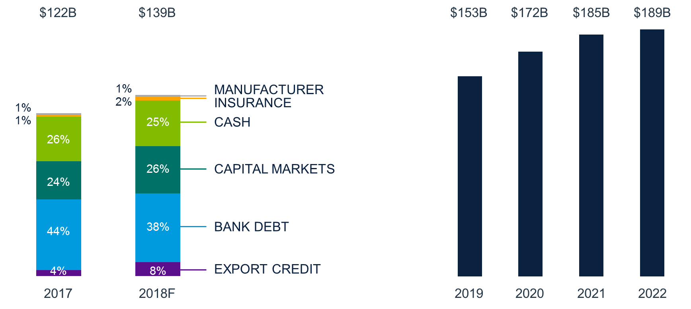
Supporting industry fleet growth
6

Slide 8
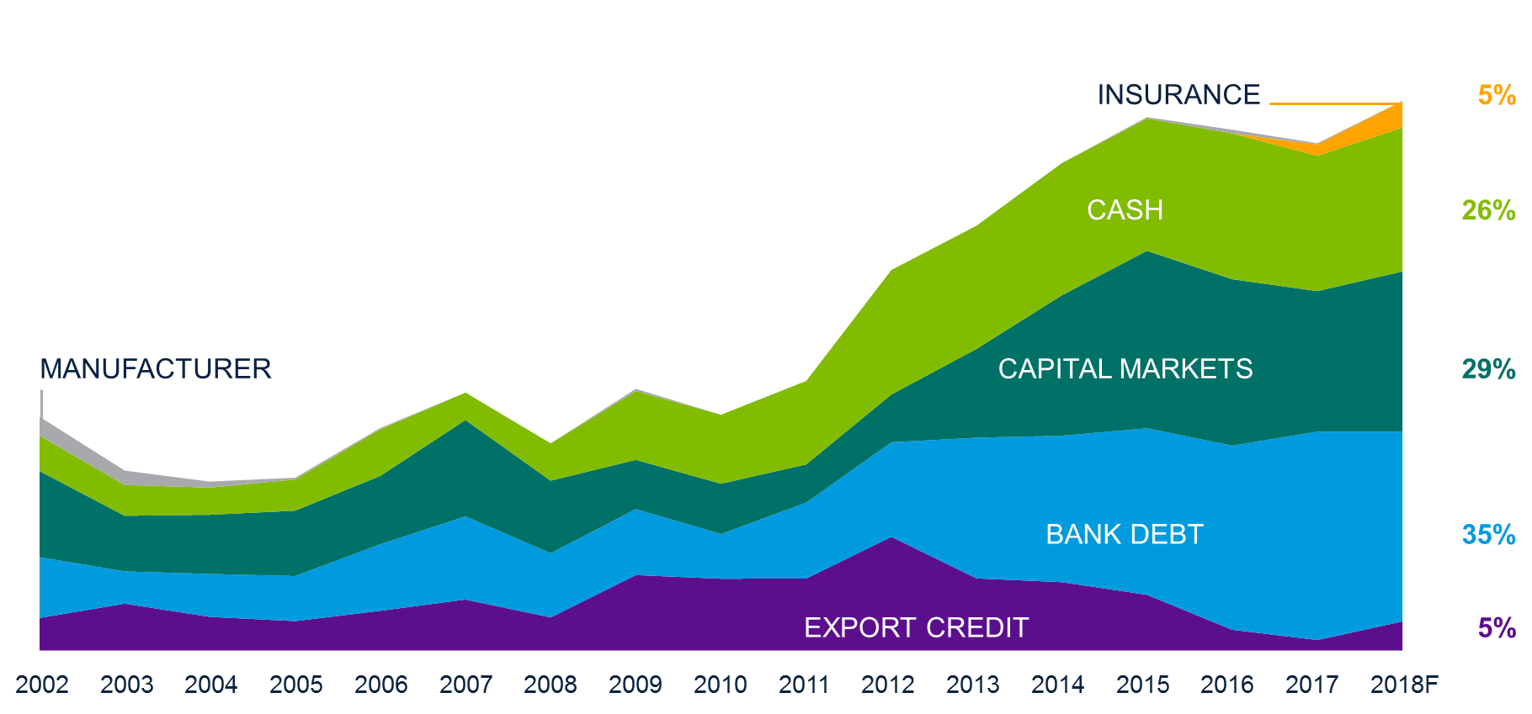
Balanced funding for Boeing deliveries
7

Slide 9
Funding distribution differs region to region
Source of financing for Boeing deliveries 2009-2017
North America
$117B
Asia Excl. China
$76B
Europe
$68B
China
$66B
Middle East
$55B
Latin America
$13B
Central Asia
$12B
Africa
$10B
Sale-leaseback
Export credit
Bank debt
Capital markets
8
Cash
Insurance
Manufacturer

Slide 10


Industry share of global fleet on operating lease stable at ~40%
LEASED
9
2009
2010
2011
2012
2013
2014
2015
2016
2017
Copyright © 2018 Boeing. All rights reserved.

Slide 11
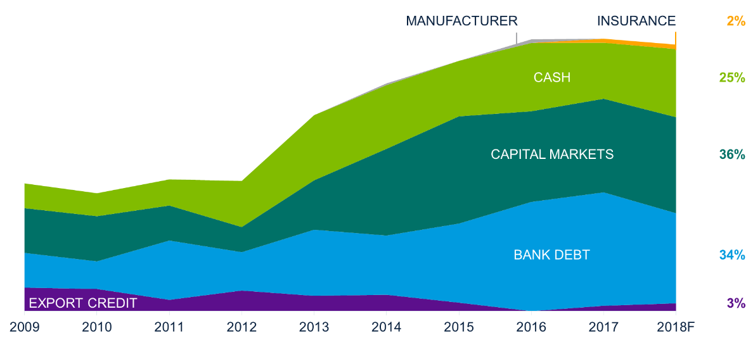
Lessors look to capital markets and bank debt for financing
Source of financing for Boeing deliveries to lessors
EXPORT CREDIT
10

Slide 12
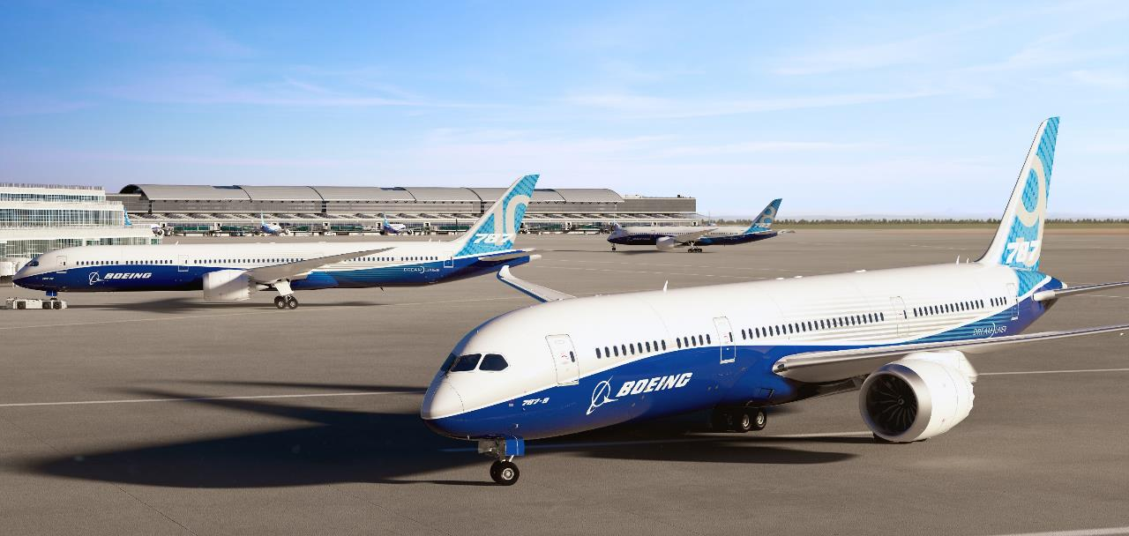
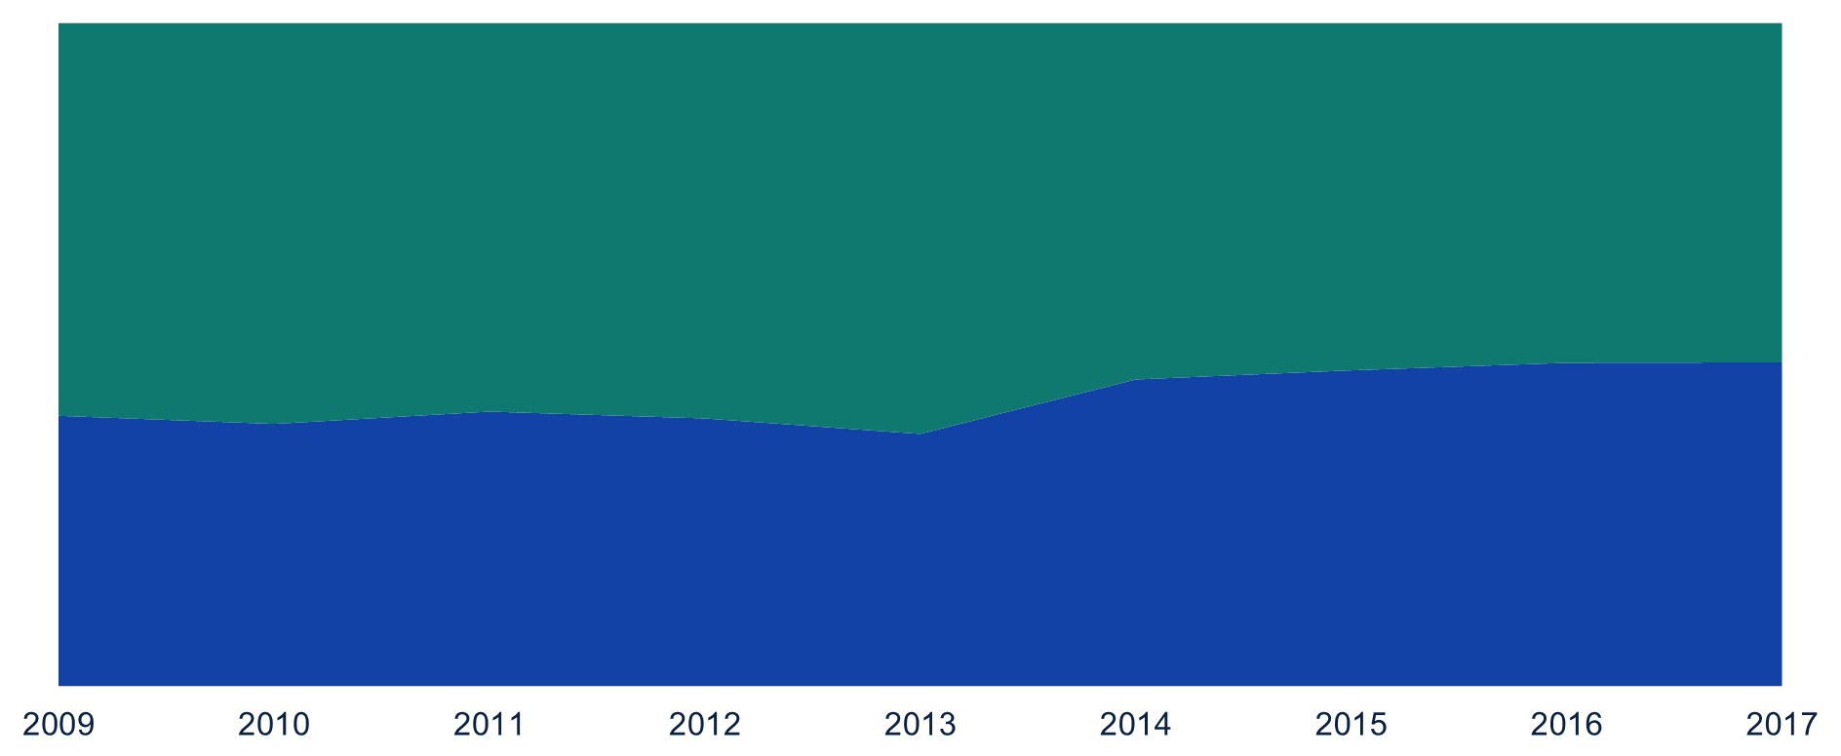
Lessors maintain a balanced portfolio
Structure of lessor purchases for Boeing deliveries
SALE-LEASEBACKS
~51%
DIRECT PURCHASES
~49%
11

Slide 13
Regional distribution of lessor-funded deliveries by structure
Operator region for Boeing deliveries in 2017
11%
North America
Europe
17%
5%
16%
Central Asia
18%
44%
China
17%
28%
Middle East
SALE-LEASEBACKS
5%
LESSOR DIRECT PURCHASES
17%
5%
Asia excl. China
6%
12%
Other
12

Slide 14
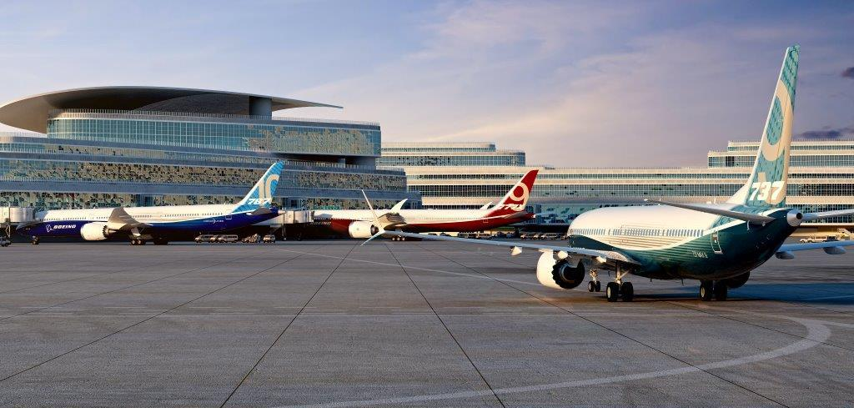
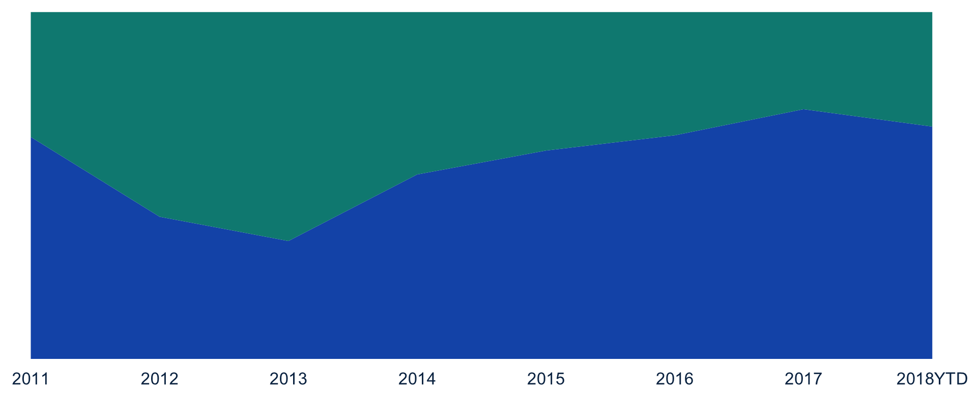
Lessors’ strong ratings drive strength in unsecured borrowing
SECURED
33%
UNSECURED
67%
13
Source: Boeing analysis as of December 2017. Amounts rounded.

Slide 15
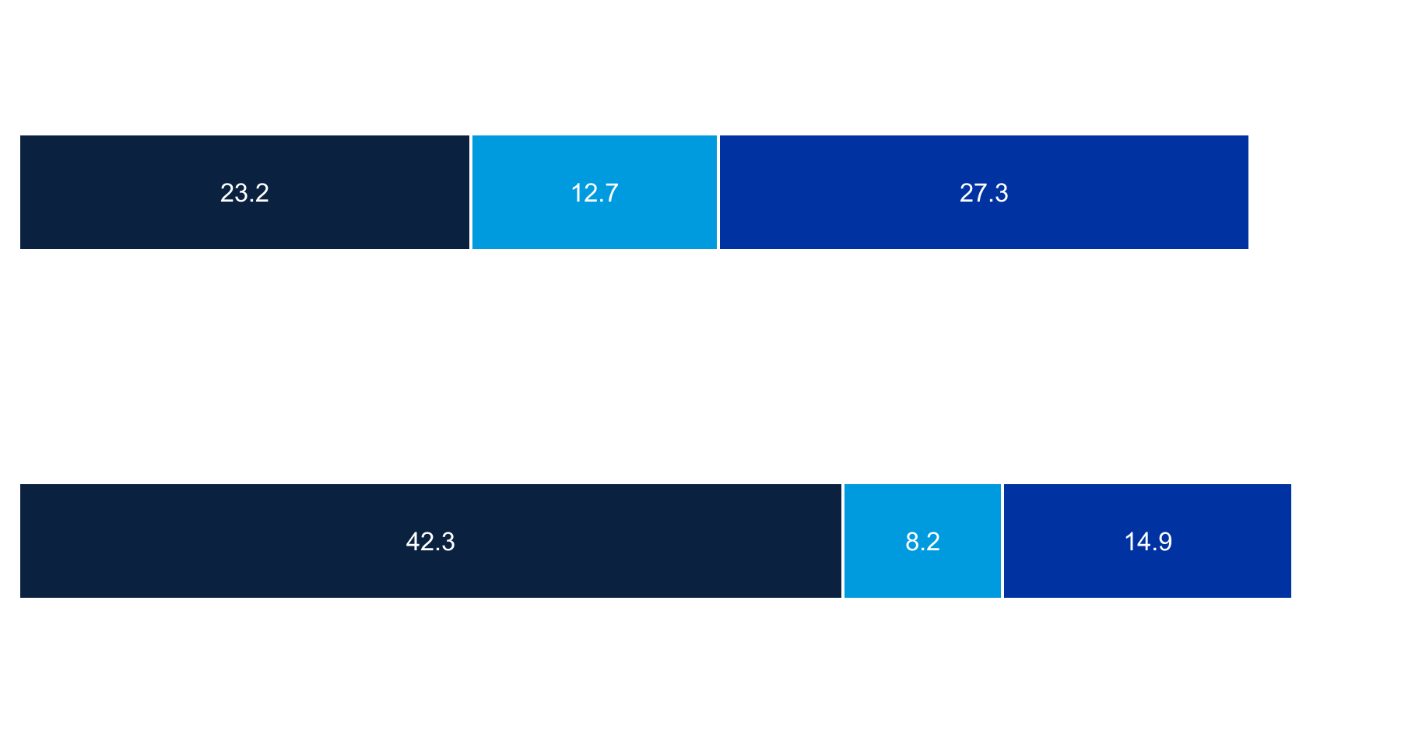
Capital markets dominated by Lessors in 2017
Lessors
US airlines
Non-US airlines
2016
$63.2B
Unsecured
Secured
Unsecured
Secured
Unsecured
Secured
Lessors
US airlines
Non-US airlines
2017
$65.4B
Unsecured
Secured
Unsecured
Unsecured
Secured
Secured
14
Source: Boeing analysis. Amounts rounded.

Slide 16
EETC volume slowed in 2017
2016
$5.3 billion
US airlines
(93%)
Non-US airlines (7%)
2017
$3.2 billion
US airlines
(75%)
Non-US airlines (25%)
USD Billions
15
Source: Boeing analysis. Amounts rounded.

Slide 17
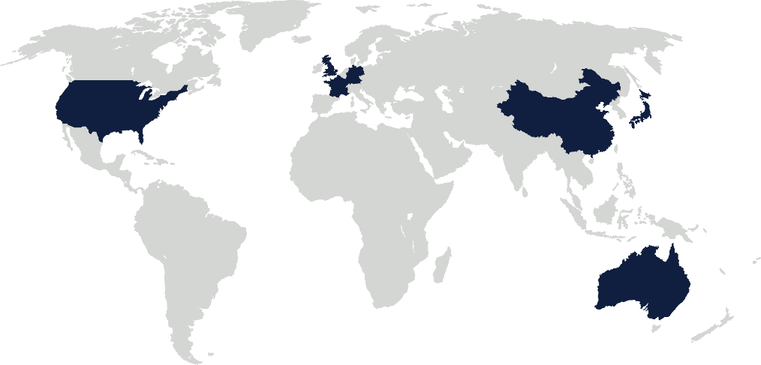
Bank debt
2017
16%
2018F
Germany
17%
15%
Japan
UK
5%
12%
5%
7%
9%
USA
France
6%
28%
8%
China
31%
11%
Other
8%
Australia
12%
7%
16
Source: Market Intelligence

Slide 18







Aircraft Finance Insurance Consortium (AFIC)
Simple financing structure
SPV
FINANCE LEASE
Airline
INSURANCE POLICY
BANK LOAN
BANK
AIRLINE EQUITY
17

Slide 19













AFIC transactions
Rapidly maturing market
(1) 747-8i and (2) 787-9s
(1) 777-300ER
(3) 737 MAX8s
(7) 737 MAX 8s
(4) 737 MAX 8 and (1) 787-9
(2) 747-8F for
(2) 777Fs
(3) 737-800
18
(2) 737 MAX 8
(1) 777Fs

Slide 20



Export credit helps bridge gaps in commercial financing
SUPPORTING EMERGING MARKETS
PROVIDING STABILITY DURING MARKET INTERRUPTIONS
MAINTAINING
A LEVEL
PLAYING FIELD
19

Slide 21
Ex-Im usage has fallen sharply since 2012
Percentage of Boeing deliveries supported by
Ex-Im Bank (USD)
FINANCIAL CRISIS
2006
2007
2008
2009
2010
2011
2012
2013
2014
2015
2016
2017
2018
20

Slide 22
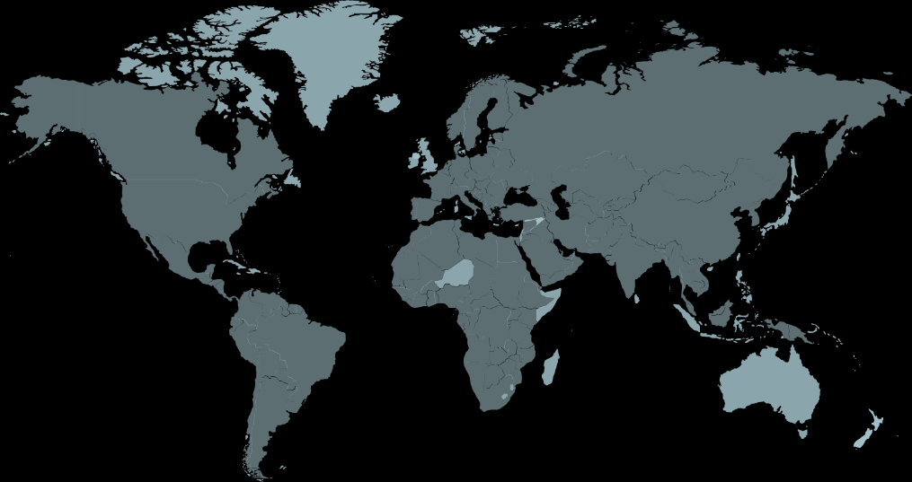




Boeing’s global Export Credit Agency strategy
21
Notes:
ECAS and AFIC:
80 a/c: $6.3B
2018 FORECASTED

Slide 23
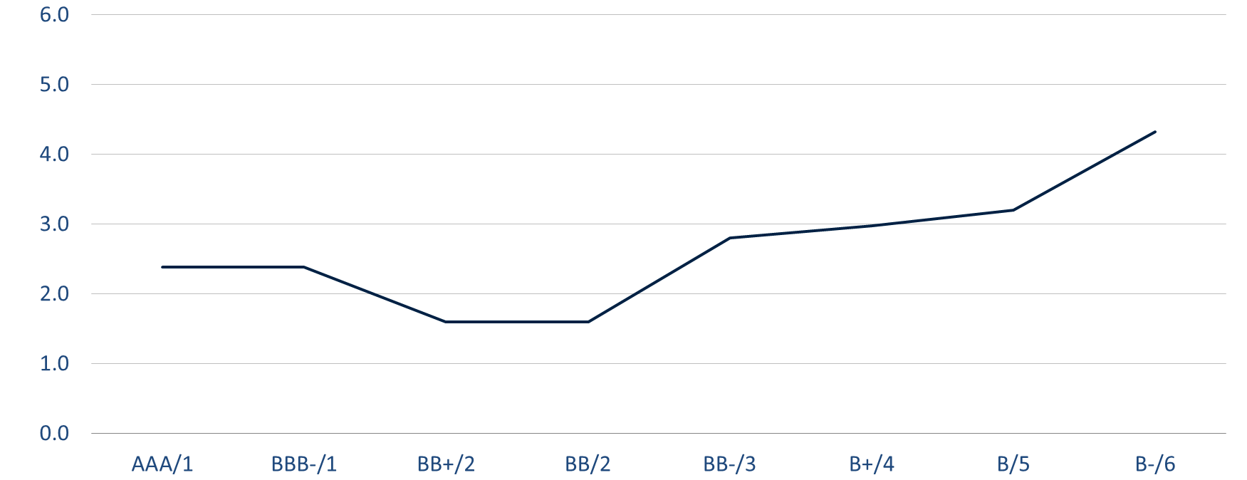
Commercial markets are more efficient than export credit
= 2017 EETCs by US airlines
Issuances collateralized by Boeing aircraft
2011 ASU
Spread over LIBOR %
Commercial debt
22
Airline credit rating / OECD risk category

Slide 24

Aviation & Aerospace
The Leader in Canadian Aviation Law and Aircraft Financing
23

Slide 25
International EETCs
24

Slide 26














1. WHAT IS AN EETC?
▪ U.S. Airlines Lead EETC Issuance
First Issuance in 1993 for Boeing Capital
Total EETC Issuance since inception: ~$92.7Bn
Source: Morgan Stanley, as of 9/13/18

Slide 27
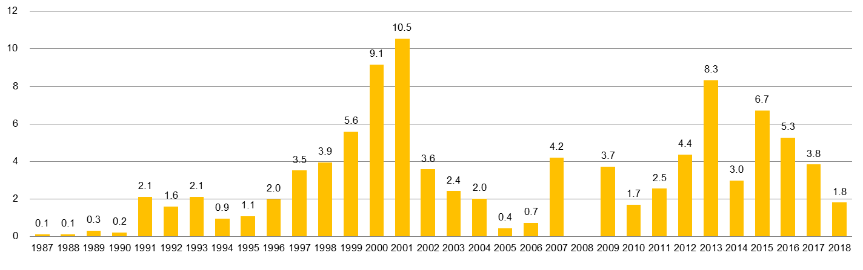
1. WHAT IS AN EETC? (cont’d)
ETC/EETC⁽¹⁾ Market
US$Bn
AA
AA
LCC
LCC
AA
DAL
LCC
UAL
AA
ALK
BA
DAL
LCC
UAL
AA
DAL
FDX
LCC
LUV
UAL
AA
CAL
FDX
LUV
NWA
UAL
AA
BA
CGO
FDX
LUV
UAL
ATA
AWA
CAL
DAL
LCC
NWA
UAL
AAIR
ACA
ATA
AWA
CAL
FDX
KTTY
LCC
NWA
UAL
AWA
CAL
CGO
FDX
LCC
LUV
MDWY
AA
AAIR
ATA
AWA
CDX
CGO
Iberia
LCC
NWA
UAL
ATA
AWA
BNDES
CAL
CGO
DAL
Iberia
LCC
MDWY
NWA
UAL
AA
AMR
DAL
LCC
LUV
NWA
UAL
AA
ATA
DAL
NWA
UAL
AA
AF
DAL
NWA
UAL
AA
Iberia
JBLU
UAL
AA
UAL
JBLU
UAL
DAL
LUV
NWA
UAL
AA
UAL
CAL
DAL
DAL
LCC
UAL
AA
DAL
LCC
DAL
DNA
LCC
UAL
AAL
ACACN
BA
DNA
HA
JBLU
LCC
UAL
VAH
AAL
UAL
AAL
ACACN
THY
LATAM
UAL
DAL
SAVE
AAL
UAL
NAS
AAL
UAL
SAVE
ACACN
AAL
UAL
BA
26
Source: Morgan Stanley, as of 9/13/18
Note:
1. The first EETC issuance was in 1994

Slide 28
1. WHAT IS AN EETC? (cont’d)
EETC Issuance 2009-18YTD
27
Source: Morgan Stanley, as of 9/13/18

Slide 29
1. WHAT IS AN EETC? (cont’d)
“MODERN” EETCs (2007-2018YTD)
For used and new Aircraft (including re-financing some maturing EETCs)
69 Deals
10 U.S. Airlines (American, Continental, Delta, Hawaiian, jetBlue, Mesa, Southwest, Spirit, United, and US Airways)
6 non-U.S. Airlines (Air Canada, British Airways, LATAM, Norwegian, Turkish Airlines, and Virgin Australia,)
1 Lessor (Doric)
More transactions executed in the 4(a)(2) US private placement market

Slide 30
2. CURRENT EETC STRUCTURES
TYPICAL EETC STRUCTURE (PRE-FUNDED MORTGAGES)
MORTGAGE PAYMENTS
NEGATIVE CARRY INTEREST CHARGES
ADVANCES AND REIMBURSEMENTS
(IF ANY)
BOEING
TITLE
AIRLINE
LOAN
TRUSTEE
LIQUIDITY
FACILITY
PROVIDER
GRANT OF AIRCRAFT
MORTGAGES (US 1110/CTC ALTERNATIVE A
PROTECTED)
EQUIPMENT NOTE PAYMENTS
AIRCRAFT 1
AIRCRAFT 2
SUBORDINATON AGENT
PRINCIPAL AND INTEREST DISTRIBUTIONS TO CERTIFICATE HOLDERS
DEPOSITARY
BANK
ISSUE OF CLASS A, B AND C EQUIPMENT NOTES
(SECURED BY AIRCRAFT)
PASS THROUGH TRUSTEE FOR CLASS A TRUST
PASS THROUGH TRUSTEE FOR CLASS B TRUST
PASS THROUGH TRUSTEE FOR CLASS C TRUST
INTEREST PAYMENTS ON DEPOSITS
ESCROW
AGENT
HOLDERS OF CLASS A CERTIFICATES
HOLDERS OF CLASS B CERTIFICATES
HOLDERS OF CLASS C CERTIFICATES
INTEREST
PAYMENTS
ON DEPOSITS
INTERCREDITOR AGREEMENT

Slide 31
3. ADVANTAGES OF EETCs (cont’d)
EETC Secondary Performance
Benchmark EETC Tranche AA & A Trading Levels
(%)
30
Source: Morgan Stanley, as of 9/13/18

Slide 32
4. International EETCs
Deal name | Jurisdiction | CTC | LF | Notes
Doric 2012-1 | UAE | Yes | 24mo | Finance Lease w/ Emirates
Doric 2013-1 | UAE | Yes | 24mo | Finance Lease w/ Emirates
AC 2013-1 | Canada | Yes | 18mo | First “true” EETC structure for non-US airline
BA 2013-1 | UK | No | 18mo | w/ JOLCO equity
VA 2013-1 | Australia and NZ | No and Yes | 18mo
AC 2015-1 | Canada | Yes | 18mo
THY 2015-1 | Turkey | Yes | 18mo | Finance Lease, only Class A
LATAM 2015-1 | Chile and Brazil | No and Yes | 21mo | Finance Lease (did a C Tranche after the fact)
AC 2015-2 | Canada | Yes | 18mo | First “AA” structure for non-US airline
Norwegian 2016-1 | Ireland | Yes | 18mo
AC 2017-1 | Canada | Yes | 18mo
BA 2018-1 | UK | Yes | 18mo | w/ JOLCO equity
AC 2018-1 | Canada | Yes | 18mo | First CAD denominated

Slide 33
5. CANADIAN EXPERIENCE
Pre-CTC
S. 1110 – like provisions adopted into insolvency laws (2006)
Judicial discretion to extend stays in the public interest
Minimal market experience with enforcement proceedings
No practical market experience with CTC proceedings (in Canada or elsewhere)

Slide 34
(b) KEY DRIVER – CTC DECLARATIONS
Alternative A selected with 60-day stay
All OECD/ASU Qualifying Declarations made
Express and specific enumeration of legislation that would take precedence over CTC
33

Slide 35
(c) KEY DRIVER - CTC LEGAL OPINIONS
Unqualified Opinion in the AWG Practitioner’s Guide recommended form, including:
- Creditor entitlement to Alternative A benefits with maximum 60-day stay period
- Entitlement to all IDERA benefits (airline plus Contracting State obligation)
- Validity and priority of international interests
34

Slide 36
(d) KEY DRIVER – JUDICIAL DEFERENCE
TO TREATY/STATUTORY LAW
Canadian Courts have long history of respecting black letter law reform
Canadian Courts have consistently held that statutes are to be applied harmoniously with scheme of statute, and intentions of Parliament (notwithstanding Court’s views of public policy)
- Transamerica case (Air Canada CCAA)
35

Slide 37
6. RATINGS AGENCY ANALYSIS
Key Drivers for non-1110 transactions:
1. Ratification of Cape Town!
2. Fulsome CTC Declarations – ASU/OECD “Five Star” list is “J.D. Power Seal
of Approval”
3. Clean CTC legal opinions:
- Effectiveness of Alternative A in Bankruptcy
- Priority of CTC over Local Law (with reasonable
but specific carve outs)
4. History of National Judicial Deference to Treaty Law

Slide 38
7. U.S. RATINGS AGENCY report excerpts
(AIR CANADA EETC 2013-1)
(a) Fitch ratings
“Importantly, Canada has adopted CTC in the manner that is intended to be most favorable to EETC holders in a potential default with all the key declarations including: (i) Alternative A, which essentially ‘exports Section 1110’ into foreign jurisdictions with the same 60-day stay period following an insolvency event (ii) self-help remedies, (iii) an Irrevocable De-Registration and Export Request Authorization (IDERA) registration, which obligates AC and the Canadian government to assist creditors in the deregistration and export of the aircraft, and (iv) choice of law. CTC Alternative A also requires AC to maintain and preserve the aircraft and its value in accordance with the financing agreement during the 60-day stay period, which is an additional enhancement over Section 1110 …
Fitch views the creditor protection provided by CTC Alternative A in Canada to be the same as the legal protection provided by Section 1110 in the U.S. The CTC has yet to be tested in Canadian courts, which adds some uncertainty, but Fitch does not view this as a significant concern in Canada given the reliability of its legal system. However, it could be an issue in other CTC jurisdictions along with the political risk inherent in some countries. The general insolvency regime in Canada is strong, with case law precedent from AC’s 2003 CCAA filing in favor of the aircraft lessor.”¹
_______________
^{1.} Press Release, 24 April 2013 (Emphasis added)
37

Slide 39
(b) moody’s investors service
“These EETCs differ from traditional EETCs in that 1) the security interest is subject to the Cape Town Treaty that became part of Canadian law on 1 April 2013, rather than Section1110 of the US Bankruptcy Code …
We believe Canada’s adoption of the Cape Town Convention provides a comparable level of protection to that found in transactions governed by Section 1110 given the form of Canada’s adoption (Alternative A) and the country’s historical record of complying with its federal and provincial laws and obligations under international treaties … Our approach to Cape Town in this transaction should not be construed as a precedent for other transactions issued in other jurisdictions; the specifics of the adoption of Cape Town can differ by jurisdiction and are an important consideration in our ratings assessment …
38

Slide 40
(b) moody’s investors service (cont’d)
The ratings assignment reflects our belief that the Government of Canada and the 10 of its 13 provinces and territories that have adopted Cape Town will honor the parameters of Cape Town that became part of Canadian and provincial and territorial law on 1 April 2013. Canada has now adopted the most creditor friendly elements of Cape Town, including Article VIII of the protocol (choice of law), Article XI (Alternative A) and Article XIII (de-registration and export request or IDERA). Cape Town’s Alternative A mirrors the terms of Section 1110 of the US Bankruptcy Code. Canada’s adoption provides for a 60 calendar day period for the mortgagee, lessee or conditional buyer of an aircraft or aircraft engine to affirm its obligations under an aircraft or engine financing, lease or CSA under a default scenario for such mortgagee, lessee or conditional buyer. Additionally, the operator is required to preserve the condition of the aircraft or engine pursuant to the terms of the underlying agreements during the 60 day period. This is an enhancement not found in Section 1110. If the airline affirms its obligations, delinquent installments, if any, under each financing plus accrued interest must be paid and the company would need to remain current on all future payments due pursuant to the CSAs. We believe that the provisions of Cape Town that are now part of Canadian, and applicable, provincial and territorial law will function as planned, such that secured parties with international interests so registered in the Cape Town registry (The International Registry) can expect to recover their aircraft and or engine assets under a default scenario where the operator no longer would like to use the aircraft or engine assets or attempts to maintain use without making contractual payments.”²
_______________
^{2.} Pre-Sale Report, April 24, 2013 (Emphasis added)
39

Slide 41
(b) moody’s investors service (cont’d)
“The ratings of the Certificates consider the credit quality of Air Canada … The ratings also reflect Moody’s opinion of … the international interests (security interests) recognized by the Cape Town Convention …
Any combination of future changes in the underlying credit quality or ratings of Air Canada … court rulings or changes to Canadian law that weaken or remove Cape Town or Alternative A could cause Moody’s to change its ratings of the Certificates …”³
_______________
^{3.} Press Release, April 24, 2013
40

Slide 42
(c) STANDARD & POOR’S
“The pass-through certificates benefit from legal protections afforded by Article XI, Alternative A, of the Protocol to the Cape Town Convention on International Interests in Mobile Equipment, as adopted in Canada. Alternative A is similar to Section 1110 of the U.S. Bankruptcy Code …
The Cape Town Convention went into effect in Canada on April 1, 2013, and has not yet been applied by the Canadian courts. Accordingly there is not precedent determining how the Cape Town Convention would be enforced by the courts of Canada. However, consistent with our generally positive view of the Canadian legal system, our analysis assumes that Canadian courts will interpret the statutory provisions that implement the Cape Town Convention in a manner that will give effect to the protections afforded by Cape Town Convention and the related protocol. Our analysis, therefore, anticipates that in a scenario where the loan trustee seeks to exercise its remedies under the conditional sale agreements or the equipment notes, as applicable, in the case of an insolvency related event of Air Canada …, that the legal protections afforded by Article XI, Alternative A of the Protocol to the Cape Town Convention will be available.”⁴
_______________
^{4.} Press Release, April 24, 2013 (Emphasis added)
41

Slide 43
8. RESULT
(AIR CANADA EETC 2013-1)
Canadian CTC adoption given similar (or enhanced) weight and respect to U.S. 1110 protections
Air Canada received U.S. - equivalent pricing
Air Canada received U.S. “pure” EETC terms
42

Slide 44
8. RESULT
(AIR CANADA EETC 2013-1)
Minimal structural/documentary changes
Air Canada received maximum available 9 Notch Ratings Upgrade (S&P/F; 7 notches for M) based largely on the view of effectiveness of CTC in Canada
Because of Cape Town and the manner of Canadian Federal and Provincial implementation, Air Canada was the first non-U.S. airline able to complete a “pure” U.S. EETC transaction!
43

Slide 45
9. LESSONS LEARNED FOR OTHER CAPE TOWN
JURISDICTIONS
Key is to overcome objection to “new law” and lack of “testing” of Cape Town enforcement locally by demonstrating, to extent possible, that:
1. CTC will always take Priority over Local Law (with certain acceptable specific exclusions)
2. Contracting State has unblemished record in respecting its Treaty Obligations
3. Courts in Contracting State do not have Discretion to ignore Black Letter Law Reforms
44

Slide 46
Cape Town Convention and AWG CTC Compliance Project
45

Slide 47










































































Cape Town Treaty with Aircraft Protocol
Ensuring proper declarations and implementation
Eligible for OECD Discount
Awaiting OECD review
Qualifying declarations
not adopted
Qualifying declarations, but implementation issues
Angola*
Australia
Brazil
AWG affirmative view on primacy
Albania
Antilles
Aruba
Afghanistan
Bangladesh
Canada
Ethiopia
Fiji*
Denmark
United Kingdom
Bahrain
Belarus
Bhutan
Indonesia*
Ireland
Jordan
India
Russia
Luxembourg
No AWG preliminary review on primacy
Burkina Faso
Cameroon
China
Kazakhstan*
Kenya*
Malawi
South Africa
Ukraine
Cape Verde
Madagascar
Cote D’Ivoire
Costa Rica
Malaysia*
Malta*
Colombia
Mongolia*
Mozambique
San Marino
UAE
Myanmar*
New Zealand
Nigeria*
Sierra Leone
D.R Congo
Rep. Congo
Cuba
Norway
Egypt
eSwatini
Gabon
Oman*
Pakistan*
Tanzania
Togo
Uzbekistan
Kuwait
Latvia
Mexico
Panama*
Rwanda*
Senegal*
Awaiting related action
Argentina
Namibia
Romania
Saudi Arabia
Singapore*
Sweden
Tajikistan*
Turkey*
Spain
USA
Vietnam*
46
*countries that are grandfathered in from pre-ASU U.S. EX-IM discount arrangements
Notes:
46
46
46
46
46
2012 Activities and Accomplishments:
Ratifications: Ukraine, Myanmar (Dec. 5, 2012)
Added to OECD List: Kazakhstan (Nov. 15. 2012)
Cape Town Forums: Bangkok, Brazil, and Tokyo
San Marino OECD status may change soon ( 9/18/2014- just acceded to convention and protocol on 9/9)

Slide 48
Aviation Working Group (AWG)
Not-for-profit entity co-chaired by Boeing and Airbus comprised of the World’s Major Aviation Manufacturers, Lessors, and Financial Institutions
Chaired the group that drafted the original Cape Town Convention Aircraft Protocol
Works closely with Governments around the World on implementation of, and compliance with, the Cape Town Convention
Chairs the Advisory Board to International Registry for Cape Town Convention
47

Slide 49




































Selected Global External Counsel 2017
48

Slide 50
Cape Town Convention (CTC) Compliance Index
Main Goals of Monitoring Treaty Compliance, providing Information to the Aviation Financing and Leasing community, and Maximizing Compliance Incentive
Improved Compliance will have effect of Reducing Risk and Positively Impacting the provision of Aviation Credit, thus Strengthening the Air Transport Sector
Assessment and Scoring, on a scale of 1 to 100, with corresponding “very high”, “high”, “medium” and “low” categorization, of each Contracting State’s actual and anticipated compliance with CTC
Input from over 200 Law Firms with expertise in Aviation Finance
49

Slide 51

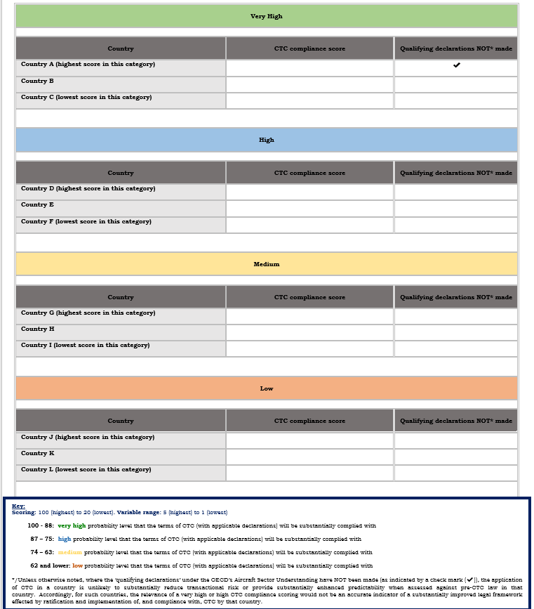
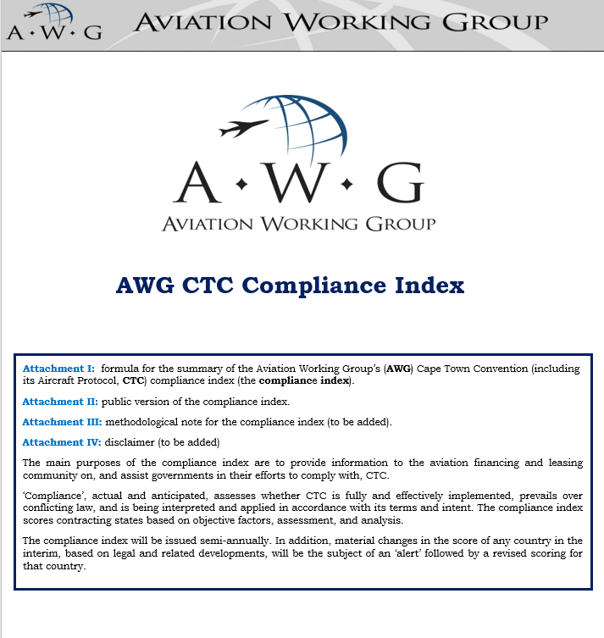
CTC compliance index [public version]
50
4

Slide 52
CTC compliance index template [proprietary version]
MADE QUALIFYING DECLARATIONS:
SCORE
CATEGORY
[SCORE]
VERY HIGH/HIGH/
MEDIUM/LOW
YES/NO
PRECEDENT-BASED ADJUSTMENT
(increasing the weight of variable B, and decreasing the weights of variables E and F, at levels I, II, or III* based on the predictive value of court cases or reported administrative action)
VARIABLE RESULTS BREAKDOWN
YES – level [I][II][III]/NO
[A] [B] [C] [D]** [E] [F]
Select explanatory comments:
Practical actions that increase would score:
51
*/ Level I corresponds to a lower predictive value; Level II corresponds to a medium predictive value; Level III corresponds to a higher predictive value
Methodological note and disclaimer: Please read the linked*/ ‘methodological note’ and ‘disclaimer’. This index is a high level assessment with speculative and predictive features (including what courts or other authorities may or may not do, acting on correct or incorrect legal analysis or impacted by other factors) which are inherently uncertain, and, thus, should not be relied upon by any party.
Copyright: © Aviation Working Group. All rights are reserved. No part of this document may be reproduced, stored in any retrieval system, or transmitted, in any form or by any means, with the prior written approval of the Aviation Working Group.

Slide 53
Cape Town Convention (CTC) Compliance Index
Main elements include whether the Treaty (1) is Fully and Effectively Implemented, (2) Prevails over Conflicting Law, and (3) is being Interpreted and Applied in accordance with its Terms and Intent
Scheduled to go Live in Q4 2019 and Updated semi-annually thereafter
52

Slide 54

Donald G. Gray
Chair, Aviation & Aerospace Group
Blake, Cassels & Graydon LLP
199 Bay Street
Suite 4000, Commerce Court West
Toronto, Ontario M5L 1A9
Dir: 416-863-2750
Cell: 416-258-8385
Email: donald.gray@blakes.com
Aviation & Aerospace
The Leader in Canadian Aviation Law and Aircraft Financing
53
Doc ID. 23482708

