Slide 1
120 N. LaSalle Street, 31st Floor
Chicago, IL 60602
(312) 899-9090
Robert A. Clifford
rac@cliffordlaw.com

Slide 2
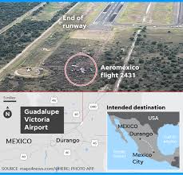
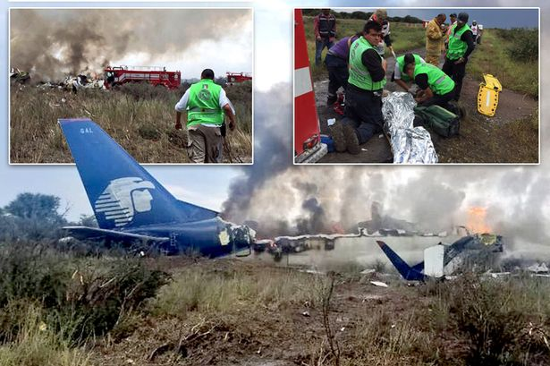
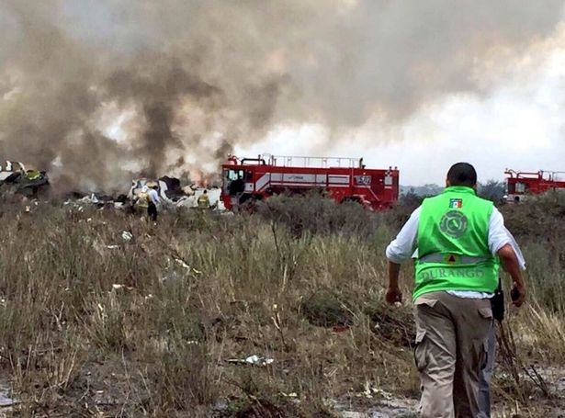
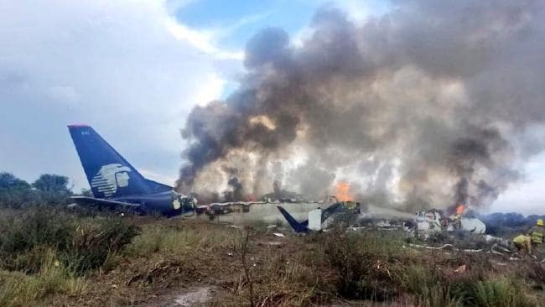
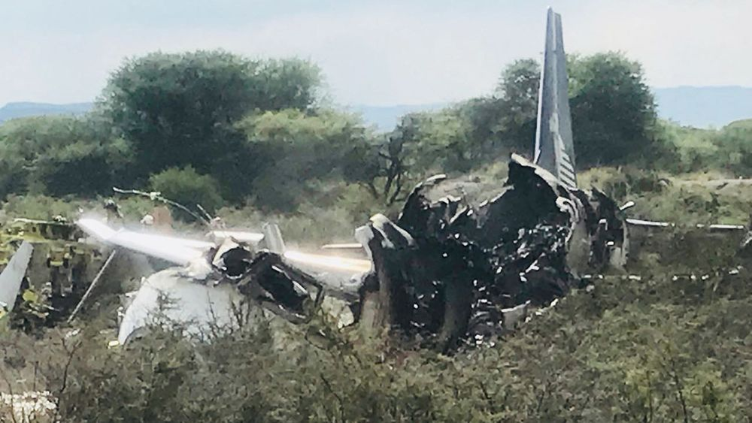
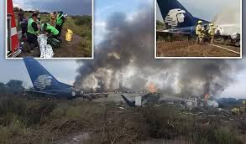
Aeromexico FLIGHT 2431

Slide 3
Aeromexico Flight 2431 Crash
Scheduled to fly from Durango to Mexico City on July 31, 2018 – Connecting flight for many passengers
Aircraft was an Embraer 190AR operated by Aeromexico Connect
103 people were onboard the aircraft
99 passengers and four flight crew
Pilots took off into a storm with rain, high winds, and hale.
Moments after takeoff the aircraft, passengers reported hearing two loud bangs, then the aircraft collided into the field about 1,000 feet off the runway.
The aircraft caught fire upon impact.
Luckily, all 103 people on board survived the crash, but many suffered severe injuries both from the impact and the fire.
What are they: Survivors; Victims; Walk-aways; and Limp-aways?

Slide 4
Issues For U.S. Counsel to Identify and Address
What cause of action can be pled?
If a passenger took the domestic flight as part of an overall international travel itinerary between two countries who are parties to the Montreal Convention, does the convention’s law apply?
Does the U.S. have jurisdiction for filing a Montreal Convention claim?
If the Montreal Convention confers jurisdiction in the United States and the case is filed in a state court, could it be removed to federal court?
How are damages assessed?

Slide 5
Montreal Convention
Limits air carriers’ liability for international flights, while also protecting the rights of passengers.
Provides the exclusive basis for a lawsuit against an air carrier for injuries arising out of international transportation.
Carrier is liable for damages sustained in case of death or bodily injury of a passenger during the flight or any operation during takeoff and landing.
121 Signatories in the Montreal Convention
120 Nations and the EU
Both the United States and Mexico are signatories.

Slide 6
Treaty’s Scope – International flights
Includes trips involving domestic flights within an international journey.
A passenger’s intent to enter into an agreement for international carriage is dispositive in determining whether a domestic flight is part of an international trip.
Five relevant factors:
Length of the layover
The itinerary
Electronic tickets
Boarding passes
Baggage tags
Application to Aeromexico Flight 2431
American passengers purchased roundtrip tickets from the U.S. to Mexico.
Flight 2431 was a leg of their international journey.
Thus, the Aeromexico crash would fall under the scope of the Montreal Convention.

Slide 7
Treaty’s Scope – Bodily Injury
Three Elements:
Occurrence of an incident within the meaning of the Convention
Injury occurred on the airplane or while embarking or disembarking
Bodily injury was caused by the incident
Application to Aeromexico Flight 2431
The plane crash-landed within seconds after takeoff.
Many passengers suffered a range of bodily injuries.
Falls within the scope of the Montreal convention.

Slide 8
Jurisdiction
Five possible forums of jurisdiction:
Domicile of the carrier
Principal place of business of carrier
Place where the contract was made
The place of the destination
Principal and permanent residence of the passenger
Application to Aeromexico Flight 2431
For passenger flights, passengers form a contract with the carrier in the place where the ticket was purchased. U.S. passengers purchased their flights online in the United States.
Place of destination is determined by the final round trip destination. All U.S. passengers booked return flights to the United States.
A passenger’s principal and permanent residence is determined at the time of the crash. Additionally, the carrier must operate air carrier services within the United States.

Slide 9
Various Federal Issues
Neither the Seventh Circuit, nor the United States Supreme Court has directly addressed the issue of whether the Montreal Convention completely preempts all state law causes of action.
Most Illinois courts view the Montreal Convention as an affirmative defense to limit carrier liability, not complete preemption to a state law claim.
A minority of Illinois courts do find the Montreal Convention poses a federal question and thus completely preempts any state law claim.
Carriers are strictly liable for the first 113, 100 Special Drawing Rights, equal to $158,826 US dollars.
A carrier is capped at this amount if it proves the injury was not caused by its act or omission.
Unlimited liability if the injury was caused by its act or omission.
Article 17 of the Montreal Convention states a passenger cannot recover damages for mental anguish without bodily injury.
However, the Sixth Circuit recently loosened the interpretation, holding an air carrier could be liable for the fear of contagion, after a passenger pricked her finger on a hypodermic needle, even if the fear was not directly caused by the physical damage to her finger.

Slide 10
Solutions
File a Montreal Convention claim in either state or federal court.
A passenger on a domestic flight as part of an overall international flight itinerary still falls under the Montreal Convention.
Jurisdiction in a Montreal Convention claim is determined by one of five potential forums. Here, the place where the contract was made, the final roundtrip destination, and the principal place of residence of the passengers were all in Illinois, thus it would have jurisdiction. Further, Aeromexico does operate within the United States.
A majority of courts find the Montreal Convention does not fully preempt claims filed in state courts, but that it can serve as the basis for an affirmative defense limiting damages.
Montreal Convention holds air carriers strictly liable for damages, but caps it to 113,100 SDRs if the air carrier’s act or omissions did not cause the crash or a third-party is liable. There is no cap if the air carrier was negligent.

