Slide 1
Global Governance of Space Security: Challenges and Prospects
Dr. Rajeswari Pillai Rajagopalan
Senior Fellow and Head, Nuclear & Space Policy Initiative
Observer Research Foundation, New Delhi
Email: rpr@orfonline.org; rajeswarirajagopalan@gmail.com

Slide 2
Space Security Background
Considered threats of the future
In reality, clear and present danger today
No effective regime in place
No guidelines and norms
Urgent need to:
Define and communicate clear boundaries of acceptable behaviour
Develop norms of responsible behaviour
While working for more binding mechanisms

Slide 3
Space Security Challenges
Advanced military space programmes, including ASAT capabilities
No weapons in outer space yet; ground-based assets significant threat
Increasing space debris, risking civilian assets
Larger than 10 cm more than 21,000; between 1 and 10 cm approx. 500,000; smaller than 1 cm exceeds 100 million
Number and types of players gone up significantly
Total no. of satellites: 1459 (until Dec 2016); US: 593; China: 192; Russia: 135
Proliferation of small satellites – mini, micro and nano satellites
Large number of state and non-state players; difficulty of detection of small sats
Unregulated regional and international space cooperation
Diverting capabilities for mil space prog; development of ballistic missiles
State of the regime
Lack of consensus among major powers

Slide 4
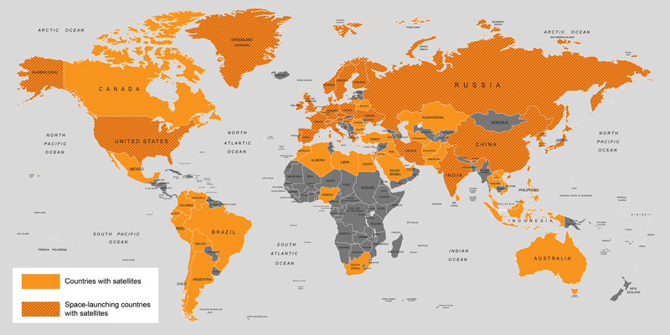
2016: UCS Database

Slide 5
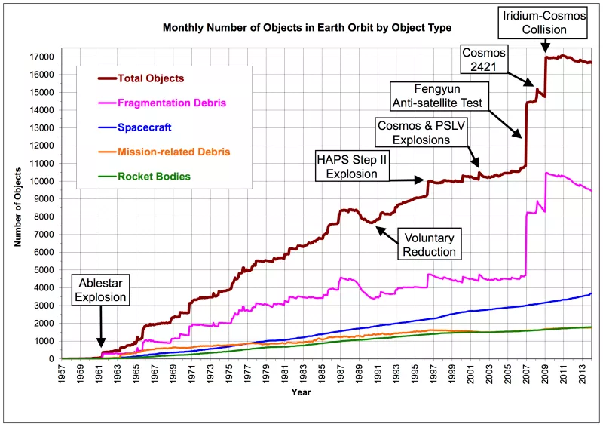

Slide 6
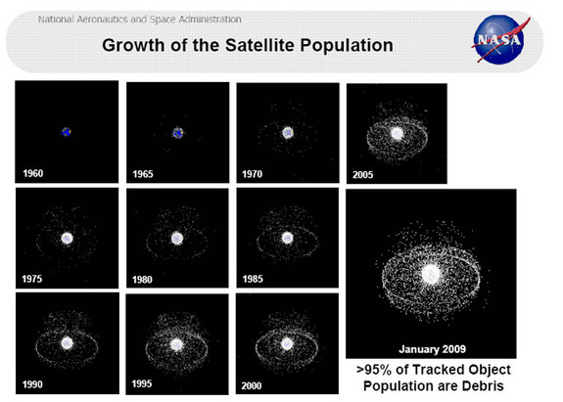

Slide 7
An Effective Outer Space Regime should…
Ensuring security of space
Preventing danger or threat to outer space utility
Ensuring order and stability
Freedom of action in outer space – no adverse effects
Ensuring sustainability
For peaceful purposes and ensuring outer space remains clean and sustainable
Accepted by most states, at least in rhetoric
State of the Int’l Space Regime
Lack of consensus among the major powers to deal with the challenges ➔ contributing to slow development of space norms

Slide 8
Several difficulties…
Changing balance of power equations
Relative decline of the US
Rise of the rest
Increasing emphasis on hard power particularly in Asia
Two opposing camps among major powers and crisis in decision-making – hampered by political hindrances
Technology proliferation
No more controlled by two or three states
Inherent interest to control technology
So we need to work on what is feasible than what is desirable and ideal

Slide 9
Norms and TCBMs
New rules of the road – essential for safe and continued access to space
Norms of responsible behaviour as the first step – draw clear red lines and establish basic parameters of responsible behaviour in outer space
No testing/ deployment of space weapons in outer space
Non-interference with peaceful activities of other states
Start with the least controversial and minimally acceptable set of measures (TCBMs, GGE, CoC)
Gradual progress toward more binding, legal, verifiable instruments
TCBMs good base for establishing greater trust between nations that might help in mitigating the political difficulties among states
Pre-launch notifications and high-risk re-entry events
Strengthen SSA cooperation
Definitional clarity

Slide 10
Why Norms and TCBMs
An intermediate step between a functional need and a binding instrument
An early place to get all sides talking and build up confidence in each other and momentum
Institutionalize best practices
Can eventually lead to more binding measures
No guarantee for responsible behaviour, international peer pressure to abide by commitments
A risk-reduction measure, basis for greater understanding and dialogue among states, a pre-requisite for addressing political challenges

Slide 11
Why Code as A TCBM?
Two key arguments:
Why should states adopt and institutionalize code with no enforcement element? Does a code beef up state security in significant terms?
These principles exist in various forms
National policies; statements in Parliament; CBMs
Codifying these principles in one instrument will bring greater cohesiveness
Endorsement of such a document by a large number of states significant
Pragmatically, a code could articulate…
Avoid activities that lead to further debris creation while developing new technologies and means in the area of Active Debris Removal and On-Orbit Satellite Servicing
New area – need to discuss how these might be employed
Need to share broader space policies and strategies
Regulate space collaboration among states; regimes need to spell out rules of the game
Benefits regional and international security

Slide 12
We need to…
Strengthen SSA capabilities
Strengthen efforts at developing norms of responsible behaviour
Better space traffic management regulations
Efforts to stem weaponisation trends
Accelerate efforts on global governance

Slide 13
Concluding Thoughts…
Time for concerted action because:
Truly global commons; one state’s action can affect a large number of states
Debris does not make a differentiation between different space objects
Space a limited commodity - measures to strengthen sustainable use be pursued
Cross-domain nature of space and cyber – states need to invest in regional and global efforts to understand these environments on a real-time basis
Move past political differences to develop a space regime (TCBMs, GGE, CoC)
Inclusive process to bring all the different stakeholders to talk to each other
Developed through an inclusive process ensure greater acceptability and compliance, contribute to the longevity of instruments
National and global levels - Ensure participation of the new and upcoming

