Slide 1
Regulatory Uncertainty for Non-Traditional Commercial Space Activities
Dr. Michael C. Mineiro

Slide 2
International Legal Background

Slide 3
Article 6 of the 1967 Outer Space Treaty
“States Parties to the Treaty shall bear international responsibility for national activities in outer space, including the Moon and other celestial bodies, whether such activities are carried on by governmental agencies or by non-governmental entities, and for assuring that national activities are carried out in conformity with the provisions set forth in the present Treaty. The activities of non-governmental entities in outer space, including the Moon and other celestial bodies, shall require authorization and continuing supervision by the appropriate State Party to the Treaty.”

Slide 4
International Responsibility
The general principle, drawn from State practice and international judicial decisions, is that the conduct of a person or group of persons not acting on behalf of the State is not considered as an act of the State under international law.
Under the Outer Space Treaty (“Treaty”), a special rule (“lex specialis”) is established under which the conduct of non-governmental entities are considered an act of the State; at least “to the extent” such activities are national activities.

Slide 5
Case Study – US Regulatory REgime

Slide 6
Sufficiency of U.S. Domestic Regulatory Regime
Three parties to consider when evaluating the sufficiency of a domestic regulatory regime implementing Article VI’s non-governmental entity authorization and supervision requirement:
Third-Party States,
State(s) responsible, and
The non-governmental entity.

Slide 7
US Domestic Regulatory Gap
Existing Regime:
NOAA licenses private remote sensing space systems,
FCC licenses the operation of space stations that transmit radio signals, and
FAA licenses the operation of launch and re-entry vehicles and sites.
Non-traditional space activities (e.g. on-orbit servicing, space-to-space for-profit remote sensing, in-situ celestial resource extraction)
Practical Concerns:
Article 6 Auth & Supervision Obligation
Exposure to International Liability
State Practice – Setting Precedent
Negatively Impacting the Private Sector

Slide 8
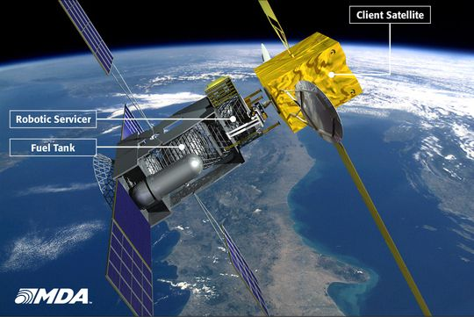
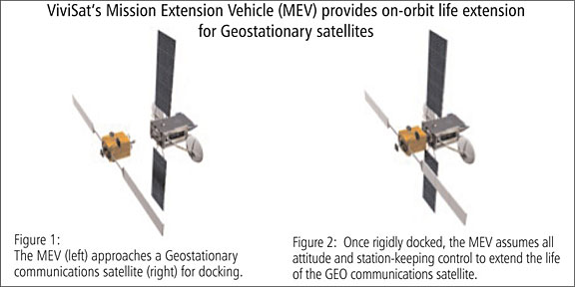
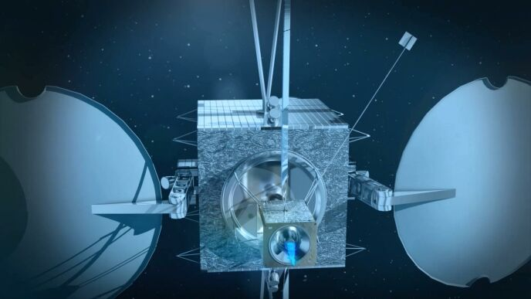

Slide 9
Example: Current U.S. Law and Regulation
No clear legal or regulatory authority to authorize and supervise U.S. private space-based on-orbit remote sensing (ORS) systems.
NOAA
FAA
FCC

Slide 10
Conclusions
Current regulatory regime does not provide for mechanisms to authorize or supervise novel on-orbit activities – like those currently being developed by the U.S. private sector.
The United States needs to reform its domestic regulatory regime to effectuate authorization and supervision of these novel non-governmental activities.
The United States should begin to socialize internationally the challenges it faces in its domestic regulatory regime and facilitate the sharing of domestic regulatory authorization and supervision best practices.

