Slide 1
The Role of COPUOS in Fostering the Safety, Security and Sustainability of Outer Space Activities
(Theme: Pillar on Space Diplomacy)
David Kendall
Chair UN COPUOS – 2016-17
2017 Manfred Lachs Conference
Panel: "Pillars for Global Governance of Outer Space Activities in the 21 Century"
5 May 2017

Slide 2
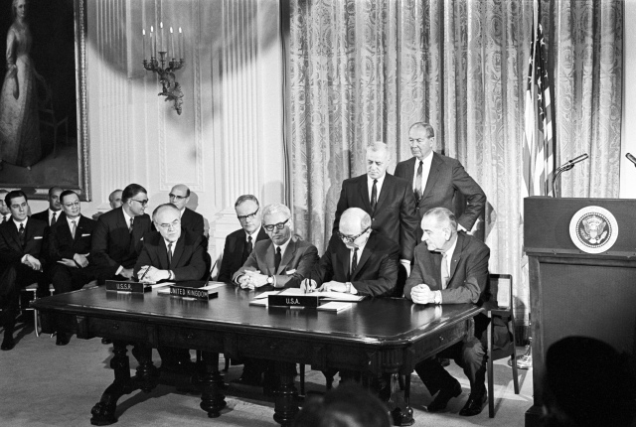
Signing of the Outer Space Treaty, 27 January 1967 in Washington, DC, USA
Soviet Ambassador Anatoly F. Dobrynin, UK Ambassador Sir Patrick Dean, US Ambassador Arthur J. Goldberg, US Secretary of State Dean Rusk, and US President Lyndon B. Johnson (source: UNOOSA)

Slide 3
Basic Facts
The full name of the Outer Space Treaty is: Treaty on Principles Governing the Activities of States in the Exploration and Use of Outer Space, including the Moon and Other Celestial Bodies.
The OST was opened for signature in the United States, the United Kingdom, and the Soviet Union on 27 January 1967, and entered into force on 10 October 1967.
The OST contains 17 Articles.
28 states members of UN COPOUOS negotiated the treaty.
62 states were original signatories.
The Committee currently comprises 84 States Members and 30 Permanent Observers (2016).
As of January 2017, 105 countries are parties to the treaty and 24 have signed the treaty but have not completed ratification.
Four other space treaties expand, refine and clarify provisions of the OST.

Slide 4
Some Highlights (Principles)
The exploration and use of outer space shall be carried out for the benefit and in the interests of all countries and shall be the province of all mankind. (sustainability)
Outer space shall be free for exploration and use by all States. (sustainability)
Outer space is not subject to national appropriation by claim of sovereignty, by means of use or occupation, or by any other means. (sustainability)
States shall not place nuclear weapons or other weapons of mass destruction in orbit or on celestial bodies or station them in outer space in any other manner. (safety, security)
The Moon and other celestial bodies shall be used exclusively for peaceful purposes. (sustainability)
Astronauts shall be regarded as the envoys of mankind. (safety, security)
States shall be responsible for national space activities whether carried out by governmental or non-governmental activities. (safety, security)
States shall be liable for damage caused by their space objects. (safety, security, sustainability)
States shall avoid harmful contamination of space and celestial bodies. (sustainability)

Slide 5
Current Situation
The OST over the past 50 years has been remarkably resilient and successful.
Current space activities, including, inter alia, advances in science and technology, the increased number of actors including developing countries, investments and initiatives by the private sector, geopolitical issues, weaponization, are opening questions on the provisions and intent of some of the articles.
The OST is primarily about safegarding outer space for all humanity, in the interests of all countries and ensuring free access (Article I). (challenges include: space debris, crowding of geostationary orbits)
Article II relating to national appropriation is being interpreted in multiple ways. (space resource extraction, exploration)
Article III deals with maintaining intn’l peace and security and promoting intn’l cooperation and understanding. (geopolitics)
Article IV deals with the placement of weapons of mass destruction in space and establishment of military bases. (weaponization)

Slide 6
COPUOS Initiatives
COPUOS is taking several steps relating to the current issues facing the OST and related treaties, including:
Encouraging states to become adherents to the OST;
Studying gaps and recommending solutions: e.g., WG of LSC on Status and Applications of the five UN Treaties on Outer Space;
Fostering open dialogue and transparency to build confidence through agenda items, Workshops, Symposia, etc. at the Committee and Sub-committees: e.g., LSC 2017 Symposium on Space Resources;
Developing guidelines and best practices through non-binding instruments: e.g., Guidelines on Space Debris Mitigation, WG of STSC on Long-Term Sustainability of Outer Space Activities;
Developing new agenda items for the Committee – UNISPACE+50: e.g., Thematic Priority 2 on “Legal regime of outer space and global space governance: current and future prospectives”.

Slide 7
CONCLUSION
The Outer Space Treaty has been a remarkable agreement ensuring a relatively harmonious space environment for 50 years in spite of geopolitical tensions, the many advances in science and technology and the utilization of space for purposes not envisioned in 1967.
Issues relating to safety, security and sustainability of outer space have gained momentum over the past several years opening up questions as to interpretations of some articles and lacunae in the treaty.
COPUOS has initiated new initiatives in relation to space governance to partially address those issues related to peaceful purposes of outer space.
UNISPACE+50 will provide an opportunity to focus the COPUOS agenda to address current challenges and the changing nature of space, including issues related to global space governance and the OST.

