Slide 1
Manfred Lachs International Conference on Conflicts in Space and the Rule of Law
SPACE SECURITY AND CYBERSECURITY:
INTERSECTING CHALLENGES
Deborah Housen-Couriel, 28.5.2016

Slide 3
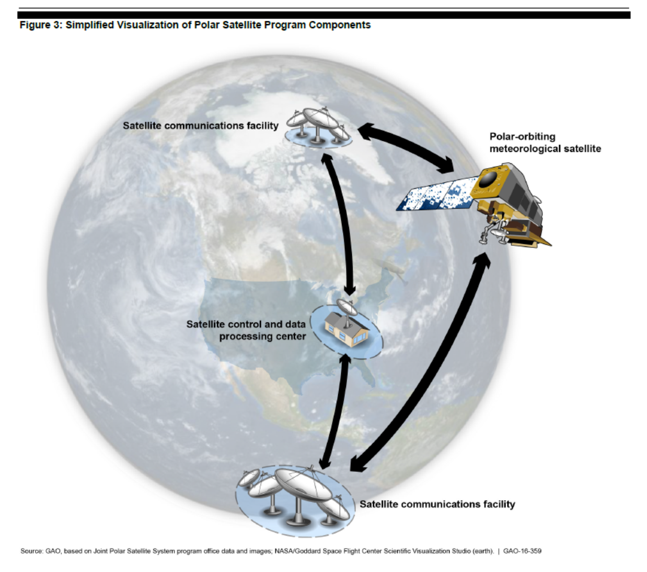


JOINT POLAR SS: HOSTILE CYBER OPERATIONS AGAINST SPACE AND GROUND SEGMENTS (May 2016)

Slide 4
NOT NEW – SOME EXAMPLES
1998 ROSAT command-and-control system failure
1997 until present - Turla internet connection hacking group
2007-8 Landsat and Terra AM-1 hacks
alleged interference in the summer of 2015 with Globalstar’s asset-tracking systems (+ SK fishermen)
Ongoing NASA hacks

Slide 5
CYBER-ENABLED DISRUPTIONS
(via EM SPECTRUM)
JAMMING
MORPHING
HIJACKING TT&C >> COLLISION
‘GRILLING’
TURLA-TYPE
SIGNAL RE-ROUTING

Slide 6
HARMFUL DISRUPTION OF satCOmm
Physical, cyber-enabled and hybrid disturbance to satellites and satellite communications, originating in a hostile intent to disrupt, damage or otherwise disturb their uninterrupted flow.
HD constitutes “harmful interference” under ITU Constitution and RR
also under Article 9 of the OST

Slide 7
VULNERABILITY TO HOSTILE DISRUPTIONS THROUGHOUT THE SATELLITE LIFESPAN
Pre-launch and launch
TT&C
Physical destruction or disabling
Disruption of transmissions- full taxonomy
End-of-life events, “crashes”

Slide 8
“Because of the criticality of satellite data to weather forecasting, the possibility of a satellite data gap, and the potential impact of a gap on the health and safety of the U.S. population and economy, we added this issue to GAO’s High Risk List in 2013 and it remained on the list in 2015.”

Slide 9
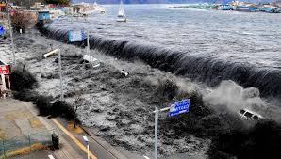
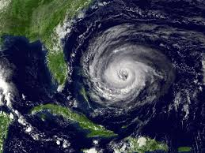
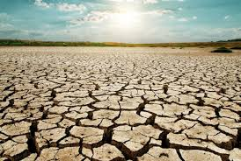
EXTRAPOLATING > LOSS-OF-LIFE SCENARIOS
Notes:
Extrapolate
Reminding us of recent cyber attacks on German nuclear plant and Ukraine electric grid – other crit infrastructure
Even NPT monitoring could be threat of loss of life scenario
Avionisc
Satellites / ground stations not necessarily considered critical infrastructure – they may be – they may not be

Slide 10
WHAT IS NEW: THE GROWING CRITICALITY AND URGENCY OF THE PROBLEM
COLLECTIVE SECURITY ISSUES
‘PEACEFUL USE’ ISSUES
SPACE SECURITY
(LAW, POLICY, GOVERNANCE)
CYBERSECURITY (EMERGING LEGAL NORMS, POLICY)
CONCEPTUAL / NORMATIVE ISSUES
LIABILITY ISSUES
STATE PRACTICE
KINETIC - VIRTUAL - HYBRID OPERATIONS IMPACT ON SATELLITE CONTROL OF CRITICAL INFRASTRUCTURE

Slide 11
WE’LL LOOK AT 3 CORE ISSUES
1
THE CURRENT NORMATIVE AMBIGUITY AT THE NEXUS OF SPACE SECURITY AND CYBERSECURITY
2
AT WHAT THRESHOLDS DO HD’s = AN ILLEGAL USE OF FORCE IN SPACE AND CYBERSPACE?
3
HOW IS THE INTERNATIONAL LEGAL COMMUNITY MEETING THIS CHALLENGE AT THE INTERSECTION OF THE TWO REGIMES?

Slide 12
2 MORE CHALLENGES
Proxy conflicts in space and cyberspace – the growing non-state actor phenomenon
Data (transmissions)
  an object capable of being targeted
  property
  subject to sovereignty?

Slide 13
THE CONTEXT: GROWING MILITARIZATION IN BOTH DOMAINS
ASSYMETRICAL THREAT LANDSCAPE
CHANGING ACTORS / STAKEHOLDERS
LACK OF NAT’L POLICY TRANSPARENCY
DUAL-USE TECHNOLOGIES
BLURRED LINES b/w OFFENSE / DEFENSE
LACK OF EFFECTIVE INTN’L COOPERATION

Slide 14
INCREASED MILITARIZATION
AND CONFLICT RISK
* INADEQUATE INTER-GOV PROCESSES
NORMATIVE AMBIGUITY re STATE / NON-STATE ACTIVITIES IN OS AND CYBERSPACE

Slide 15
*SPACE GGE + CYBER GGE
2013
2015

Slide 16
HOSTILE DISRUPTIONS UNDER SPACE LAW
OST- international law and UN collective security specifically applies - § 1bis, 3
  States …shall carry on activities in the exploration and use of outer space…in accordance with international law, including the Charter of the United Nations…
Peaceful use principle - § 4 OST
  No WMD, UN work guided by PAROS
Harmful interference prohibited
  § 9 OST / § 45 ITU / § requirement to identify and no superfluous or misleading sigals
Liability for damage to satellite transmissions - § 7 OST and Convention
Notes:
prevention of an arms race in outer space

Slide 17
LIABILITY CONVENTION - § 2- 6
§ 1 - "damage" : “… [the] loss of life, personal injury or other impairment of health; or loss of or damage to property of States or of persons, natural or juridical, or property of international intergovernmental organizations

Slide 18
NORMATIVE CHALLENGES
TERMINOLOGY- where’s space / what’s a space object?
  Joseph Pelton’s “protozone”
  Tomasso Sgobba’s delimitation of “space” areas
SETTING THE THRESHOLD FOR HD CONSTITUTING A VIOLATION OF INTERNATIONAL LAW
ATTRIBUTION
  - partially technical
LIABILITY, STATE RESPONSIBILITY AND ENFORCEMENT
  – discussed yesterday

Slide 19
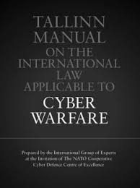
NASCENT CYBERSECURITY NORMS

Slide 20
“CYBER OPERATION”
The employment of cyber capabilities with the primary purpose of achieving objectives in or by the use of cyberspace.

Slide 21
“CYBER ATTACK”
RULE 30
A cyber attack is a cyber operation, whether offensive or defensive, that is reasonably expected to cause injury or death to persons or damage or destruction to objects.

Slide 22
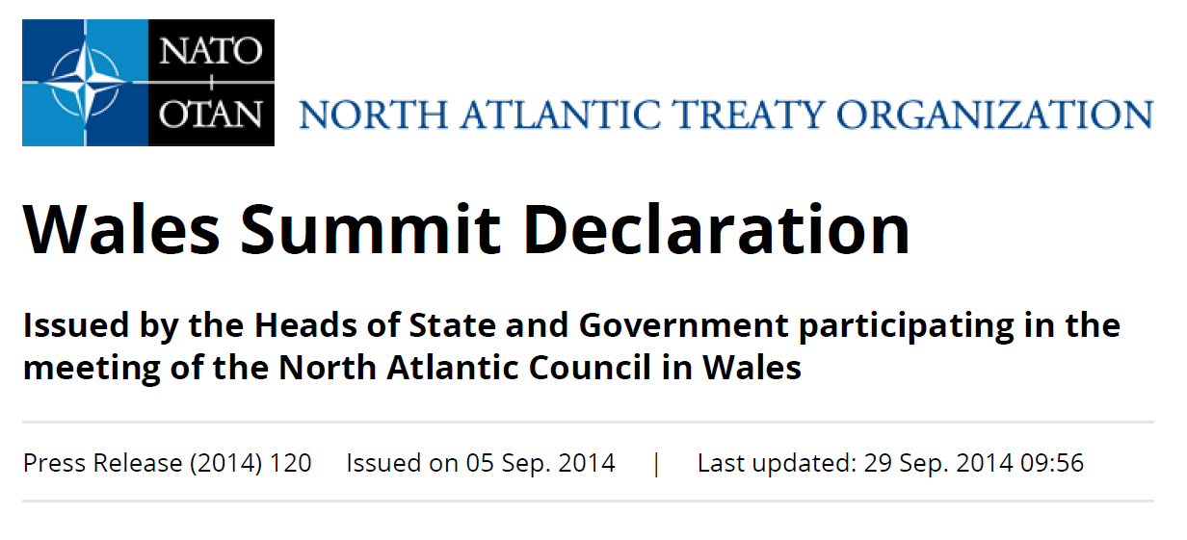
2014
72. Our policy also recognises that international law, including international humanitarian law and the UN Charter, applies in cyberspace. ..We affirm therefore that cyber defence is part of NATO's core task of collective defence.
> A decision as to when a cyber attack would lead to the invocation of Article 5 would be taken…on a case-by-case basis.

Slide 23
RULE 11
A cyber operation constitutes a use of force when its scale and effects are comparable to non-cyber operations rising to the level of a use of force.
(ICJ Nicaragua 1986)
RULE 13
A State that is the target of a cyber operation that rises to the level of an armed attack may exercise its inherent right of self-defense.
(Stuxnet 2010, Ukraine electrical grid 2016, Germany nuclear plant 2016)

Slide 24
51
Nothing in the present Charter shall impair the inherent right of individual or collective self-defense if an armed attack occurs against a Member of the UN, until the Security Council has taken measures necessary to maintain international peace and security.

Slide 25
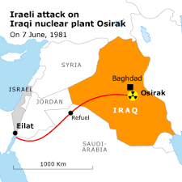

Slide 26
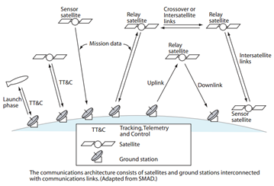
HARMFUL DISRUPTION VULNERABILITIES

Slide 27
GGE SPACE
2013
SHANGHAI
PPWT
June 2014 (rev)
EU
CODE OF CONDUCT
March 2014 (rev)
GGE CYBER 2015
SHANGHAI CODE OF CONDUCT
January 2015 (rev)
EU / CoE
Network Security Directive, 2013
Budapest Convention, 2001
Other initiatives:
Canada Proposal, CD, June 2009; ITU-R; UNGA 69/32, 2014; Working Group on 5 Treaties, 2016
Other initiatives:
Tallinn Manuals 1 & 2
SUBSTANTIVE NORMS
Notes:
Inside and outside of UN frameworks
New blocs
Revised versions

Slide 28
NORMATIVE CHALLENGES IN OS and CS
attribution
thresholds
non-state actors
basic definitional constructs
commercialization
dual use

Slide 29
SUMMING UP
HD to satellite transmissions constitute real threats and challenges, with significant ramifications for collective security
These challenges intersect because satellite communications are cyber operations
Beyond operative issues, there are important normative overlaps
Yet in both domains, normative ambiguity prevails
While there’s some intergov’t progress re admin measures – TCBMs, BPs (GGE’s)…

Slide 30
1
Insufficient awareness of the operational and normative overlaps
2
State practice is neither explicit nor transparent
3
The necessary conversation between these 2 legal regimes has yet to begin

Slide 31
NEXT STEPS: WHAT’S TO DONE AND WHO SHOULD DO IT?
CRITICAL CHALLENGES FOR LEGAL AND POLICY COMMUNITIES
CONSIDER HOW TO MOVE JOINTLY
FROM TCBMs TO SUBSTANTIVE
NORMS
AS NORMATIVE WORK IS ONGOING – IDENTIFY AND SHARE BEST PRACTICES (ENCRYPTION)
MERGE WORK PROCESSES OF RELEVANT INTER-GOV’T INITIATIVES (CO-COMMITTEES, CONFERENCES)
Notes:
Paralllells with the challenges that Sgobba described re global space traffic management – no one wants to discuss jurisdictional issues because they want to maintain freedom of action

Slide 32
THANK YOU.

