Slide 1
Uni 101: Course Registration
April Calo
Student Life Associate
Daria Lisus
Undergraduate Programs Assistant
Summer 2022

Slide 2
Land Acknowledgment
15th Annual McGill Pow Wow
©Joshua De Costa
McGill University is located on unceded land which has long served as a site of meeting and exchange amongst Indigenous peoples, including the Haudenosaunee (hoe-dee-no-SHOW-nee) and Anishinabeg (uh-NISH-ih-NAH-bay) nations. McGill honours, recognizes, and respects these nations as the traditional stewards of the lands and waters on which we meet today.
McGill Indigenous Initiatives website: https://www.mcgill.ca/indigenous/
Native Land Digital: https://native-land.ca/

Slide 3
Zoom Etiquette
The slides from this presentation will be shared with you
Please save your questions for the end of the session

Slide 4
McGill PRO Schedule
May 24th – 29th | May 30th–June 3rd | June 6th–10th | June 14th –16th
University 101: Course Registration | Faculty-Specific Sessions OSD Advising Info Session (May 31st) English Placement Test (May 31st) French Placement Tests (June 1st & 2nd) | Faculty-Specific Sessions English Placement Test (June 6th & 8th) OSD Advising Info Session (June 8th) | U0 registration opens (June 13th, 16th & 17th)

Slide 5
When to Register
June 6th: CEGEP Scholarship Recipients​
June 8th: CEGEP students ​
June 13th: U1 Scholarship Students​
June 15th: All U1 Students​
Minerva opens at 9:00 a.m. EDT on the first day and then is open 24/7​
May be difficult to log in during the first hour​
Don’t worry. Keep trying! Refresh ☺​
Register for one class by the deadline of August 14 to avoid a late fee​

Slide 6
Today’s Topics
Understanding Your Program Structure
eCalendar: How to Look for Courses
How to Build a Class Schedule
How to Register for Courses

Slide 7
Understanding Your Program

Slide 8
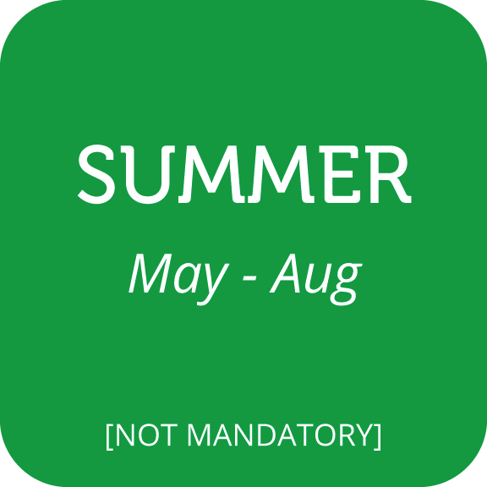
McGill Academic Year
Fall Classes Start: August 31, 2022
Add/drop deadline: September 13, 2022
Fall Reading Break: October 11 & 12, 2022
Winter Classes Start: January 4, 2023
Add/drop deadline: January 17, 2023
Reading Week: February 27–March 3, 2023

Slide 9
Faculties, Schools, and Departments

Slide 10
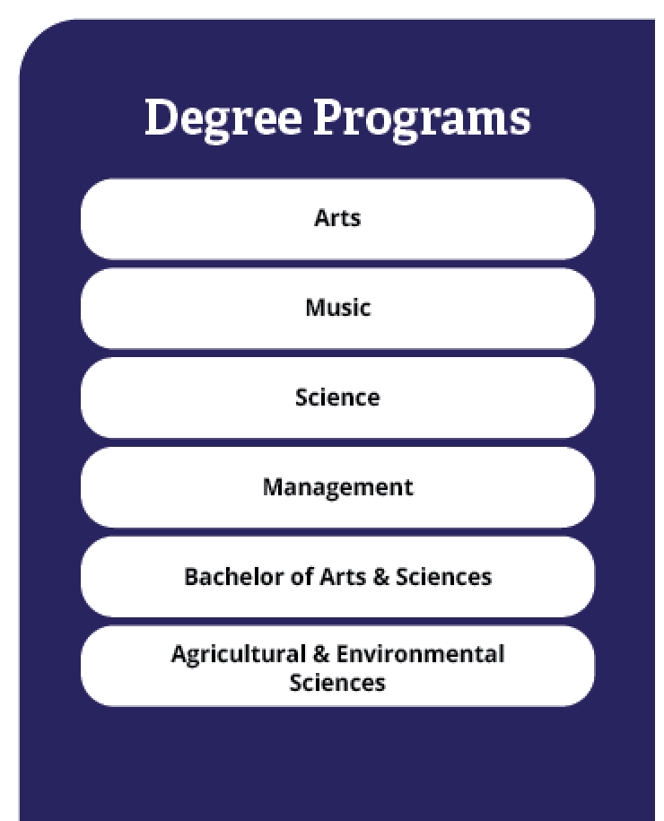
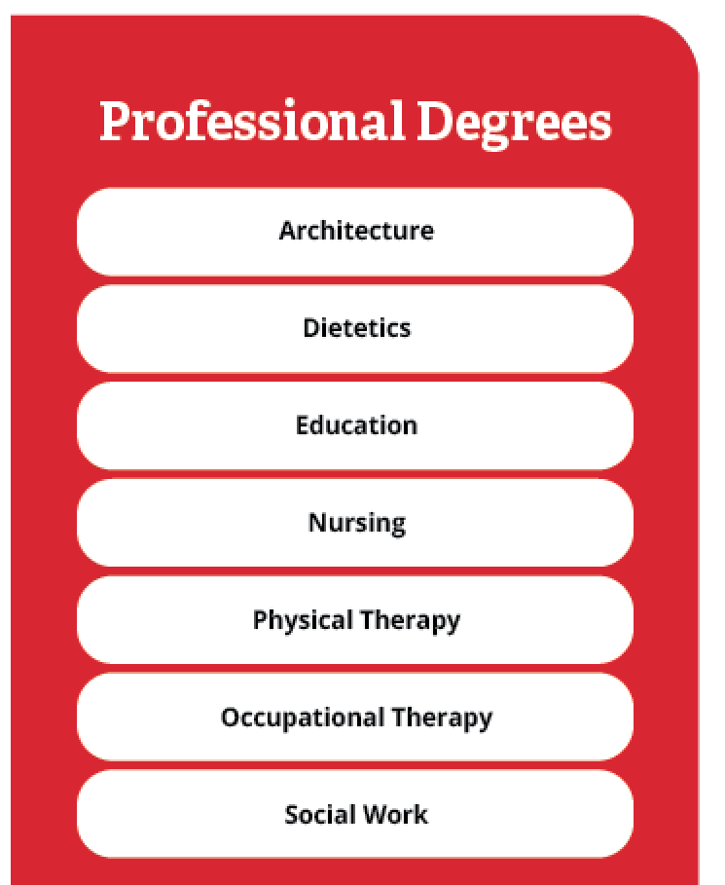
Degree vs. Professional Programs

Slide 11
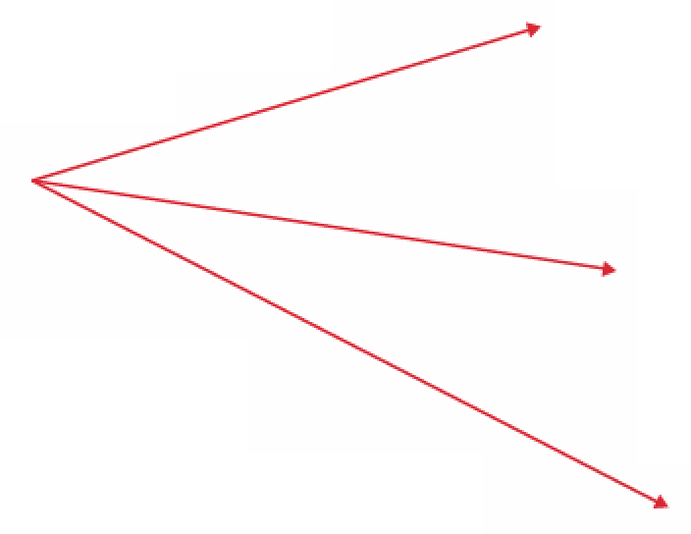
Schools vs. Faculties

Slide 12
POLL
Which faculty are you in?

Slide 13
Am I a U0 or U1 student?
I do not have any advanced standing credit.
I have completed fewer than 24 credits of advanced standing.
I have completed 24 credits or more of advanced standing.
You are a U0 student. (120-credit degree, incl. 30-credit freshman program, graduate in 4 years) However, you may be exempted from some freshman program courses, which may enable you to take a lighter course load and/or graduate early.
You are a U1 student. You will complete a 90-credit degree, typically in 3 years. However, you are NOT automatically exempt from all of the freshman program courses. You may be required to complete some freshman courses, so it may take 3.5 or 4 years to complete your degree.
You are a U0 student. You will complete a 120-credit degree, including a 30-credit freshman program. Your degree is designed to be completed in 4 years.
Transfer credit & advanced standing website: https://www.mcgill.ca/transfercredit/prospective

Slide 14
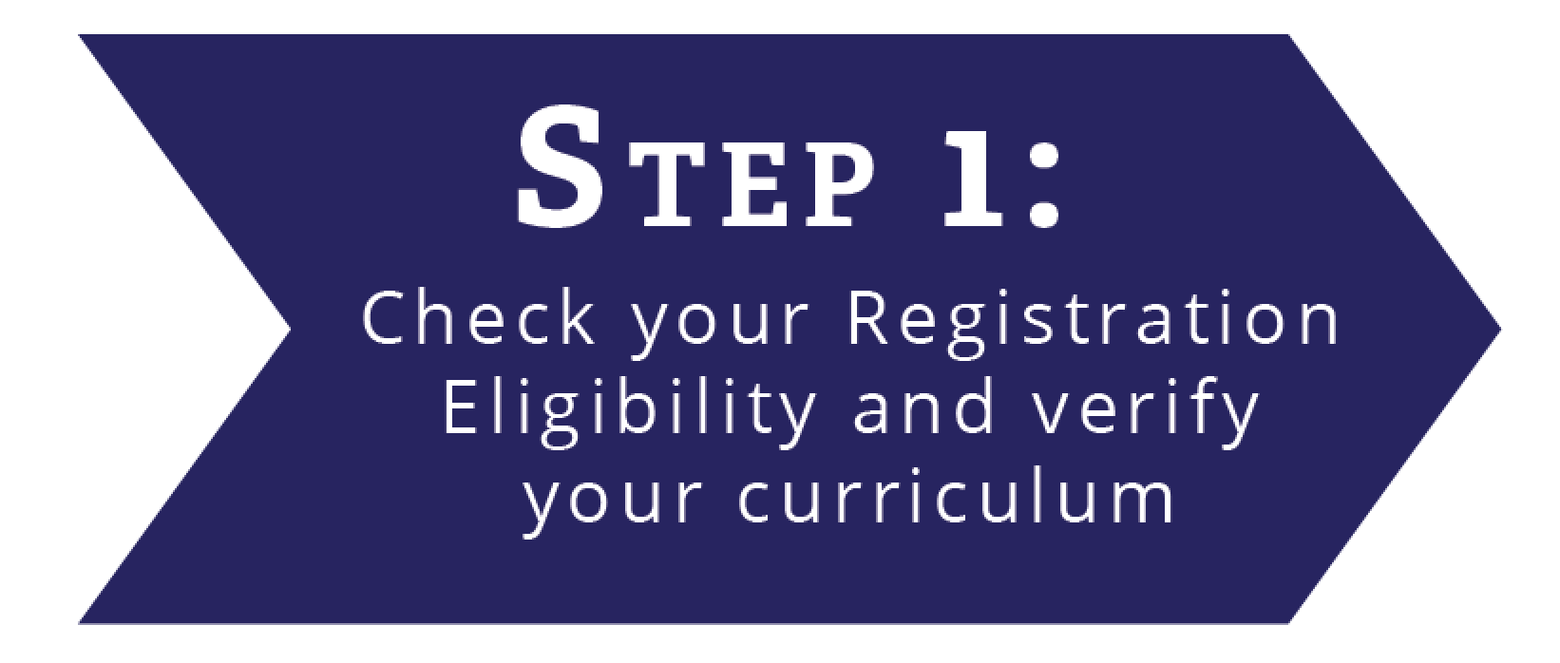
Newly Admitted Student
If you are unsure, Verify on Minerva by following the steps below:
Minerva will show that you need to complete 120 credits until McGill receives proof of your advanced standing. Once they receive proof, your status will be updated to U1. Keep in mind that in some cases, your U1 status may not be updated until after course registration begins.

Slide 15
The 90-Credit Degree
90 credits ÷ 3 years
= 30 credits per year
U1
U2
U3
30 credits
÷ 2 semesters
= 15 credits per
semester
Fall
Winter
15 credits ÷ 3 credits per class = 5 classes per semester

Slide 16
Course Load
Normal Course Load
15 credits ÷ *3 credits per class = 5 classes per semester
Part-time Student
Fewer than 12 credits
Affects:
student loans,
scholarships,
study permit/CAQ,
employment on campus,
access to services
May require Faculty Approval to be a part-time student
(e.g. Education)
Full-time Student
12 credits ÷ *3 credits per class = 4 classes per semester
*While most classes are worth 3 credits, there are exceptions. Be sure to double check how many credits each class you are taking is worth.

Slide 17
Major, Minor, and Honours
Major: Primary area of study
Honours: Involves a higher degree of specialization
Has additional requirements, including GPA requirements
Minor: Area of secondary concentration
Note: In some faculties, you have already been admitted to a specific major (e.g. Engineering, Education, Music). In other faculties (e.g. Arts, Science, Management), you will typically declare your major in your second year.

Slide 18
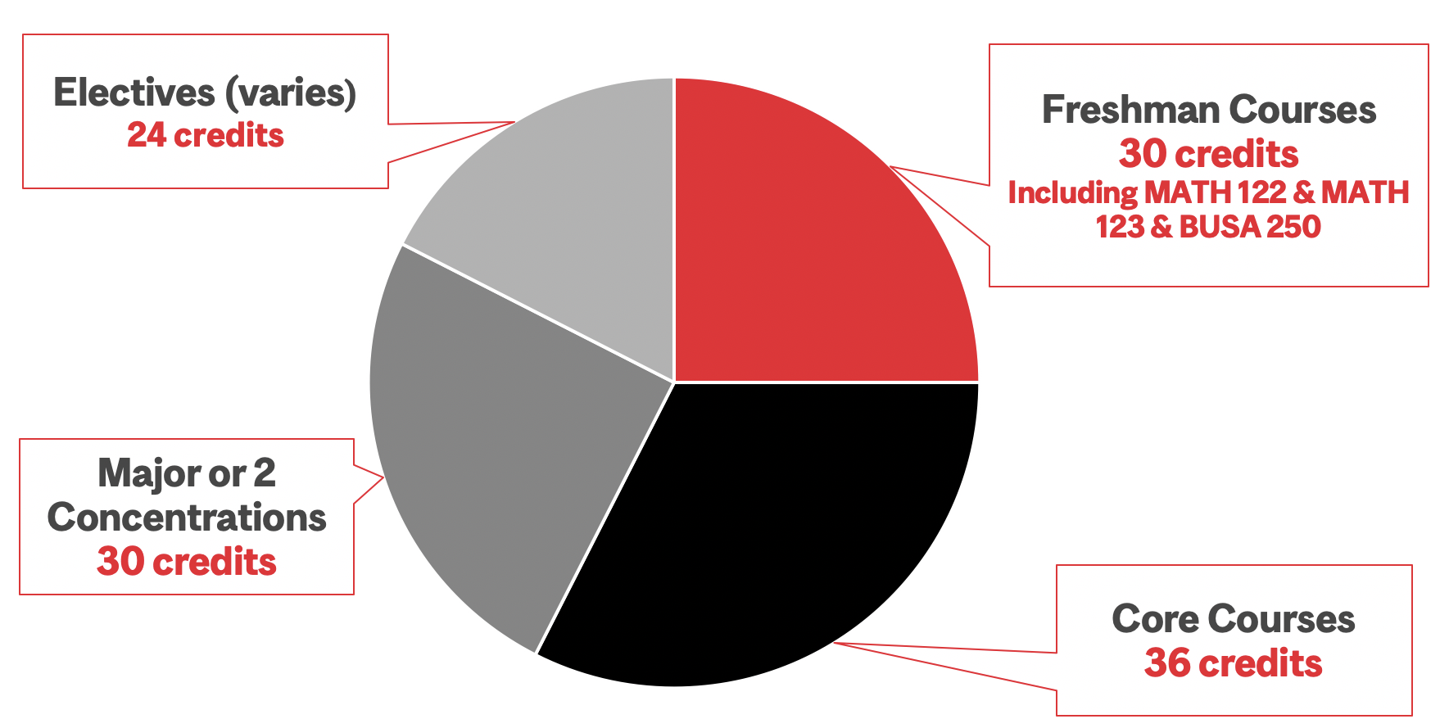
Building Your Degree 1
Example:
Faculty of Management
B.Com.
120 credits

Slide 19
Building Your Degree 2
Another example: Faculty of Arts – B.A. 120 credits
30-credit Freshman Program
+
90-credit Multi-Track System:
Options
A | Major Concentration (36) + Minor Concentration (18) + electives (36)
B | Major Concentration (36) + Major Concentration (36) + electives (18)
C | Major Concentration (36) + Minor Concentration (18) + Minor Concentration (18) + electives (18)

Slide 20
Courses
Major, Minor, Honours
Required Courses
All mandatory
Complementary Courses
Chosen from a specified list
Elective Courses
Do not count towards a major, minor, or honours

Slide 21
Types of Classes
Lecture
Conference
Tutorial
Lab
Class Size:
Large to Small
Seminar
Fieldwork/ internships

Slide 22
The Course Identifier
CHEM
110
General Chemistry 1
ABCD – Subject Code
Indicates the department/unit offering the course
123 – Course Number
Refers to the course itself, with the first numeral indicating the level of the course
The Alphabet – Course Name

Slide 23
Multi-Term Courses
Multi-term courses terminology
D1/D2: Courses taught in 2 consecutive terms
N1/N2: Courses taught in 2 non-consecutive terms
J1/J2/J3: Courses taught in 3 consecutive terms
Example:
FRSL 207D1 Elementary French 01 – offered in Fall 2022
FRSL 207D2 Elementary French 01 – offered in Winter 2023
Always be sure to read course descriptions carefully making sure to note those courses that are taught only in alternate years or those that require departmental approval.

Slide 24
eCalendar: How to Look for Courses

Slide 25
eCalendar
Here are some helpful websites for finding your courses:
The eCalendar: https://www.mcgill.ca/study/2022-2023/
The advanced standing/transfer credit website: https://www.mcgill.ca/transfercredit/prospective
The accepted students’ website: https://www.mcgill.ca/accepted/nextsteps/register

Slide 26
Building a Class Schedule

Slide 27
Designing Your Class Schedule
Option A: Visual Schedule Builder (VSB)
Adding classes to your VSB does not mean you are registered for them!
Registration is exclusively through Minerva
VSB is refreshed from Minerva only once each morning, be sure to check Class Schedule before registration for up-to-the-minute changes.
https://vsb.mcgill.ca/
Option B: Manual Search using Minerva Class Schedule

Slide 28
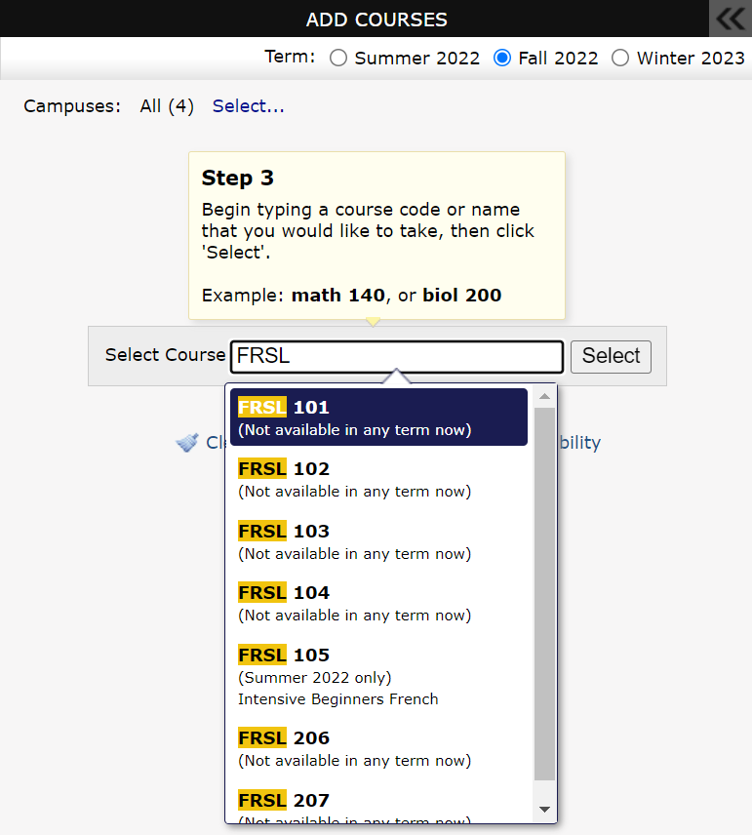
Planning Your Program (VSB)
Select term
Select your courses

Slide 29
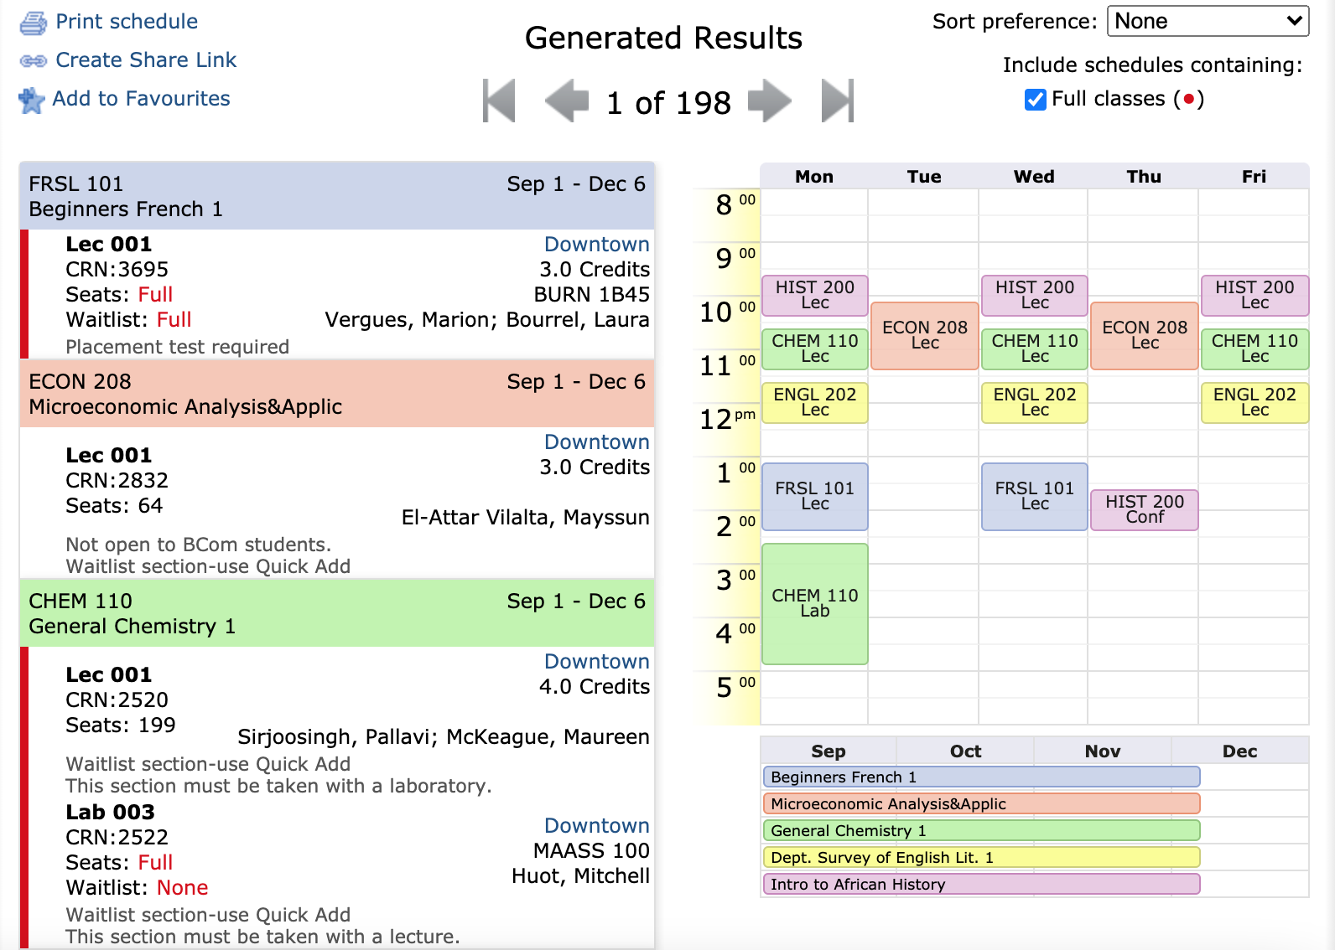
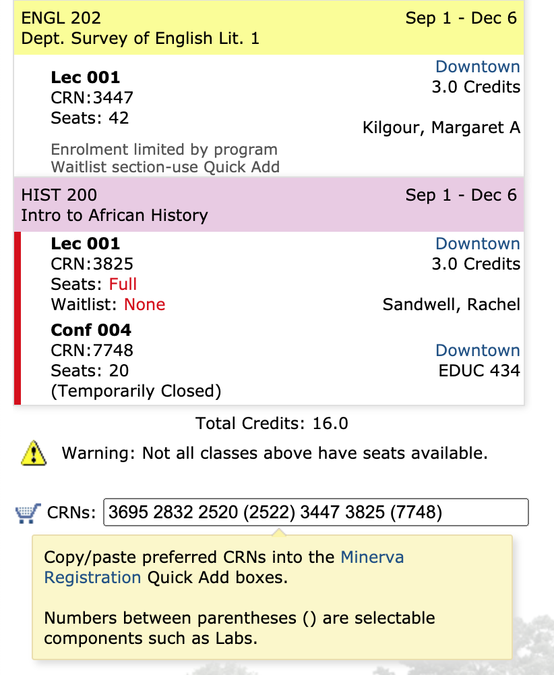
VSB Program Planning
View Alternate Schedules with these classes
All CRNs

Slide 30
Registering for Your First-Year Courses

Slide 31
Option A: VSB + Minerva “Quick Add”

Slide 32
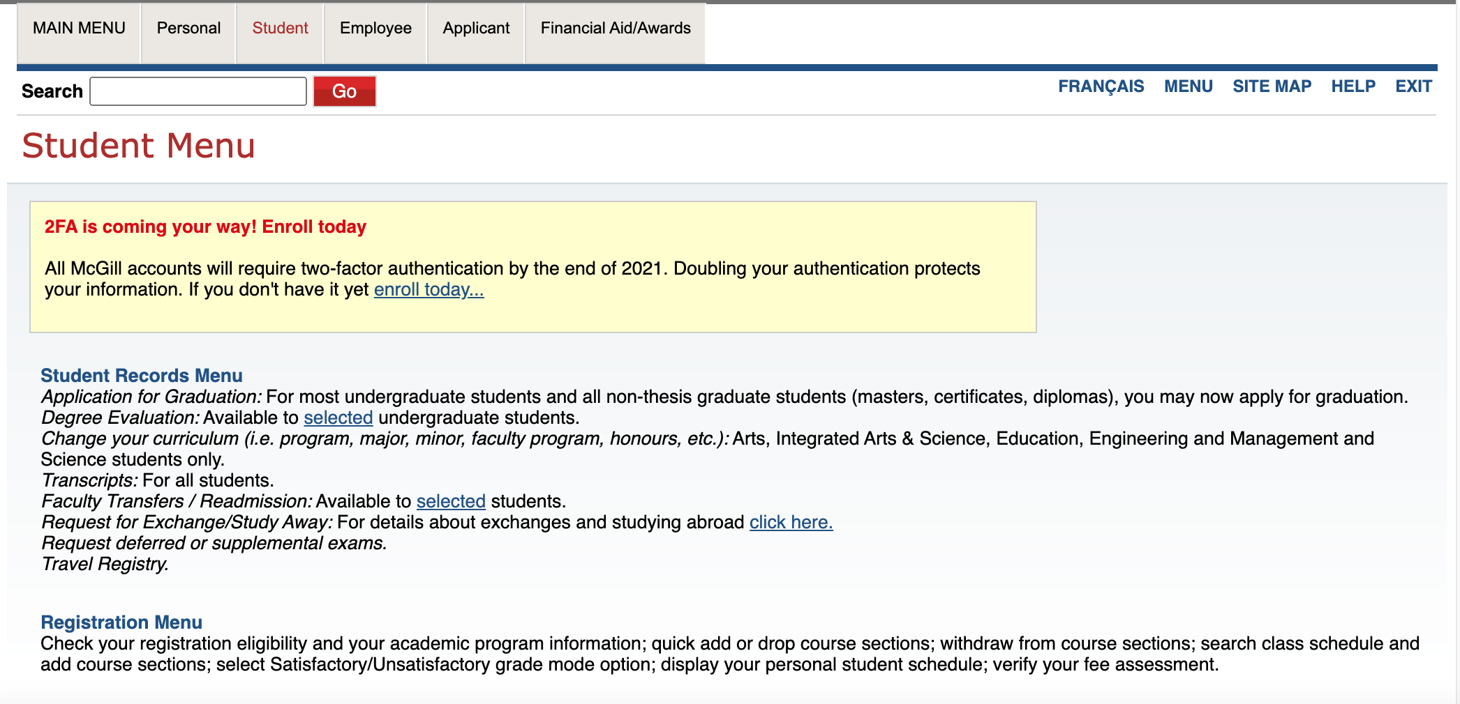
Option A: Registering for courses 1

Slide 33
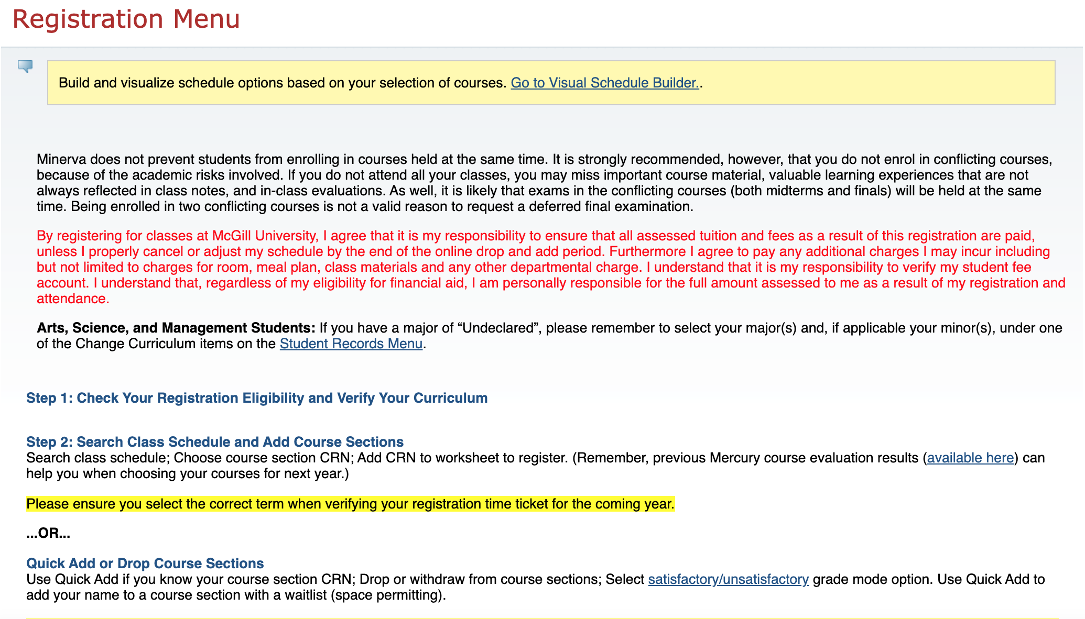
Option A: Registering for courses 2

Slide 34
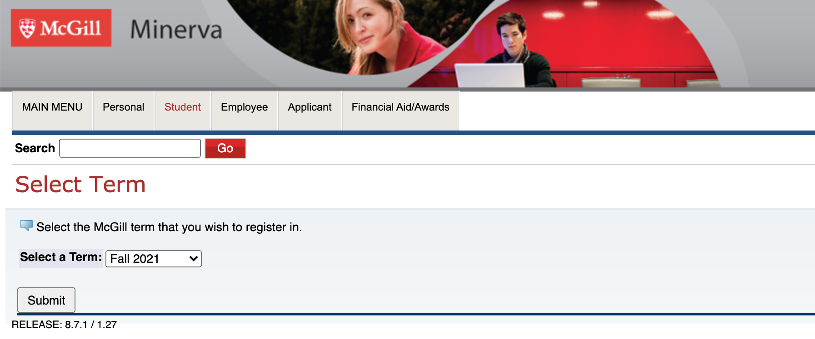
Option A: Registering for courses 3

Slide 35
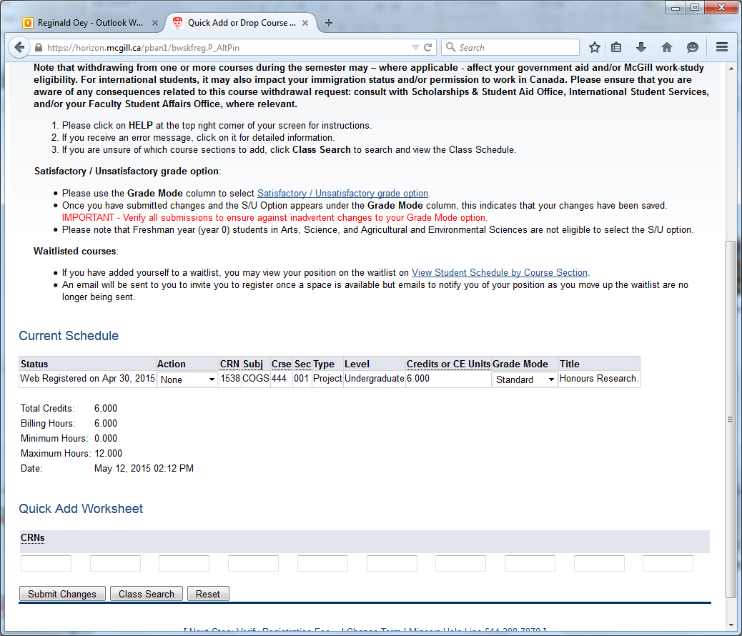
Option A: Registering for courses 4
Max 17 credits per semester
Input CRNs

Slide 36
Option B: Minerva Class Schedule
Main Menu →
Student Menu →
Registration Menu

Slide 37
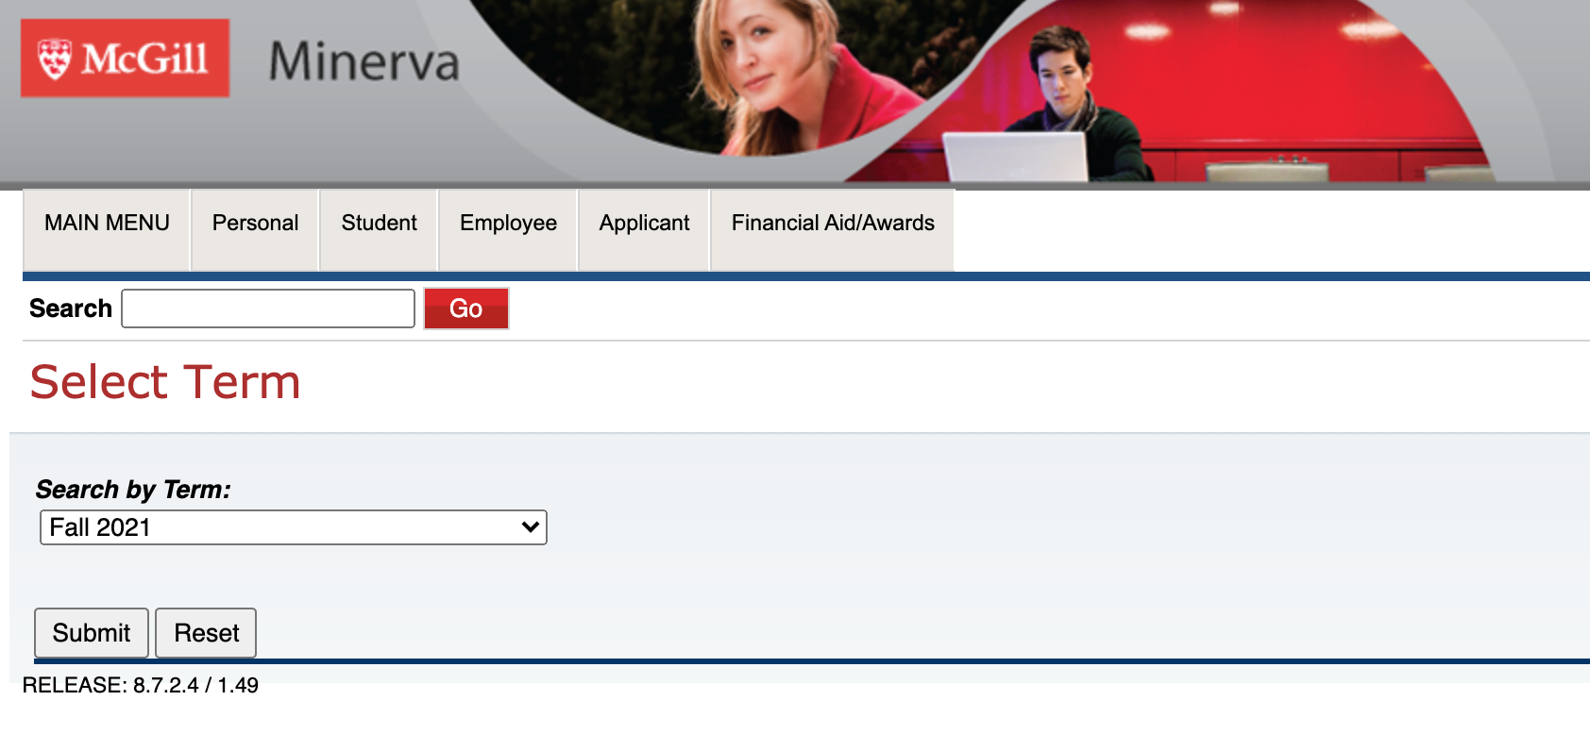
Option B: Registering for courses 1

Slide 38
Option B: Registering for courses 2
Search for subject code (e.g. CHEM)
Course Search

Slide 39
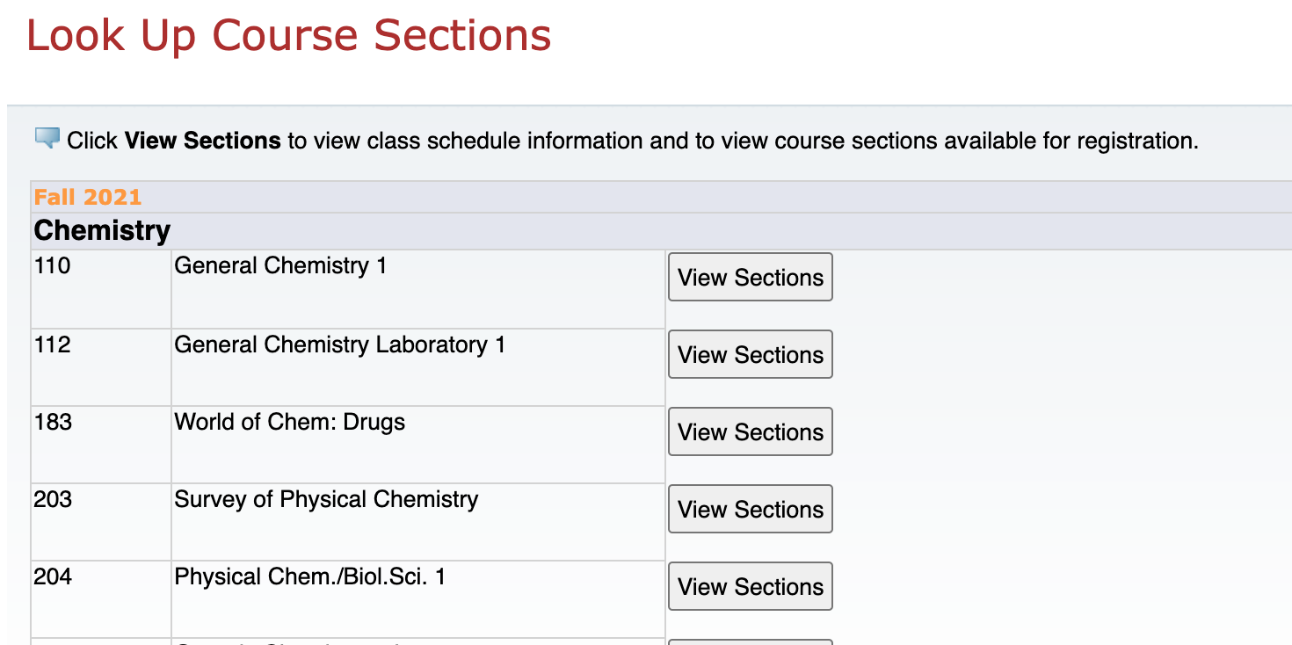
Option B: Registering for courses 3
View Sections

Slide 40
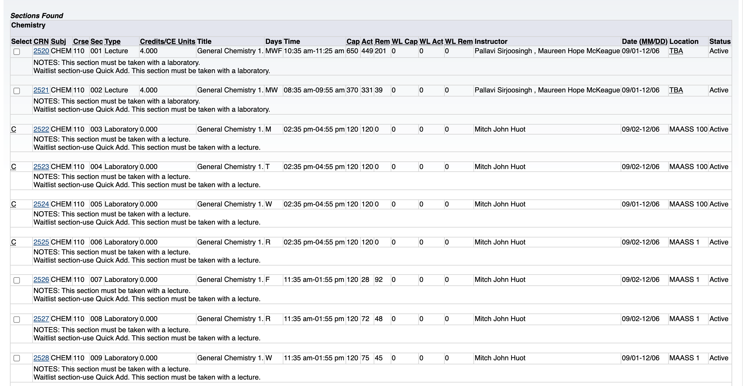
Option B: Registering for courses 4
C = class is full

Slide 41
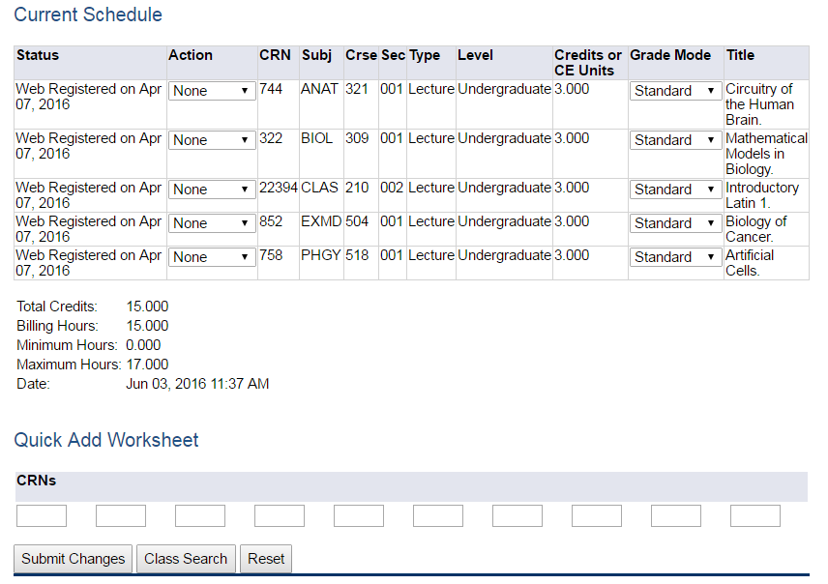
Option B: Registering for courses 5
Click here to “webdrop” a course

Slide 42
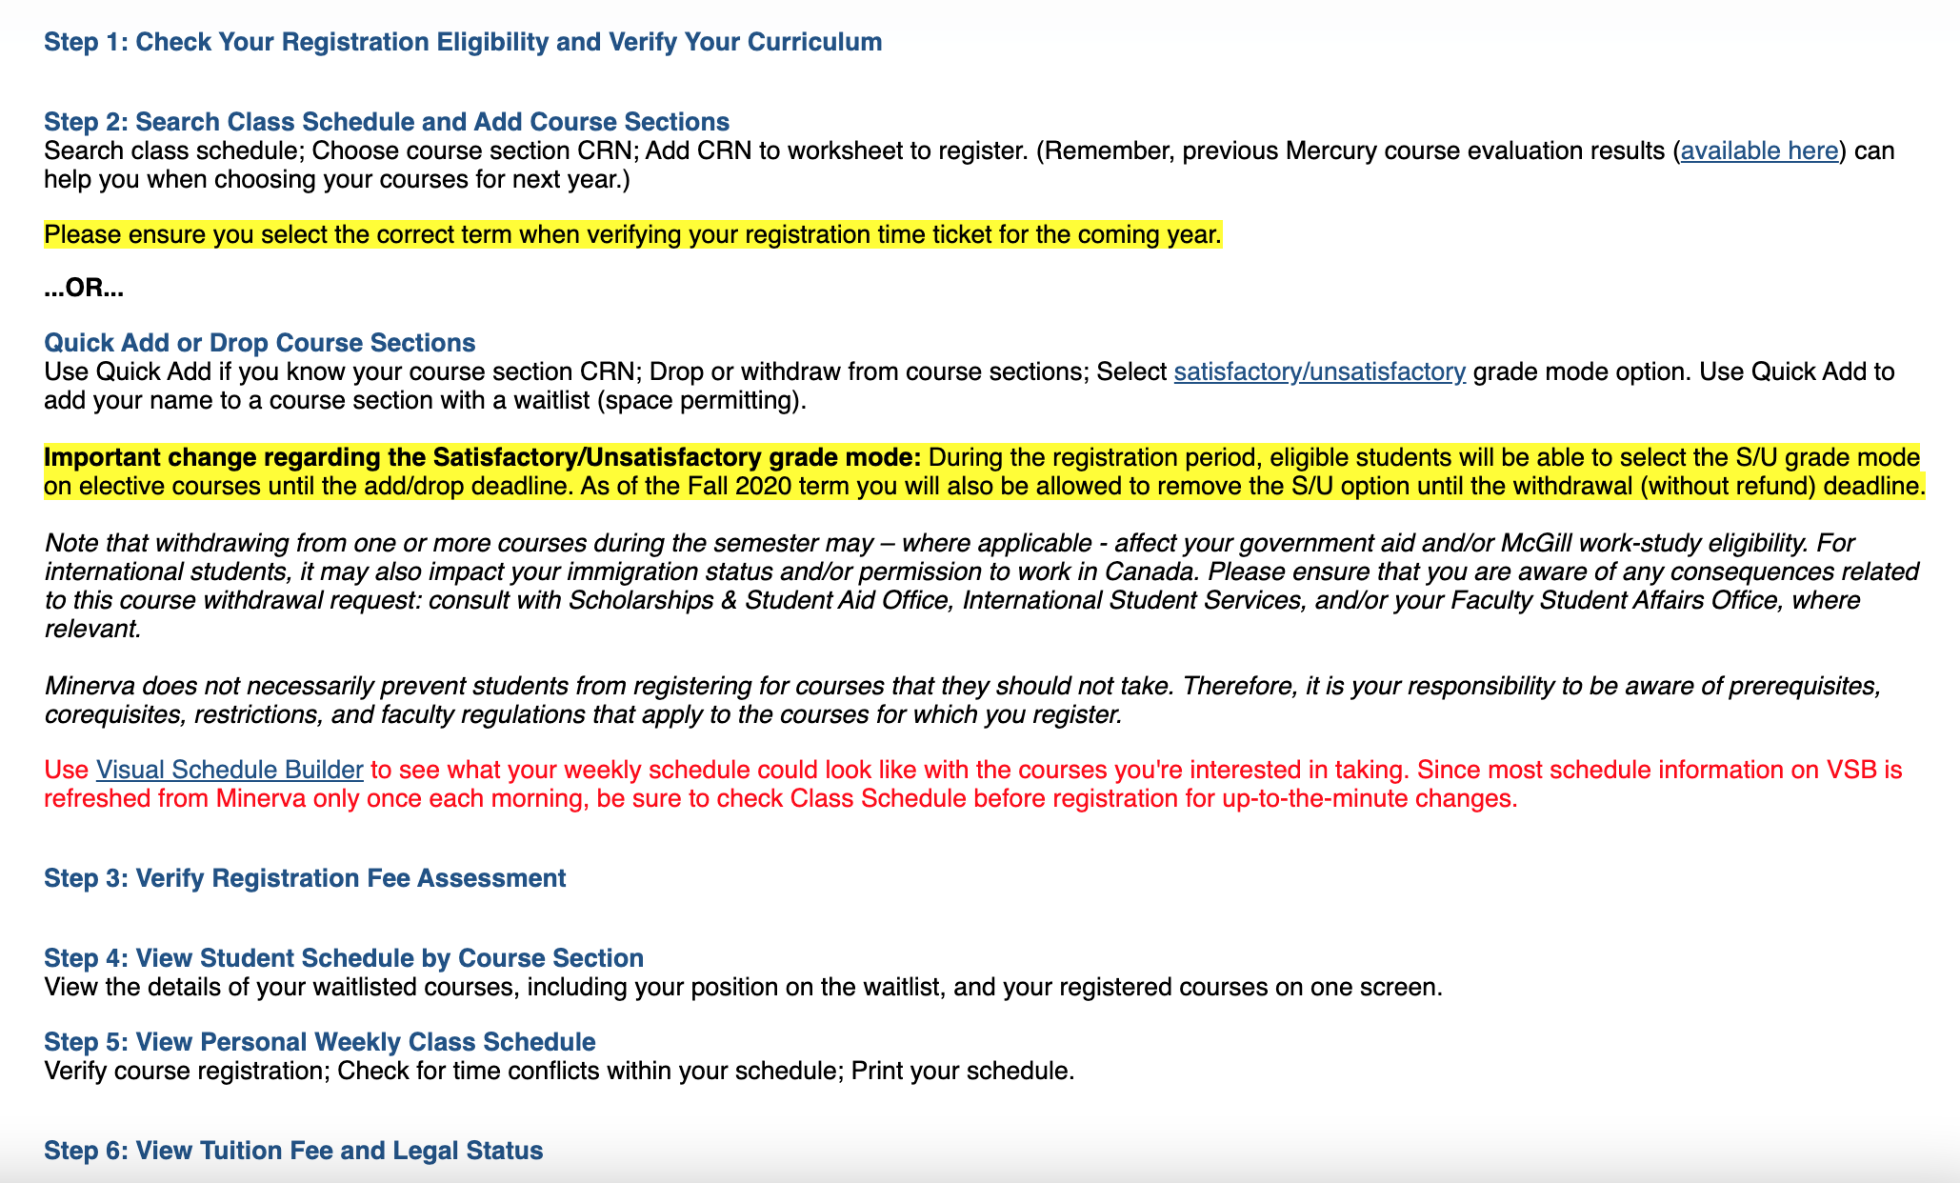
View Your Class Schedule
Main Menu →
Student Menu →
Registration Menu

Slide 43
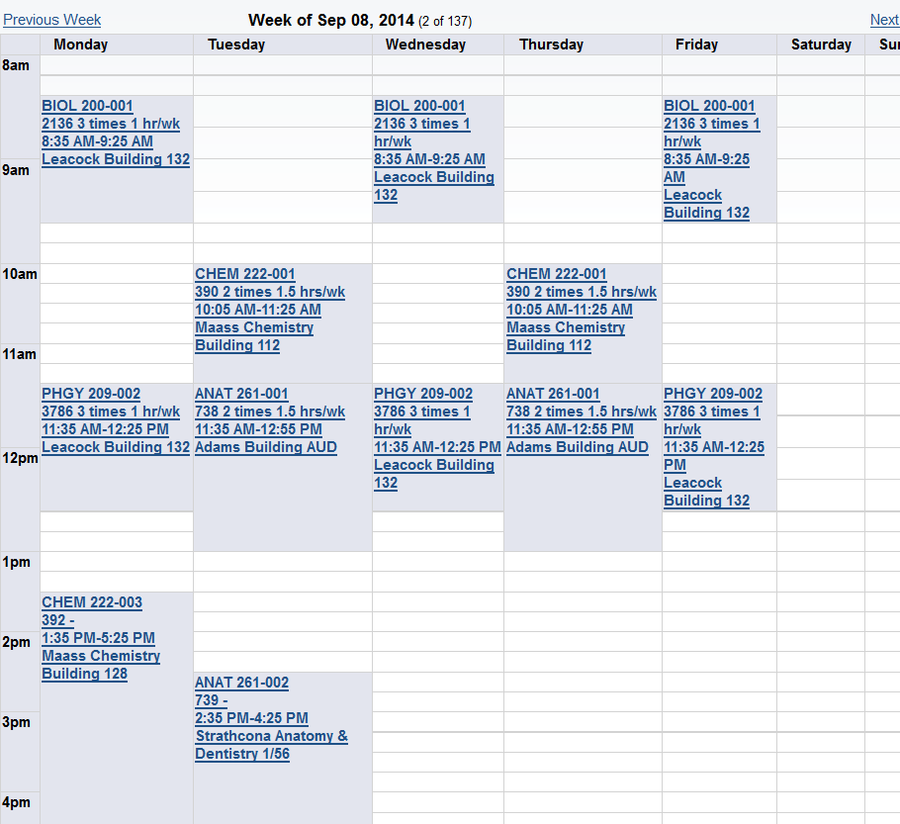
View Your Weekly Class Schedule
Student Menu
Registration Menu
Step 5: Personal Weekly Class Schedule
Note: you will have to click the Next button in the top right corner to switch the weeks until you get to September

Slide 44
Waitlists
Not all courses have waitlists – be sure to check
To add yourself to a waitlist, you must use the Quick Add page
To Find:
Main Menu → Student Menu → Registration Menu → Step 2: Search by Class Schedule & Add Course Sections
# of waitlist spots remaining
Total waitlist spots available
# of people currently on the waitlist

Slide 45
Accessing a waitlist 1
Main Menu →
Student Menu →
Registration Menu

Slide 46
Accessing a waitlist 2
Input CRN

Slide 47
Accessing a waitlist 3
Main Menu →
Student Menu →
Registration Menu
When you are first in line, you will receive an email to your McGill email telling you to register. You will have 24 hours to register or you will get kicked off the waitlist.

Slide 48
Verify Your Registration Date and U0/U1 Status
Main Menu → Student Menu → Registration Menu

Slide 49
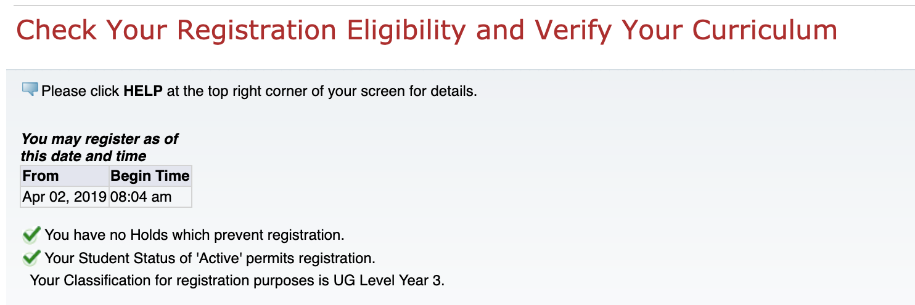
Registration Date and U0/U1 Status
Your registration start date
Your year

Slide 50
View Your Unofficial Transcript 1

Slide 51
View Your Unofficial Transcript 2

Slide 52
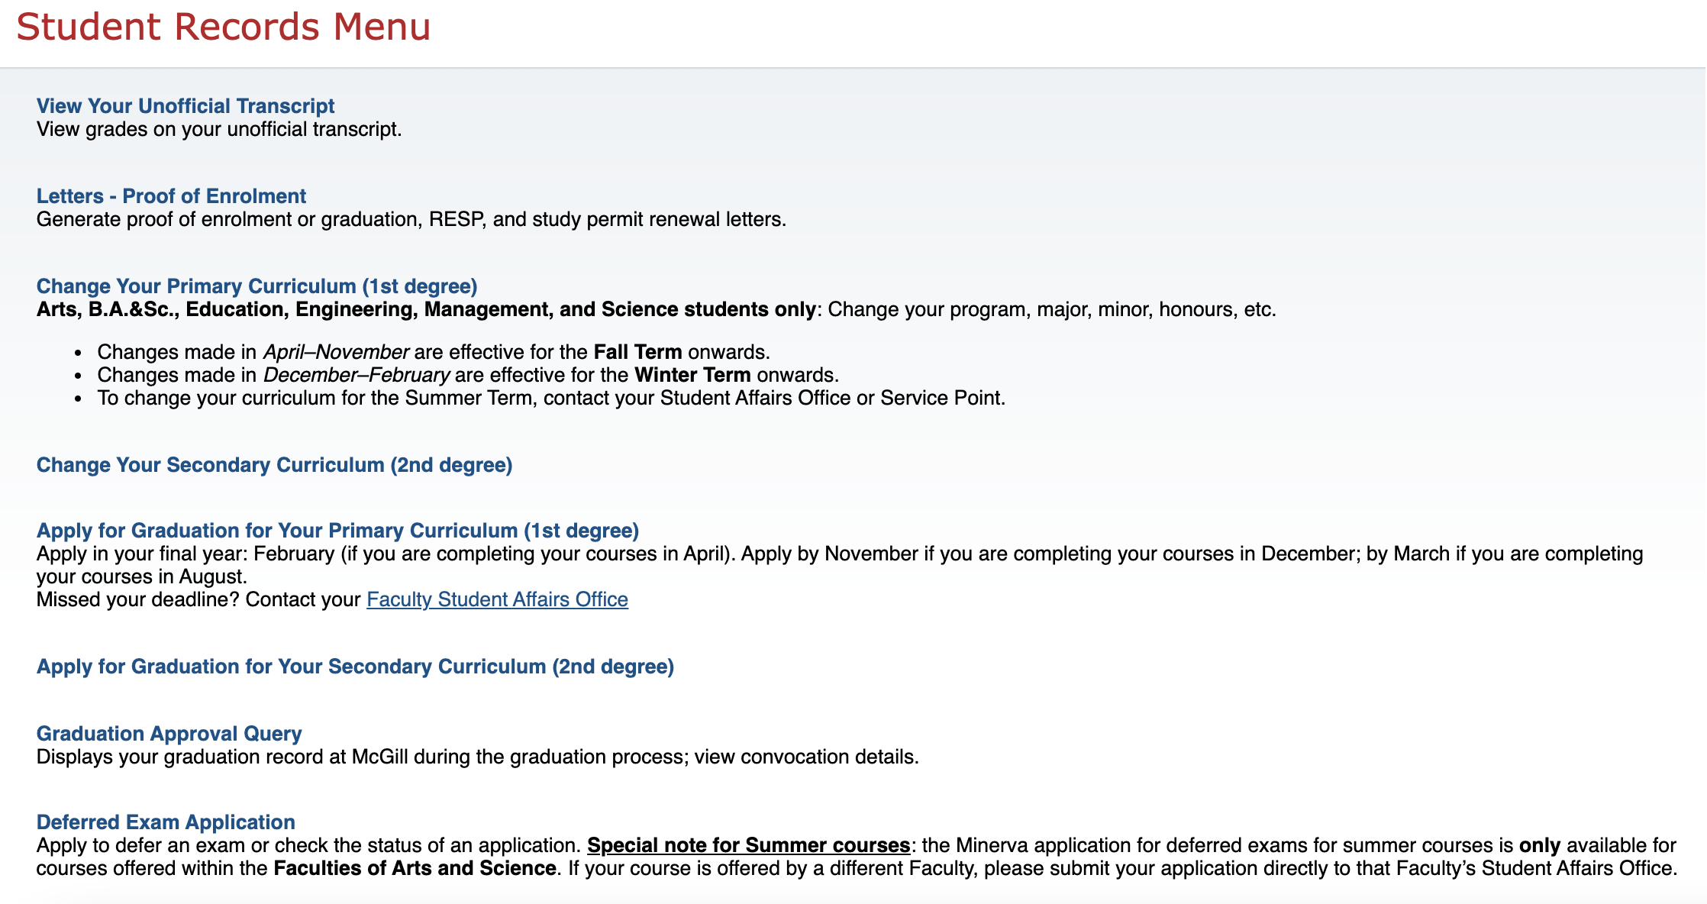
View Your Unofficial Transcript 3

Slide 53
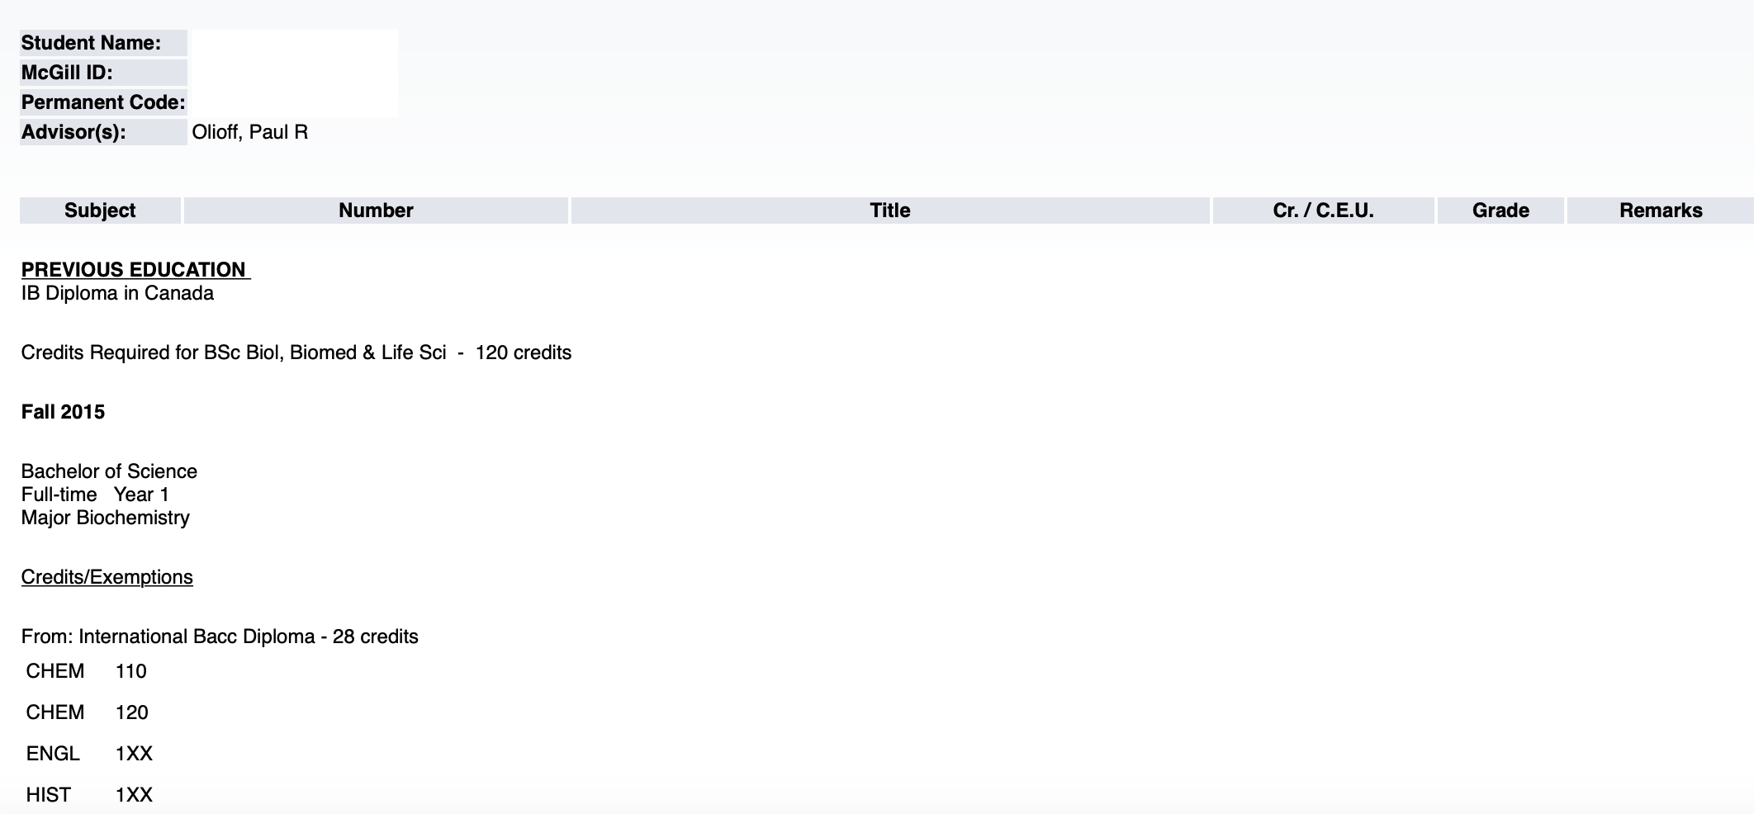
View Your Unofficial Transcript 4
Your Academic Advisor (if applicable)
Previous Education
Your Year (U1 vs U0)
Advanced Standing/Transfer Credits
↓ Registered Courses Will Appear Below ↓

Slide 54
How to Declare Your Major/Minor
Main Menu → Student Menu → Student Records Menu

Slide 55
Why Can’t I Register?
Course may be full and waitlist is not available (not all courses use waitlist)
You are missing a co-requisite or pre-requisite
Ensure you register for co-requisites together
You may need to complete the pre-requisite before you can take the course (or get permission to take the pre-requisite as a co-requisite).
Placement tests can also be a pre-requisite (ex: language courses)
You do not have permission for that course
Some courses are restricted by program (common error message: “Reserved Closed”)
Check your primary curriculum
Speak with an advisor to get permission (if possible)
http://www.mcgill.ca/students/advising/advisordirectory
Reminder: Minerva will NOT prevent you from registering for courses that have a time conflict, nor will it ensure you are fulfilling your program requirements.

Slide 56
Types of Academic Advising
Faculty Advisor
Faculty Student Affairs Office
Ensure you are on track to graduate
Peer Advisors
e.g., Arts
Departmental / School Advisors
Help you plan your major/minor/honours program
Professors / Lecturers
www.mcgill.ca/students/advising/advisordirectory/

Slide 57
Placement Exams
French: OPTIONAL – only required for students wishing to take French as a Second Language (FRSL) courses.
https://www.mcgill.ca/flc/registration/placement-tests
English: OPTIONAL – only required for CESL courses. CESL courses are for non-anglophone students looking to practice/improve their English academic reading and writing skills.
https://www.mcgill.ca/mwc/courses/placement-tests
Other languages: No placement exam required for registration. Register for the level you think is a good fit, and a placement exam will occur during first day of class.
Science: OPTIONAL for students who feel that they've completed the equivalent of one or more university-level science courses, but do not have acceptable certification to that effect. Offered for biology, chemistry, math, and physics courses.
https://www.mcgill.ca/exams/dates/science

Slide 58
Registration Tips!
Prepare more than one schedule
A class may not be offered every year
Add/Drop period is when many full courses will see openings
Ends Tuesday, September 13th
Change is possible!
Inter-Faculty Transfers
Check any holds/warnings on your account

Slide 59
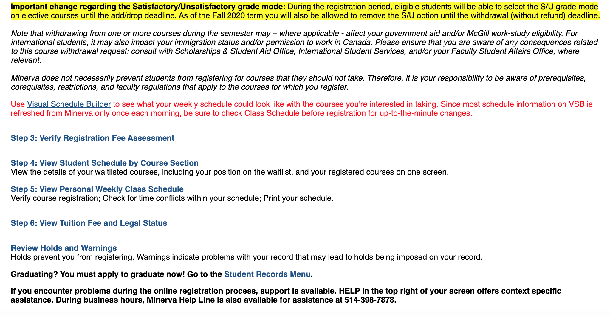
Reviewing Holds and Warnings
Main Menu →
Student Menu →
Registration Menu

Slide 60
Registration Resources
Minerva: www.mcgill.ca/minerva-students
Minerva Help Line, Service Point: 514-398-7878. They can help identify why you can’t register
Your Advisors: http://www.mcgill.ca/students/advising/advisordirectory
They can help you determine which classes you need!
Courses and Programs: www.mcgill.ca/students/courses/
Access eCalendar, Step by step videos on registrations, Program Calendar, Important dates
Accepted students’ website: https://www.mcgill.ca/accepted/nextsteps/register
If you are struggling to find your program requirements or academic advisor
U1 vs. U0 status: https://www.mcgill.ca/accepted/nextsteps/register
Advanced standing/transfer credit website: https://www.mcgill.ca/transfercredit/prospective
McGill PRO Slides and Recordings: https://www.mcgill.ca/firstyear/undergraduate/orientation-week/mcgill-pro-pre-registration-orientation/recordings-and-powerpoint-slides

Slide 61
First-Year Resources
CL&E’s Get Ready Website: https://www.mcgill.ca/getready/
New Students’ Website: www.mcgill.ca/accepted/
Student Information: www.mcgill.ca/students
Everything you could possibly want to know as a McGill student
Get Involved: www.mcgill.ca/engage
Peer Mentorship/Support Programs: https://www.mcgill.ca/peerprograms/undergraduate-students-seeking-peer-support

Slide 62
Preferred Name
The university recognizes that as a community many of its members use first names other than their legal first names to identify themselves. Students can add a preferred name to their record using Minerva. Your preferred name will then appear on your Student ID card and other university documentation.
Go to Minerva
Select “Personal Menu”
Select “Name Change”
Enter your Preferred First Name

Slide 63
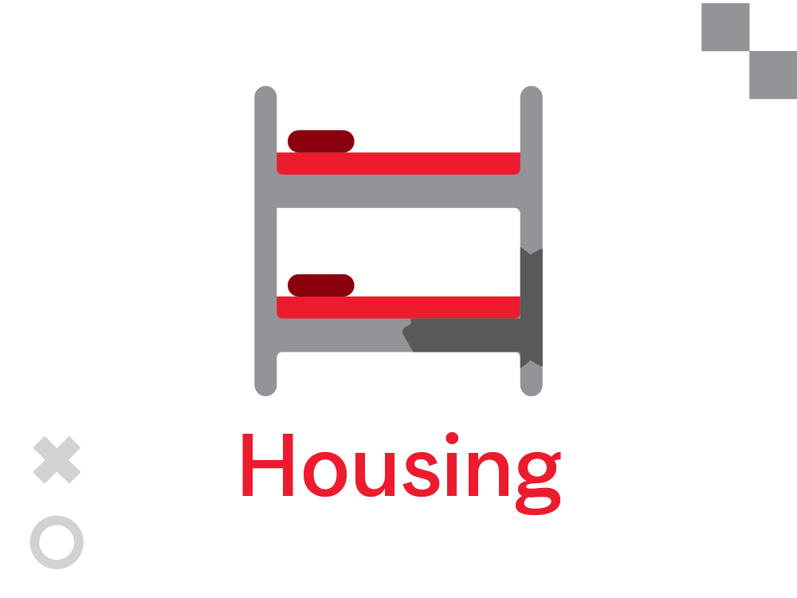
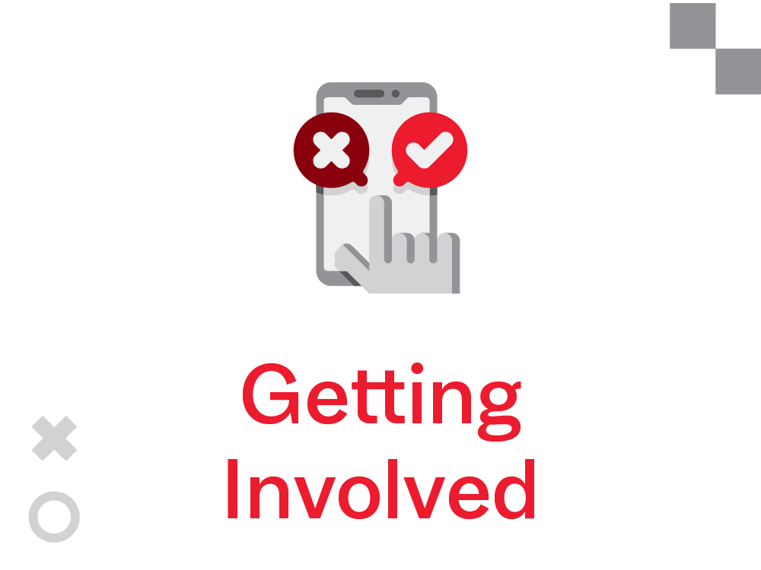
McGill 101 Reminder
An online information hub for all new McGill undergraduate students
Complete quizzes, checklists, and other activities
Earn badges
Win prizes!
https://mycourses2.mcgill.ca/

Slide 64
Pre-Arrival Webinars
Webinar | Dates
Housing On and Off-Campus | May 31
Dollars and Sense | June 8
Dollars & Sense: Planning for Your Time at McGill | June 8
Know Your Rights | June 15
Making Connections | June 29
MTL Healthcare Community | July 6
What I Wish I Had Known (Student Panel) | July 27
Learning at McGill | Aug 2
Parents: How to Support Your New McGill Student | Aug 10
https://www.mcgill.ca/getready/webinars

Slide 65
Thank you!
Remember to contact Campus Life & Engagement if you have any questions!
fb.com/CLEMcGill
@CLEMcGill
Entering Class of 2022 Facebook Group
Entering Class of 2022 Discord Community
Web: www.mcgill.ca/getready
Email: firstyear@mcgill.ca
Phone: (514) 398-6913

