Slide 1
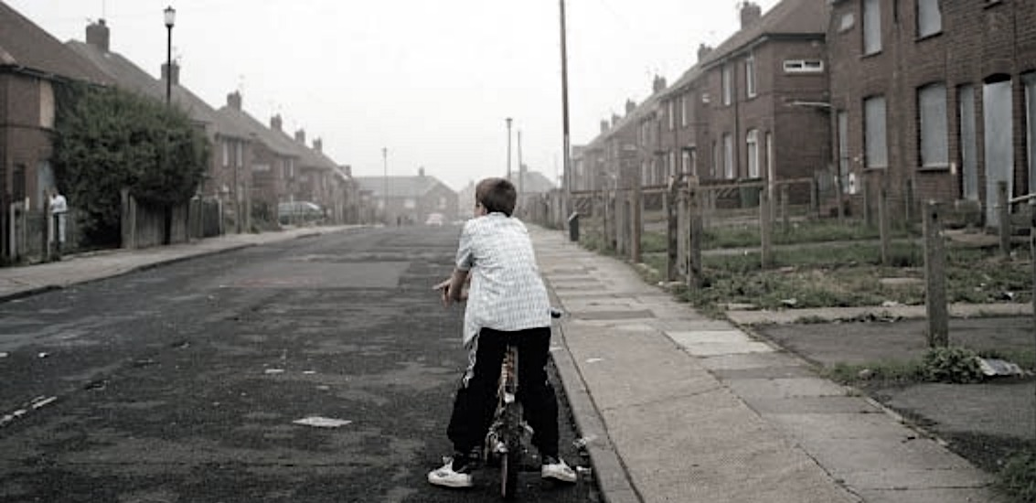
Early-life exposure to income inequality and adolescent health
Frank Elgar
McGill University

Slide 2
The importance of adolescence
Adolescence - new in human history
  Divergence of social and physical developmental milestones
So-called “healthy years” of adolescence are mostly neglected in policy
Health tracks strongly from childhood to adulthood
  Many chronic health problems are shaped by exposures during adolescence

Slide 3

Collaborative study of WHO/EURO
Established in 1986
Currently in 42 countries
School-based survey of 11- to 15-year-olds every 4 years
Measures mental and physical health, health behaviours, and social contexts
Each country is self-funded
www.hbsc.org

Slide 4
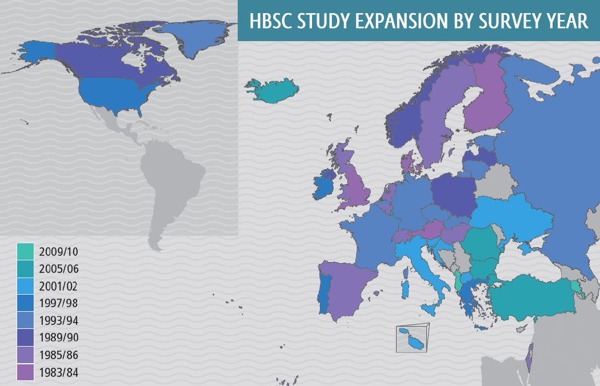
www.hbsc.org
www.hbsc.org

Slide 5
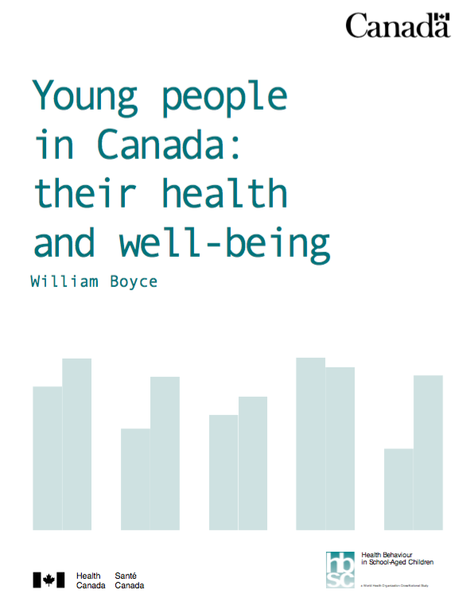


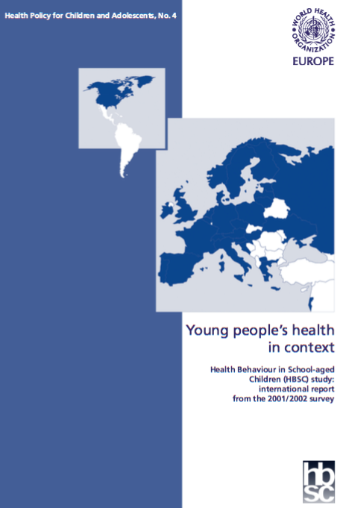


Slide 6
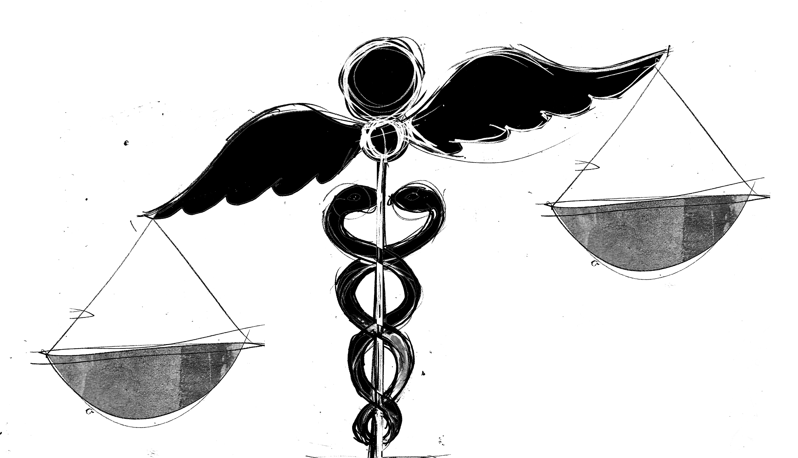
Socioeconomic gradient in health
The odds that a child is healthy, happy and doing well in school significantly improves as social class rises
Social pattern is shaped by developmental, material and psychosocial mechanisms
  Data show absolute and relative differences in affluence

Slide 7
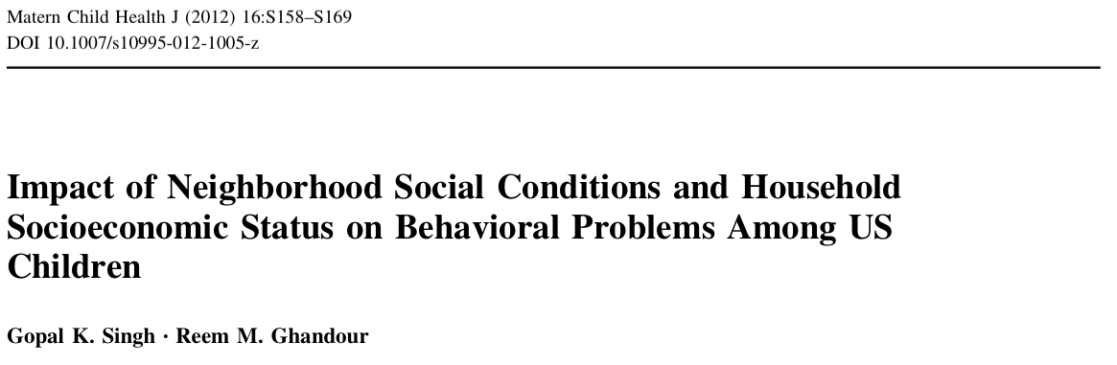

Slide 8
HBSC Family Affluence Scale
Does your family have a car or a van?
  (0 = no; 1= yes one; 2 = yes two or more)
Do you have your own bedroom for yourself?
  (0 = no; 1 = yes)
How many times did you travel abroad for holiday/vacation last year?
  (0 = not at all, 1 = once, 2 = twice, 3 = more than twice)
How many computers does your family own?
  (0 = none, 1 = one, 2 = two, 3 = more than two)
At home, do you have a dishwasher
  (0 = no, 1 = yes)
How may bathrooms (room with a bath) are in your home
  (0 = none, 1 = one, 2 = two, 3 = more than two)
Elgar FJ, McKinnon B, Torsheim T, Schnohr CW, Mazur J, Cavallo F, Currie C. Patterns of socioeconomic inequality in adolescent health differ according to the measure of socioeconomic position. Soc Indic Res; in press.

Slide 9
Prevalence of fair or poor health (left) and low life satisfaction (right) across quintile groups in four measures of socioeconomic position
Elgar FJ, McKinnon B, Torsheim T, Schnohr CW, Mazur J, Cavallo F, Currie C. Patterns of socioeconomic inequality in adolescent health differ according to the measure of socioeconomic position. Soc Indic Res; in press.

Slide 10
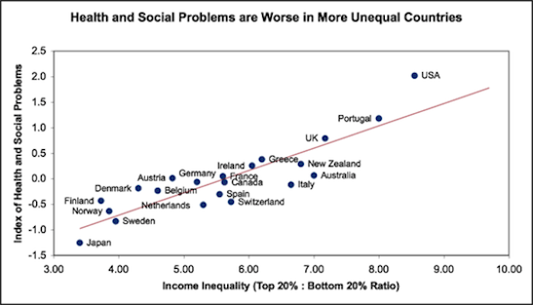
Health and social problems that relate to socioeconomic status are more prevalent in more unequal societies
Index of:
life expectancy
math and literacy scores (PISA)
infant mortality
homicides
imprisonment
teenage pregnancy
trust
obesity
mental illness
alcohol and drug addiction
social mobility
Wilkinson & Pickett (2009), The Spirit Level

Slide 11
“What matters in determining mortality and health in a society is less the overall wealth of that society and more how evenly wealth is distributed.”
Source: The big idea [Editor’s Choice]. BMJ 1996;312. (20 April.)

Slide 12

Income inequality correlates with international differences in
  Life expectancy (r = -.44)
  Infant mortality (r = .42)
  Obesity (r = .57)
  Mental illness (r = .73)
  Teenage births (r = .73)
  Homicides (r = .47)
  Imprisonment (r = .75)
  Social mobility (r = .93)
  Drug addiction (r = .63)
  Caloric intake (r = .46)
  Overweight children (r = .59)
  Child well-being (r = -.64)

Slide 13
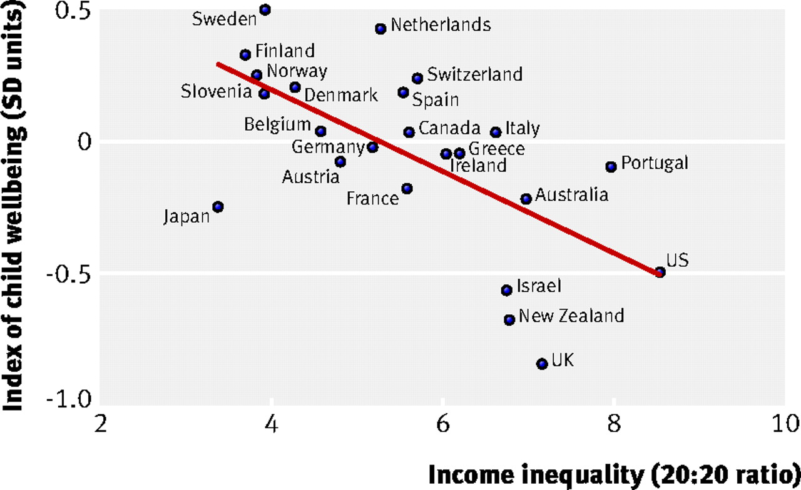

Children have lower well-being in more unequal countries:
Income inequality and Unicef index of child wellbeing in 23 rich countries
Copyright ©2007 BMJ Publishing Group Ltd.
Pickett, K. E et al. BMJ 2007;335:1080

Slide 14
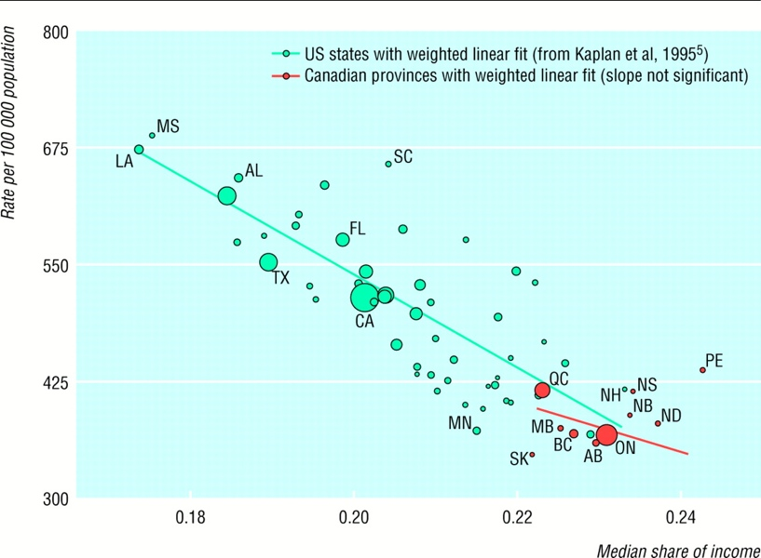
Mortality in working age men by proportion of income belonging to the less well off half of households, US states (1990) and Canadian provinces (1991).
Source: Ross et al. (2000). BMJ, 320, 898-902.

Slide 15
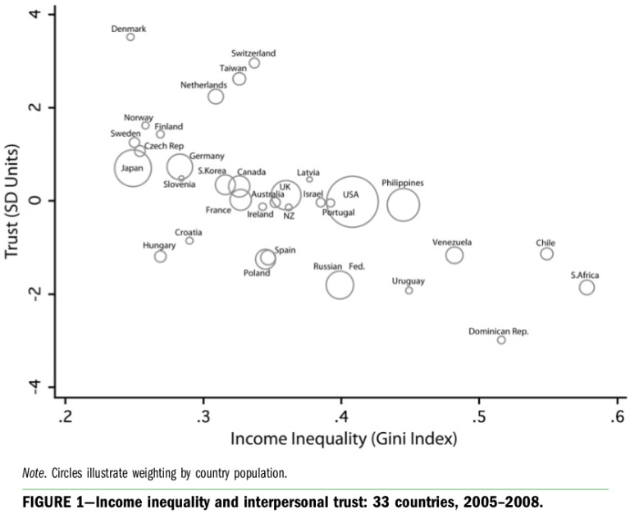
Income inequality relates to less social trust
Elgar FJ. Income inequality, trust, and population health in 33 countries. Am J Public Health. 2010 Nov;100(11):2311-5.

Slide 16
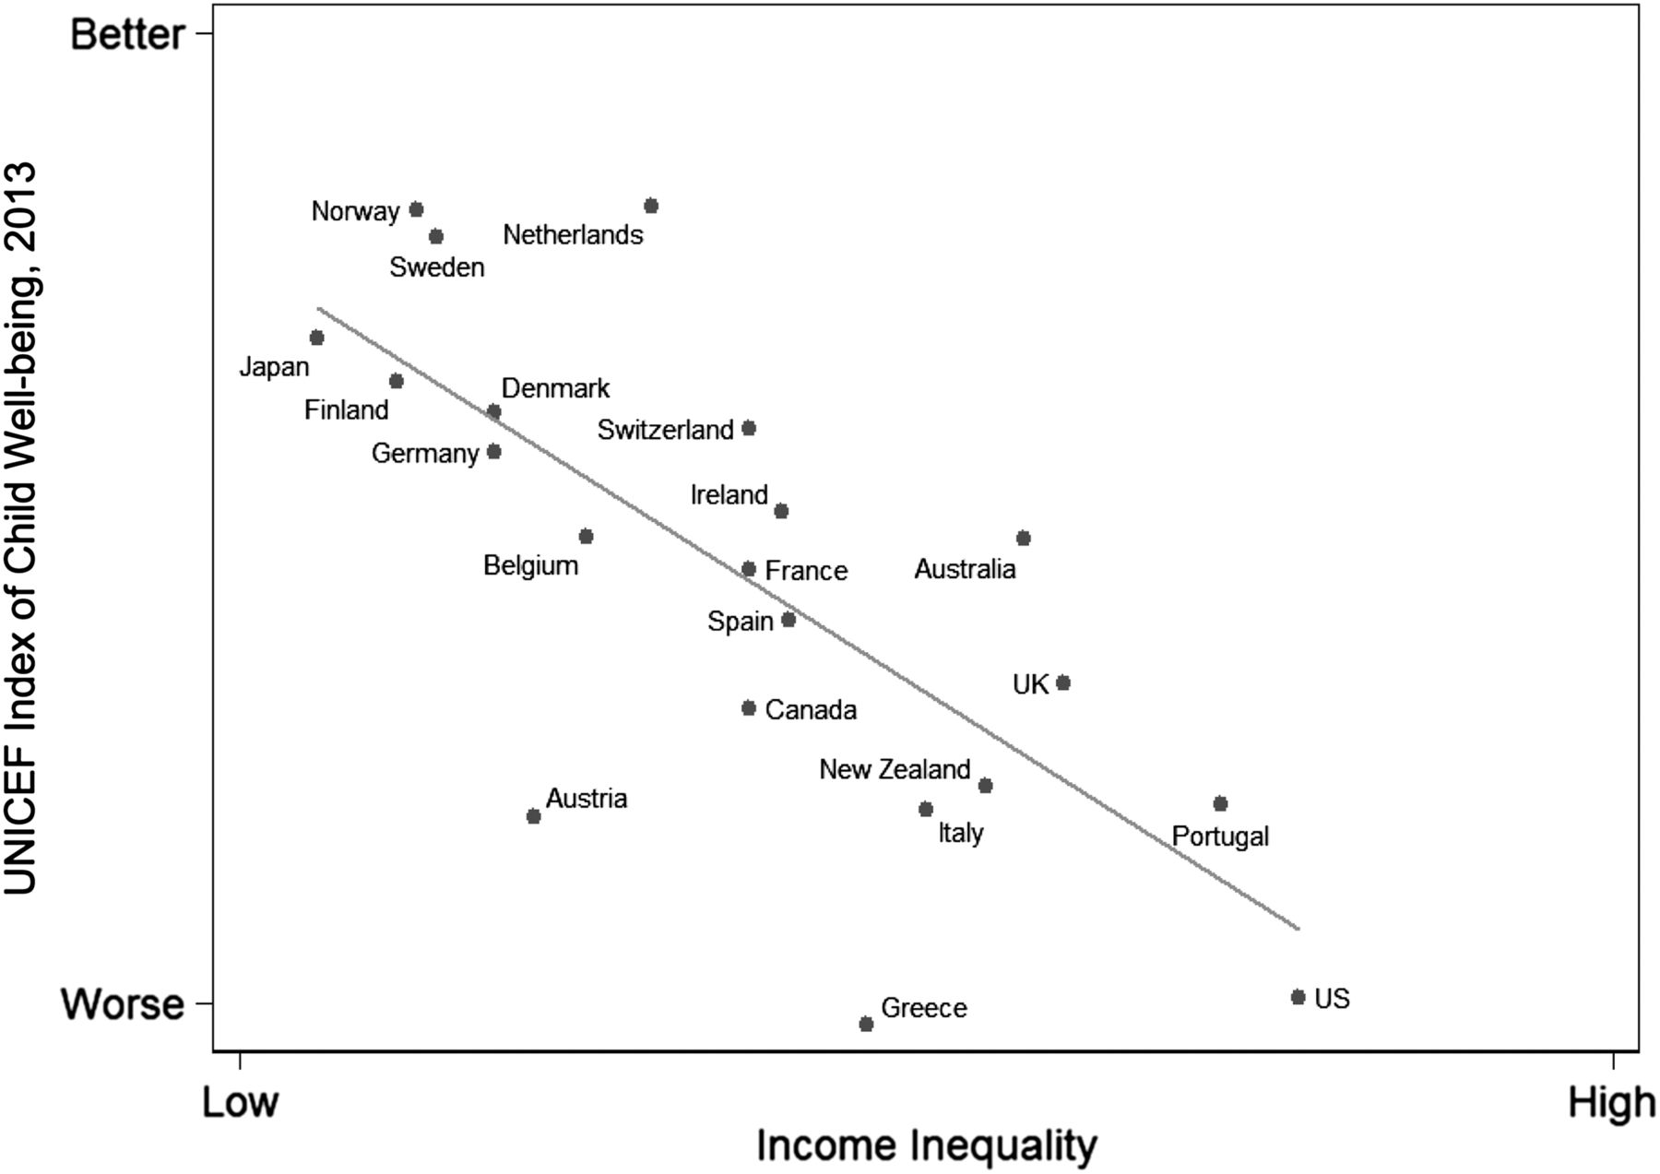
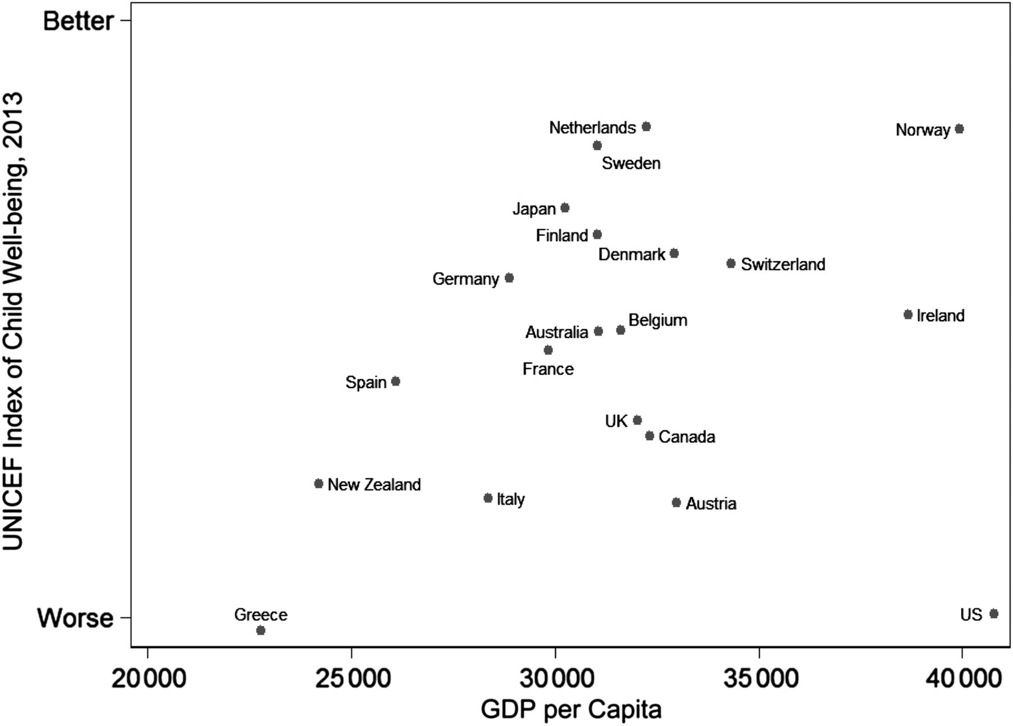

Higher levels of income inequality are associated with worse scores on the 2013 UNICEF Index of Child Well-being in 21 wealthy countries.
Average levels of income are not associated with the 2013 UNICEF Index of Child Well-being in 21 wealthy countries.
Kate E. Pickett, and Richard G. Wilkinson Pediatrics 2015;135:S39-S47
Notes:
Higher levels of income inequality are associated with worse scores on the 2013 UNICEF Index of Child Well-being in 21 wealthy countries. UK, United Kingdom; US, United States.

Slide 17
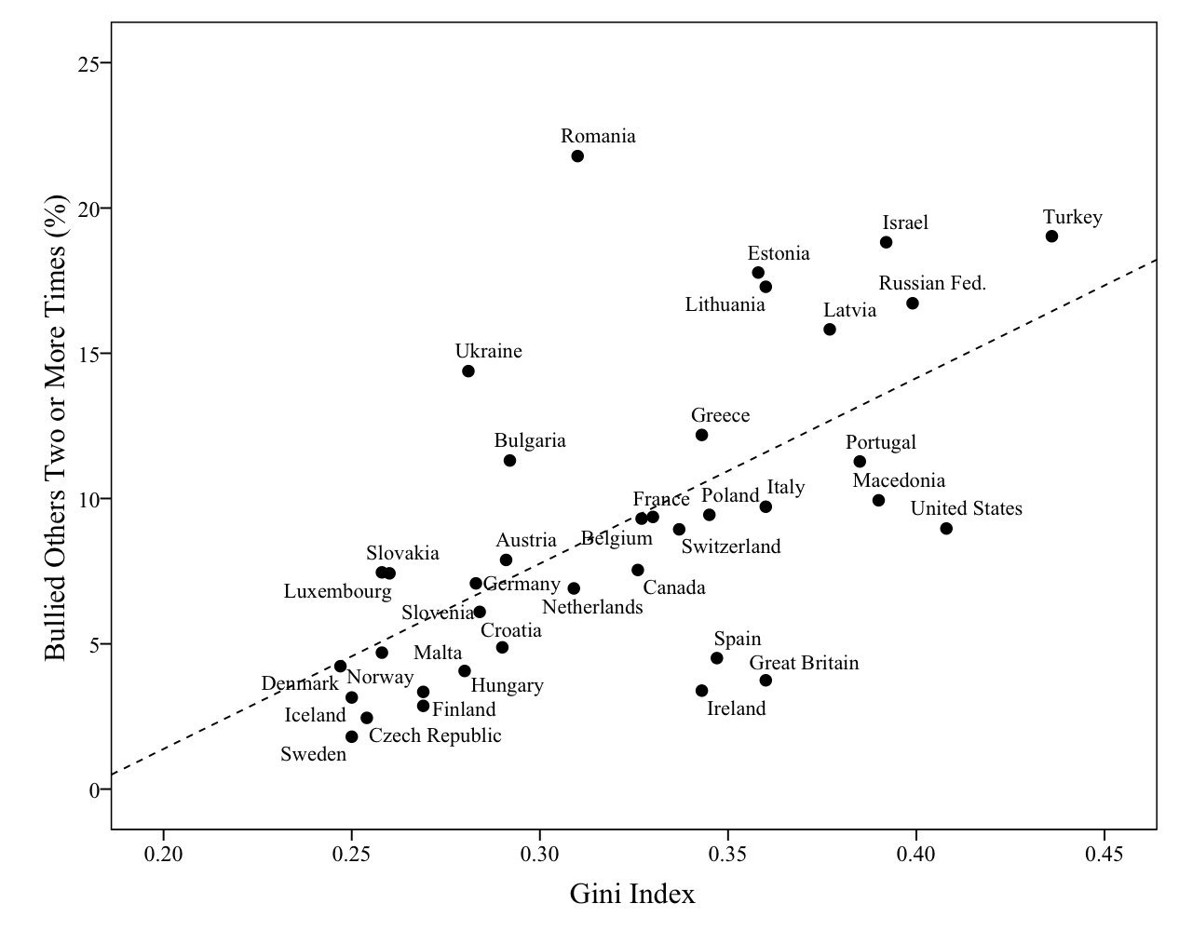
Income inequality and school bullying in 11-year-olds in 37 countries (n=66,817)
Multilevel analysis confirmed that a +1 SD in income inequality increased likelihood of bullying by males (OR = 1.17) and by females (OR = 1.24).
Elgar FJ, Craig W, Morgan A, Vella-Zarb R (2009). Income inequality and school bullying: multilevel study of adolescents in 37 countries. Journal of Adolescent Health, 45(4),351-359.

Slide 18
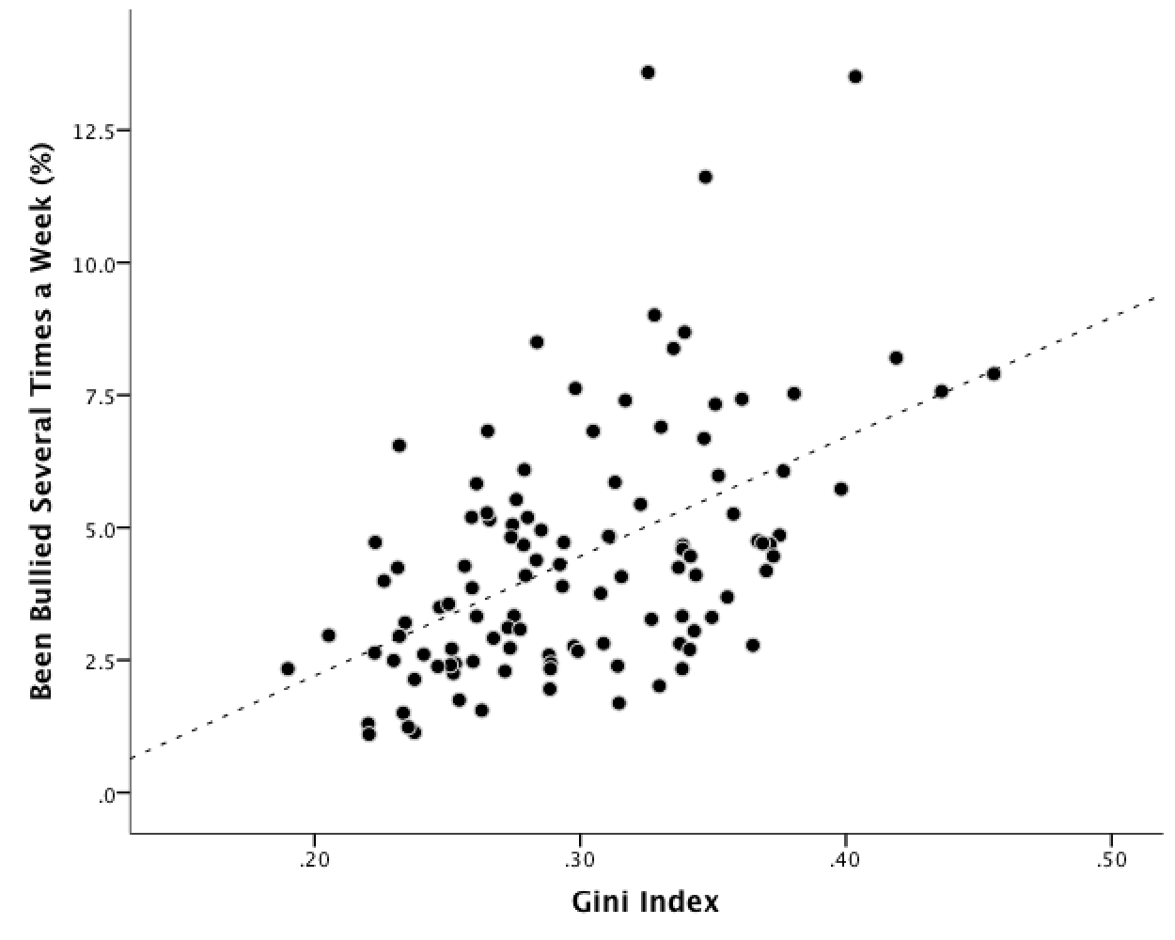
Income Inequality, Homicide and School Bullying: Pooled Time Series Analysis (1994-2006)
1994 | 1998 | 2002 | 2006
Austria Belgium Canada Czech Republic Denmark Estonia Finland France Germany Hungary Israel Latvia Lithuania Netherlands Norway Poland Russia Slovak Republic Spain Sweden Switzerland United Kingdom United States | Austria Belgium Canada Czech Republic Denmark Estonia Finland France Germany Greece Hungary Israel Latvia Lithuania Norway Poland Portugal Rep. of Ireland Russia Slovak Republic Spain Sweden Switzerland United Kingdom United States | Austria Belgium Canada Croatia Czech Republic Denmark Estonia Finland France Germany Greece Hungary Israel Italy Latvia Lithuania Macedonia Malta Netherlands Norway Poland Portugal Rep. of Ireland Russia Slovak Republic Slovenia Spain Sweden Switzerland Ukraine United Kingdom United States | Austria Belgium Bulgaria Canada Croatia Czech Republic Denmark Estonia Finland France Germany Greece Hungary Iceland Israel Italy Latvia Lithuania Luxembourg Macedonia Malta Netherlands Norway Poland Portugal Rep. of Ireland Romania Russia Slovak Republic Slovenia Spain Sweden Switzerland Turkey Ukraine United Kingdom United States
Elgar FJ, Pickett KE, Pickett W, Craig W, Molcho M, Hurrelmann K, Lenzi M. School bullying, homicide and income inequality: a cross-national pooled time series analysis. International Journal of Public Health, 58, 237-245.

Slide 19
relative deprivation
Income inequality at the macro level is conceptually (and computationally) related to relative deprivation at the micro level.
Yitzhaki index: average distance between an individual’s affluence and all the affluence scores above, within a social reference group (e.g., school).
‘Upward-looking’ measure of relative deprivation
Elgar FJ, De Clercq B, Schnohr CW, Bird P, Pickett KE, Torsheim T, Hofmann F, Currie C. Absolute and relative family affluence and psychosomatic symptoms in adolescents. Soc Sci Med. 2013 Aug;91:25-31.

Slide 20
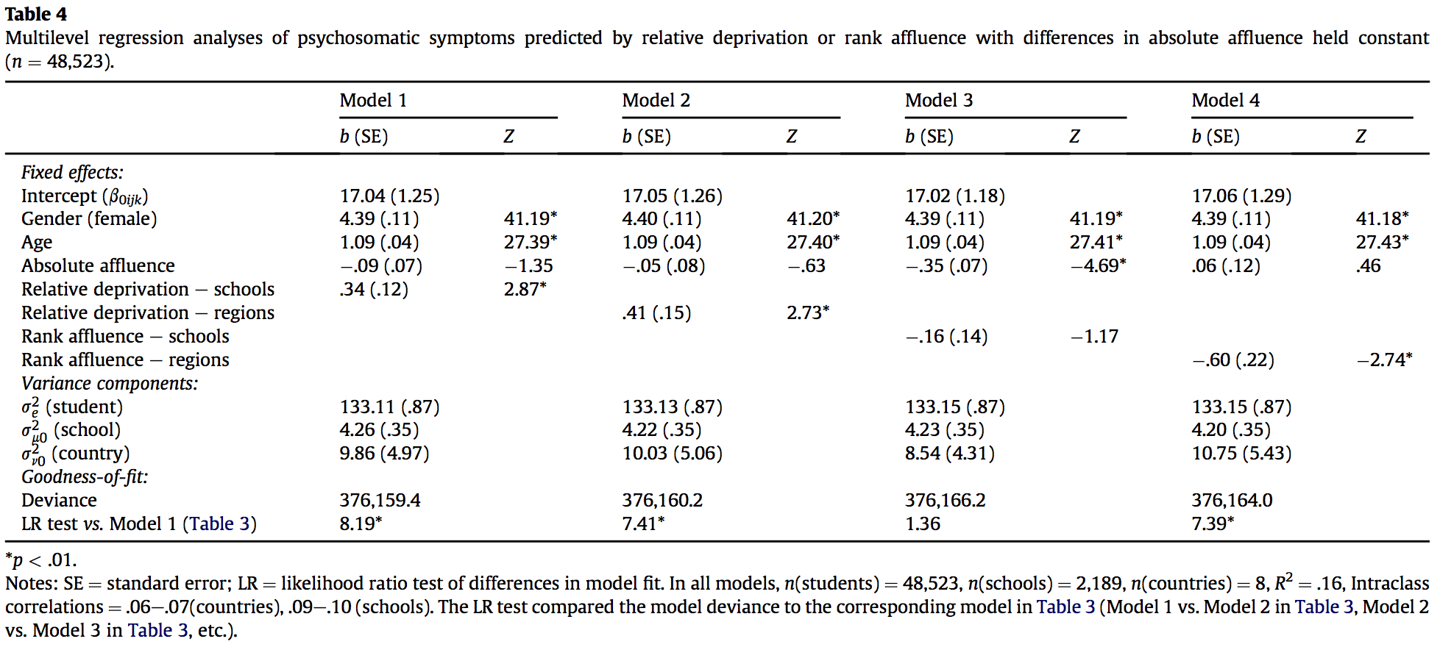
Relative deprivation and psychosomatic symptoms in adolescents
Elgar FJ, De Clercq B, Schnohr CW, Bird P, Pickett KE, Torsheim T, Hofmann F, Currie C. Absolute and relative family affluence and psychosomatic symptoms in adolescents. Soc Sci Med. 2013 Aug;91:25-31.

Slide 21
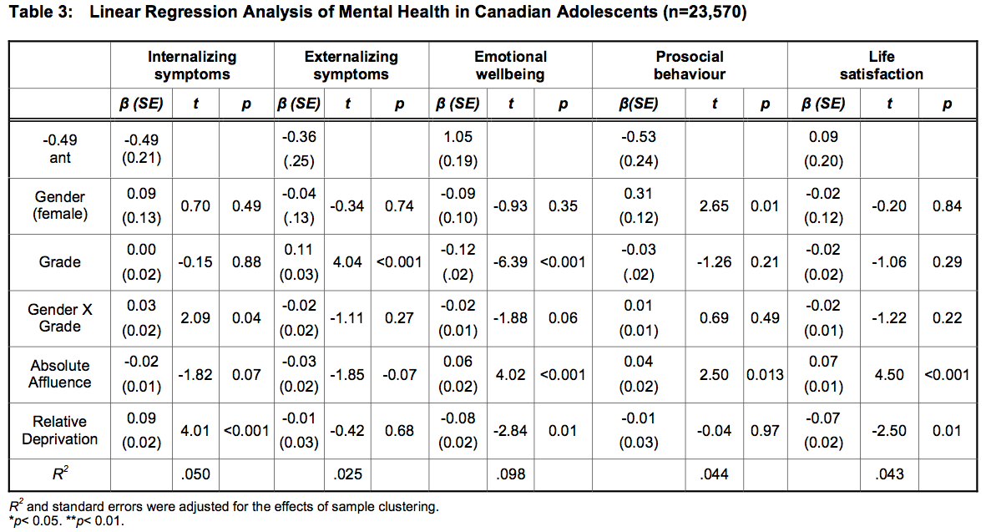
Relative deprivation and adolescent mental health
Elgar FJ, Baranek H, Saul G, Napoletano A.(2013). Relative Deprivation and Mental Health in Canadian Adolescents International Journal of Clinical Psychiatry and Mental Health 1 (1), 33-40.

Slide 22
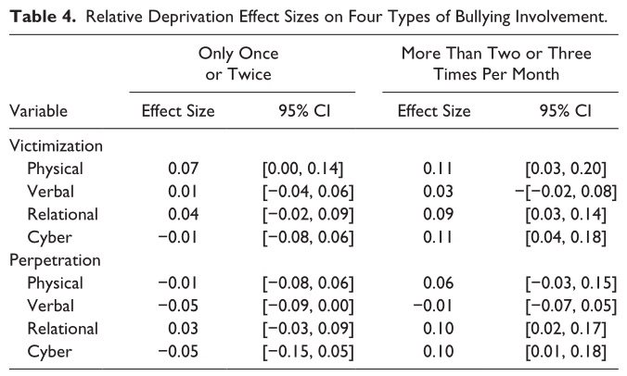
Relative deprivation and school bullying
Napoletano A, Elgar FJ, Saul G, Dirks M, Craig W. (in press) The View From the Bottom: Relative Deprivation and Bullying Victimization in Canadian Adolescents. Journal of Interpersonal Violence.

Slide 23
Relative deprivation and risk factors for obesity in Canadian adolescents
Elgar FJ, Xie A, Pförtner TK, White J, Pickett W. (under review) Relative deprivation and risk factors for obesity in Canadian adolescents.

Slide 24




Trends in adolescent health inequalities
Monitoring health inequalities and their structural determinants are essential to using policy to redress them
- Evidence on adolescents is limited
Current trends in income inequality and health inequalities in adults suggest that the gap in adolescent health has also widened

Slide 25
Trends in adolescent health inequalities
Sample
  492,788 adolescents, 34 countries/regions
  3 HBSC survey cycles (2002, 2006, 2010)
Individual variables
  Family Affluence Scale (FAS)
  Physical activity (days of moderate to vigorous activity 60+ min in previous week)
  Body mass index (z-score deviations from international norms)
  Psychological symptoms
  Physical symptoms
  Life satisfaction (Cantril ladder)
Country variables
  Income inequality
  Gini index
Elgar FJ, Pförtner TK, Moor I, De Clercq B, Stevens GW, Currie C. Socioeconomic inequalities in adolescent health 2002-2010: a time-series analysis of 34 countries participating in the Health Behaviour in School-aged Children study. Lancet. 2015 May 23;385(9982):2088-95.

Slide 26
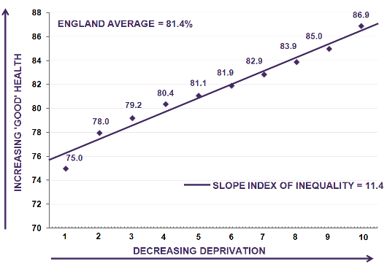
Measuring inequality
Slope index of inequality (SII)
  absolute difference in health between most and least affluent groups
Relative index of inequality (RII)
  percentage of population health that differs between most and least affluent groups
SII/RII involves converting affluence scores to weighted probability groups (ridits), which range from 0 (most affluent) to 1 (least affluent).
Elgar FJ, Pförtner TK, Moor I, De Clercq B, Stevens GW, Currie C. Socioeconomic inequalities in adolescent health 2002-2010: a time-series analysis of 34 countries participating in the Health Behaviour in School-aged Children study. Lancet. 2015 May 23;385(9982):2088-95.

Slide 27
Country A
%
Health
Low High
0% 100%
Country B
SII = difference in health between least and most affluent groups
%
Health
Low High
0% 100%
Country C
%
Health
Low High
0% 100%
Elgar FJ, Pförtner TK, Moor I, De Clercq B, Stevens GW, Currie C. Socioeconomic inequalities in adolescent health 2002-2010: a time-series analysis of 34 countries participating in the Health Behaviour in School-aged Children study. Lancet. 2015 May 23;385(9982):2088-95.

Slide 28
Modeling approach
Part 1: Trends in health inequality
  3-level regression models, (country (school (individual)))
  Models include age, gender, ageXgender, family affluence (ridit), survey year, and affluence/year interaction (trend)
Part 2: Structural determinants of health inequalities
  Pooled time-series analysis of 102 country/year groups
  Calculated means, SIIs, and RII for each health variable for each country/year group
  Prais-Winsten time series models with panel-corrected SEs
    RII_{it} = α + β₁Income_{it} + β₂Gini_{it} + μ_{it} + ε_{it} : where observations vary across country i and time t, α is the slope intercept, μ_{it} is between-country/year error, ε_{it} is within-country/year error
Elgar FJ, Pförtner TK, Moor I, De Clercq B, Stevens GW, Currie C. Socioeconomic inequalities in adolescent health 2002-2010: a time-series analysis of 34 countries participating in the Health Behaviour in School-aged Children study. Lancet. 2015 May 23;385(9982):2088-95.

Slide 29
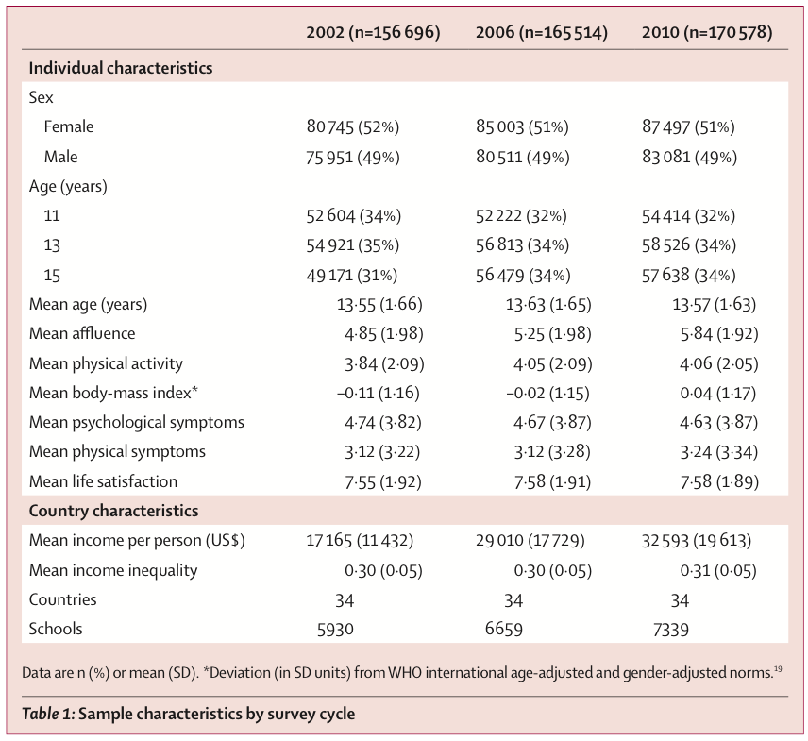
Elgar FJ, Pförtner TK, Moor I, De Clercq B, Stevens GW, Currie C. Socioeconomic inequalities in adolescent health 2002-2010: a time-series analysis of 34 countries participating in the Health Behaviour in School-aged Children study. Lancet. 2015 May 23;385(9982):2088-95.

Slide 30
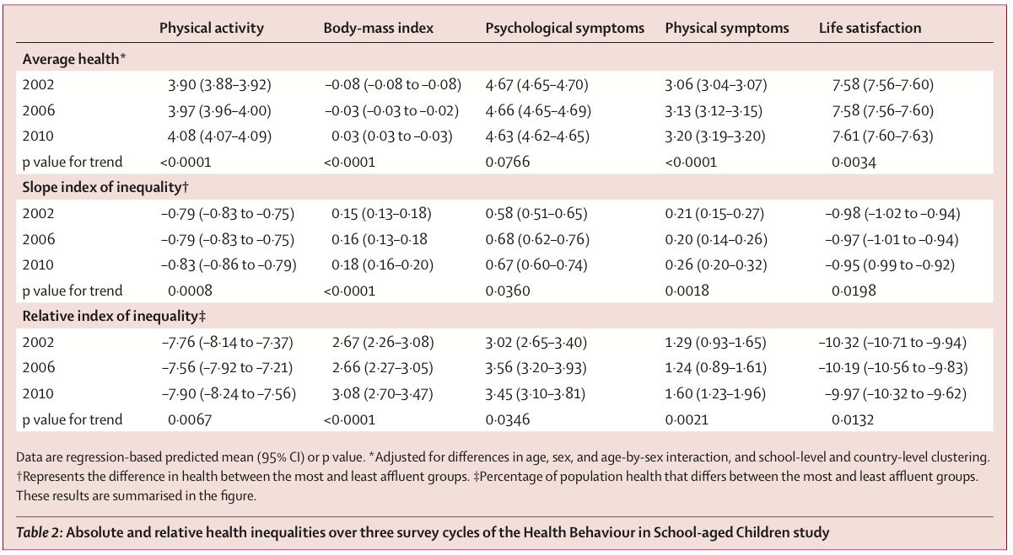
More unequal
Elgar FJ, Pförtner TK, Moor I, De Clercq B, Stevens GW, Currie C. Socioeconomic inequalities in adolescent health 2002-2010: a time-series analysis of 34 countries participating in the Health Behaviour in School-aged Children study. Lancet. 2015 May 23;385(9982):2088-95.

Slide 31
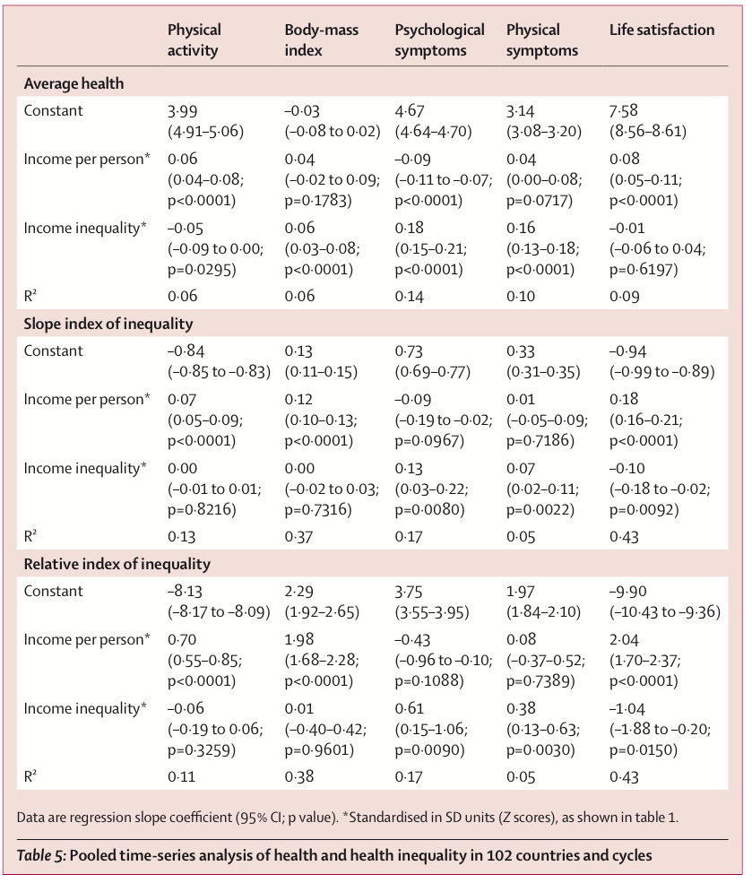
With country differences in per capita income controlled, income inequality related to
Less physical activity
Higher body mass indices
More psychological and physical symptoms
Larger inequalities between socioeconomic groups in
  psychological symptoms
  physical symptoms,
  life satisfaction
Elgar FJ, Pförtner TK, Moor I, De Clercq B, Stevens GW, Currie C. Socioeconomic inequalities in adolescent health 2002-2010: a time-series analysis of 34 countries participating in the Health Behaviour in School-aged Children study. Lancet. 2015 Feb 3. pii: S0140-6736(14)61460-4.

Slide 32
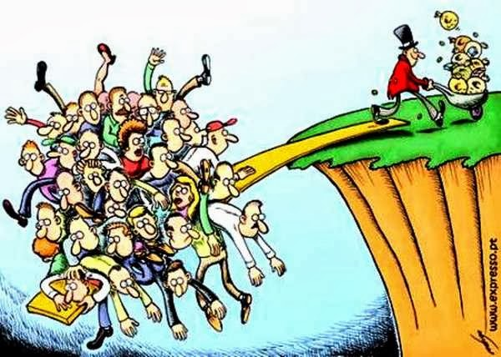
Inequality. Ruins. Everything.

Slide 33
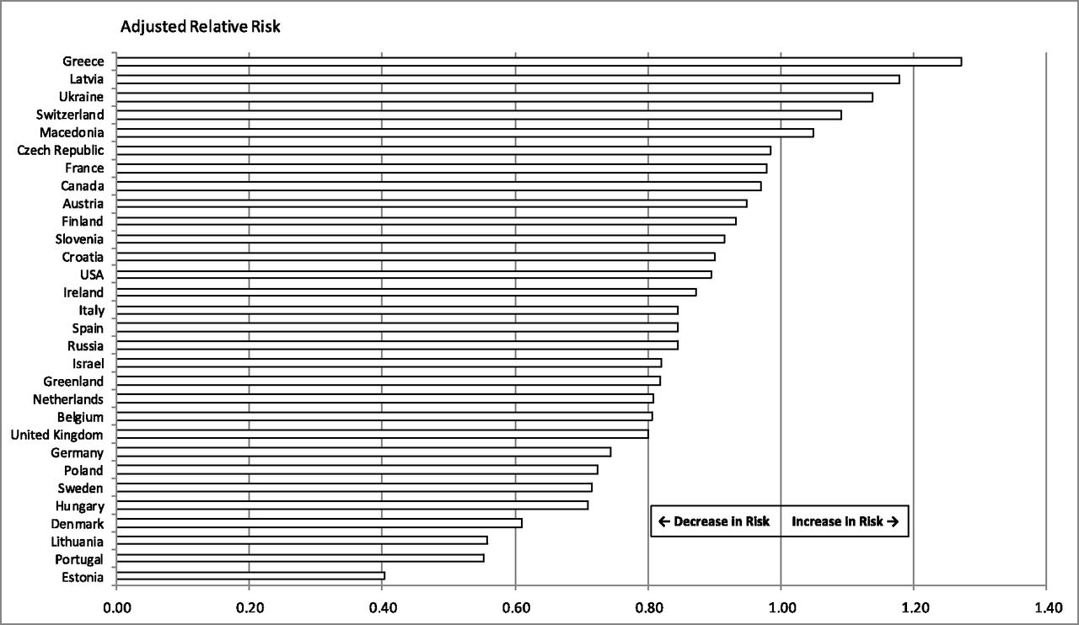
Cross-national comparison of the adjusted relative risk of frequent physical fighting, 2010 vs 2002.
William Pickett et al. Pediatrics 2013;131:e18-e26
©2013 by American Academy of Pediatrics
Notes:
Cross-national comparison of the adjusted relative risk of frequent physical fighting, 2010 vs 2002.

Slide 34
Structural determinants of youth bullying and fighting in low- and high-income countries
Analysed data on 79 high- and low-income countries in 2006-2010 HBSC surveys and 2003-2001 Global School-based Health Survey
Variables:
  Bullying victimisation
  Frequent physical fighting (4+ episodes in past year)
  Gross national income per capita
  Income inequality (Gini index)
  Government spending on education (% of total budget)

Slide 35
Structural determinants of youth bullying and fighting in low- and high-income countries
Elgar FJ, McKinnon B, Walsh SD, Freeman J, D Donnelly P, de Matos MG, Gariepy G, Aleman-Diaz AY, Pickett W, Molcho M, Currie C. Structural Determinants of Youth Bullying and Fighting in 79 Countries. J Adolesc Health. 2015 Oct 14.

Slide 36
Structural determinants of youth bullying and fighting in low- and high-income countries
Elgar FJ, McKinnon B, Walsh SD, Freeman J, D Donnelly P, de Matos MG, Gariepy G, Aleman-Diaz AY, Pickett W, Molcho M, Currie C. Structural Determinants of Youth Bullying and Fighting in 79 Countries. J Adolesc Health. 2015 Oct 14.

Slide 37
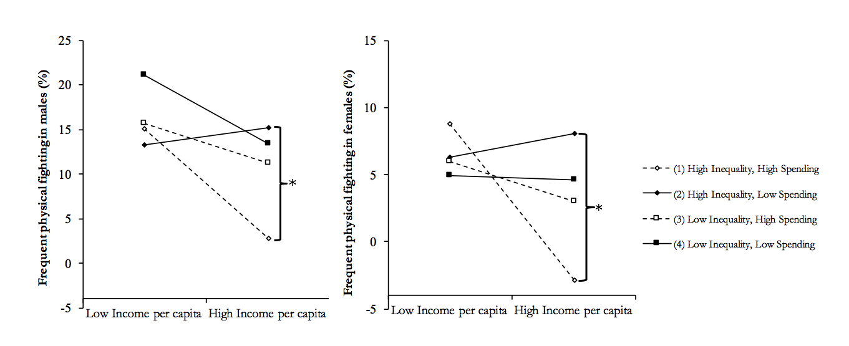
Country wealth relates to less fighting and bullying.
Income inequality and education spending modifies the association between wealth and fighting.
  Where inequality is high, country wealth relates more closely to violence if education spending was also high
Elgar FJ, McKinnon B, Walsh SD, Freeman J, D Donnelly P, de Matos MG, Gariepy G, Aleman-Diaz AY, Pickett W, Molcho M, Currie C. Structural Determinants of Youth Bullying and Fighting in 79 Countries. J Adolesc Health. 2015 Oct 14.

Slide 38
Unicef
Report Card #13:
Bottom-end inequality in child wellbeing in rich countries
(April 2016)
Early-life exposure to income inequality and adolescent health
Background paper to UNICEF Report Card #13

Slide 39
Early-life exposure to income inequality and adolescent health
Evidence of contextual health impacts of income inequality is compelling, but relies on cross-sectional designs and aggregated data.
  Literature lacks developmental studies of children and adolescents.
Psychosocial interpretation: income inequality intensifies social hierarchies, erodes social capital, and consequently harms health (Wilkinson & Pickett, 2009).
Are there lagged or cumulative effects of early life exposure to income inequality on later health outcomes?

Slide 40
Early-life exposure to income inequality and adolescent health
Using repeated, cross-sectional data from HBSC study
  6 cycles (1996 to 2014)
  888,841 adolescents
Societal growth curve model was used to isolate age, cohort and period effects.
  Also allowed us to pool data while retaining the multilevel structure
  Linked HBSC data to historical data to national per capita income (country wealth) and income inequality (gini index), going back to 1979.
  Country/year groups are ‘nested’ within each country
  Time is a random effect
  Age is a fixed effect

Slide 41
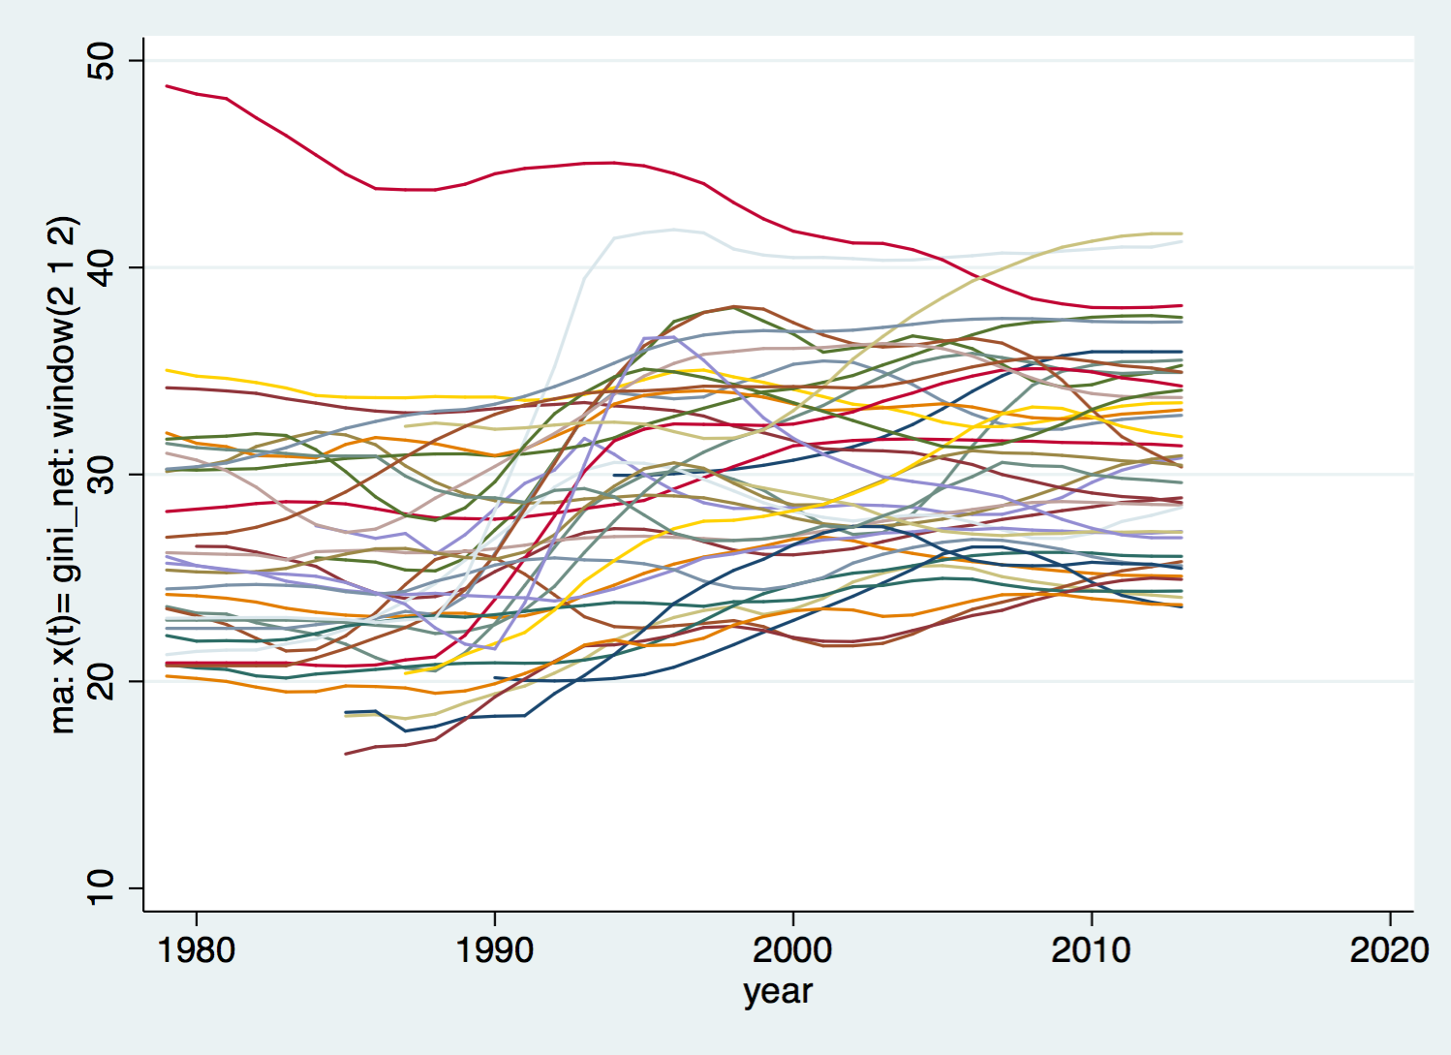
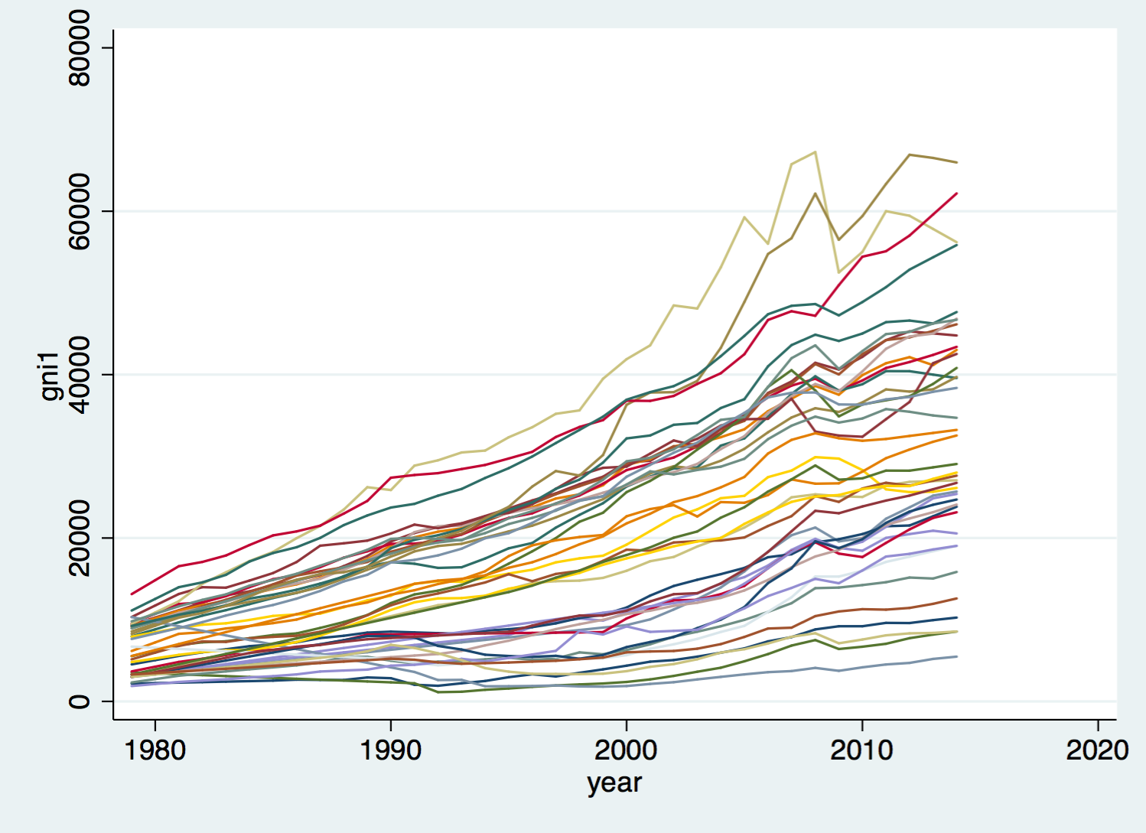
Income inequality (left) and per capita income (right) in 40 HBSC countries, 1979 to 2014

Slide 42
Regression analysis of psychosomatic symptoms in 11- to 15-year-olds in 40 countries (1994 to 2014).
Variable | Model 1 | Model 2 | Model 3 | Model 4
 | b (95% CI) | b (95% CI) | b (95% CI) | b (95% CI)
Constant Gender (female) Age group 11 years 13 years 15 years Affluence Time (years) Income inequality: Current 0 to 4 years 5 to 9 years GNI per capita | 2.56 (0.66, 4.46) 2.05 (2.02, 2.07) ref. 1.04 (1.01, 1.07) 1.81 (1.77, 1.84) -0.81 (-0.85, -0.76) -0.01 (-0.04, 0.02) 6.14 (0.18, 12.11) 0.01(-0.02, 0.03) | 2.31 (0.37, 4.25) 2.05 (2.02, 2.07) ref. 1.04 (1.01, 1.08) 1.82 (1.78, 1.86) -0.81 (-0.86, -0.77) -0.02 (-0.05, 0.02) 6.19 (0.20, 12.18) 0.94 (-0.59, 2.48) 0.01 (-0.02, 0.03) | 2.10 (0.19, 4.02) 2.05 (2.02, 2.07) ref. 1.05 (1.02, 1.08) 1.84 (1.80, 1.87) -0.81 (-0.85, -0.76) -0.02 (-0.05, 0.01) 3.45 (-2.62, 9.52) 4.39 (2.57, 6.21) 0.01 (-0.02, 0.03) | 2.02 (0.08, 3.96) 2.05 (2.02, 2.07) ref. 1.05 (1.02, 1.08) 1.84 (1.80, 1.87) -0.81 (-0.86, -0.77) -0.02 (-0.06, 0.01) 3.67 (-2.42, 9.75) 0.18 (-1.39, 1.75) 4.33 (2.48, 6.20) 0.01 (-0.02, 0.03)
Variances (random part):
Country: Time Constant | 0.00 (0.00, 0.00) 1.39 (0.82, 2.38) | 0.00 (0.00, 0.00) 1.43 (0.84, 2.43) | 0.00 (0.00, 0.00) 1.35 (0.79, 2.32) | 0.00 (0.00, 0.00) 1.40 (0.82, 2.39)
Country*year Constant | 0.24 (0.18, 0.33) | 0.24 (0.18, 0.32) | 0.24 (0.18, 0.33) | 0.24 (0.18, 0.32)
Residual | 37.09 (36.98, 37.20) | 37.11 (37.00, 37.22) | 37.09 (36.98, 37.20) | 37.11 (37.00, 37.21)
Goodness-of-fit: AIC BIC | 5734914 5735055 | 5712698 5712850 | 5730930 5731082 | 5712677 5712841
n(countries) n(country*years) n(students) | 40 180 888,841 | 40 179 885,335 | 40 180 888,220 | 40 179 885,335

Slide 43
Regression analysis of life satisfaction in 11- to 15-year-olds in 40 countries (2002 to 2014).
Variable | Model 1 | Model 2 | Model 3 | Model 4
 | b (95% CI) | b (95% CI) | b (95% CI) | b (95% CI)
Constant Gender (female) Age group 11 years 13 years 15 years Affluence Time (years) Income inequality: Current 0 to 4 years 5 to 9 years GNI per capita | 6.13 (5.14, 7.12) -0.21 (-0.23, -0.20) ref. -0.82 (-0.84, -0.81) -1.36 (-1.37, -1.34) 1.30 (1.28, 1.32) 0.02 (0.00, 0.03) -2.22 (-5.27, 0.82) -0.01 (-0.02, 0.00) | 6.20 (5.21, 7.19) -0.21 (-0.23, -0.20) ref. -0.82 (-0.84, -0.81) -1.36 (-1.38, -1.34) 1.30 (1.28, 1.33) 0.02 (0.00, 0.03) -1.97 (-5.01, 1.06) -0.51 (-1.26, 0.24) -0.01 (-0.02, 0.00) | 6.28 (5.29, 7.27) -0.21 (-0.23, -0.20) ref. -0.83 (-0.84, -0.81) -1.37 (-1.39, -1.35) 1.30 (1.28, 1.32) 0.02 (0.00, 0.03) 0.89 (-2.31, 4.08) -3.62 (-4.88, -2.37) -0.01 (-0.02, 0.00) | 6.29 (5.29, 7.28) -0.21 (-0.23, -0.20) ref. -0.83 (-0.84, -0.81) -1.37 (-1.39, -1.35) 1.30 (1.28, 1.32) 0.02 (0.00, 0.03) 0.90 (-2.30, 4.09) -0.04 (-0.81, 0.73) -3.61 (-4.90, -2.32) -0.01 (-0.02, 0.00)
Variances (random part):
Country: Time Constant | 0.00 (0.00, 0.01) 0.25 (0.14, 0.44) | 0.00 (0.00, 0.01) 0.25 (0.14, 0.43) | 0.00 (0.00, 0.05) 0.25 (0.14, 0.43) | 0.00 (0.00, 0.05) 0.25 (0.14, 0.43)
Country*year Constant | 0.06 (0.04, 0.10) | 0.06 (0.04, 0.09) | 0.07 (0.05, 0.10) | 0.07 (0.05, 0.10)
Residual | 7.42 (7.39, 7.44) | 7.42 (7.39, 7.44) | 7.42 (7.39, 7.44) | 7.42 (7.39, 7.44)
Goodness-of-fit: AIC BIC | 3283684 3283821 | 3283684 3283833 | 3283653 3283802 | 3283655 3283815
n(countries) n(country*years) n(students) | 40 137 678,031 | 40 137 678,031 | 40 137 678,031 | 40 137 678,031

Slide 44
Our preliminary findings
Results suggest a temporal order in the association between income inequality and adolescent health
  Lagged and contemporaneous effects on psychsomatic symptoms
  Lagged effect on life satisfaction
Exposure to inequality in early childhood (5 to 9 years) could have developmental consequences on health and wellbeing.
  Exposure in infancy (0 to 4 years) may not.
A causal pathway?
  SES differences in health originate in early childhood experiences
    developmental processes that shape physiological stress responses
    Neuroregulatory systems in the brain that govern emotion, attention and social interactions.

Slide 45
Inequality begets inequality
Income inequality relates to worse health and more unequal health in adolescents.
  Shapes unjust inequities in education, employment, adult health
Worse to come?
  Consider the durability of health inequalities through the life course, the health and social problems related to income inequality, and current trends in income inequality
Notes:
Especially disconcerting considering their origin: the so-called healthy years of adolescence in a group of mostly rich countries

Slide 46
Why inequality matters
Poverty …projects is nagging, prehensile tentacles in lands and villages all over the world…
The problem of poverty is not only seen in the class division between the highly developed industrial nations and the so-called underdeveloped nations; it is seen in the great economic gaps within the rich nations themselves.
Martin Luther King Jr., Nobel Prize Address, 1964

