Slide 1
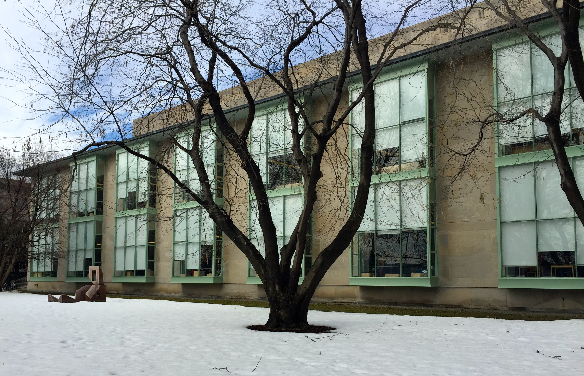
The once and future librarian
Chris Bourg, PhD
Director of Libraries, MIT

Slide 2
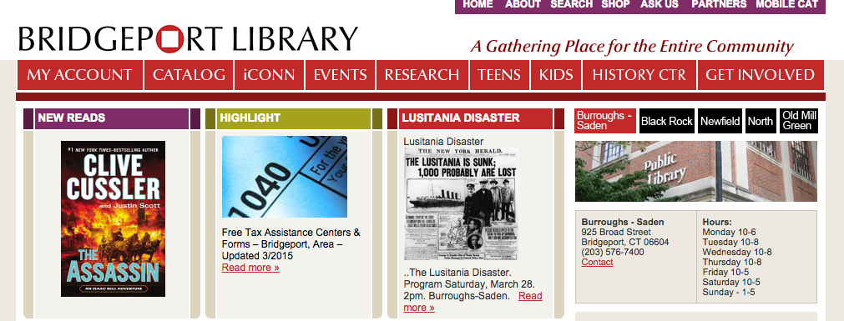
“we believe that libraries can change people’s lives and are a cornerstone of our democracy”

Slide 3
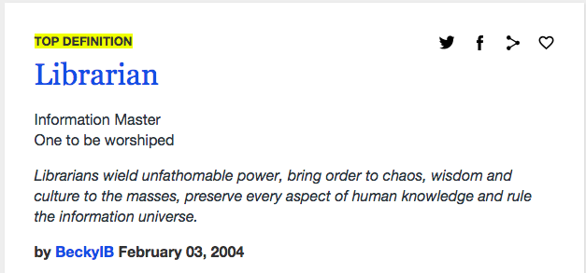

Slide 4
A new perspective
Scholar
Librarian
Discipline
Core titles and authors
Data
Scholarly article/book
Short/Medium term
Multi-discipline
Publishers
Metadata
Scholarly communication
Long term

Slide 6
Free advice
Visibility
Diversity
Collaboration

