Slide 1
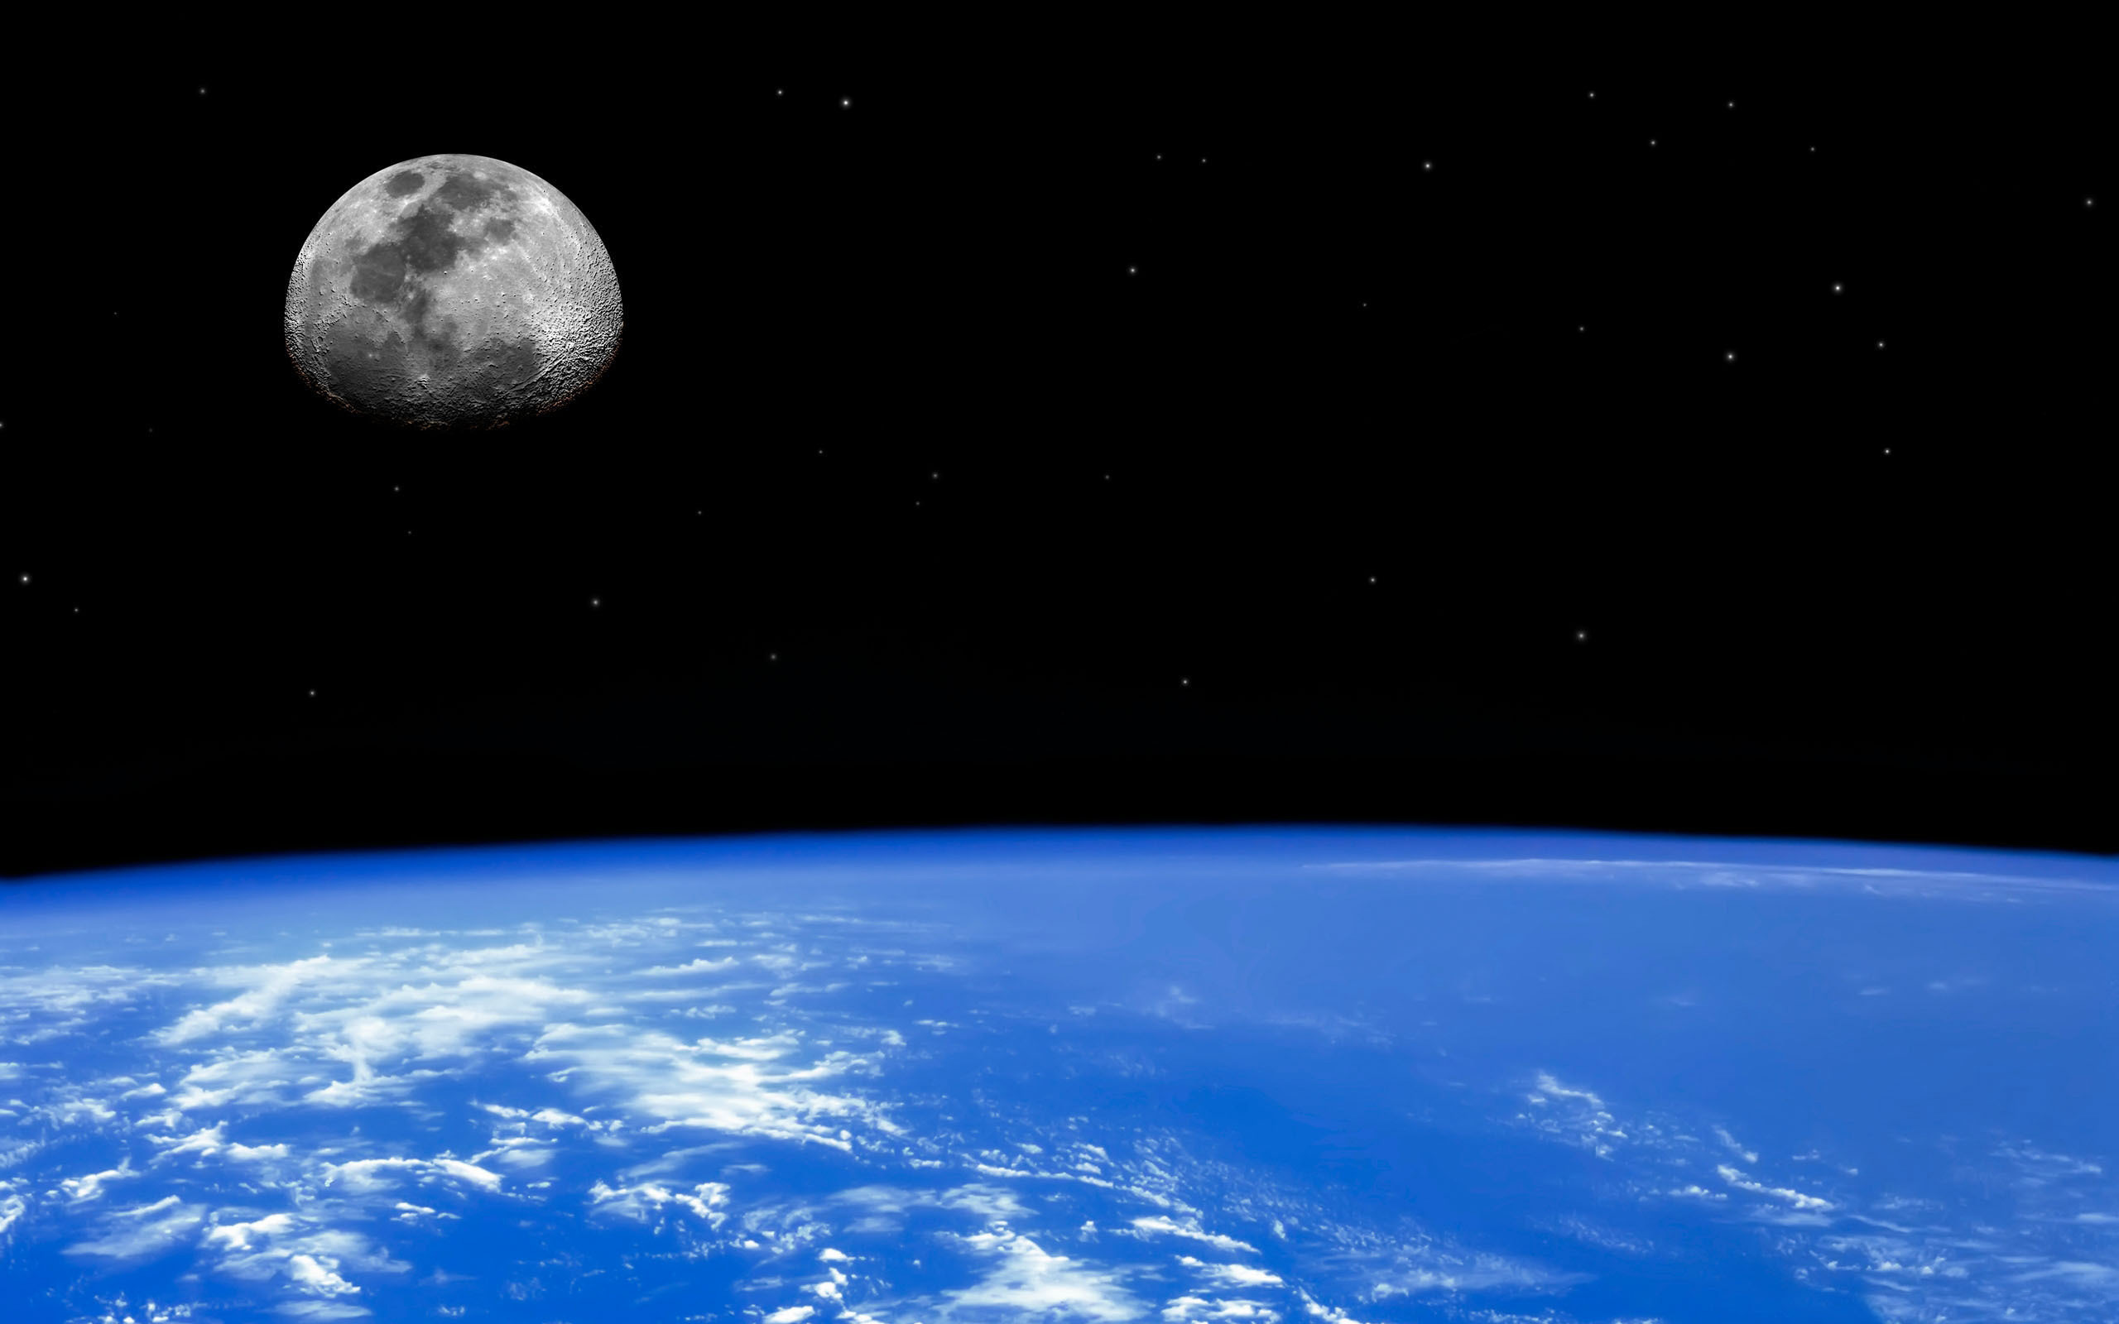
The Integral Contribution and Limitations Of A Space Property Regime To Sustainable Development
The Integral Contribution and Limitations Of A Space Property Regime To Sustainable Development
Lawrence D. Roberts
Lawrence D. Roberts

Slide 2
WHAT IS MEANT BY SUSTAINABLE DEVELOPMENT?

Slide 3
WHAT IS MEANT BY SUSTAINABLE DEVELOPMENT?
“development that meets the needs of the present without compromising the ability of future generations to meet their own needs”
- The Brundtland Report

Slide 4
QUESTIONS OF DEFINITION: • How are the needs of future generations to be determined? • How are conflicts between the present and future to be resolved? • To what extent does the principle of equity impact on development interests? • Should the definition of sustainable development incorporate, in whole or in part, an ecological / non-anthropocentric view of the environment? • Does the notion of sustainability apply to culture?

Slide 5
QUESTIONS OF DEFINITION: • How are the needs of future generations to be determined? • How are conflicts between the present and future to be resolved? • To what extent does the principle of equity impact on development interests? • Should the definition of sustainable development incorporate, in whole or in part, an ecological / non-anthropocentric view of the environment? • Does the notion of sustainability apply to culture?

Slide 6
HOW DOES SPACE PROMOTE SUSTAINABLE DEVELOPMENT CONSIDERATIONS?
Monitoring the environment
Discovering new resources
Enhancing quality of life for individuals and communities by facilitating communication
Supplying raw material and energy

Slide 7
The Existing Regime
The exploration and use of outer space, including the moon and other celestial bodies, shall be carried out for the benefit and in the interests of all countries, irrespective of their degree of economic or scientific development, and shall be the province of all mankind.
Outer space, including the moon and other celestial bodies, shall be free for exploration and use by all States without discrimination of any kind, on a basis of equality and in accordance with international law, and there shall be free access to all areas of celestial bodies.
The Outer Space Treaty, Article I.

Slide 8
The Existing Regime
Outer space, including the moon and other celestial bodies, is not subject to national appropriation by claim of sovereignty, by means of use or occupation, or by any other means
The Outer Space Treaty, Article II.

Slide 9
RES COMMUNIS

Slide 10
RES COMMUNIS PROBLEMS
• Tragedy of the Commons
• Underdevelopment
• No Provision for Redistribution
• Undermines Future Interests

Slide 11
ALTERNATIVES TO RES COMMUNIS
Res Nullius International Development Authority
Strong Development Interest Weak Development Interest
Weak Redistribution Interest Strong Redistribution Interest

Slide 12
Regime Premised Upon SustainableDevelopment
Externality Internalization
Redistribution
Accounting for Future Interests

Slide 13
What Mechanisms?
Private Property Regime
securable financing
avoids free riders
minimizes the number of issues that rise to political incidents
incentive process internalizes externalities

Slide 14
What Mechanisms?
Private Property Regime
Redistribution via Auction
enhances prospects for international consensus
financial incentives
low stakes in the short term
efficient
automatic adjustment to resource valuation change
separation from the development process from the ownership interest

Slide 15
What Mechanisms?
Private Property Regime
Redistribution via Auction
Gradual Implementation
a partial solution to incorporating future interests

Slide 16
What Mechanisms?
Private Property Regime
Redistribution via Auction
Gradual Implementation
Robust Adjudication System
Problem – adjudication not a prominent part of most
international regimes
commercial examples offer hope for implementation

Slide 17
What Mechanisms?
Private Property Regime
Redistribution via Auction
Gradual Implementation
Robust Adjudication System
Regulation
Markets often superior, but not perfect
Regulation useful for dispersed externalities with high
transaction costs
Potential for procedures to address future interests

Slide 18
Limits to the Proposed Standard
Unknown Unknowns – Especially with Regard to Future Interests
The Limits of Remedies
Assumption that Law is Predicated Upon Conflict
Low Probability / Catastrophic Harm Events

