Slide 1
The 4th Manfred Lachs Conference
on Conflicts in Space and The Rule of Law
McGill University, Montreal, 27-29 May 2016
TOWARD A COLLECTIVE SPACE SECURITY
José Monserrat Filho
Brazilian Association of Air and Space Law (SBDA)
International Institute of Space Law (IISL)
International Astronautics Academy (IAA)
Brazilian Society for the Advancement of Science (SBPC)

Slide 2
It is just building a realistic utopia.

Slide 3
Since the early 21st century, the possibility of military conflicts in outer space has increased considerably.
The accelerated preparation for placing weapons in outer space is a concrete reality.
The world community is more and more concerned about this growing threat.
That is surely the main strategic global question of our time.

Slide 4
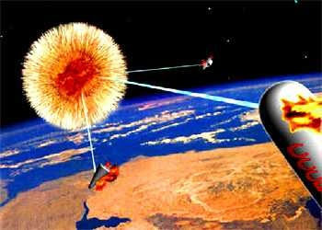

Slide 5
A concrete solution for this huge danger is to create a “collective space security system,“
led by a specialized Security Council.
It could be done through a special protocol
as a contribution to the building
of a new Space Age.
In this new Space Age the exploration
and use of outer space and celestial bodies
will be carried out only for peaceful purposes, and in benefit of all countries.

Slide 6
EVEN
IN THE
HEAVENS:
THE WAR
IS HELL
Keep space for peace

Slide 7
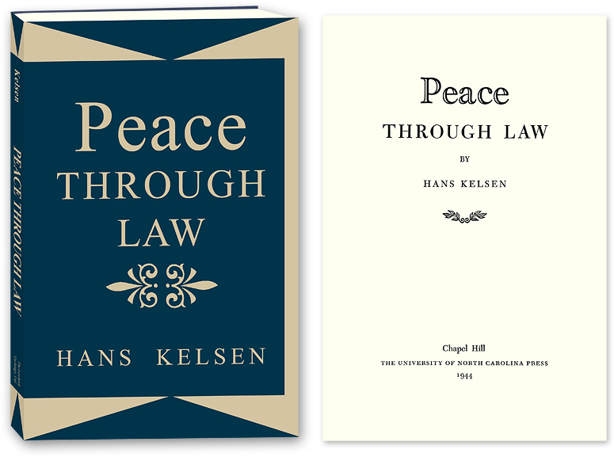
"The elimination of war
is our main problem.“
Hans Kelsen,
in Peace Through Law, 1944.
After 72 years, this issue
is light-years far from
be solved on Earth.

Slide 8
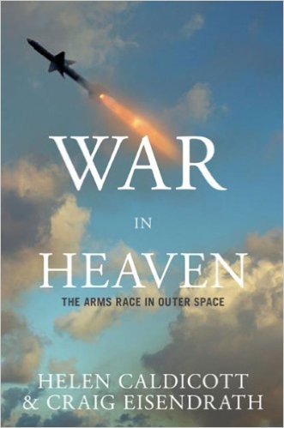
Today, we suffer with wars and threats of wars in many regions of the world, and we are threatened by
a new Cold War.
This new Cold War already includes an arms race in outer space, with the danger of turning it into
the newest theater of war.

Slide 9
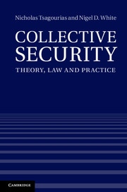
To develop the concept of collective security
in outer space
it is necessary to examine, inter alia:
# the potential conflicts
in outer space and their specificities.
# the legal rules available to face them and the level of authority and efficiency of its rule of law.

Slide 10
In not so distant future, we can envision
great legal economic controversy involving
outer space with strong impact over Earth.
The question is how to regulate the extraction
of precious minerals from celestial bodies,
probably the 21th century gold rush.
Regulated by a national unilateral law
to benefit, in particular, national private corporations, it can cause violent global competition and serious conflicts,
including militaries.

Slide 11
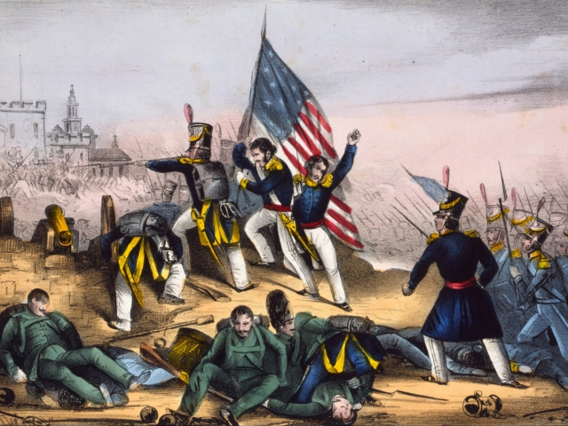
Gold Rush War in California

Slide 12
The current space arms race and
the intense promotion of the inevitability
of war in space are growing.
However, there are reasonable grounds
to prevent conflicts in outer space.
No one loses. Or, at least, no one dies.
And we avoid a collapse on Earth.
The overwhelming majority of nations
is contrary to the war in space.

Slide 13
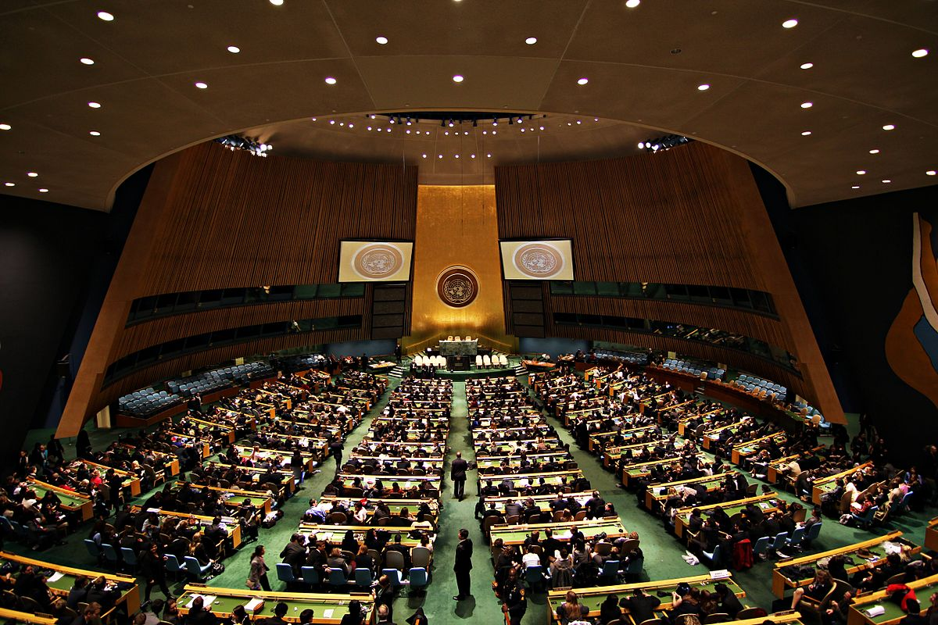
How many States here accept a war in space?

Slide 14
Urge unlock the Conference on Disarmament
to continue the discussion on the only existing treaty project to prevent the deployment of weapons
and the use of force in outer space:
The Russian-Chinese draft of The Treaty
on Prevention of the Placement of Weapons in Outer Space and of the Threat or Use of Force Against Outer Space Objects (PPWT).
[Updated version (CD/1985), of June 10, 2014.]

Slide 15
The major objective of the UN – to adopt
“collective measure for prevention and removal of threats to the peace, and for the suppression of acts of aggression or other breaches of the peace”
– must also be the purpose of the exploration,
use and exploitation of outer space.
Hence we need to create an appropriate
legal system of collective security
for outer space.

Slide 16
The specialized Security Council
should be much more representative and take
its decisions about outer space conflicts based above all in Article I (§ 1) of Outer Space Treaty,
well known as the “Common Benefit Clause.”

Slide 17
The main function of such Security Council would be to face threats to the peace and to seek peaceful solutions to impending armed conflicts in space, using all possible means,
and acting in accordance with the
Chapter VI of the UN Charter,
in order to prevent the outbreak of war.
The protocol must define "breach of the peace"
and "acts of aggression" space with precision,
and change the Chapter VII, to impede that its application intensifies armed conflicts in space, rather than solve them as quickly as possible.

Slide 18
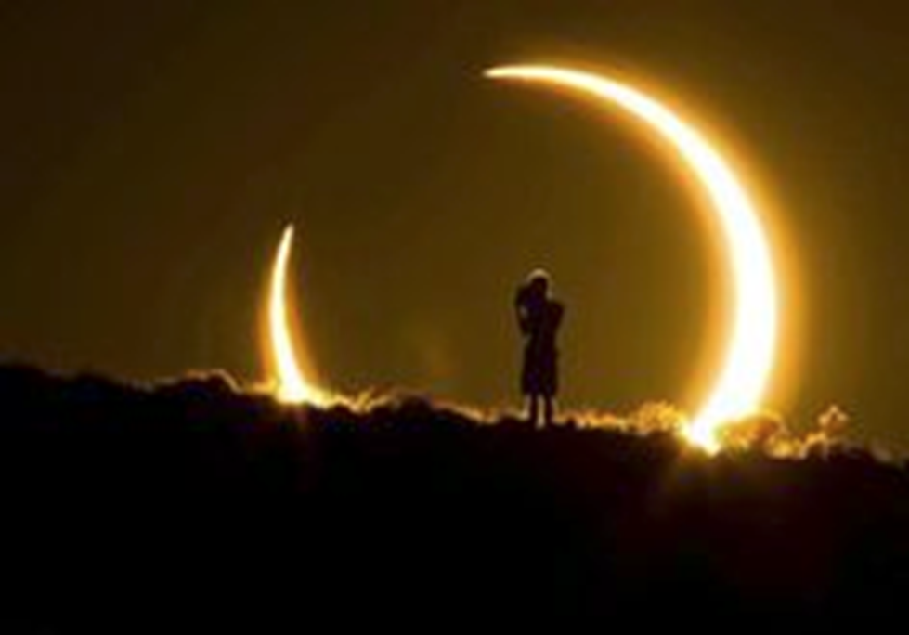

Slide 19
Some conclusions
Only a strong legal alliance of most countries
and global public opinion can decide
if space will be a sanctuary of peace,
or a new theater of war.
The importance of rule of law in outer space
is directly proportional to the importance
of the space activities in our time.
The probable but not yet inevitable space weaponization and the consequent conversion
of outer space into a theater of war
is the greatest danger to space security and sustainability, with an untold impact over Earth.

Slide 21
The “collective measure for prevention and removal
of threats to the peace, and for the suppression
of acts of aggression or other breaches of the peace” must also be the main objective of the International Space Law, to prevent space conflicts and assure the sustainability in long term of space activities.
The collective security system for outer space and space activities must be specific, as an appropriate and effective legal mechanism to assure
the highest level of peace and security.

Slide 23
A strong and dynamic system of collective security
for outer space can be proposed as
a subsidiary organ or a specialized
mission of the Security Council.
The specialized Security Council should take its decisions about any kind of outer space conflict
based above all in the Common Benefit Clause,
in Article I (§ 1) of Outer Space Treaty.
The main purpose of this collective security system
is to adopt a peaceful solution to any impending
space conflicts and to prevent the outbreak
of any armed conflict in outer space.

Slide 24
Collective space security, the nicest perspective.
Thank very much for your attention.

