Slide 1
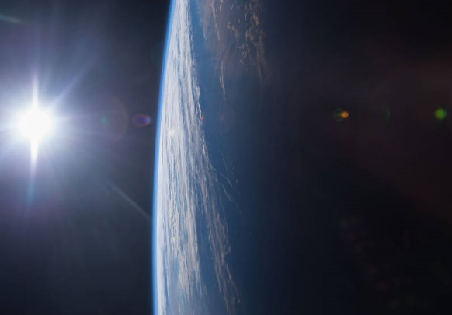
Space Security Index
Jessica West
Project Ploughshares
The Simons Foundations
McGill University
University of Adelaide
George Washington University
Xi'an Jiaotong University
www.spacesecurityindex.org

Slide 2
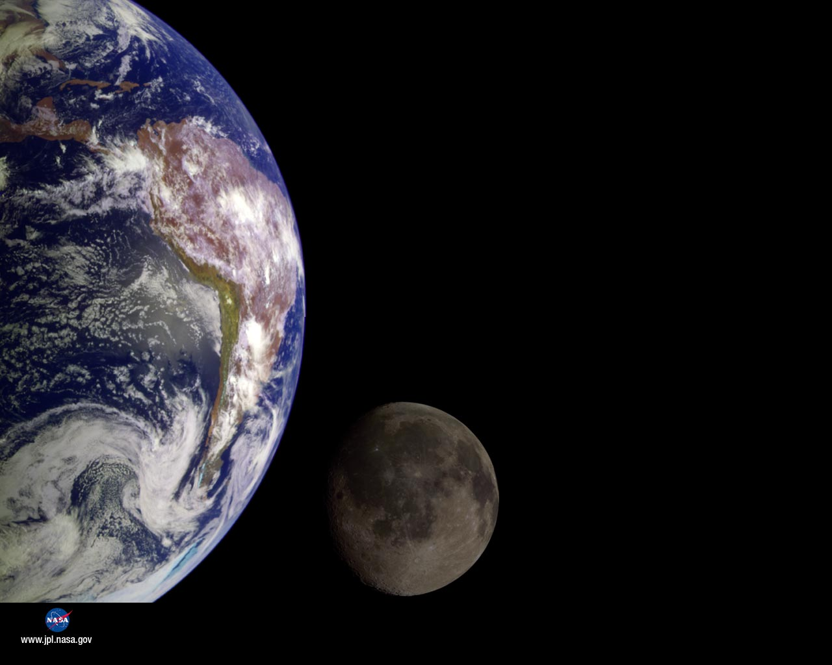
Secure and sustainable access to and use of space, and freedom from space-based threats
Theme 1: Condition of the space environment
Theme 2: Access to and use of space
Theme 3: Security of space systems
Theme 4: Outer space policies and governance

Slide 3
SSI 2016: toward the use of force in outer space?
Ongoing development and testing of technologies for the use of force in space
New national directions that signal preparation for offensive operations in space
Ongoing failure to agree to restraints in outer space

Slide 4
Paper
Contested Security and Strategic Restraint
Space may be ‘contested, congested and competitive, but this can be governed

Slide 5
Threats to restraint:
Space as tactical – a continuation of the use of force on Earth
Advancing technologies for the use of force
Shift in military space strategy toward offensive uses

Slide 6
Signs of restraint:
Debris-causing anti-satellite tests
Information exchanges between the US and China

Slide 7
Restraint and the SSI:
Broadening view of self-interest in outer space
Space security as the security of space
Transparency and understanding of activities in outer space
Variety of uses of space, and claims to security

