Slide 1
RECENT DEVELOPMENTS IN AVIATION LIABILITY AND INSURANCE
McGill Institute of Air and Space Law
April 17, 2015

Slide 2
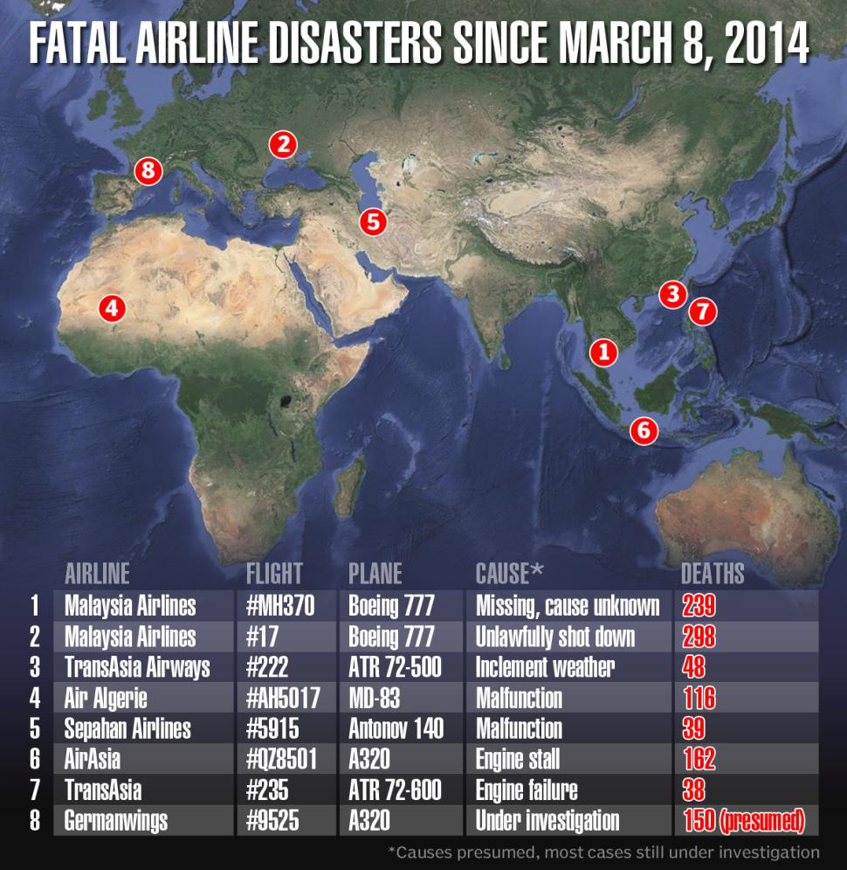
1,090 deaths in 8 commercial disasters overseas since early 2014.
Recent decisions that will affect plaintiffs’ ability to get in, stay in and successfully recover in the courts of the United States.

Slide 3
PERSONAL JURISDICTION
GENERAL JURISDICTION
Daimler AG v. Bauman, 134 S. Ct. 746 (2014)
Foreign plaintiffs suing defendants for alleged conduct occurring abroad
Unanimous decision further narrows Goodyear Dunlop Tires Operations, S.A. v. Brown requirements for the exercise of general jurisdiction
General jurisdiction can exist only in state where the corporation is “at home”
“At home” equated with corporate citizenship - requires incorporation, principal place of business
“A corporation that operates in many places can scarcely be deemed at home in all of them”
Imputing subsidiary’s actions in forum to parent appropriate only in context of specific jurisdiction, not general
Effect on claims against manufacturers
Effect on jurisdictional provisions of Montreal
SPECIFIC JURISDICTION
Walden v. Fiore, 134 S. Ct. 1115 (2014)
“Case linked jurisdiction”
Court considers relationship between defendant, the forum and the litigation; does not consider defendant’s relationship with people inside the forum
Look at whether the defendant’s conduct connects him to forum
Forseeability of injury in the forum state insufficient to confer jurisdiction over foreign defendant; fact of accident occurring in the forum state insufficient
Court notes that in prior cases in which damages were suffered in the jurisdiction, some part of tortious conduct occurred within jurisdiction
Must tortious conduct occur within forum state to support specific jurisdiction?

Slide 4
VENUE
REMOVAL
Class Action Fairness Act (28 U.S.C. 1332 (d))
-“mass action” can be removed to federal court provided jurisdictional requirements are met
-“mass action” is “any civil action. . . in which monetary relief claims of 100 or more persons are proposed to be tried jointly on the ground that the plaintiffs’ claims involve common questions of law or fact.” 28 U.S.S. § 1332(d)(11)(B)(I).
Requirements:
(1) at least 100 claims at issue; (2) action as a whole must exceed $5,000,000 in damages; (3) one claimant must have pled in excess of $75,000; (4) minimal diversity of citizenship must exist; and (5) the plaintiff must have made a proposal to try the cases jointly.
Altoum v. Airbus S.A.S., et al, 2010 WL 3700819 (N.D. Ill. Sept. 9, 2010)
Scriveners’ error that resulted in single complaint with 102 named plaintiffs irrelevant to CAFA removal; refusal to allow plaintiffs to correct the complaint “amend away” CAFA jurisdiction
Koral v. Boeing Co., 628 F.3d 945 (7th Cir. 2011)
Consolidation for of 29 lawsuits on behalf of 117 plaintiffs for pre-trial discovery insufficient; prediction by plaintiff that the court might order joint trial insufficient; “proposal” of joint trial must come from plaintiff (not court)

Slide 5
VENUE
REMOVAL
ASIANA FLIGHT 214
Admiralty Jurisdiction
Lu v. Boeing Co., 2014 U.S. Dist. LEXIS 50210 (N.D. Ill. April 11, 2014)
Three part test:
did the general character of the activity giving rise to the incident show a substantial relationship to traditional maritime activity; (2) did the incident have a potentially disruptive impact on maritime commerce; and (3) did the tort occur over navigable water.
  Only the third factor at issue. To establish that the tort occurred over water, the company had to show that, at some point while the plane was over water, the passengers faced certain injury. Court held that evidence did not support that conclusion. Remanded.
Federal Officer Jurisdiction
Yang v. Boeing Co., 2013 WL 6633075 (N.D. Ill 2013)
Four part test:
Requires a showing that defendant was a “(1) ‘person’; (2) ‘acting under’ the United States, its agencies, or its officers; (3) that has been sued ‘for or relating to any act under color of such office’; and (4) has a colorable federal defense.
  Boeing argued that because the Plaintiffs’ tort claims challenge work performed by Boeing employees, who certified the aircraft’s safety according to a highly regulated Federal Aviation Administration (FAA) process, it is entitled to assert Federal Officer jurisdiction.
  Court disagreed that a products liability action against manufacturer is necessarily a suit for negligent certification. Remanded.

Slide 6
VENUE
FORUM NON CONVENIENS
Galbert v. West Caribbean Airways, 715 F.3d 1290 (11th Cir. 2013)
Appellate court affirms District Court’s refusal to vacate FNC order after French Court of Cassation rules that Martinique was unavailable forum for plaintiffs’ Montreal claims.
Plaintiffs failed to challenge availability of Martinique before the Southern District of FL during FNC briefing, instead affirmatively challenging the jurisdiction of that forum in Martinique.
Court took particular umbrage at plaintiffs’ efforts to make the alternate forum unavailable.
Dismissal by French court was not “extraordinary circumstance” warranting vacating FNC dismissal.
Bjorkstam v. MPC Prods. Corp., 21 N.E.3d 1216 (App. Ill. 1st. Dist. 2014)
Conditional FNC dismissal from Cook County, Illinois required defendants to accept service of process from the Texas court.
Plaintiffs did not effectuate valid service of process out of Texas court, action dismissed for failure to prosecute.
Illinois Court refuses to reinstate on the basis that defendants did not violate the FNC order, despite the defendants actual knowledge of TX proceedings. Holds defendant’s obligation under the FNC order were never triggered as a result of plaintiff’s failure.
Requiring defendant to accept service of process in alternate forum is not equated with requiring that defendant not challenge adequacy of process.

Slide 7
VENUE
FORUM NON CONVENIENS
Bochetto v. Piper Aircraft, 94 A.3d 1044 (PA Super. June 9, 2014)
Appellate court vacates FNC dismissal of action brought by foreign plaintiffs arising out of crash in Portugal.
Appellate court critical of trial court’s failure to consider the action’s connections to the United States as a whole rather than simply the forum state of Pennsylvania.
Onita-Olojo v. Sellers, 2014 U.S. Dist. LEXIS 43670 (S.D. Fl. March 31, 2014)
Action arising from June 2012 crash of Dana Airlines Flight 992 in Lagos, Nigeria removed to S.D. FL
Court dismisses actions by foreign plaintiffs on FNC grounds but retains actions brought by US residents.
Considers whether Nigeria and adequate and available forum and weighs private and public factors that would justify keeping cases in US.
Location of damages evidence related to deaths of US residents weighed in favor of keeping the US cases.
Finds defendant’s willingness to concede liability in Nigerian courts a factor that makes the forum more attractive than US.

Slide 8
PREEMPTION
STANDARD OF CARE
NEGLIGENT HIRING, RETENTION, SUPERVISON
In Re Air Crash Near Clarence Center, 2013 WL 5964480 (W.D.N.Y. 2013)
see also In Re Air Crash Near Clarence Center, 798 F. Supp. 2d 481 (W.D.N.Y. 2011)
Matter of Air Crash Near Clarence Center, 44 Misc. 3d 724 (Erie Co. 2014)
Crash of Colgan Air Flight 3407
Court refused to permit discovery on the issues of pilot hiring, training, selection and supervision because those issues were unrelated to a violation of any federal standard of care.
General prohibition against careless or reckless operation of an aircraft (14 C.F.R. 91.13) inapplicable to claims of negligent hiring, training and supervision.
PRODUCTS LIABILITY
Sikkelee v. Precision Airmotive, 2014 US. Dist. LEXIS 126204 (M.D. Pa 2014)
Summary judgment granted to the defendant engine manufacturer on the grounds that the issuance of a type certificate is conclusive proof of the engine’s compliance with design and construction regulations.
While aircraft operators are subject to a general prohibition against careless or reckless operation (91.13), makers of aircraft engines and components are subject only to specific regulations; there is no catchall general standard of care applicable to manufacturers.
Compliance with the specific regulations is per se satisfaction of the standard of care.

Slide 9
PREEMPTION
PRODUCTS LIABILITY
Lewis v. Lycoming, 957 F. Supp. 2d 552 (E.D. Pa 2013)
Products liability action arising from 2009 helicopter crash in England.
Narrow reading of Abdullah, calls the expansive language that found “implied federal preemption of the entire field of aviation safety” merely dicta.
Notes the express preemption language of GARA in terms of 18 year statute of repose.
Declines to award defendants judgment on the pleadings on the grounds of implied field preemption.
COMPLETE v. DEFENSIVE PREEMPTION
Greig v. US Airways, Inc., 28 F. Supp. 3d 2014 (D. Ariz. 2014)
Defendants conflate conflict and complete preemption.
Montreal Convention does not completely preempt state law claims to the extent that warrants removal, but conflict preemption may provide an affirmative defense.

Slide 10
CHOICE OF LAW
DAMAGES
Lewis v. Lycoming, 2014 U.S. Dist. LEXIS 175967 (E.D. Pa 2014)
Wrongful death action for UK decedents arising from helicopter crash in England.
Court rejects the application of restrictive UK damage law in favor of more generous Pennsylvania law.
PA’s interest in affecting the conduct of its manufacturers would be impaired by the application of more restrictive English law; England’s interest in ensuring recovery for its residents not impaired by application of Pennsylvania law.
In re Air Crash near Clarence Ctr., 983 F. Supp. 2d 249 (W.D.N.Y. 2013)
Court refuses to displace damage law of New York, the locus of the tort, as to Plaintiff and decedent who were domiciliaries of China at the time of the crash.

Slide 11
FSIA
In Re Terrorist Attacks on September 11, 2001, 741 F.3d 353 (2d. Cir. 2013)
Plaintiffs sued the Kingdom of Saudi Arabia and various governmental entities for damages caused by the September 11, 2001 terrorist attacks. I
In 2009, The Kingdom and the SHC moved to dismiss the claims against them on the ground that they were immune from suit under the Foreign Sovereign Immunities Act. Plaintiffs claimed defendants actions fell within the "terrorism exception" and a "tort exception“ to sovereign immunity. See 28 U.S.C. §§ 1605(a)(5), 05A.
District Court concluded that the plaintiffs' claims fell within the discretionary function limitation on the tort exception (tort exception does not apply to claims based on the performance of, or failure to perform, a discretionary function), and it dismissed the claims against the Kingdom and the Saudi High Commission.
Second Circuit affirmed, but on different grounds, concluding that where claims are based on acts of terrorism, only the terrorism exception — and not the tort exception — could be used to lift the statute's protection of foreign states.
In Doe v. Bin Laden, 663 F.3d 64 (2d Cir. 2011). The plaintiff sued Afghanistan, among other defendants, for the death of his wife in the September 11 attacks, arguing that the defendant was not immune from suit based on the tort exception. On appeal in Bin Laden, the Second Circuit overruled its conclusion in In Re Terrorist Attacks that where the alleged tort is an act of terrorism, the tort exception is inapplicable.
In Re Terror Attacks plaintiffs obtained relief from the original dismissal, though briefing is currently underway on the renewed motions to dismiss based upon the discretionary function limitation on the tort exception.
16

Slide 12
FSIA
Justice Against Sponsors of Terrorism Act, S.1535 (“JASTA”)
Bill introduced in U.S. Congress in 2009 following the dismissal of Saudia Arabia with bipartisan support. Passed the Senate, remains pending in the House.
Amends the federal judicial code to include among the exceptions to U.S. jurisdictional immunity of foreign states any statutory or common law tort claim arising out of an act of extrajudicial killing, aircraft sabotage, hostage taking, terrorism, or the provision of material support or resources for such an act, or any claim for contribution or indemnity relating to a claim arising out of such an act.
Grants U.S. district courts personal jurisdiction over any person who commits or aids and abets an act of international terrorism, or who otherwise sponsors such act or the person who committed such an act, that injures a U.S. national.
Applicable to any civil action: (1) pending on, or commenced on or after, this Act's enactment date; and (2) arising out of an injury to a person, property, or business on or after September 11, 2001.

